Slide 1
Overcome challenges of tracking-searching problem by hierarchy geo-based micro-services
MUM tech talk - July 06, 2019

Slide 2
Syllabus
Tracking-searching problem
Hierarchy geo-based sharding
MongoDb-based implementation
Micro-services-based implementation
Live demo
Some tips to work with Micro-services
Conclusions
Future research.

Slide 3

Tracking-searching problem (like Uber)
Need to tracking location of multiple providers
Need to search providers based on location and range (with additional criteria)

Slide 4
Tracking-searching problem – challenges
Huge volume of searching requests.
170,000 daily rides in San Francisco
230,000 rides every hour or an average of 5.5 million rides a day
Massive volume of tracking requests.
67,000 active drivers in the Chicago city
3.9 million drivers worldwide
Real-time.
Unequal distribution
→ Need asynchronous, scaling, sharding

Slide 5
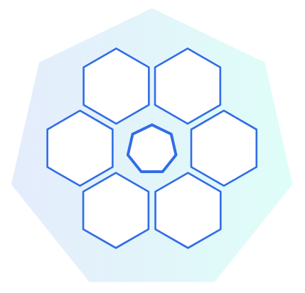
Tracking-searching problem – challenges
clustering is not enough
Requests can be processed by any node
(Every single tracking request have to be processed by all nodes)

Slide 6
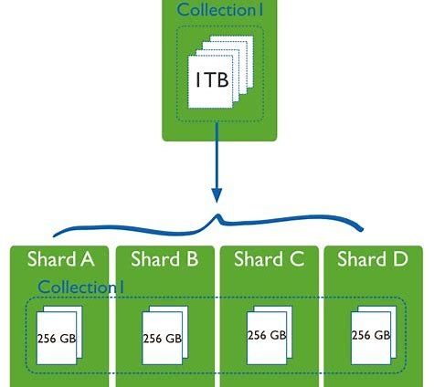
Tracking-searching problem – challenges
Field-based sharding is not efficient
Every single search request have to be processed by all nodes
Provider moving across shardings
→ Question: can we have relationships between sharding collections so that search requests can be served efficiently?

Slide 7

Hierarchy geo-based sharding
Each area is a hub
Hub structure is a tree
1 Global node
Country nodes
State/City nodes
Areas inside city
Provider tracking sharded by hubid
For tracking-requests, attach associated hubid (only 1)
For searching-requests, query with related hubids (multiple)

Slide 8
Hierarchy geo-based sharding – Tracking
Find associated hub by top-down traversing the hub tree.
At each level, chose the in-range & closest hub (only 1)
If there’s no qualified sub-nodes, then current node is final result
→ complexity is log(n)

Slide 9
Hierarchy geo-based sharding – Searching
Find all related hubs top-down traversing the hub tree.
At each level, chose all those hubs are in-range
If there’s no qualified sub-nodes, then current node is added to result
→ complexity is log(n)

Slide 10
Hierarchy geo-based sharding – testing data
Tracking location of 240K objects in LOS, San, Chicago, New York
Location updated every 30s
Simulated by
1 machine for tracking requests
1 machine for searching requests
Each machine run 3K threads ~ 6K concurrent requests (tracking & searching).
Spit each of LOS, San, Chicago, New York to 16 sub-areas so we have 1 global, 4 cities & 4x16 sub-areas → 69 nodes in 3 layers tree

Slide 11
MongoDb-based implementation
1 machine for gobetween load balancer + Netty Server for REST api server
1 machine for Netty Server + REST api server (weight 2)
REST API find & attach associated/related hub(s) before send requests to MongoDb
1 machine for Mongo master
2 machines for Mongo sharding nodes
Tracking data sharded by hubid & and geo-indexed.

Slide 12
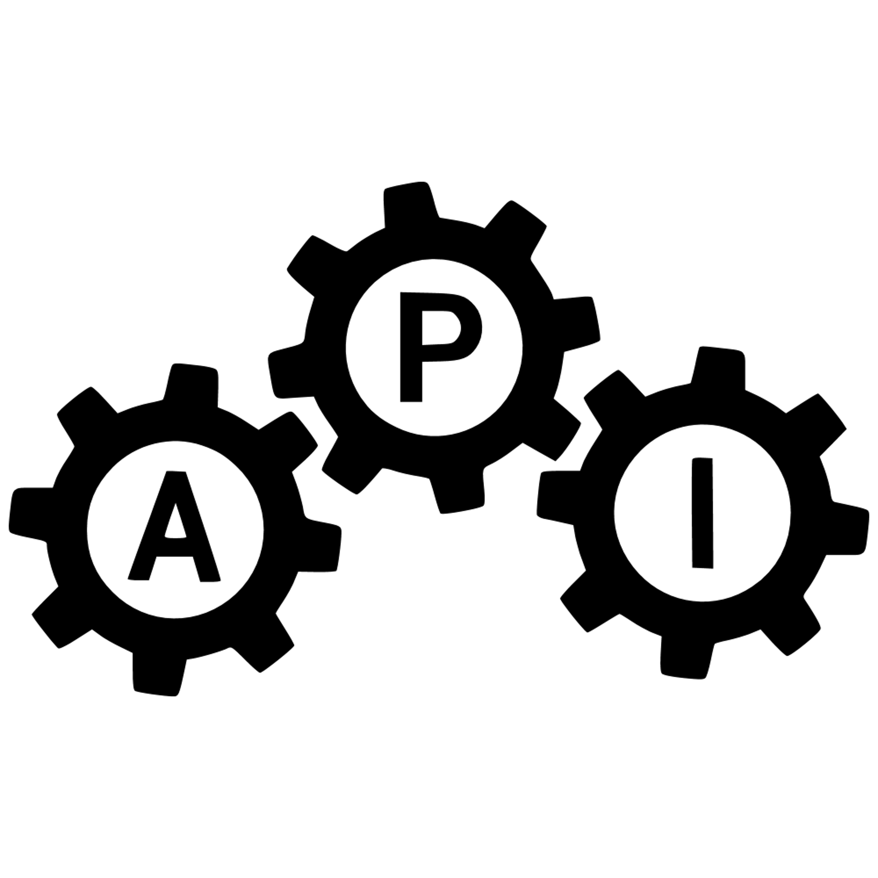


MongoDb-based implementation
Load balancer
Master Node
REST API servers
Sharding Nodes
Clients

Slide 13
MongoDb-based implementation – Results
Able to scale rest api out to multiple machines
Able to scale processing out to multiple machines (Mongo sharding)
Able to handle 6K concurrent requests
Max time for processing one request ~15s
Avg ~2K requests/s (tracking+query)

Slide 14
MongoDb-based implementation – drawbacks
Not much differ when compare to Single machine for REST API + Single machine for MongoDb or adding more sharding nodes
The MongoDb Master handle too heavy job.
Can only scale up for MongoDb Master
Hard drive for short-term data

Slide 15
Micro-services-based implementation
Use Kafka as middleware messaging
Each Hub is a service node.
Each hub/service node handle 2 (tracking/searching) message topics.
69x2 topics for test case.
Separate storage so that no need kind of MongoDB master
Use jvptree to store tracking data in memory on each service node
REST API find & attach associated/related hub(s) then send message to target topic(s)
Each REST API server have a response topic
REST API collect & combine results then send response to client.

Slide 16


Micro-services-based implementation
Load balancer
Kafka
REST API servers
Clients
Service units

Slide 17
Micro-services-based implementation
1 machine for gobetween load balancer + Netty Server for REST api server
1 machine for Netty Server + REST api server (weight 2)
1 machine for Kafka
1 machine for Mongo Db (store & serve provider info query only)
2 machines for service nodes
Each handle 2 city nodes + 2x16 sub-area nodes
The first processing machine also handle global node.

Slide 18
Micro-services-based implementation – Results
Able to scale processing, rest api out to multiple machines
Able to handle 6K concurrent requests
Max time for processing one request ~ 10s
4.5K+++ requests/s (tracking + searching)
Easily indefinitely scaling out because of decentralizing

Slide 19
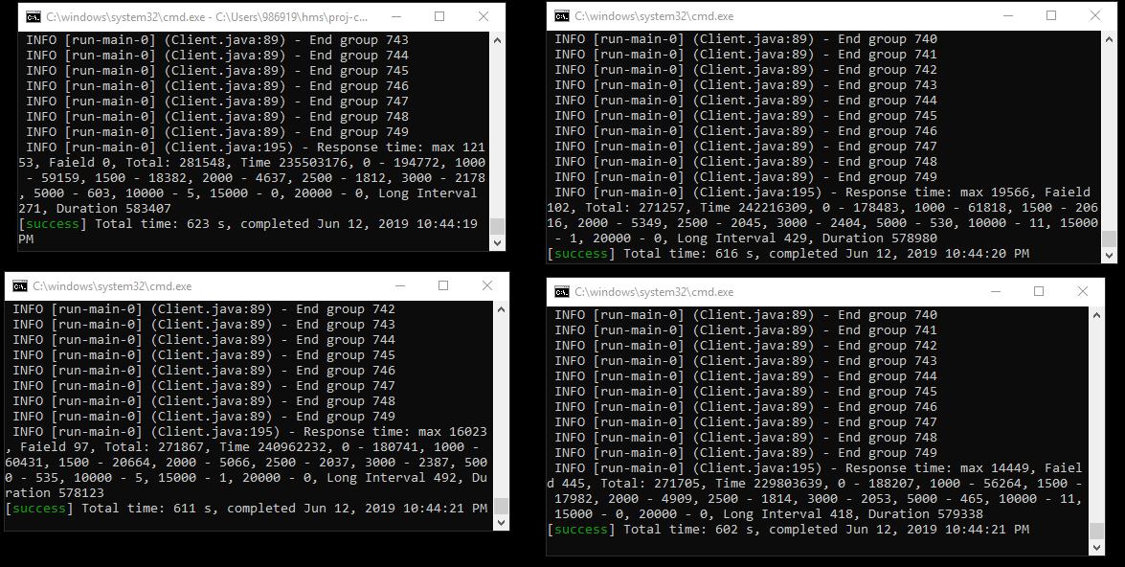
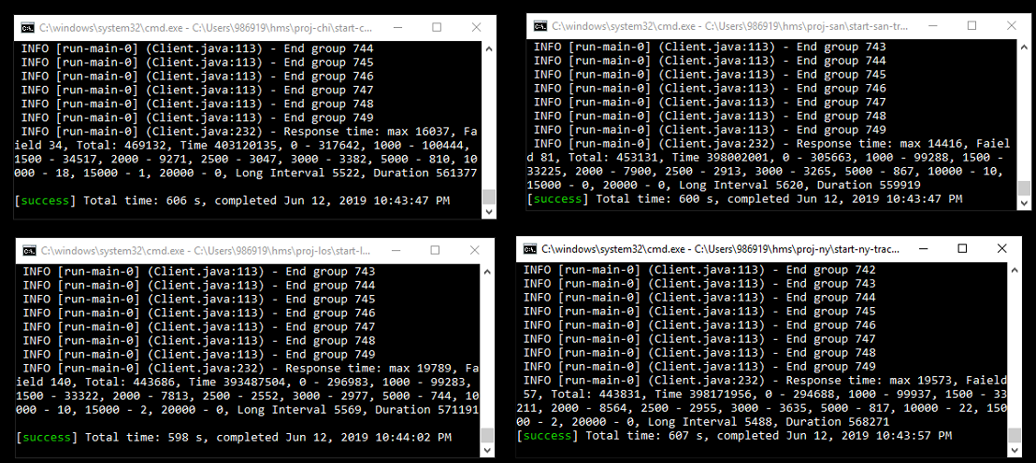
Micro-services-based implementation – Demo

Slide 20
Some tips to work with Micro-services
Need asynchronous programing
CompletableFuture / TaskCompletionSource
Consume / produce
Load balancer
Kafka
REST API servers
Clients
Service units

Slide 21
Some tips to work with Micro-services
Need parallel programing
Load balancer
Kafka
REST API servers
Clients
Service units

Slide 22
Some tips to work with Micro-services
Need concurrent programing: avoid locking/synchronized as possible
By chained read/write.
By single thread of service executor.
Load balancer
Kafka
REST API servers
Clients
Service units

Slide 23
Some tips to work with Micro-services
Need concurrent programing: when locking/synchronized is mandatory, reduce collision as much as possible
By adding more shared resources
Load balancer
Kafka
REST API servers
Clients
Service units

Slide 24
Some tips to work with Micro-services
The bottle neck of micro-services would be network transportation
Reduce amount of transported data/messages
Optimizing by memory buffer
Load balancer
Kafka
REST API servers
Clients
Service units

Slide 25
Conclusions
Micro-services is
Clustering
Sharding
Decentralized
Fault tolerant/elastics/scale out
Asynchronous & parallel & concurrent programing
Not a magic-stick
Need good algorithm
Need optimizations

Slide 26
Future research
Auto deploy & scaling service nodes (Docker & Kubernetes)
A micro-services framework that can auto balance service to nodes in a cluster system
For example, currently I used 2 processing machines for 69 service nodes
If I add another machine to processing-network, it’s auto balanced so that 23 services run on each machine.
Or auto balanced by processing weight of each node so that the sum of processing weight would be same for each processing machine.

Slide 27
Q&A

Slide 28
Thanks
Prof. Steve Nolle – MPP - Took me to Java would
Prof. Rene de Jong – Software engineering - Sprint to finish this projects
Ph.D Bruce Lester – Parallel programming - Parallel is powerful but be careful with collision
Prof. Asaad Saad – Mordern web application - Asynchronous programming is awesome.
Prof. Mrudula Mukadam - Big Data Technology - The power of cluster system.
Prof. Michael Zijlstra - Enterprise Architecture - Micro–services, the cutting-edge technology
Dr. Renuka Mohanraj – helped me a lot to have this teach talk.
MUM Compro department - Took me to next level of development

