Slide 1

Overcome challenges of tracking-searching problem by hierarchy geo-based micro-services
MUM-Compro tech talk – July 06, 2019

Slide 2
Agenda
Tracking-searching problem
Hierarchy geo-based sharding
MongoDb-based implementation
Micro-services-based implementation
Live demo
Some tips to work with Micro-services
Conclusions
Future research
Thanks

Slide 3

Tracking-searching problem (like Uber)
Need to tracking location of multiple providers
Need to search providers based on location and range (with additional criteria)

Slide 4
Tracking-searching problem – challenges
Huge volume of searching requests.
170,000 daily rides in San Francisco
230,000 rides every hour or an average of 5.5 million rides a day
Massive volume of tracking requests.
67,000 active drivers in the Chicago city
Real-time.
Unequal distribution
→ Need asynchronous, scaling, sharding

Slide 5
Tracking-searching problem – Test data
Tracking location of 240K providers in LOS, San, Chicago, New York
Simulated by
1 machine for tracking requests
1 machine for searching requests
Each machine run 3K threads ~ 6K concurrent requests (tracking & searching).

Slide 6
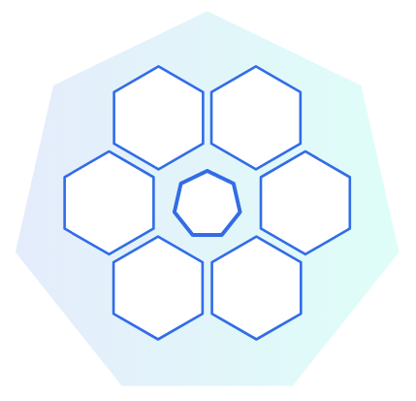
Tracking-searching problem – challenges
clustering is not enough
Requests can be processed by any node
(Every single tracking request have to be processed by all nodes)

Slide 7
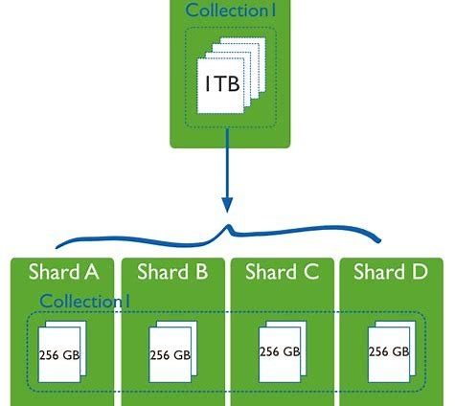
Tracking-searching problem – challenges
Field-based sharding is not efficient
Every single search request have to be processed by all nodes
Provider moving across shardings
→ Question: can we have relationships between sharding collections so that search requests can be served efficiently?

Slide 8

Hierarchy geo-based sharding
Each area is a hub
Hub structure is a tree
Country node
State/City nodes
Areas inside city
Small number of node in tree, can be cache in memory for fast traveral
Provider tracking sharded by hubid
For tracking-requests, attach associated hubid (only 1)
For searching-requests, query with related hubids (multiple)

Slide 9
Hierarchy geo-based sharding – Tracking
Find associated hub by top-down traversing the hub tree.
At each level, chose the in-range & closest hub (only 1)
If there’s no qualified sub-nodes, then current node is final result
→ complexity is log(n)

Slide 10
Hierarchy geo-based sharding – Searching
Find all related hubs top-down traversing the hub tree.
At each level, chose all those hubs are in-range
If the searching range is fully covered by a sub-node, then not add current node to result
→ complexity is log(n)

Slide 11
MongoDb-based implementation
Spit each of these cities (LOS, San, Chicago, New York) into 16 sub-areas so we have 1 global, 4 cities & 4x16 sub-areas → 69 nodes in 3 layers tree
REST API find & attach associated/related hub(s) before send requests to MongoDb
Tracking data sharded by hubid & and geo-indexed.

Slide 12



MongoDb-based implementation
Load balancer
Master Node
REST API servers
Sharding Nodes
Clients

Slide 13
MongoDb-based implementation
1 machine for Gobetween load balancer + REST api on Netty Server server
1 machine for REST api on Netty Server server (weight 2)
1 machine for Mongo master
2 machines for Mongo sharding nodes

Slide 14
MongoDb-based implementation – Results
Able to scale rest api out to multiple machines
Able to scale processing out to multiple machines (Mongo sharding)
Able to handle 6K concurrent requests
Max time for processing one request ~15s
Avg ~2K requests/s (tracking+searching)

Slide 15
MongoDb-based implementation – drawbacks
No much differ when compare to Single machine for REST API + Single machine for MongoDb or adding more sharding nodes
The MongoDb Master handle too heavy job.
Can only scale up for MongoDb Master (central node issue)
Using hard drive for short-term data

Slide 16
Micro-services-based implementation
Use Kafka servers as middleware messaging
Each hub is a micro-service node
Each micro-service node handle 2 hub-based message topics from specific Kafka
Total 69x2 (tracking/searching) topics for test case.
Use jvptree to store tracking data in memory on each micro-service node
Separate storage so that no need kind of node like MongoDB master (decentralized)
Each hub ~ [kafka server & 2 topics] (Hubs grouped by zone)
REST API find & attach associated/related hub(s) then send message to target [Kafka - topic(s)]
Also attach api server info
Each REST API server have 2 response topics (tracking/searching-result) on each Kafka servers
Micro-services will write result to api-server source’s response topic
REST API collect & combine results then send response to client.

Slide 17


Micro-services-based implementation
Zones
REST API servers
Clients
Kafka servers
Service nodes

Slide 18
Micro-services-based implementation
1 machine Netty Server for REST api that handle tracking requests
1 machine for Netty Server REST api that handle searching requests
1 machine for Mongo Db (store & serve provider info only)
2 machines for Kafka & service nodes
Each handle 2 city nodes + 2x16 sub-area nodes
The first processing machine also handle global node.

Slide 19
Micro-services-based implementation – Results
Able to scale processing, rest api out to multiple machines
Able to handle 6K+++ concurrent requests
Max time for processing one request ~10s
4.5K+++ requests/s (tracking + searching)
Easily indefinitely scaling out because of decentralizing

Slide 20
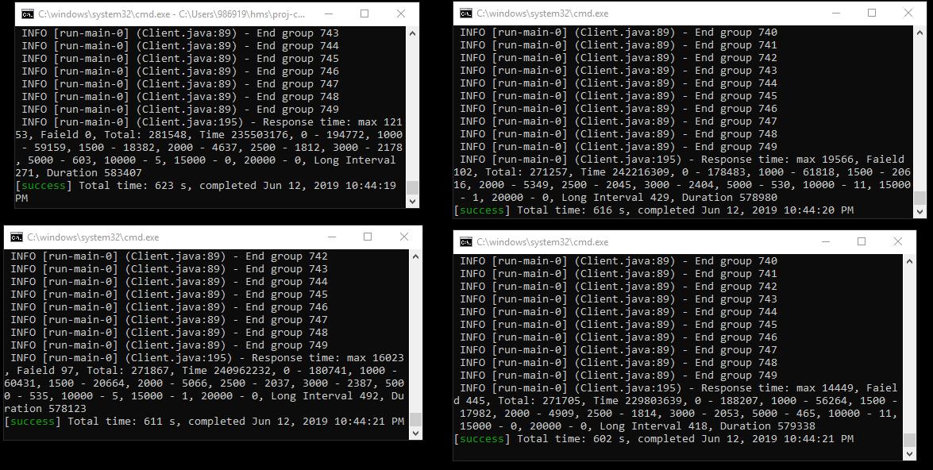
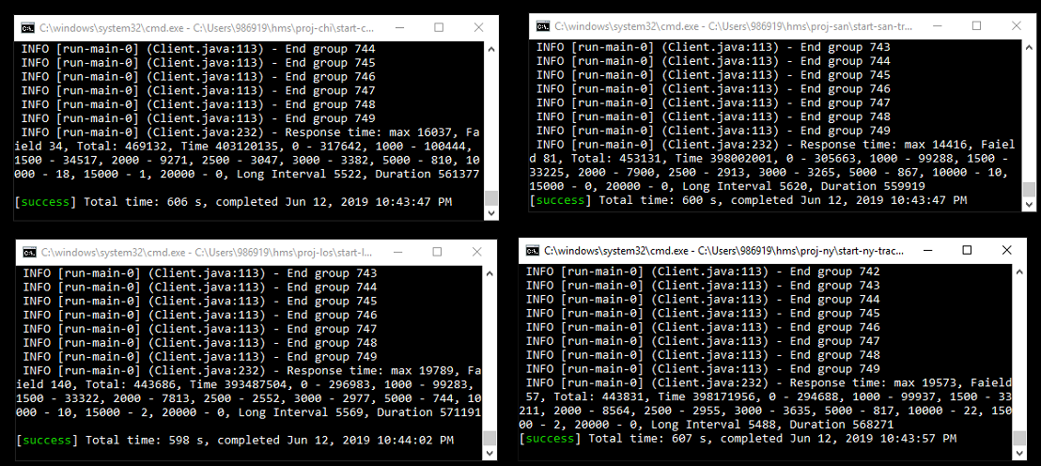
Micro-services-based implementation – Demo

Slide 21
Some tips to work with Micro-services
Need asynchronous programing
CompletableFuture / TaskCompletionSource
Consume / produce requests
REST API servers
Kafka
Service units
Clients

Slide 22
Some tips to work with Micro-services
Need parallel programing
REST API servers
Kafka
Service units
Clients

Slide 23
Some tips to work with Micro-services
Need concurrent programing: avoid locking/synchronized as possible
By chained read/write.
By single thread service executor.
REST API servers
Kafka
Service units
Clients

Slide 24
Some tips to work with Micro-services
Need concurrent programing: when locking/synchronized is mandatory, reduce collision as much as possible
Adding more shared resources
REST API servers
Kafka
Service units
Clients

Slide 25
Some tips to work with Micro-services
The bottle neck of micro-services would be network transportation
Reduce amount/size of messages
Optimizing by memory buffer
Combine services
REST API servers
Service units
Clients
Kafka

Slide 26
Conclusions
Micro-services is
Clustering
Sharding
Decentralized
Fault tolerant/elastics/scale out
Asynchronous & parallel & concurrent programing
Not a magic-stick
Need good algorithm & design & optimizations

Slide 27
Future research
Auto deploy & scaling service nodes (Docker & Kubernetes)
A micro-services framework that can auto balance micro-services to nodes in a cluster system
For example, currently I used 2 processing machines for 69 service nodes
If I add another machine to processing-network, micro-services are auto re-organized so that 23 services run on each machine.
Or auto re-organized by processing weight of each node so that the sum of processing weight would be same for each processing machine.

Slide 28
Q&A

Slide 29
Thanks
Prof. Steve Nolle – MPP - Took me to Java would
Prof. Rene de Jong – Software engineering - Sprint to finish this projects
Ph.D Bruce Lester – Parallel programming - Parallel is powerful but be careful with collision and need good algorithm
Prof. Asaad Saad – Modern web application - Asynchronous programming is awesome.
Prof. Mrudula Mukadam - Big Data Technology - The power of cluster system.
Prof. Michael Zijlstra - Enterprise Architecture - Micro–services, the cutting-edge technology
Dr. Renuka Mohanraj – helped me a lot to have this teach talk.
MUM Compro department - Took me to next level of development progress

