Slide 1
Signal and Image Processing
Ramin Zabih

Slide 2
Administrivia
https://github.com/cornelltech/signal-and-image-processing
Lecture slides (only after lecture!)
Homework, code, optional reading, etc.
Will use surveymonkey for informal feedback
First survey: your math & programming comfort levels
Three problem sets
Occasional quizzes are possible
Optional: contribute to an open source project (OpenCV, etc.)

Slide 3
Topics (tentative!) from web page

Slide 4
Outline for today
Signals and models
Model fitting with least squares
Wavelet transforms
Linear shift-invariant systems
We will take a short break mid-lecture to go around and introduce ourselves

Slide 5
What is a signal?
A function that conveys information
Functions of 1 argument are usually viewed in terms of time
First half of the course
Functions of 2 arguments are usually images
Second half of the course!

Slide 6
What should we do with a signal?
Many possible things, but let’s look at some applications
1D examples for the moment
Example data sets (all are real data)
Accelerometer from an Android phone
Currency exchange and interest rates
Cardiac waveforms from an ECG

Slide 7
Accelerometer data

Slide 8
Currency exchange and interest rates

Slide 9

ECG

Slide 10
What should we do with a signal?
Accelerometer
Classify activity, count jumps, detect movements
Currency exchange
Predict movements, discover causality
ECG
Determine heart rate, detect abnormalities

Slide 11
Homework overview
Implement algorithms we covered in class on real-world data
Experiment with, e.g., parameter effects
No proofs or calculations, which are typical in DSP courses
You can choose a subset of the problems
Each application has its own story, with follow-up available
Usually there will be an industry contact c/o Ramin or Greg
Example domains: mobile sensing, finance, medicine
Accelerometer data from your smartphone
Your own mini-version of Shazam (audio fingerprinting)

Slide 12
Modeling a signal
In many cases we have an idea of what we expect to see
Accelerometry: repeated jumps when skipping rope, little change when stationary
Currency exchange: interest rate increase goes along with exchange rate increase
ECG: repeated heartbeats
This allows us to understand the information in a signal
Even if what we observe is not exactly what we expected

Slide 13
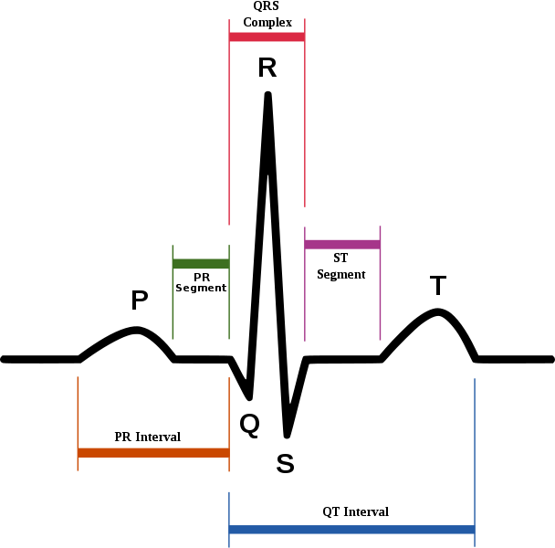
Complex model: ideal ECG

Slide 14

Model matches data (sometimes!)
www.uptodate.com
Use the model to answer obvious questions
How many beats
Is there an inverted T-wave?

Slide 15
Slightly harder case
www.uptodate.com

Slide 16
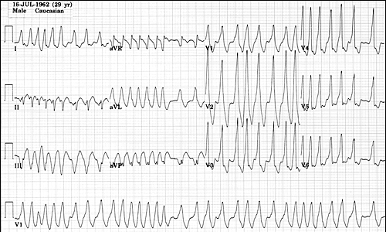
Sometimes the signal is not your friend
The Alan E. Lindsay ECG Learning Center ; http://medstat.med.utah.edu/kw/ecg/

Slide 17
Models and data
Model: mathematical function from inputs (e.g., time) to output (e.g., acceleration, interest rate, voltage)
Simple example: car traveling at constant speed
x(t) = v∙t
Velocity v is a parameter of the model
Given some data we might wish to explain it with a model
Find best parameter (parameter estimation)
Choose right model (model selection)
Goals: prediction, irregularity detection,…

Slide 18
Models and parameters
A model predicts dependent variable from independent one
A model also has some internal variables, called parameters θ
Simple example: fit a line to odometer
parameters are m,b (where m is velocity)
Parameters (m,b)
Dependent
variable (mileage)
Independent variable (time)

Slide 19
Statistical models
Even if the parameters are right, don’t see what model predicts
Lots of hard-to-model issues, primarily measurement
Also known as noise
Observation is prediction plus noise
For our constant speed car, x(t) = v∙t + n(t)
It is typical to assume “IID” noise
Error at each point does not depend on anything else, and is time-invariant
Tune your model parameters to match your data!

Slide 20
The ideal car

Slide 21
The real (lying) car

Slide 22
Linear regression
Simplest case: fitting a line

Slide 23
Linear regression
Outliers?

Slide 24
Parameters via optimization
What makes a line good versus bad?
This is actually a very subtle question

Slide 25
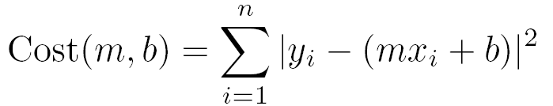
Least squares fitting
Squared residuals

Slide 26
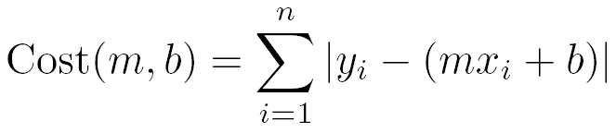
LS cost function
The cost function (objective) is convex
No local minima, so you can just roll downhill
There is a closed form solution!
Other functions are convex, but have no closed-form solution:
LS can be generalized to fit, e.g., polynomials

Slide 27
LS fit to exchange rate data

Slide 28
Do we always fit an explicit model?
Currency and ECG problems have a natural model that comes from first principles
Economics, physiology
What about jumping rope?
It is possible to build a very complex model
What about Shazam?
Can model the speakers, room reflectances, other noise sources, microphone characteristics, etc.

Slide 29
Other strategies
The Nike approach (“just do it”)
Glue together some unprincipled hacks
Usually there is an implicit model
Supervised learning
Search the space of models
Change to a different input representation
Cleanly separate the signal from the noise

