Slide 1
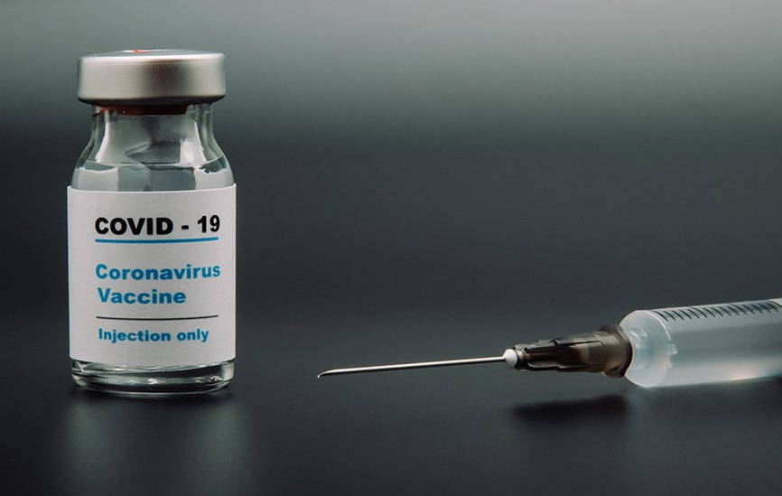
Project 5: COVID19 Vaccination a race of injection vs. infection
Group 1 - Rahul Parab, Jesse Tao, Letty Wu, Alyssia Oh
Notes:
Hi, we are group 1.
Our project, is on covid 19 vaccination, which has been described as a race between injection and infection,
And we we looked at whether we can use modeling to forecast the infection to optimize vaccine distribution plan.

Slide 2
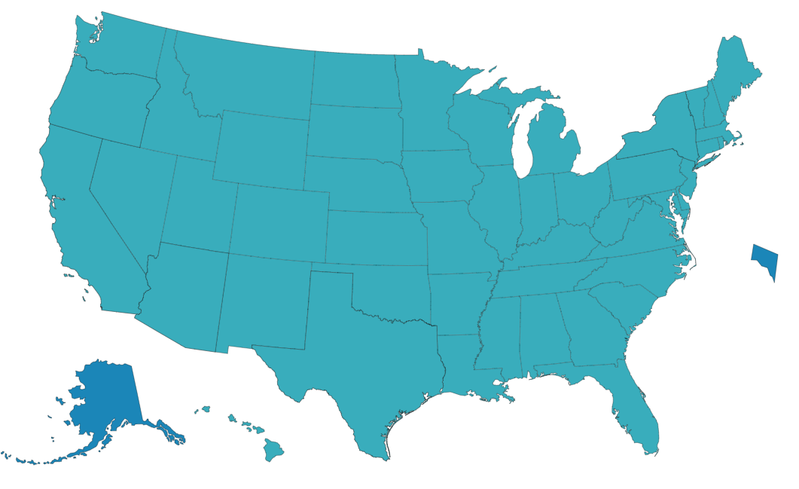
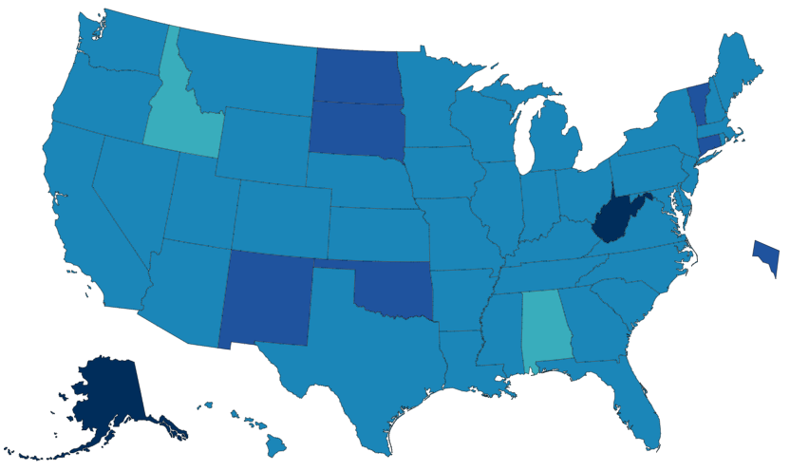
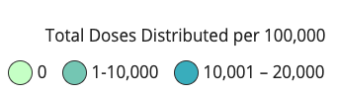
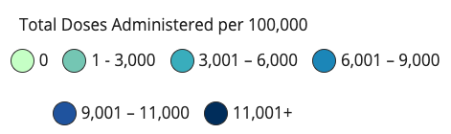
How are we doing on vaccine distribution?
Federal Allocation
14,000-16,000 / 100K
State Distribution
3,000-11,000+ / 100K
Notes:
So how are we doing on vaccine distribution?
At the federal level, allocation has been more or less uniform.
Currently, the government allocated vaccines based on population to about 10-20% of the total
However, there is higher discrepancies of distributions within the state level,
Anywhere from about 3k to 15k per 100k, which is a source of frustration for many people.

Slide 3
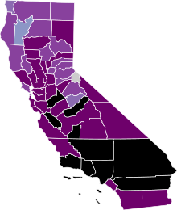
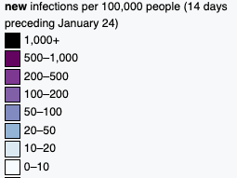
Total vaccines administered = 5200 per 100k
New cases = 1142.3 per 100k in the last 14 days
Speed matters
Highly Impacted States like CA - Slow in Vaccine Distribution
Costs lives
Costs money
Virus mutates
- new variants may spread faster
- escape current vaccines
Notes:
This is quite unfortunate
Especially for highly impacted states like CA, who seems to be on a slow end of vaccine distribution
So far total vaccine administered hovers around 5000 per 100K
although just within the last 2 weeks, more than 1000 people per 100k have been newly confirmed.
Some might ask “well we have the vaccine already, so does the speed actually matter that much”,
But speed is extremely important
First, obviously it costs human lives daily. The faster we control the infection, you are saving human lives
Also, there are many people struggling because of the impact the infection has on the economy.
Lastly, coronavirus mutates into new variants, which became especially a big concern in the last few days with the introduction of UK, b

Slide 4
Problem Statement
Can we optimize vaccine distribution by forecasting the next hot spots? 1. can we develop a model to forecast hot spots? 2. what is the current distribution protocol and how to modify it? 3. should we make the change?
Notes:
- Subject to change as the model develops…

Slide 5
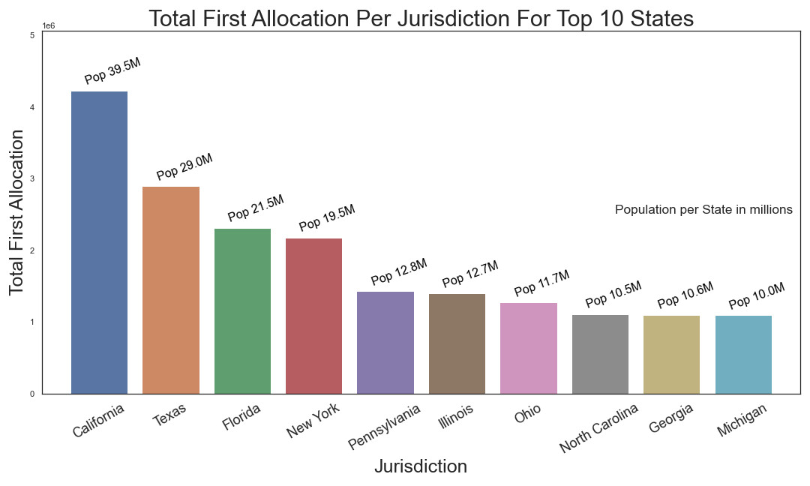
- Pfizer and Moderna are vaccine suppliers
- From 12/14/2020 to 02/01/2021
- Vaccine Allocation: California: 4,226,100; Texas: 2,894,925; Florida: 2,313,050

Slide 6
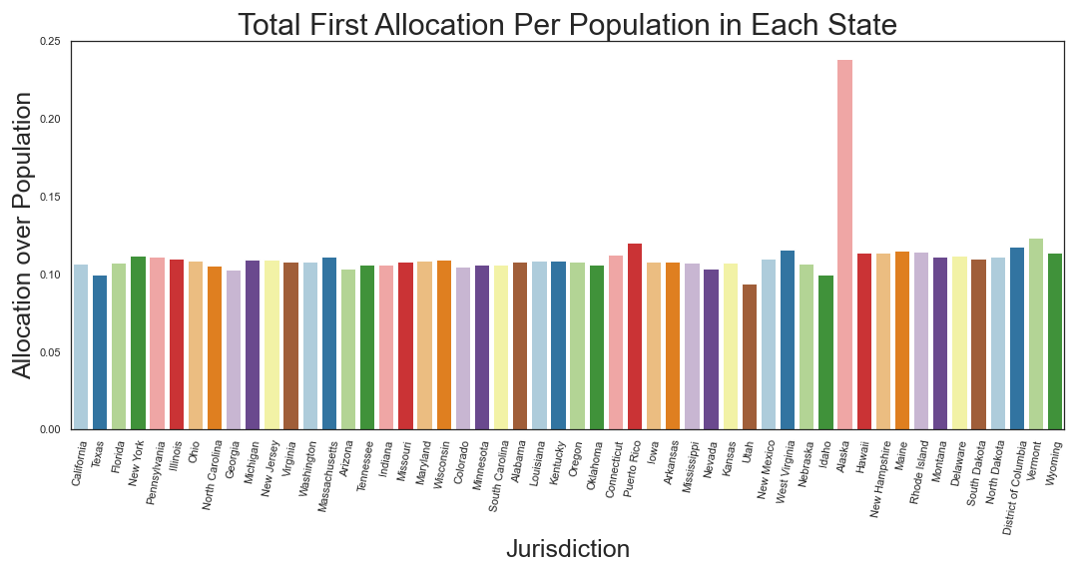

Slide 7
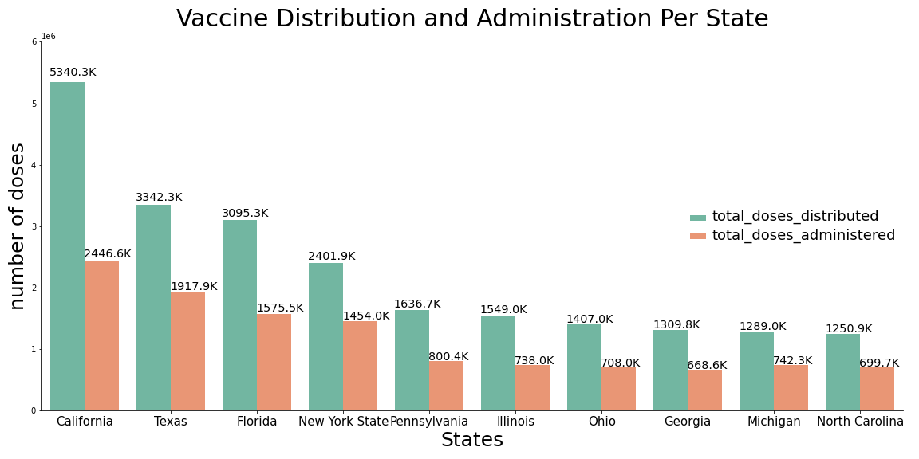
- From 1/16 to 1/27
- California got 5,340,275 distribution, but only 2,446,577 got administered

Slide 8
Modeling - RNN
As time series and geospatial data is hard to visualize in slides, we will be using an interactive web app to go through our modeling process
- Visit this link to follow along: https://covid.jesseptao.com

Slide 9
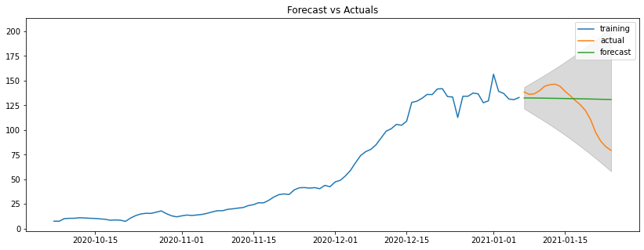
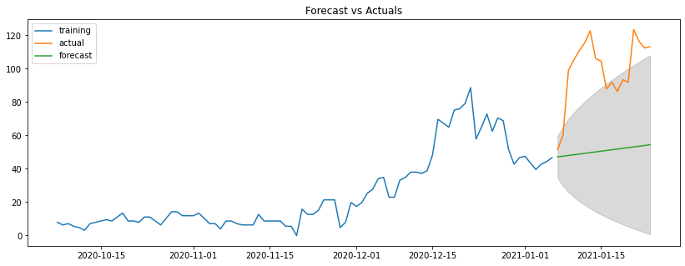
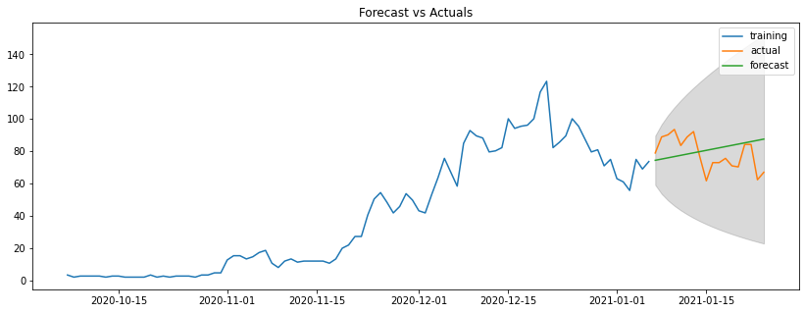
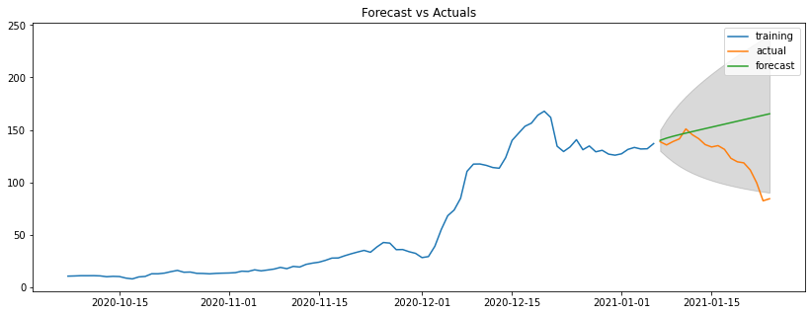
Modeling –ARIMA
Los Angeles Inyo
Colusa Riverside

Slide 10
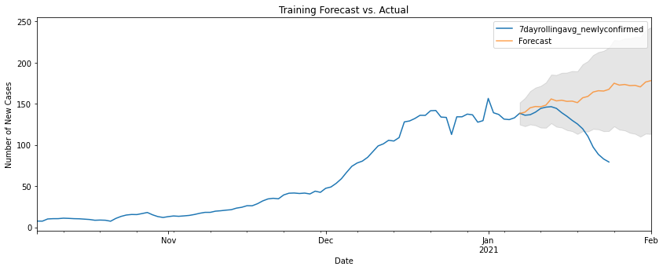
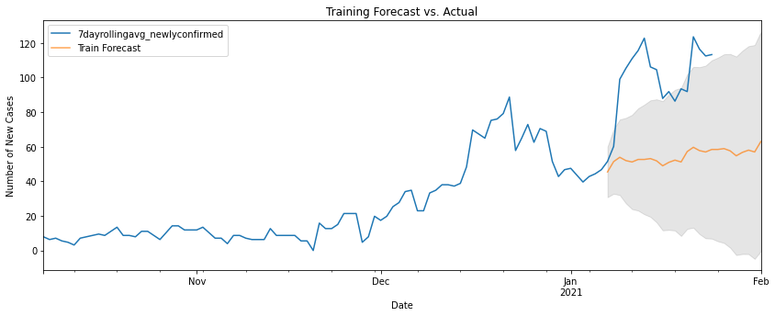
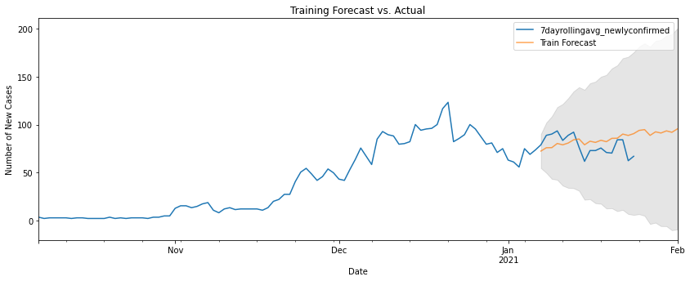
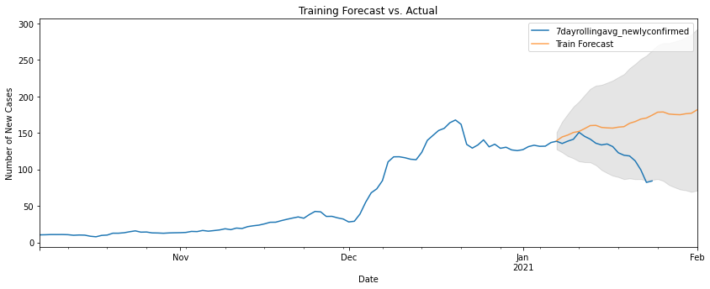
Modeling –SARIMAX
Los Angeles Inyo
Colusa Riverside

Slide 11
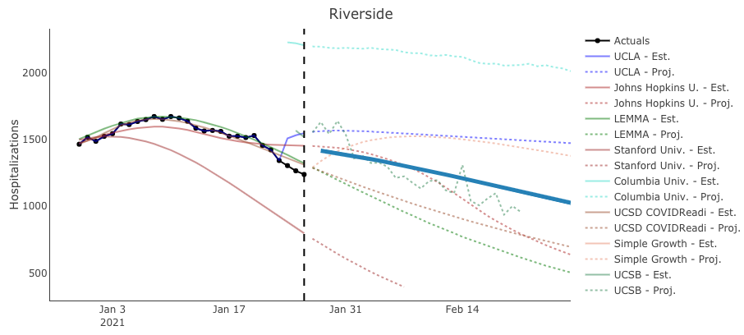
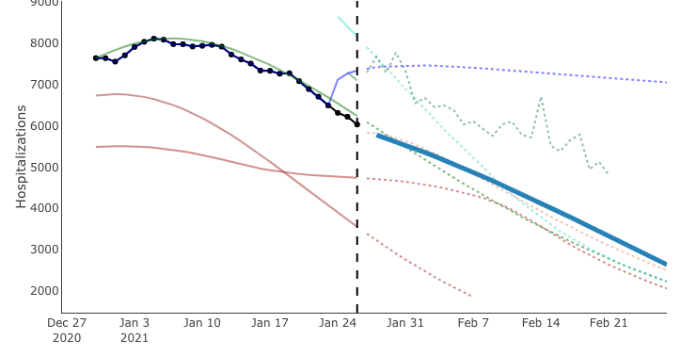
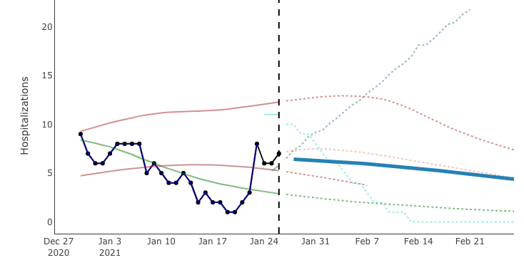
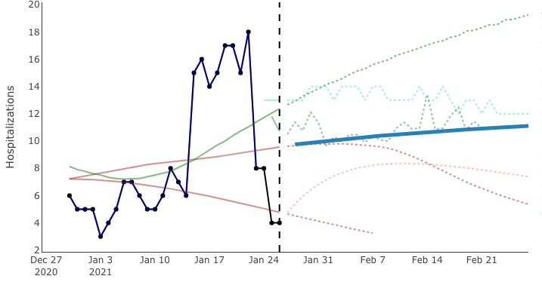
How does our model compare to existing models?
Los Angeles Inyo
Colusa Riverside
Notes:
None of the models predict the actual change very well
May need to consider numerous other factors to consider

Slide 12
CA’s Vaccine Distribution Plan
Phase 1A (in progress)
Phase 1B
Phase 1C
Age 50-64 yrs old
~ 3 million
healthcare workers
long-term care residents
Tier 1 (we are here)
Age 65+ yrs old
Essential workers
Tier 2
Essential workers
Age 16-49 yrs old with underlying health conditions
(education, childcare, emergency services, food, agriculture)
(transportation, residential, and sheltering facilities, services, critical manufacturing)
Notes:
What is the current distribution plan?
Prioritize on healthcare workers and elderly
Makes sense to protect the elderly and most exposed workers, but also heavily influenced by “ethics”

Slide 13
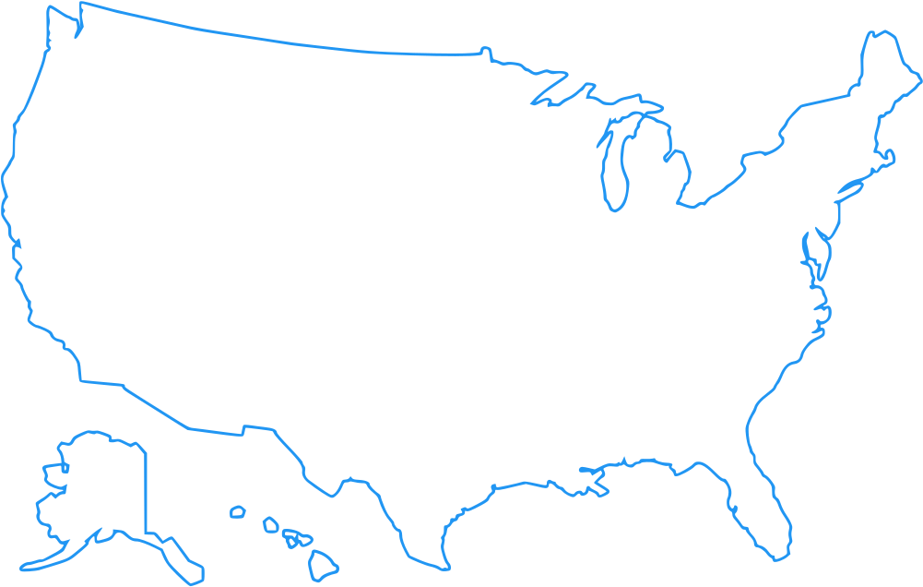



Federal Vaccine Allocation Plan
2.8 million/week
(1.4 million people)
Total doses allocated (Jan 28th 2021) = 48 million
Total doses ordered (July 31st 2021) = 600 million
Total doses received (Jan 28th 2021) = 5.5 million
Total doses expected (July 31st 2021) = 69 million

Slide 14
Observation :
Uncertainty in events and external factors ( cadence of allocation, new strains , government decisions)
No short fall , with 2.8 MM vaccine allocated (per week ) to California over next 22 weeks.
Southern California, esp. LA, Orange, Riverside, are expected to have a spike in new cases(by volume) and LA, Marin, Kern counties (by density)
Notes:
None of the models predict the actual change very well
May need to consider numerous other factors to consider

Slide 15
Conclusion
If assumption made around Distribution / Allocation / Administration of vaccine hold true, reallocation of vaccine resources is not needed.
UK, Brazil and South Africa strain of Covid virus may cause an increase in cases across counties.
Need to develop an an ethical (age, gender, race, mortality rate, poverty status ? )methodology to redistribute vaccine across counties, if required.
Notes:
None of the models predict the actual change very well
May need to consider numerous other factors to consider

