Slide 1

BiTranslator: Bridging Language Barriers with Voice
BiTranslator is a two-way language translation application that helps two people speaking two different languages to communicate easily by voice.
For example:
Person A speaks Vietnamese
The system translates to English and plays the audio
Person B replies in English
The system translates back to Vietnamese and plays the audio
by Tú Lê

Slide 2
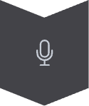

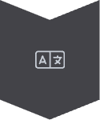
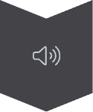
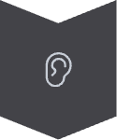
How the System Works
Capture Voice Input
Record spoken language from the user via a microphone.
Speech-to-Text Conversion
Convert the captured voice into written text.
Text Translation
Translate the text into the target language using the Google Translate API.
Text-to-Speech Conversion
Convert the translated text back into spoken language.
Play Audio Output
Play the translated audio for the listener.
The process is then reversed for the other person in the conversation.

Slide 3



Technologies & Tools Used
Python: The Core Language
Key Libraries
Python serves as the primary programming language for the application.
speech_recognition: for converting speech to text
googletrans (or deep_translator): for text translation (free, uses unofficial API)
gtts: for converting text to speech
pygame: for playing audio
pyttsx3: (if using offline TTS for Vietnamese)
100% Free
Runs on Personal Computers
No GPU or Server Required

Slide 4




Advantages & Practical Applications
Direct & Natural Communication
No Typing Required
Multi-Language Support
Easy to Use
Designed for simplicity and accessibility, making it user-friendly for everyone.
Facilitates cross-language communication that feels immediate and intuitive.
Eliminates the need for manual text input, streamlining conversations.
Supports various languages including Vietnamese, English, Japanese, Korean, and more.
Practical Applications:
Language Learning
Travel & Basic Communication
Interacting with Foreigners
Two-Language Personal Assistant

Slide 5
Demo & Conclusion
Conclusion:
Simple, effective, and easily expandable application
Can be further upgraded with: GUI, support for more languages, AI context recognition...
Bonus: Expansion Suggestions (if you wish to add more)
Automatic spoken language detection
Web / desktop interface (using Tkinter or Flask)
Text translation from images (OCR + Google Translate)

