Slide 1
Team Jupiter VGU SIEM-Project Instructor: Prof. Martin Kappes and Manuel Grob
Team leader: Vo Le Tung contact email: 13105@gmail.com
Dang Chi Cong
Bui Xuan Phuoc
Pham Nguyen Thanh An

Slide 2
Second week work distribution
Subtasks | Time allocated | Personnel

Slide 3
Communication
Daily scrum will be hosted every weekday and Saturday at 9AM
Sprints duration: 1 week.
Sprint review and sprint retrospective at the end of every week.
Zoom channel as the communication channel for daily scrums, sprint review and sprint retrospective.
Additional meetings can be hosted via Zoom or these can be face to face meetings.
Meetings duration may vary, depends on the purpose of the meeting and problems being brought up.

Slide 4
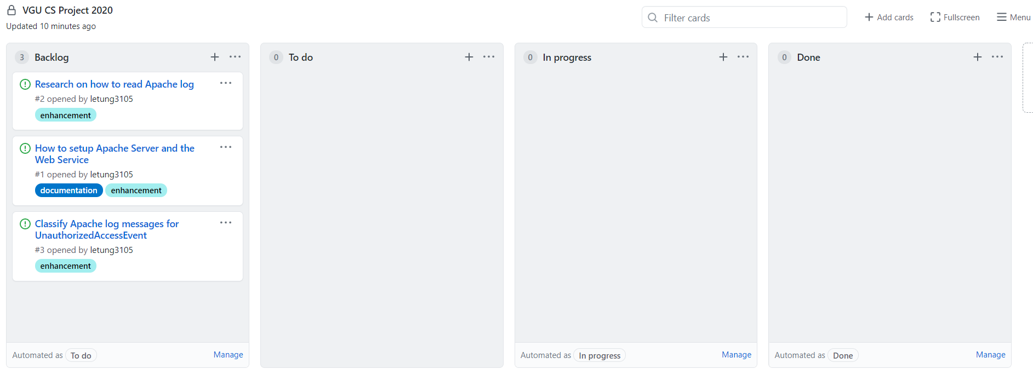
Document and code sharing
Version control system and code sharing: Github.
Project planning schedule and description: Github’s project service

