Slide 1
Team Jupiter VGU SIEM-Project Instructor: Prof. Martin Kappes and Manuel Grob
Team leader: Vo Le Tung contact email: 13105@student.vgu.edu.vn
Dang Chi Cong
Bui Xuan Phuoc
Pham Nguyen Thanh An

Slide 2
Product backlog
Subtasks | Time allocated | Personnel
How to setup Apache Server | 4 hours (First sprint) | Dang Cong
Research how to read Apache log (raw event) | 6 hours (First sprint) | Xuan Phuoc
Research on how to use Pcap4J (raw event) | 7 hours (First sprint) | Thanh An
Classify Apache log messages for ConsecutiveFailedPasswordEvent | 10.5 hours (TBD)
Classify Apache log messages for UnauthorizedAccessEvent | 10.5 hours (TBD)
Detect HorizontalPortScanEvent | 10.5 hours (TBD)
Detect BlockPortScanEvent | 10.5 hours (TBD)
Detect VerticalPortScanEvent | 10.5 hours (TBD) | Le Tung

Slide 3
Communication
Daily scrum will be hosted every weekday and Saturday at 1PM ICT.
Sprint duration: 1 week.
Sprint review and sprint retrospective at the end of every week.
Zoom channel as the communication channel for daily scrums, sprint review and sprint retrospective.
Additional meetings can be hosted via Zoom or these can be face to face meetings.
Meetings duration may vary, depends on the purpose of the meeting and problems being brought up.

Slide 4
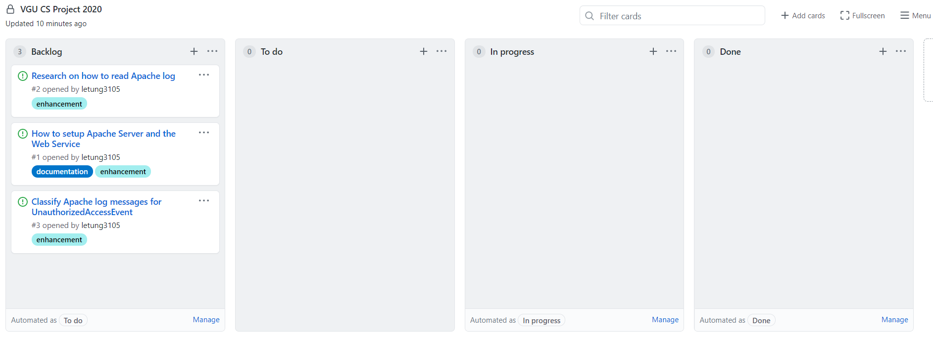
Document and code sharing
Version control system and code sharing: Github.
Project planning schedule and description: Github’s project service

Slide 5
This week plan
Each team member is assigned to one task.
Continue taking items from the product backlog after finishing a task.

Slide 6
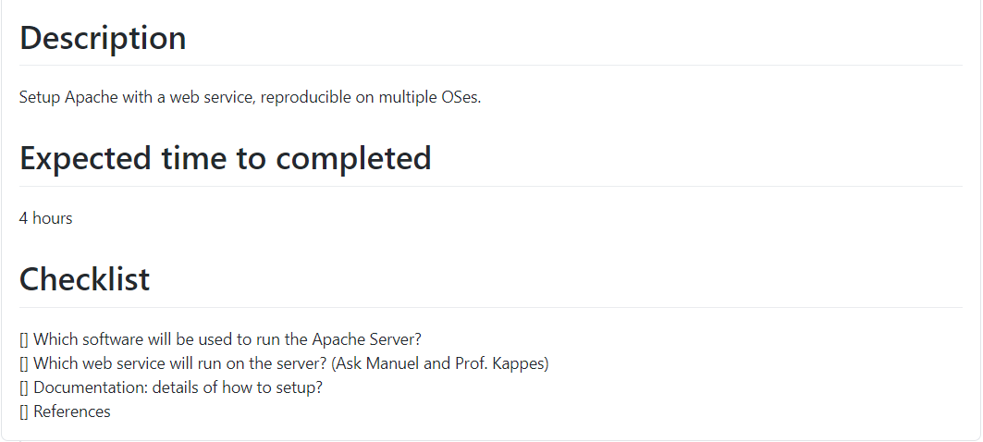
This week plan – Setting up Apache server

Slide 7
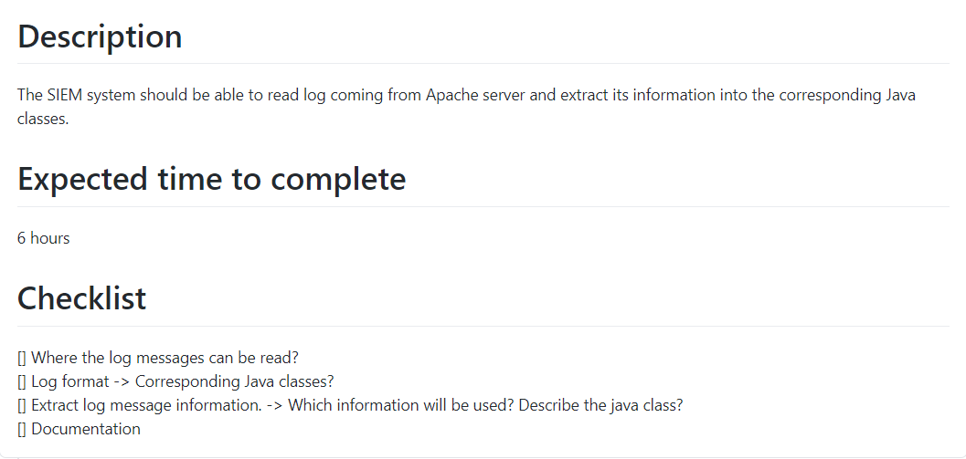
This week plan – Research on how to read Apache log

Slide 8
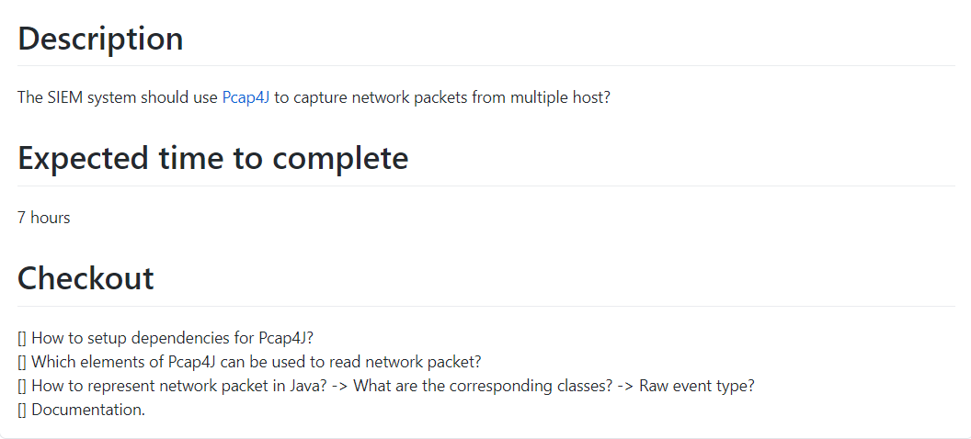
This week plan – Research on how to use Pcap4J

Slide 9
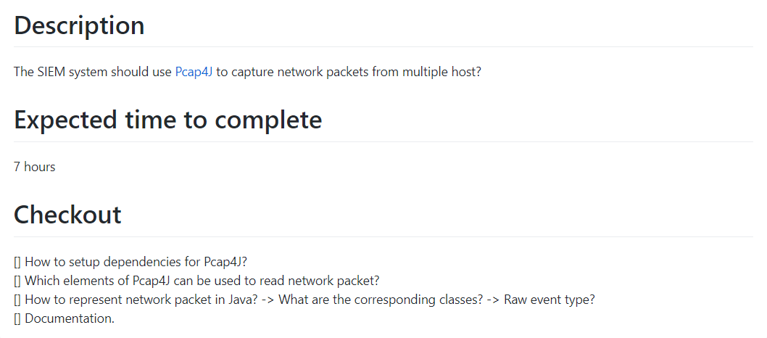
This week plan – Detect VerticalPortScanEvent

