Slide 1
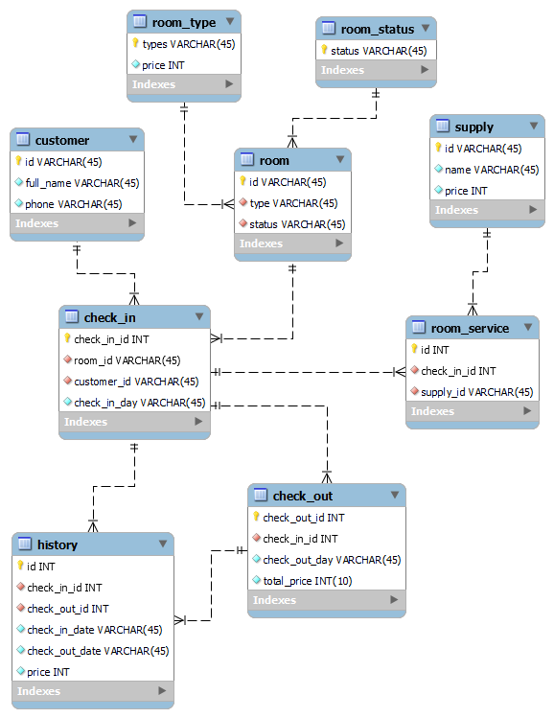



MAIN PART
INTRODUCTION
TABLE OF CONTENTS
GROUP 8
HOTEL MANAGEMENT SYSTEM
INTRODUCTION
03
02
MAIN PART
01
LÊ ANH TÚ
ĐỖ MẠNH THẮNG
NGUYỄN NGỌC KHIÊM
NGUYỄN VĂN CƯỜNG
ĐẶNG HOÀNG PHÚC
FUNCTIONS
MEMBERS
CUSTOMERS
HOTEL
SYSTEM
CONCLUSION

Slide 2

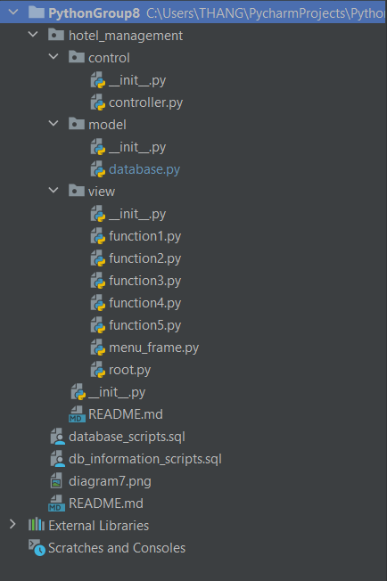
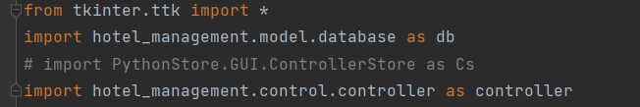

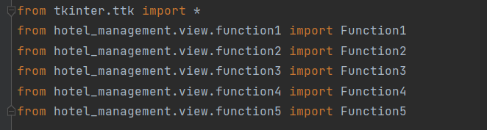
CLASSES AND MODULES

Slide 3






CLASS FUCTION
01
02
FUNCTION 1
03
CHECK IN
FUNCTION 2
ROOM
MANAGEMENT
04
FUNCTION 3
05
ROOM ORDER
FUNCTION 4
CHECK OUT
FUNCTION 5
HISTORY

Slide 4
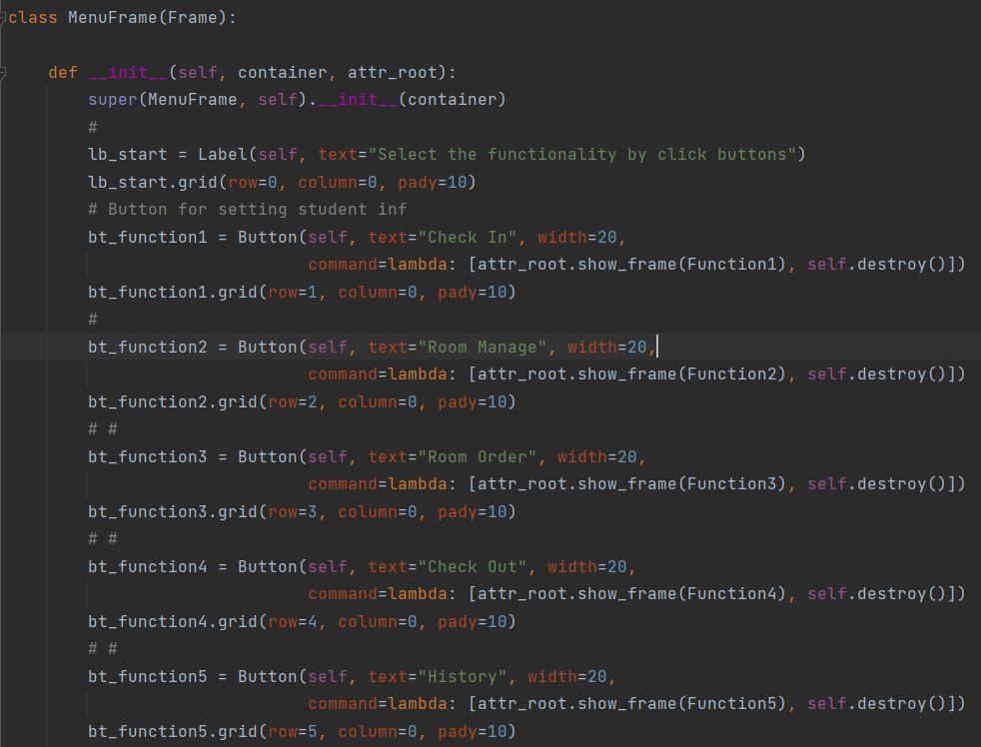
CLASS FUCTION

Slide 5
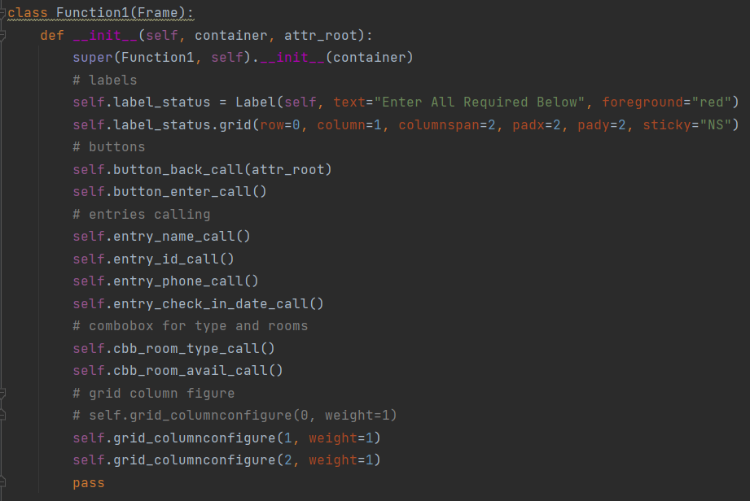
CLASS FUCTION

Slide 6
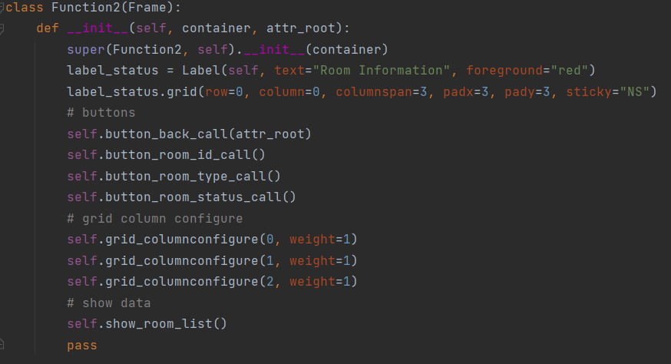
CLASS FUCTION

Slide 7
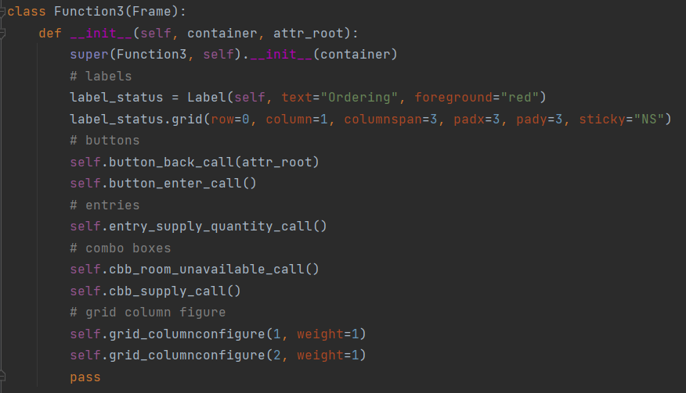
CLASS FUCTION

Slide 8
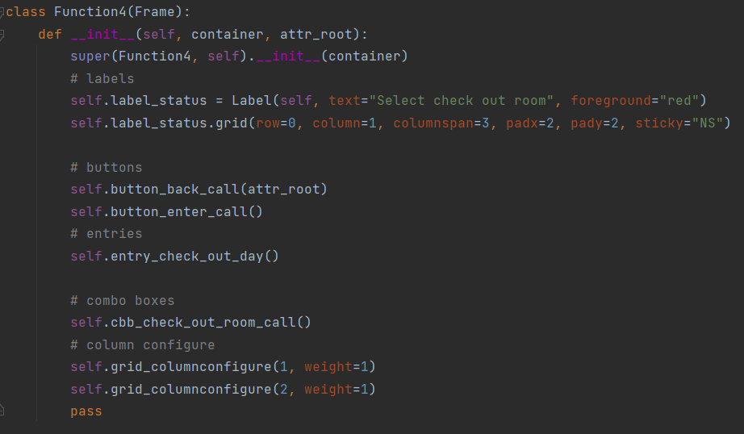
CLASS FUCTION

Slide 9
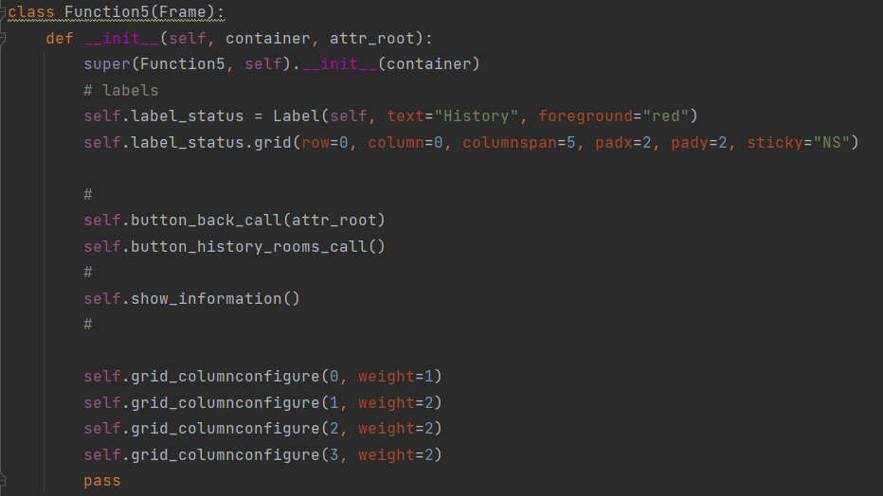
CLASS FUCTION

Slide 10
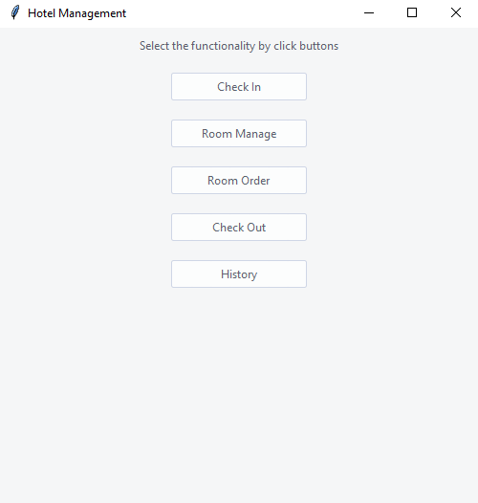
TKINTER

Slide 11
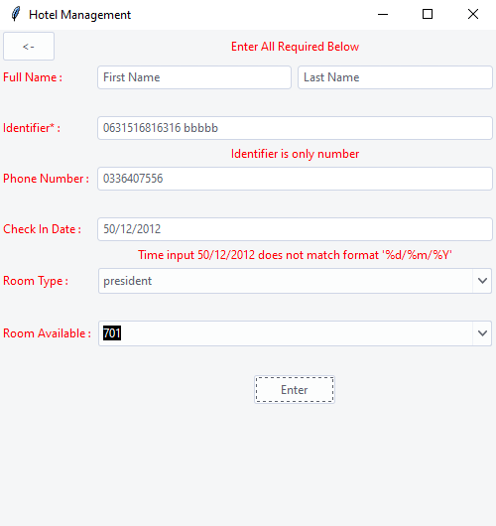

TKINTER
CHECK IN

Slide 12
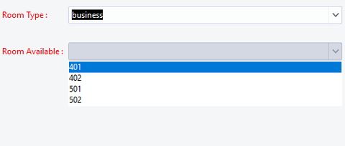
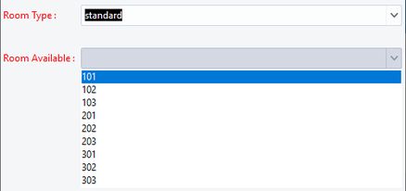
TKINTER
BUSINESS ROOM
STANDARD ROOM

Slide 13
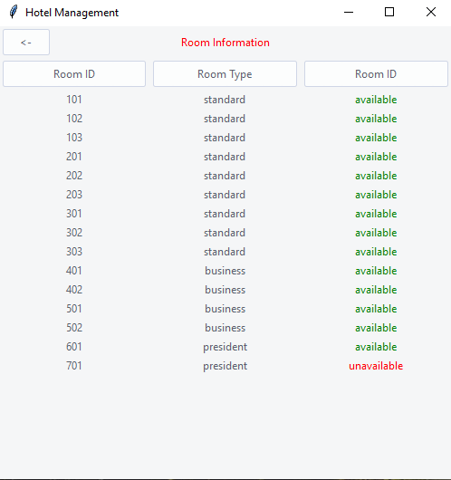

TKINTER
ROOM INFORMATION

Slide 14
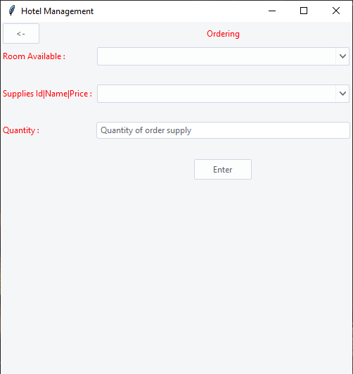

TKINTER
ORDERING

Slide 15
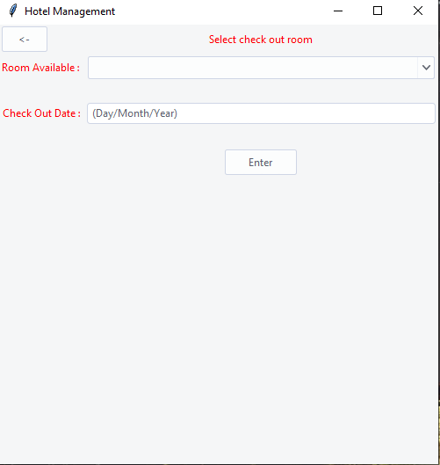

TKINTER
CHECK OUT

Slide 16
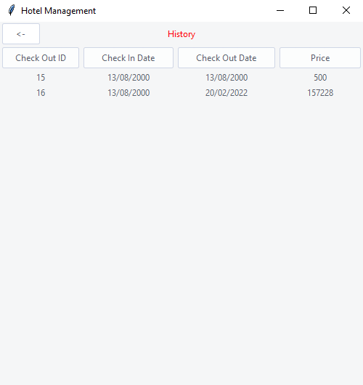

TKINTER
HISTORY

Slide 17
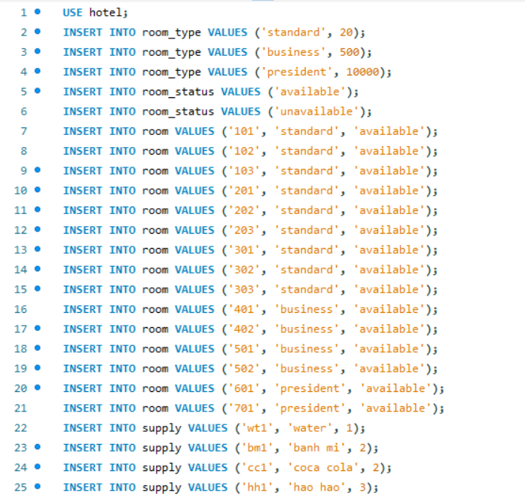
DATABASE

Slide 18




CONCLUSION
While developing this project we have learnt a lot about hotel management.
During the development process we studied carefully and understood the criteria of Implementation process.
We have learnt how to make a system user friendly.
The Online Hotel Management System was developed to replace the manual process of booking for a hotel room or any other facility of the hotel.

Slide 19


