Slide 1
Introduction
PET PARADISE
Le Cong Dat – Student1022144
Tran Thi Tuyet Duyen – Student1030933
Tran Tan Duy – Student1053750
22 May 2019

Slide 2
Content
Introduction
Actual requirements
Requirements of the project
Deployment diagram
Test result
Conclusion and development
Task list

Slide 3
Introduction - Actual requirements
Building a website to enter e-commerce market of Pet
Services
Shop
Pet Dating

Slide 4
Introduction - Requirements of the project
Functional
Admin:
View;
Update (existing product) gallery, services.. ;
Delete Product (supper admin role)
User:
Search for service, product, partner to date with.
Register account
Book service: pet care, pet grooming, pet hotel
Buy products: food, carrier, toy, kennel, collar, treatment products..
Take part in Pet dating club
Notes:
Non-functional (how the system works)
Functional (what the system should do)

Slide 5
Introduction - Requirements of the project
Non-functional
HARDWARE | SERVER
 | Minimum | Recommended
Processor | 800 MHz Intel Pentium III | 2.6 GHz Intel Pentium IV
Memory | 2 GB | 4 GB
Disk space | 8 GB | 16 GB
Monitor | Super-VGA (800x600) or higher resolution monitor
Internet | Internet access is required
 | CLIENT
Processor | 800 MHz Intel Pentium III
Memory | 512 MB
Monitor | Super-VGA (800x600) or higher resolution monitor
Internet | Internet access is required
SOFTWARE | SERVER
Operating System | Windows XP or later
Browser | Google Chrome 65.0
Database | Microsoft SQL Server 2014
Software | Java SDK 1.8
 | GlassFish Server 4.0
 | CLIENT
Operating System | Windows XP or later
Browser | Google Chrome 65.0
Notes:
Non-functional (how the system works)
Functional (what the system should do)

Slide 6
Introduction - Requirements of the project
Non-functional
DEVELOPMENT SOFTWARE
Microsoft Windows 10
Java SDK 1.8
TECHNOLOGY
J2EE
JSP, Servlet
Netbeans IDE 7.4
GlassFish Server 4.0
Microsoft SQL Server 2016
Google Chrome 65.0
EJB
HTML/CSS
JavaScript
Apache Tiles Framework
Notes:
Non-functional (how the system works)
Functional (what the system should do)

Slide 7
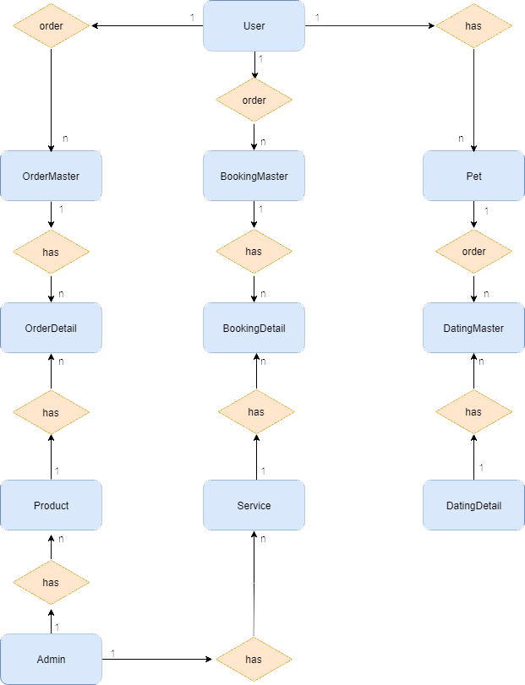
Introduction - Deployment diagram

Slide 8
Test Result [1-n]
Help…

Slide 9
Test Result [2-n]
Help…

Slide 10

Conclusion
People Who willing pay lots of money for their pet but they have no much time to shopping directly at store easily realize that the e-commerce market is growing rapidly, easily approaching the right customers
This e-commerce website will help people save time and minimize carrying cash when shopping, also helps reduce the risk of robbery when traffic is circulated, while reducing the rate of social evils also helps to build and develop the country.

Slide 11
Development
Help…

Slide 12
Task List
Pet Dating: manage pet in dating club, update pet, book dating service..
Shop: search, order, recommend product, manage product (insert, update, delete, …)
Pet Service: Book services: grooming, hotel, care, manage Service (insert, update, delete)

Slide 13

Thank You

Slide 14
Reference
Help…

