Slide 1




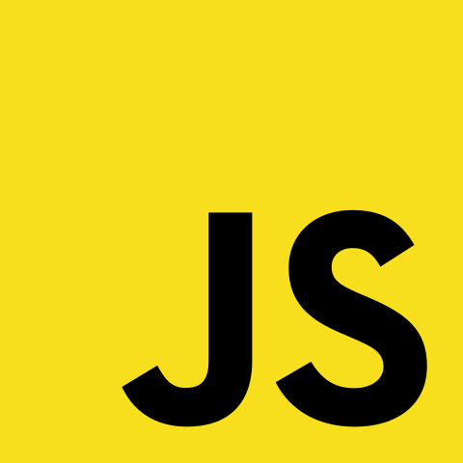

Full Stack Development using MERN
Instructor : Gautam Patil

Slide 2
No need to maintain Student-Professor Relation
Learn in Public
Learning is fun when done in SOCIAL
You will LOSE it if you DONT USE it .
Week 5 days Training
Saturday == Teach Me Day
Sunday == Building Day
Things to know before Starting

Slide 3
Understanding Basics of WEB and INTERNET

Slide 4



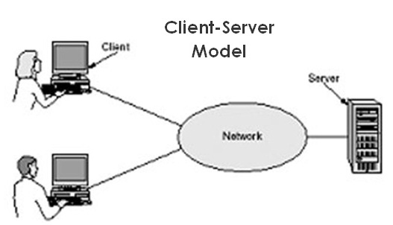
￼
Basic Termonologies
Server ?
Client ?
Domain Name ?
IP ?
DNS ?

Slide 5
What is a Website AND webpage and how it is created?

Slide 6
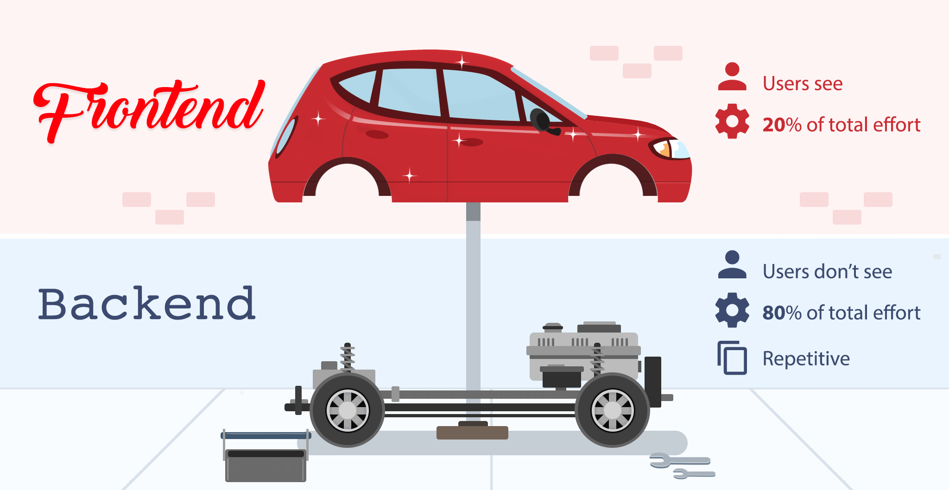
Frontend V/S Backend

Slide 7
FrameworkV/S Library

Slide 8
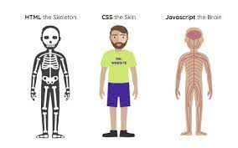
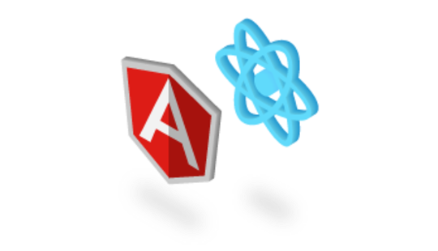
￼
Frontend Languages and Framework
Languages
HTML | CSS | JS
FrameWorks
React | Vue | Angular

Slide 9
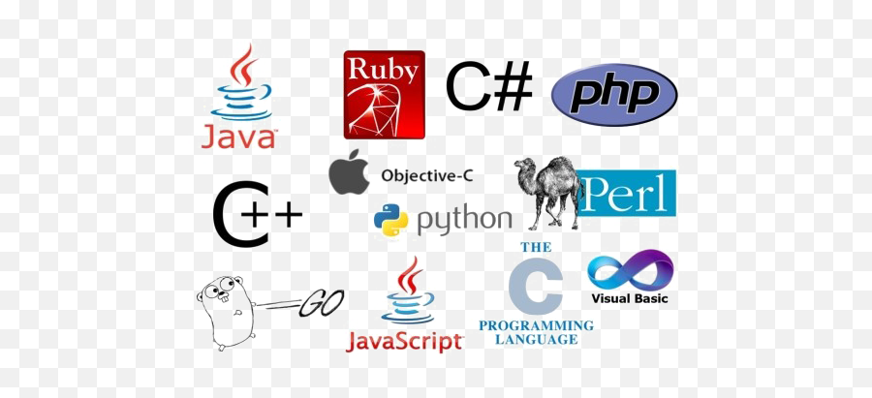
￼
Backend Languages and Framework
Languages
Python | Java | Node JS | Golang | C# | PHP, etc
FrameWorks
Django | Spring | Express | DotNet | Laravel

Slide 10
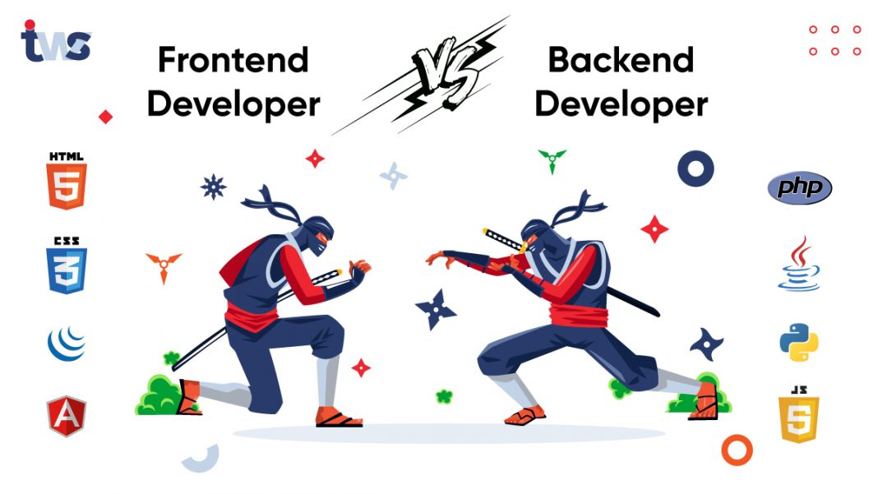
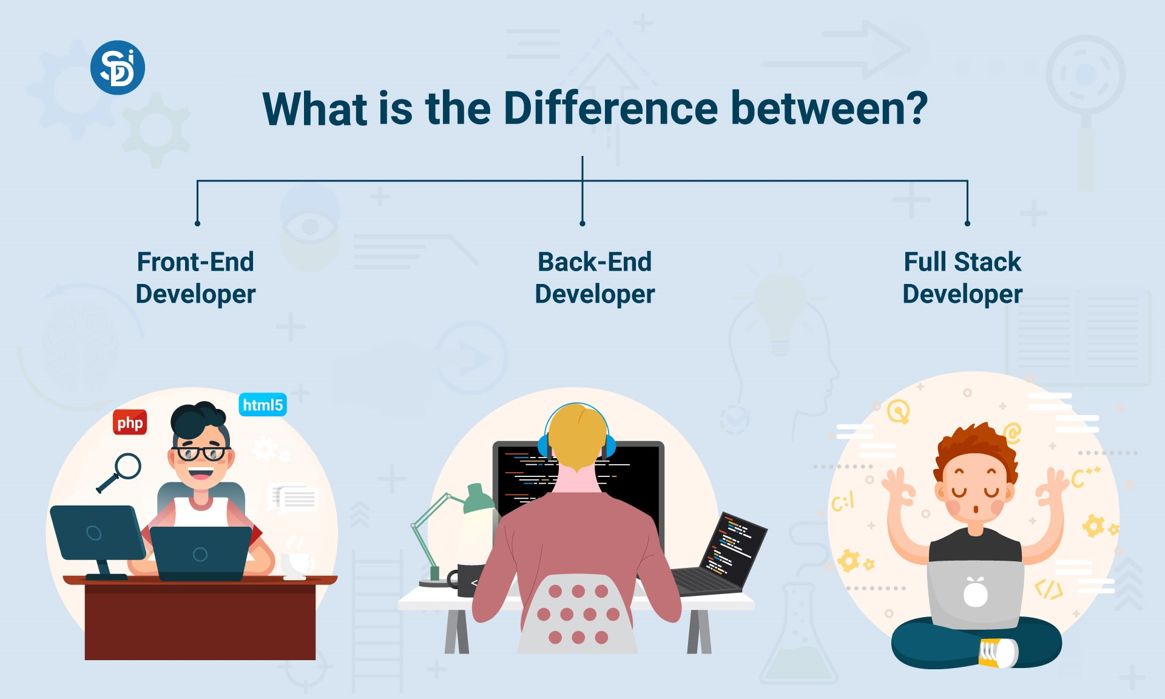
Whole Picture

Slide 11
Static V/S Dynamic Site

Slide 12
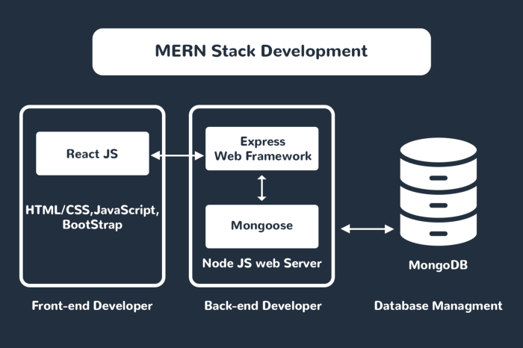
Why MERN Stack ?
Advantages
How MERN works ?
Fast and Smooth UI with React
Currently very Trending in Industry
CostEffective
Good Community
Efficiency in Developement
Open Source

Slide 13
Introduction to HTML

