Slide 1
KING COUNTY HOUSE PROJECT
METHODOLOGY AND RECOMMANDATION FOR NON TECHNICAL STAKEHOLDER

Slide 2
PROJECT’S GOAL
This project was about determining how the value of a house may be impacted by its location (zip codes, latitude and longitude), its size (lot size, size living area), the number of floor, bedrooms or bathrooms and also grade and condition of the house.

Slide 3
OUR ASSUMPTION
A higher number of bathrooms, bedrooms and floors may mean higher price for the house.
A house with better condition, better grade will probably be more expensive.
The size of the lot couple with the size of the living area will also make the house pricy.

Slide 4
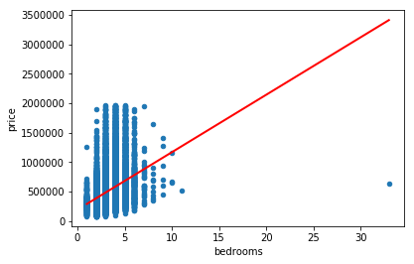
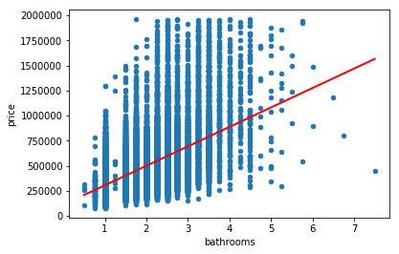
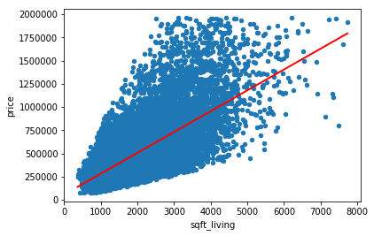
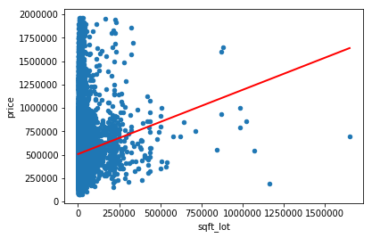
Verifying our assumption with graphical illustration 1

Slide 5
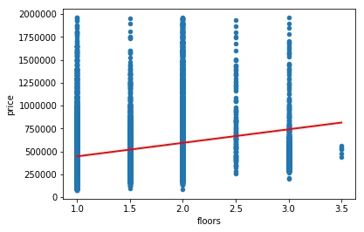
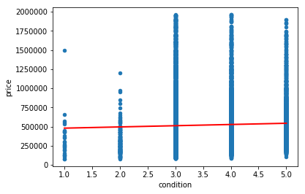
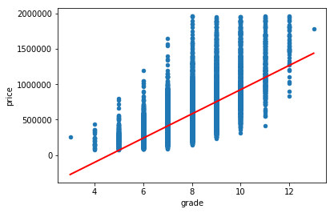
Verifying our assumption with graphical illustration 2

Slide 6
Verifying our assumption with graphical illustration 2
It is clear base on the graphs above that taken individually as the number of bedrooms and bathrooms increases, the price of the house increases;
The size of the lot and the size of the living area are individually impacting the price of the house.
The impact of the condition and floor is not really seen here, but the one of the grade is.

Slide 7
Conclusion 1
Our assumption is holding for most of our variable while taken individually. What will be the impact of our variables on the price when we combine all of them in our models?

Slide 8
Multivariable Models
After applying statsmodel and scikit to our variable we have determine that in the case of multiple variables the number of bedrooms will actually affect the price of the house negatively which is paradoxical. But overall the combination of the remaining variables can help determine the values of a house in King County.

Slide 9
Project conclusion
Our model is 68% accurate and will be a good predictor of the value of a property in King County. Our model can be used to help a prospective seller fix the price of his house in King County. At the same token, a prospective buyer can use our model to determine if the house he want to buy in King County is worth its price.
In conclusion we can help a customer set the price of his house in King County by collecting the 14 remaining variable and plug them into our model.
Our recommendation to a prospective buyer will be to chose house in low latitude(positive coefficient), high longitude(negative coefficient) with higher number of bedrooms(negative coefficient) as this will lower the price of the house. She/he must definitely stay away from waterfront(high positive). coefficient
Based on the value resulting from the outcome of our model, our model will predict the value of a house in King County with 69.4% accuracy.

