Slide 1
Cancer Detection in Histological Slides
Pankaj Acharya
Springboard Data Science Career Track
Capstone Project 02 - Final Report
December 08, 2019
Mentor: Kevin Glynn

Slide 2
The Problem
Classify histological slides of lymph nodes of patients to predict whether they have cancer or not.

Slide 3
Why is this interesting?
Currently pathologists manually look through the slides for diagnosis.
Diagnosis can vary between person to person.
In addition, it is time consuming.
Once trained, computers make unbiased decisions quickly.

Slide 4
Description of Data
Kaggle competition data set
Train_labels.csv files with labels 0 for normal and 1 for cancer.
220,025 images for training.
57,458 images for testing.

Slide 5
Data Wrangling
Data sampled to make it balanced:-
20,000 images for normal tissue
20,000 images for cancerous tissue
Data split into train and validation sets (80-20):-
16,000 images for training on each class (normal, cancer)
4,000 images for validation on each class (normal, cancer)

Slide 6
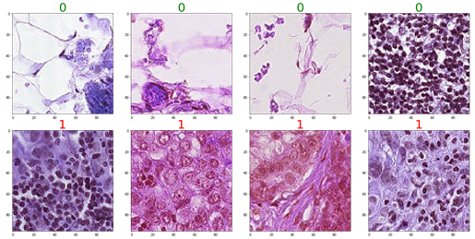
Example images
Normal
Cancer

Slide 7
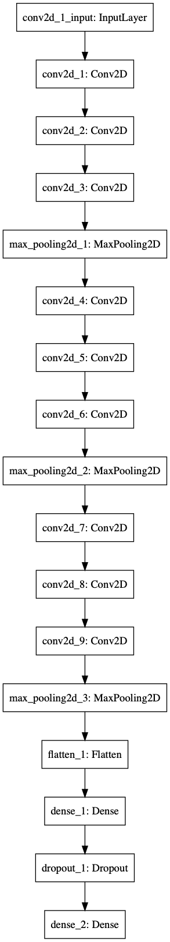
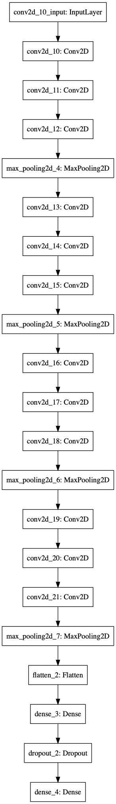
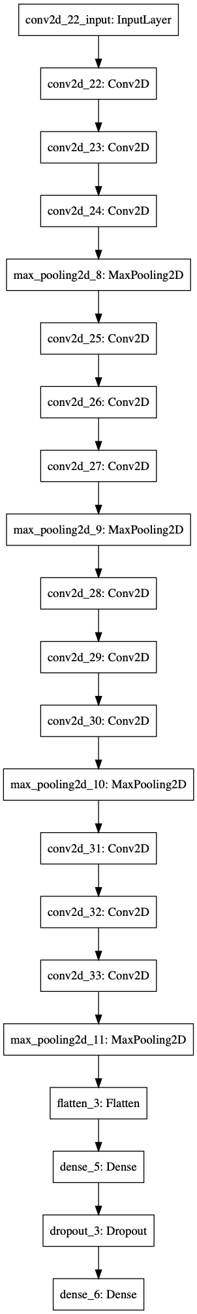
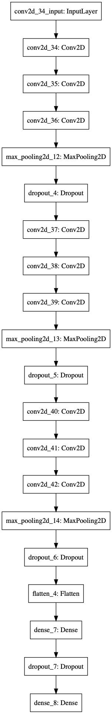
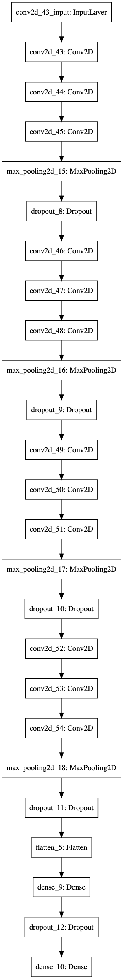
Models

Slide 8
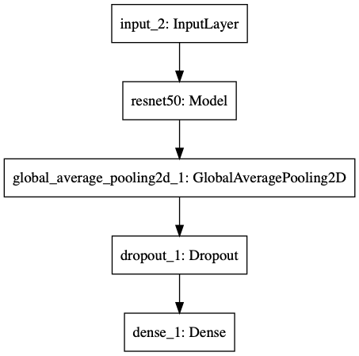
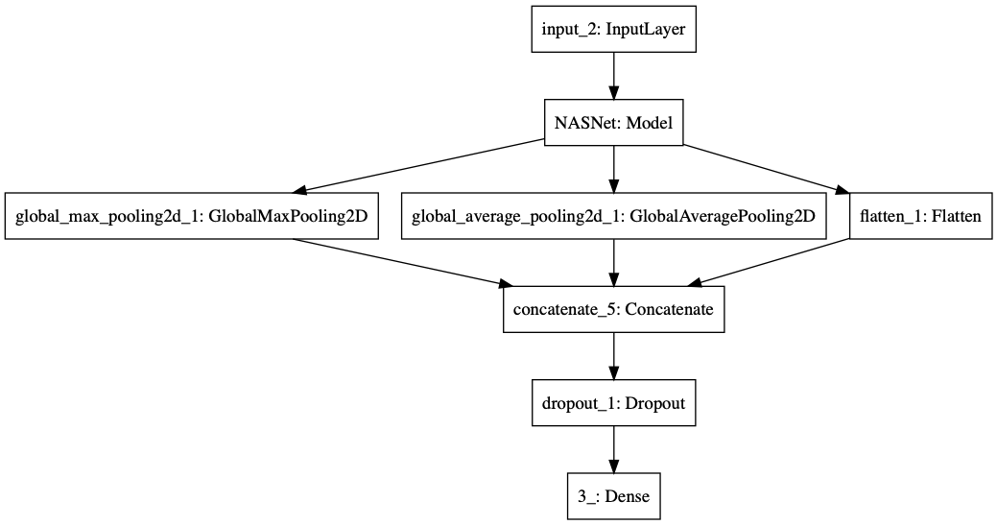
Models contd..

Slide 9
Model Performance
 | val_loss | val_acc | roc_auc_scores
model1 | 0.003166 | 0.935250 | 0.940142
model2 | 0.017603 | 0.872125 | 0.945869
model3 | 0.014006 | 0.871375 | 0.946251
model4 | 0.028071 | 0.839000 | 0.922560
model5 | 0.041226 | 0.850625 | 0.926007
model6 (ResNet50) | 0.008133 | 0.935375 | 0.980530
model7 (NASNet) | 0.031510 | 0.840813 | 0.925162

Slide 10
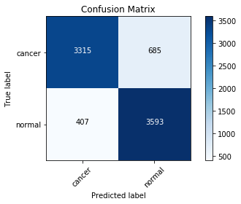
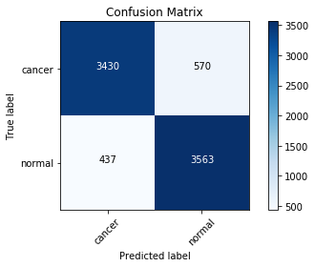

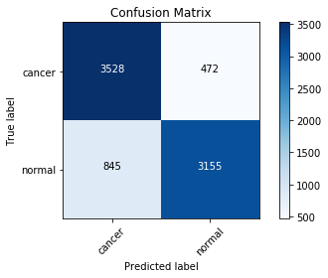
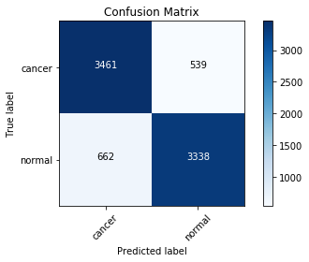
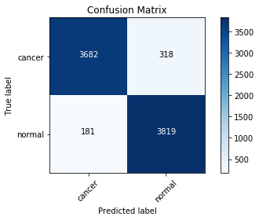

Model Performance (contd…)
model1
model2
model3
model4
model5
model6
model7

Slide 11
Model Performance (contd…)
 | precision |  | recall |  | f1-score
 | cancer | normal | cancer | normal | cancer | normal
model1 | 0.89 | 0.84 | 0.83 | 0.9 | 0.86 | 0.87
model2 | 0.89 | 0.86 | 0.86 | 0.89 | 0.87 | 0.88
model3 | 0.89 | 0.86 | 0.85 | 0.9 | 0.87 | 0.88
model4 | 0.81 | 0.87 | 0.88 | 0.79 | 0.84 | 0.83
model5 | 0.84 | 0.86 | 0.87 | 0.83 | 0.85 | 0.85
model6 | 0.95 | 0.92 | 0.92 | 0.95 | 0.94 | 0.94
model7 | 0.8 | 0.88 | 0.9 | 0.78 | 0.85 | 0.83

Slide 12
Final Prediction
Picked model6 (ResNet50) as it was best among all the models tested.

Slide 13
Future Directions
Could use entire dataset to train models.
Could use other pretrained models to see if can get better predictions.

