Slide 1
Web design and programming || Mini project
MEMBER’S
NAME ID
LEUL SOLOMON 2260/12
LEIUL MEKONNEN 2248/12
KEYTROS GECHO 2183/12
ABDETA JEMAL 0253/12
ABDULAHI MOHAMMED 3186/12
KEMAL TAJUDIN 2200/12

Slide 2
.
TITLE
HARAMAYA UNIVERSITY TRANSPORT REQUEST MANAGEMENT SYSTEM (HUTRMS).

Slide 3
DESCRIPTION
HU-Transport request management system is a web-based system that automates the transport request operations like requesting for service, approval of the request. The main job of the system is to provide easy and simple transport request service to users.

Slide 4
Cont.
The system application used to maintain day to day transportation request process. Using this system user can request for the vehicle over their phone connected with internet. User can also check if the request is approved or declined.

Slide 5
Objective
The main objective of this web based transport request system is to automate the complete operations of the current way of requesting for the vehicle. The current manual system is time consuming. This system major object is to handle this problem.

Slide 6
Service
The major service the system provides is facilitating web based easy, fast and reliable way for requesting vehicle in the compound. Request for a vehicle and the system allow making a response to the request the approval or rejection of the vehicle request by a responsible and authorized part.

Slide 7
ACTORS/ MAJOR USERS OF THE SYSTEM
Staff members(must have staff member id)
Teachers
Students
Office workers
Staff community
Collage admin
Collage account manager
System admin
System admin manages account

Slide 8
Features
The system allows staff members to register
The system allows staff members to login to their account
The system have a full vehicle request form for uses to complete it
The system allows users to send the form to the correspondent collage
The system allows each collages to have an account

Slide 9
Cont.
The system allows collages to have account only through system admin
The system allow system admin to create, view and manage collages page
The system allow collages to login according to the account provided by the system admin

Slide 10
Cont.
The system must allow to review the sent request from the user
The system allow collage admin to respond to the request
The system allow collages to Approve or reject the request form
The system allow to logout the system

Slide 11
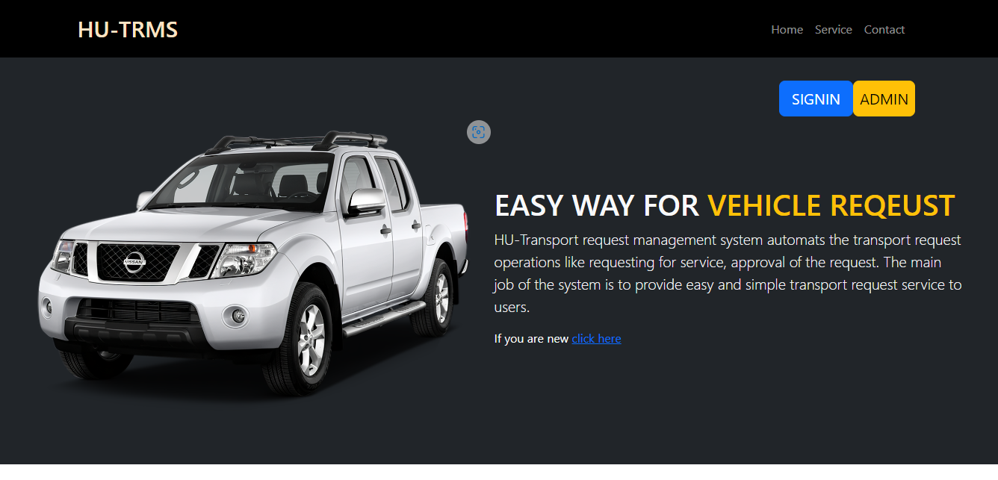
Home page

Slide 12
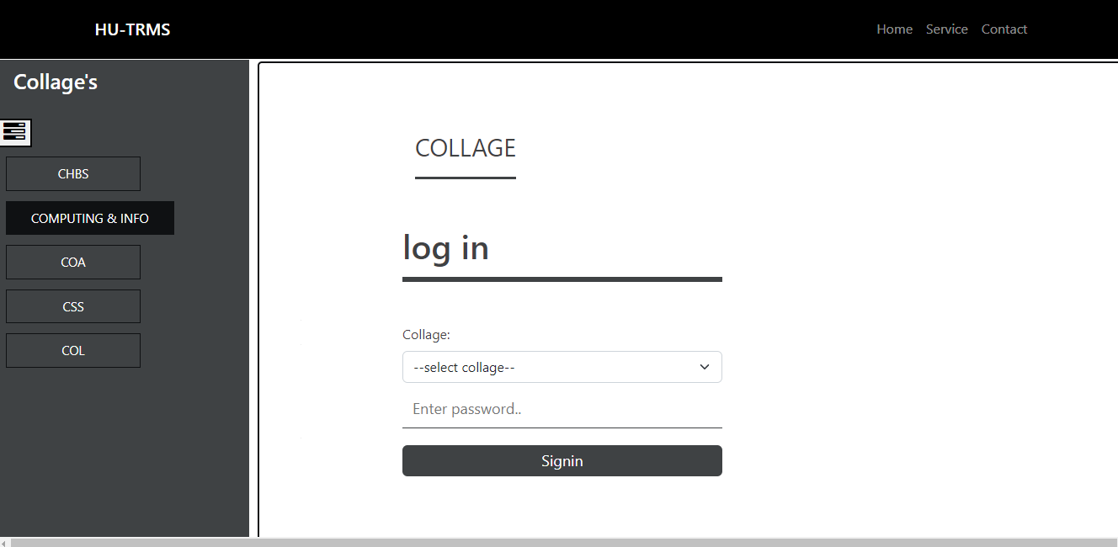
Collage’s page

Slide 13
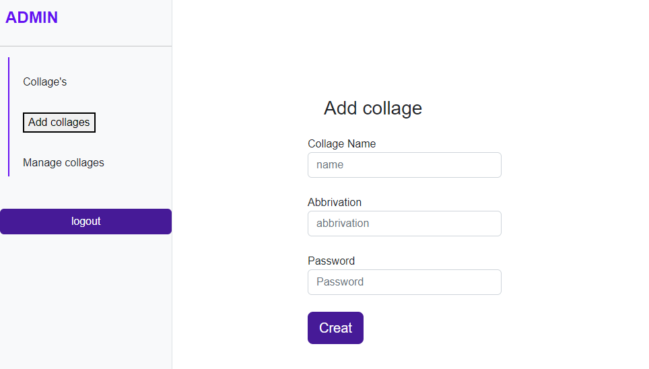
Admin page

Slide 14
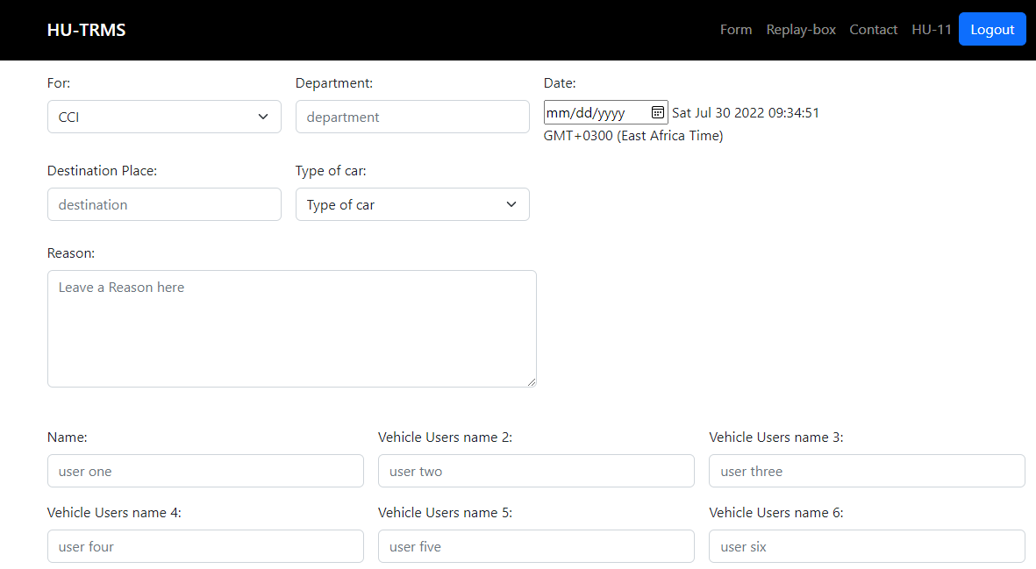
Request form

