Slide 1
5G LAB-IN-A-BOX · PHASE 2A
Network Slicing in 5G
One physical core, many isolated networks — what slicing is, what we built in the lab, and how we proved it works.
2 SLICES
2 UPFS
ISOLATION
eMBB + IoT
separate user planes
proven by capture
Notes:
Intro: this deck explains 5G network slicing from the concept, through what we built in the lab, to the demo that proves two slices are physically isolated.

Slide 2
THE CONCEPT
What is network slicing?
One physical 5G network partitioned into multiple independent logical networks — “slices” — that share the same hardware and RAN.
Each slice is tuned for a different purpose and is isolated from the others.
A slice is identified by its S-NSSAI = SST (slice/service type) + optional SD (differentiator).
The analogy
One highway, several lanes:
1
express
fast traffic (video)
2
freight
bulk / IoT sensors
3
emergency
low-latency control
Same road, separated lanes — that's slicing.
Notes:
Slicing turns one physical 5G network into several logical ones on shared hardware, each tuned and isolated. The identifier is the S-NSSAI (SST + optional SD). The highway/lanes analogy lands it for a general audience.

Slide 3
WHY IT MATTERS
Different traffic, different needs — on one network
e
eMBB
U
URLLC
m
mMTC / IoT
Enhanced Mobile Broadband
Ultra-Reliable Low Latency
Massive Machine-Type Comms
high throughput — video, AR/VR
control, robotics, vehicles
huge numbers of cheap sensors
The payoff: isolation
Each slice gets its own resources and treatment — so one slice's traffic surge, failure, or attack does not spill into another. Operators monetize this as differentiated, guaranteed services.
Notes:
Different services have opposite needs — broadband wants throughput, control wants latency, IoT wants scale. Slicing lets one network serve all three with isolation, which is both a reliability property and a monetization lever.

Slide 4
HOW IT WORKS
Shared brain, separate lanes
Shared
Split
Control plane (AMF · SMF · NSSF) and the RAN are common to all slices — one set of signalling.
The user plane is per-slice: each slice gets its own UPF, DNN, and IP subnet — physically separate data paths.
The two functions that make it happen
NSSF (Network Slice Selection Function) resolves which slice a device may use; the SMF then routes the session to the correct UPF by its DNN. Result: the right user plane, per slice.
Notes:
The core trick: keep the control plane and RAN shared, but split the user plane so each slice has its own UPF/DNN/subnet. The NSSF decides which slice is allowed; the SMF steers the session to the matching UPF by DNN.

Slide 5
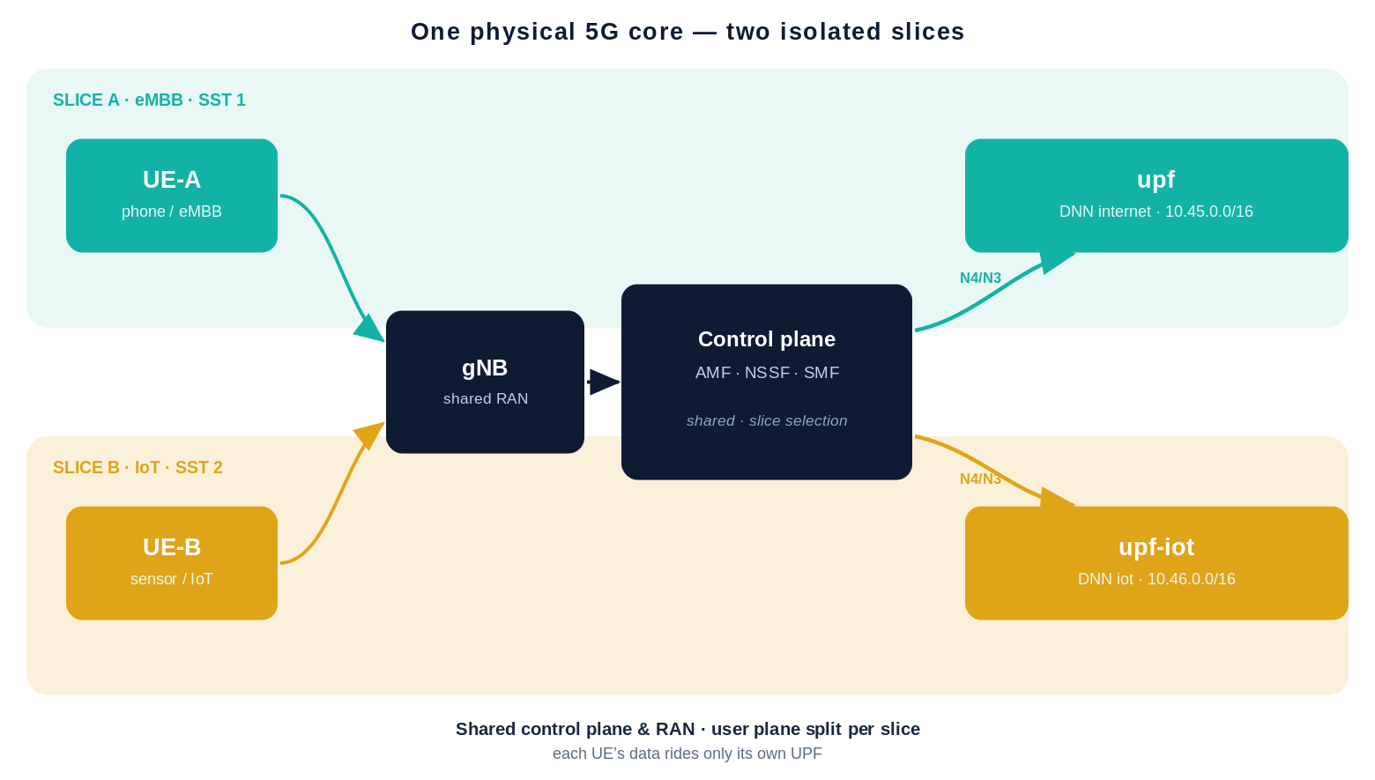
OUR LAB
What we built: two slices, two user planes
The two slices
A
Slice A
SST 1 · eMBB
DNN internet
10.45.0.0/16
→ upf
B
Slice B
SST 2 · IoT
DNN iot
10.46.0.0/16
→ upf-iot
Notes:
This is our lab: one shared control plane and gNB, and two separate user planes — upf for slice A (internet, 10.45) and upf-iot for slice B (iot, 10.46). Two UEs, one per slice.

Slide 6
UNDER THE HOOD
What we configured to enable slice 2
1
AMF
2
NSSF
advertise a second S-NSSAI (SST 2)
map both slices to the NRF (slice selection)
3
SMF
4
upf-iot
two DNN-tagged UPFs + advertise both slices
new UPF: DNN iot, subnet 10.46.0.0/16
5
Subscriber
6
RAN
provision the device for slice 2 (iot)
gNB advertises both slices; a 2nd UE on slice 2
All additive — the original single-slice lab keeps working unchanged.
Notes:
Six changes turn a single-slice lab into two slices: AMF advertises SST2, NSSF maps both slices, SMF gains DNN-based UPF routing plus an info block advertising both, a new upf-iot on 10.46, a slice-2 subscriber, and a second UE. Everything is additive.

Slide 7
SLICE SELECTION
How a device lands on the right slice
1
2
3
4
5
UE requests
AMF ↔ NSSF
SMF selected
UPF by DNN
IP assigned
its S-NSSAI (which slice)
checks the allowed slice
for that slice + DNN
SMF routes to the right UPF
from that UPF's pool
Subscriber data (in the UDM/Mongo) says which slices a device is allowed on — so a UE can't just pick any slice.
Notes:
Selection flow: the UE requests an S-NSSAI, the AMF checks with the NSSF and the subscription whether it's allowed, then an SMF is chosen for that slice and it routes to the matching UPF by DNN, which assigns the IP. The subscriber's allowed-slice data gates the whole thing.

Slide 8
THE DEMO
Two UEs attach — two different subnets
UE-A · Slice 1 (eMBB)
UE-B · Slice 2 (IoT)
10.45.0.2
10.46.0.2
via upf · DNN internet
via upf-iot · DNN iot
uesimtun0 · internet egress OK
uesimtun0 · internet egress OK
Both UEs attached to the same core, over the same gNB — but received addresses from two different pools and reach the internet through two different UPFs.
Notes:
The demo: both UEs attach through the same gNB and core, but land on different subnets — UE-A on 10.45 via upf, UE-B on 10.46 via upf-iot — and both reach the internet through their own UPF. Different addresses is the first visible sign of two slices.

Slide 9
THE PROOF
Isolation — each slice rides only its own UPF
We captured on each UPF's data interface while both UEs pinged. Each UPF saw only its own slice's subnet — never the other's:
upf (slice 1)
upf-iot (slice 2)
10.45.0.2 > 8.8.8.8 ICMP echo request
10.46.0.2 > 8.8.8.8 ICMP echo request
8.8.8.8 > 10.45.0.2 ICMP echo reply
8.8.8.8 > 10.46.0.2 ICMP echo reply
✓
only 10.45.x seen
✓
only 10.46.x seen
Neither UPF ever saw the other slice's traffic → physical user-plane isolation, proven.
Notes:
The proof of isolation: capturing on each UPF's ogstun while both UEs generated traffic, upf saw only 10.45.x and upf-iot saw only 10.46.x. Neither UPF ever saw the other slice's subnet — that's physical user-plane separation, not just different labels.

Slide 10
SO WHAT
Slicing as a containment boundary
We built and proved real network slicing on the lab: two slices, two user planes, isolation demonstrated by capture.
Isolation isn't just performance — it's security: a surge or attack in one slice stays contained.
This is the foundation for the MEC edge demo and the self-securing story.
Next
1
Attack one slice
2
MEC edge demo
3
Per-slice detection
show the other stays clean
reuse the 2nd-UPF plumbing
the detector scopes to each UPF
5G Lab-in-a-Box · Phase 2A network slicing — built, validated, and isolation-proven
Notes:
Takeaway: we built and proved real slicing — and isolation is a security property, not just performance. It's the containment boundary that the MEC demo and the self-securing story build on: attack one slice, show the others stay clean, with the detector scoped per UPF.

