Slide 1
A GUIDED WALKTHROUGH
Inside the 5G Core
Reading the architecture diagram — what every box and line means, in plain language.

Slide 2
FIRST, THE COLORS
How to read the diagram
Every line is colored by what it carries. Learn these four and the whole picture reads itself.
User-plane data Your actual traffic — web, video, everything you send and receive. (N3, N6)
Control / signaling The network talking to itself to set things up — no user data. (N2, SBI)
N4 · PFCP One specific control link: the core telling the data gateway how to run a session.
Lab tooling The security add-ons — generating attacks and recording traffic.
Inside the 5G Core — Walkthrough
2

Slide 3
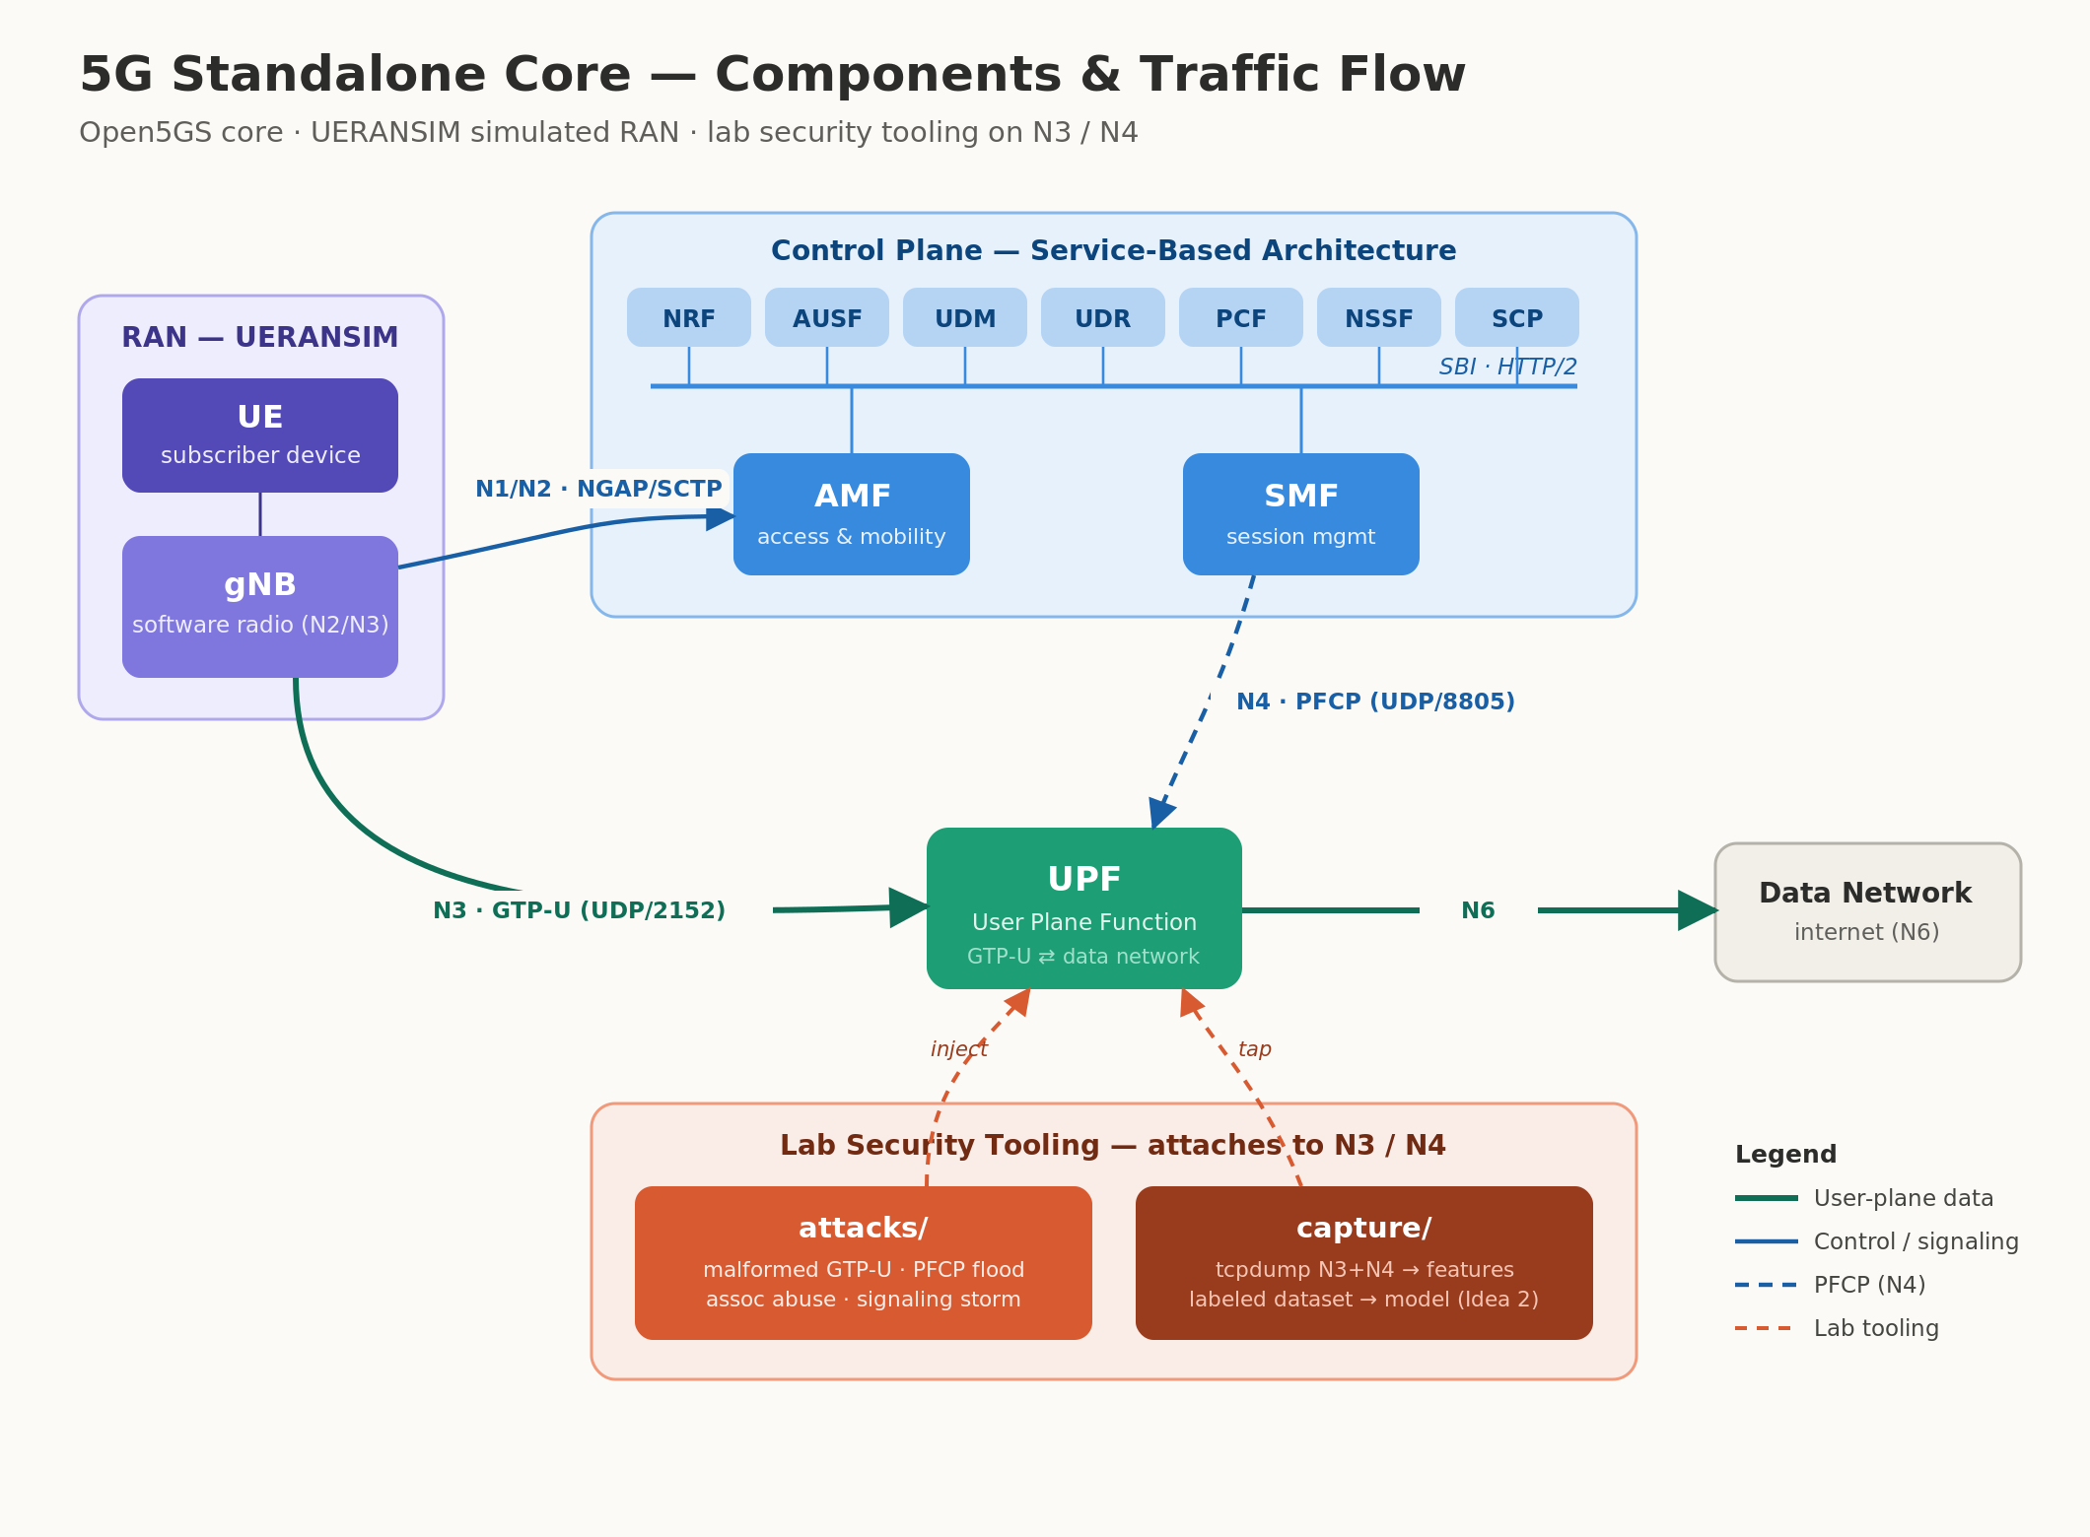
ORIENTATION
The whole picture
Traffic flows left → right: phone & tower (RAN) → the core's brains (control plane) → the data gateway (UPF) → the internet. We'll take it one region at a time.

Slide 4
LEFT SIDE · STEP 1
The RAN — the phone & the tower
RAN = Radio Access Network. In the diagram this is the purple box on the far left. It holds two things a real network keeps miles apart — here both are simulated by one program.
UE the handset + SIM
Everything a phone does to get online starts here and flows rightward into the core. The blue line leaving the tower (N1/N2) is the “let this phone on” conversation.
gNB the 5G radio tower
→ N1/N2 to the core
Inside the 5G Core — Walkthrough
4

Slide 5
TOP CENTER · STEP 2
The Control Plane — the brains
The big blue box: the decision-makers. Think of them as the staff of a members' club — each does one job, and they talk to each other over web technology (the “SBI” line).
AMF
The greeter / front desk — First contact from the tower; handles the phone joining and moving around.
AUSF · UDM · UDR
The ID desk & records — Check the SIM is genuine (authentication) and look up what it's allowed to do.
SMF
The session organizer — Sets up your internet session when you actually want to use data.
PCF · NSSF · NRF · SCP
The supporting staff — Rules & data limits, network “slicing,” the internal directory, and message routing.
Inside the 5G Core — Walkthrough
5

Slide 6
BOTTOM CENTER · STEP 3
The UPF — the fast lane
The green box. Once the phone is approved, your data doesn't crawl through all that staff — it takes the express doorway straight through the UPF (User Plane Function).
SMF
session organizer
Two lines touch it. Green (N3) carries your data in from the tower, tunneled. Blue-dashed (N4) is the SMF telling it how to handle the session.
N4
UPF
the data gateway
N3 in
→ N6 out to the internet
Inside the 5G Core — Walkthrough
6

Slide 7
PUTTING IT TOGETHER
Two journeys, end to end
The whole diagram is really just these two paths. Trace them and you understand 5G.
Your data · the green path
UE
radio
gNB
N3
UPF
N6
Internet
Setup & signaling · the blue path
gNB
N2
AMF
SBI
SMF
N4
UPF
Blue sets the phone up; green carries the data. Every other box on the diagram supports one of these two.
Inside the 5G Core — Walkthrough
7

Slide 8
BOTTOM OF THE DIAGRAM
What makes it a security lab
The coral box underneath hooks onto the two data-plane pipes — because N3 and N4 are exactly where a real attacker would strike.
attacks/
capture/
“inject”
“tap”
Fires malformed or flood traffic at N3 and N4 — the realistic attack surface of a live 5G core.
Records everything crossing N3 and N4, turning it into labeled data to train an anomaly detector.
Because the lab knows which attack is running, every capture is labeled automatically — clean training data.
Inside the 5G Core — Walkthrough
8

Slide 9
IN ONE SENTENCE
The phone reaches the tower, the tower talks to the core's brains to log it in, and then your data rides the fast lane out to the internet.
Green = your data
Blue = signaling
Coral = the lab
N3 and N6 carry real traffic.
N2, SBI and N4 set everything up.
Attacks & capture live on N3/N4.

