Slide 1
A GUIDED WALKTHROUGH
How an Attack Becomes a Detection
Reading the attack-&-detection diagram — the security loop, and the attacks it runs, in plain language.

Slide 2
ORIENTATION
The diagram has two parts
Top strip — The security loop
One assembly line, left to right: make bad traffic → let it hit the core → record it → boil it down to numbers → let a model flag it. Follow the arrow labels: inject, tap, parse, score.
Bottom table — The attacks themselves
Five specific attacks. Each row reads: what it is → which pipe it hits → what it does → the number that gives it away. The colored bar shows the pipe: green N3, blue N4, purple N2.
The Security Loop — Walkthrough
2

Slide 3
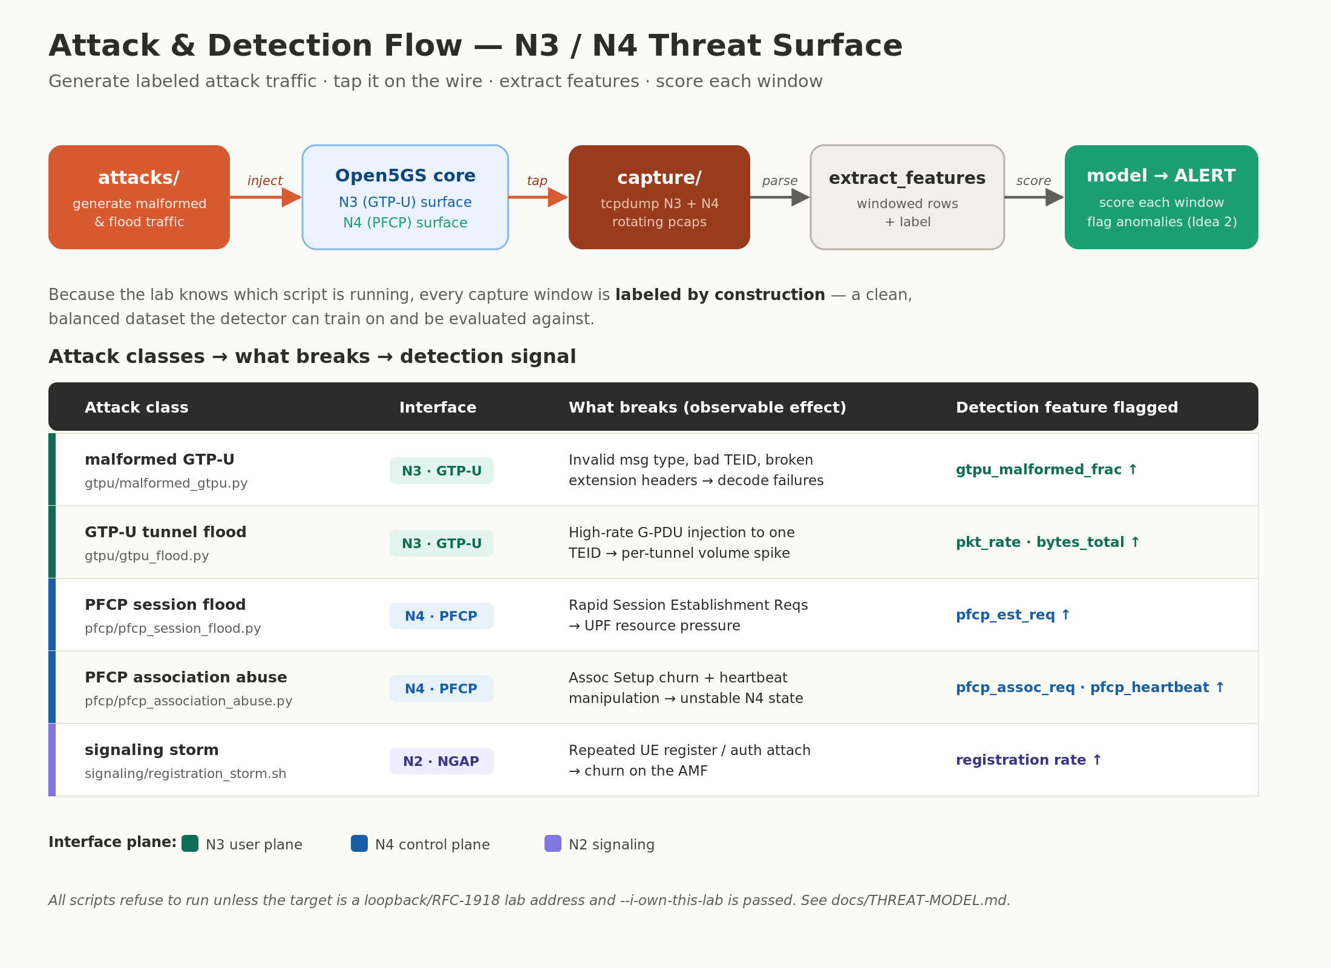
THE FULL DIAGRAM
Attack & detection flow
The Security Loop — Walkthrough
3

Slide 4
THE TOP STRIP
The security loop — five steps
attacks/
inject
5G core
tap
capture/
parse
extract_features
score
model → ALERT
Generate malformed
& flood traffic
The live core
being attacked
Record N3 + N4
to files (pcaps)
Boil each window
down to numbers
Score each window,
flag anomalies
In one line: make bad traffic → let it hit the core → record it → turn it into numbers → let a model catch it.
The Security Loop — Walkthrough
4

Slide 5
THE CLEVER PART
“Labeled by construction”
To train a detector you need traffic tagged as “normal” or “attack.” Getting those labels is usually the hard part.
The usual way
This lab
A human hunts through millions of recorded packets and hand-tags which ones were attacks. Slow, tedious, and error-prone — and public datasets are scarce.
The lab launched the attacks, so it already knows exactly when each one ran. Every recorded window is stamped with the truth — automatically, for free.
vs
The Security Loop — Walkthrough
5

Slide 6
THE ATTACKS · 1 OF 2
On the data tunnel (N3)
Both target N3 — the pipe carrying user data. One breaks packets; the other overwhelms with volume.
N3 · GTP-U
N3 · GTP-U
malformed GTP-U
GTP-U tunnel flood
gtpu/malformed_gtpu.py
gtpu/gtpu_flood.py
Broken packets
Too much, too fast
Sends deliberately malformed data — wrong type, garbage tunnel IDs, corrupted headers. Like mailing envelopes with nonsense addresses to jam the mailroom.
Not broken — just a firehose of data down a single tunnel, far more than normal.
The tell: decode-failure rate spikes (gtpu_malformed_frac ↑)
The tell: packet rate & byte volume spike (pkt_rate · bytes_total ↑)
The Security Loop — Walkthrough
6

Slide 7
THE ATTACKS · 2 OF 2
On control & signaling (N4 · N2)
N4 · PFCP
A rapid burst of “start a new session” requests, trying to exhaust the core — like thousands slamming the front desk at once.
The tell: session-request count spikes (pfcp_est_req ↑)
PFCP session flood
N4 · PFCP
Churns the standing handshake between the session-manager and the gateway, and fakes heartbeats.
The tell: abnormal association / heartbeat counts
PFCP association abuse
N2 · NGAP
Floods the “greeter” (AMF) with endless join attempts, overwhelming the login desk.
The tell: registration rate spikes · (weakly caught today — N2 gap)
signaling storm
The Security Loop — Walkthrough
7

Slide 8
THE SMALL PRINT
Built-in safety rail
Every attack script refuses to run unless BOTH are true:
!
1. the target is your own lab — a loopback or private address, not a real network, and 2. you explicitly confirm it — by passing the --i-own-this-lab flag.
It's deliberate friction, so the tooling can't be casually pointed at anything but the lab you control.
The Security Loop — Walkthrough
8

Slide 9
IN ONE SENTENCE
Attack your own core on purpose, record it on the N3/N4 pipes, turn the recording into numbers, and let a model learn to spot the attacks.
Inject → tap
Parse → score
Labeled for free
attacks hit N3/N4; capture records them.
windows become numbers; a model flags them.
the lab knows the truth — perfect training data.

