Slide 1
A FIELD GUIDE
5G Core Lab-in-a-Box
A complete 5G network in software — the big picture, the architecture, and the security loop, all in plain language.
Part 1 Big picture
Part 2 Architecture
Part 3 Security loop

Slide 2
WHAT'S INSIDE
Three parts, one story
1
The big picture
What a 5G network is, what we installed, and how a phone gets online — with the club-staff analogy.
2
Reading the architecture
A guided tour of the components diagram: the colors, the RAN, the core's brains, the data gateway, and the two end-to-end journeys.
3
Reading the security loop
A guided tour of the attack-flow diagram: inject → tap → parse → score, and the five attacks with their tells.
5G Core Lab-in-a-Box · Field Guide
2

Slide 3
PART 1
The Big Picture
What it is, what's installed, and how it works.

Slide 4
THE BIG PICTURE
What is this, really?
A real 5G network is three things: a phone with a SIM, a cell tower, and a “core” in a data center that decides who gets on and routes their data. Normally that's rooms of expensive hardware spread across a city.
Phone
Here, every piece is software — all on one computer, talking to each other exactly the way the real hardware would.
Tower
Core
5G Core Lab-in-a-Box · Field Guide
4

Slide 5
WHAT'S INSTALLED
The four building blocks
UERANSIM the phone & the tower
One program that simulates both a handset and a 5G radio. No SIM cards, no hardware — it exchanges the same messages a real phone and tower would.
Open5GS the core “brains” — about a dozen containers
Like the staff of a members' club: one checks your SIM, one registers you, one opens your session, one enforces the rules, a directory lets them find each other.
UPF the data gateway — runs on the host
The doorway your actual traffic flows through on its way out. Runs directly on the machine (our workaround for a kernel quirk).
Security tooling attack & capture — the whole point
Generate malformed or flood traffic on the core's internal pipes, record it, and train a model to tell normal from malicious.
5G Core Lab-in-a-Box · Field Guide
5

Slide 6
HOW IT WORKS
Getting a phone onto the network
1
2
3
4
5
Find the tower
Prove the SIM
Register
Open a session
Get an IP
In our lab this fully works. The simulated phone registered, authenticated, opened a session, and was assigned the address 10.45.0.2 — a working connection through the core.
✓
5G Core Lab-in-a-Box · Field Guide
6

Slide 7
THE PLUMBING
The pipes that matter
N2
N3
N4
The conversation
The data tunnel
The control link
Signaling between the tower and the core — “let this phone on.”
Your actual traffic, wrapped up and carried between tower and gateway.
The core telling the data gateway how to handle each session.
NGAP
GTP-U
PFCP
These three pipes — especially N3 and N4 — are exactly what the security tooling targets.
5G Core Lab-in-a-Box · Field Guide
7

Slide 8
STATUS
Where it stands today
Working
10.45.0.2
5G core
UE connected
Registration, auth, PDU session, N4 & N3 all verified end-to-end.
A simulated phone attached and got a working data session.
N3 + N4
Optional
Traffic flowing
Internet egress
User-plane and control-plane pipes carry live traffic to capture.
One host-networking quirk on a non-standard kernel; not needed for the lab work.
5G Core Lab-in-a-Box · Field Guide
8

Slide 9
PART 2
Reading the Architecture
A guided tour of the components diagram.

Slide 10
FIRST, THE COLORS
How to read the diagram
Every line is colored by what it carries. Learn these four and the whole picture reads itself.
User-plane data Your actual traffic — web, video, everything you send and receive. (N3, N6)
Control / signaling The network talking to itself to set things up — no user data. (N2, SBI)
N4 · PFCP One specific control link: the core telling the data gateway how to run a session.
Lab tooling The security add-ons — generating attacks and recording traffic.
5G Core Lab-in-a-Box · Field Guide
10

Slide 11
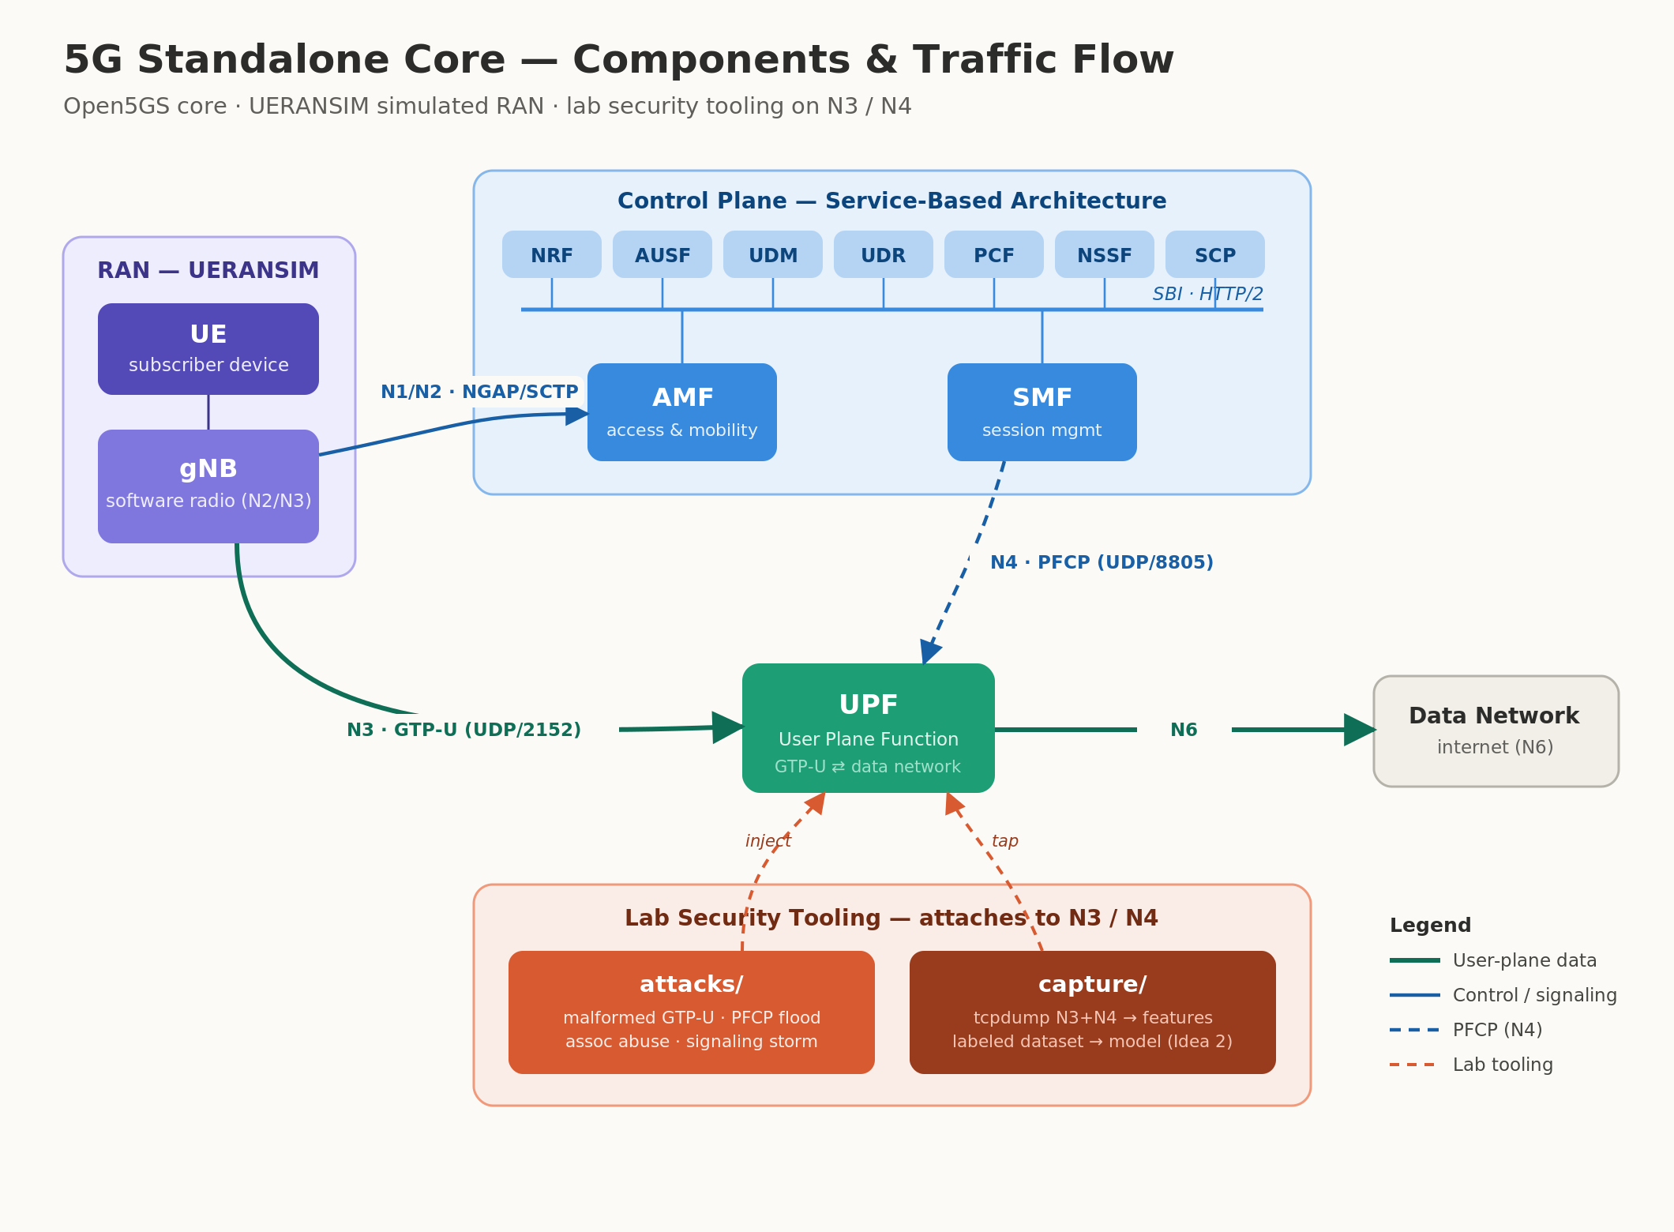
ORIENTATION
The whole picture
Traffic flows left → right: phone & tower (RAN) → the core's brains → the data gateway (UPF) → the internet.
5G Core Lab-in-a-Box · Field Guide
11

Slide 12
LEFT SIDE · STEP 1
The RAN — the phone & the tower
RAN = Radio Access Network. In the diagram this is the purple box on the far left. It holds two things a real network keeps miles apart — here both are simulated by one program.
UE the handset + SIM
Everything a phone does to get online starts here and flows rightward into the core. The blue line leaving the tower (N1/N2) is the “let this phone on” conversation.
gNB the 5G radio tower
→ N1/N2 to the core
5G Core Lab-in-a-Box · Field Guide
12

Slide 13
TOP CENTER · STEP 2
The Control Plane — the brains
The big blue box: the decision-makers. Think of them as the staff of a members' club — each does one job, and they talk over web technology (the “SBI” line).
AMF
The greeter / front desk — First contact from the tower; handles the phone joining and moving around.
AUSF · UDM · UDR
The ID desk & records — Check the SIM is genuine (authentication) and look up what it's allowed to do.
SMF
The session organizer — Sets up your internet session when you actually want to use data.
PCF · NSSF · NRF · SCP
The supporting staff — Rules & data limits, network “slicing,” the internal directory, and message routing.
5G Core Lab-in-a-Box · Field Guide
13

Slide 14
BOTTOM CENTER · STEP 3
The UPF — the fast lane
The green box. Once the phone is approved, your data doesn't crawl through all that staff — it takes the express doorway straight through the UPF (User Plane Function).
SMF
session organizer
Two lines touch it. Green (N3) carries your data in from the tower, tunneled. Blue-dashed (N4) is the SMF telling it how to handle the session.
N4
UPF
the data gateway
N3 in
→ N6 out to the internet
5G Core Lab-in-a-Box · Field Guide
14

Slide 15
PUTTING IT TOGETHER
Two journeys, end to end
The whole diagram is really just these two paths. Trace them and you understand 5G.
Your data · the green path
UE
radio
gNB
N3
UPF
N6
Internet
Setup & signaling · the blue path
gNB
N2
AMF
SBI
SMF
N4
UPF
Blue sets the phone up; green carries the data. Every other box supports one of these two.
5G Core Lab-in-a-Box · Field Guide
15

Slide 16
BOTTOM OF THE DIAGRAM
What makes it a security lab
The coral box underneath hooks onto the two data-plane pipes — because N3 and N4 are exactly where a real attacker would strike.
attacks/
capture/
“inject”
“tap”
Fires malformed or flood traffic at N3 and N4 — the realistic attack surface of a live 5G core.
Records everything crossing N3 and N4, turning it into labeled data to train an anomaly detector.
Because the lab knows which attack is running, every capture is labeled automatically — clean training data.
5G Core Lab-in-a-Box · Field Guide
16

Slide 17
PART 3
Reading the Security Loop
A guided tour of the attack-flow diagram.

Slide 18
ORIENTATION
The diagram has two parts
Top strip — The security loop
One assembly line, left to right: make bad traffic → let it hit the core → record it → boil it down to numbers → let a model flag it. Follow the arrow labels: inject, tap, parse, score.
Bottom table — The attacks themselves
Five specific attacks. Each row reads: what it is → which pipe it hits → what it does → the number that gives it away. The colored bar shows the pipe: green N3, blue N4, purple N2.
5G Core Lab-in-a-Box · Field Guide
18

Slide 19
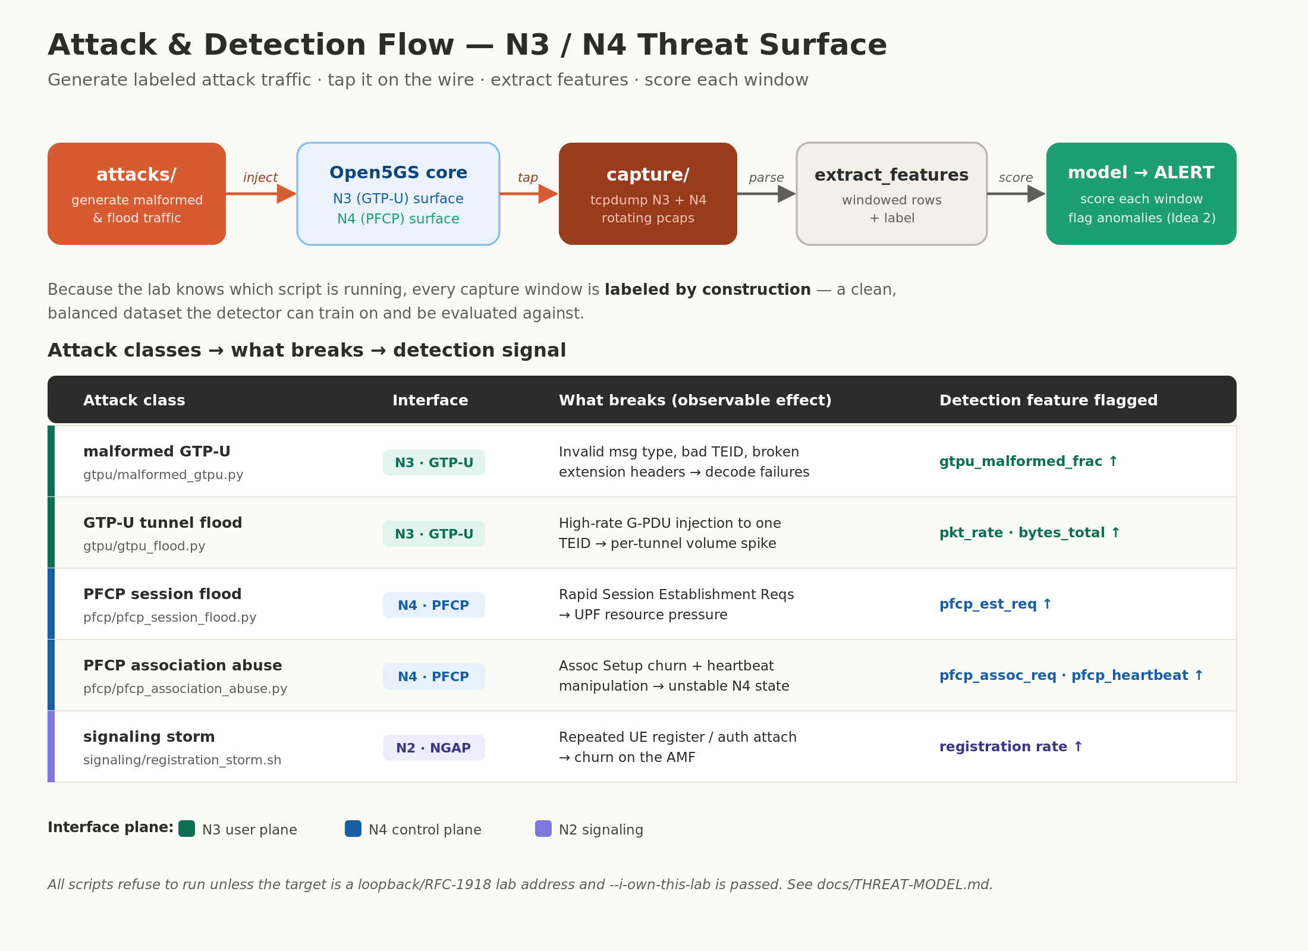
THE FULL DIAGRAM
Attack & detection flow
5G Core Lab-in-a-Box · Field Guide
19

Slide 20
THE TOP STRIP
The security loop — five steps
attacks/
inject
5G core
tap
capture/
parse
extract_features
score
model → ALERT
Generate malformed
& flood traffic
The live core
being attacked
Record N3 + N4
to files (pcaps)
Boil each window
down to numbers
Score each window,
flag anomalies
In one line: make bad traffic → let it hit the core → record it → turn it into numbers → let a model catch it.
5G Core Lab-in-a-Box · Field Guide
20

Slide 21
THE CLEVER PART
“Labeled by construction”
To train a detector you need traffic tagged as “normal” or “attack.” Getting those labels is usually the hard part.
The usual way
This lab
A human hunts through millions of recorded packets and hand-tags which ones were attacks. Slow, tedious, and error-prone — and public datasets are scarce.
The lab launched the attacks, so it already knows exactly when each one ran. Every recorded window is stamped with the truth — automatically, for free.
vs
5G Core Lab-in-a-Box · Field Guide
21

Slide 22
THE ATTACKS · 1 OF 2
On the data tunnel (N3)
Both target N3 — the pipe carrying user data. One breaks packets; the other overwhelms with volume.
N3 · GTP-U
N3 · GTP-U
malformed GTP-U
GTP-U tunnel flood
gtpu/malformed_gtpu.py
gtpu/gtpu_flood.py
Broken packets
Too much, too fast
Sends deliberately malformed data — wrong type, garbage tunnel IDs, corrupted headers. Like mailing envelopes with nonsense addresses to jam the mailroom.
Not broken — just a firehose of data down a single tunnel, far more than normal.
The tell: decode-failure rate spikes (gtpu_malformed_frac ↑)
The tell: packet rate & byte volume spike (pkt_rate · bytes_total ↑)
5G Core Lab-in-a-Box · Field Guide
22

Slide 23
THE ATTACKS · 2 OF 2
On control & signaling (N4 · N2)
N4 · PFCP
A rapid burst of “start a new session” requests, trying to exhaust the core — like thousands slamming the front desk at once.
The tell: session-request count spikes (pfcp_est_req ↑)
PFCP session flood
N4 · PFCP
Churns the standing handshake between the session-manager and the gateway, and fakes heartbeats.
The tell: abnormal association / heartbeat counts
PFCP association abuse
N2 · NGAP
Floods the “greeter” (AMF) with endless join attempts, overwhelming the login desk.
The tell: registration rate spikes · (weakly caught today — N2 gap)
signaling storm
5G Core Lab-in-a-Box · Field Guide
23

Slide 24
THE SMALL PRINT
Built-in safety rail
Every attack script refuses to run unless BOTH are true:
!
1. the target is your own lab — a loopback or private address, not a real network, and 2. you explicitly confirm it — by passing the --i-own-this-lab flag.
It's deliberate friction, so the tooling can't be casually pointed at anything but the lab you control.
5G Core Lab-in-a-Box · Field Guide
24

Slide 25
THE WHOLE STORY
A working 5G network you can attack, capture, and learn from — safely, on one machine.
The network
The data path
The security loop
Phone + tower + core, all in software.
Green carries data; blue sets it up.
Inject → tap → parse → score; labeled for free.

