Slide 1
CAPABILITY OVERVIEW
5G Core Lab-in-a-Box
A complete 5G network — phone, tower, and core — running entirely in software on a single machine.
RAN
Core
Data plane
Security

Slide 2
THE BIG PICTURE
What is this, really?
A real 5G network is three things: a phone with a SIM, a cell tower, and a “core” in a data center that decides who gets on and routes their data. Normally that's rooms of expensive hardware spread across a city.
Phone
Here, every piece is software — all on one computer, talking to each other exactly the way the real hardware would.
Tower
Core
5G Core Lab-in-a-Box
2

Slide 3
WHAT'S INSTALLED
The four building blocks
UERANSIM the phone & the tower
One program that simulates both a handset and a 5G radio. No SIM cards, no hardware — it exchanges the same messages a real phone and tower would.
Open5GS the core “brains” — about a dozen containers
Like the staff of a members' club: one checks your SIM, one registers you, one opens your session, one enforces the rules, a directory lets them find each other.
UPF the data gateway — runs on the host
The doorway your actual traffic flows through on its way out. Runs directly on the machine (our workaround for a kernel quirk).
Security tooling attack & capture — the whole point
Generate malformed or flood traffic on the core's internal pipes, record it, and train a model to tell normal from malicious.
5G Core Lab-in-a-Box
3

Slide 4
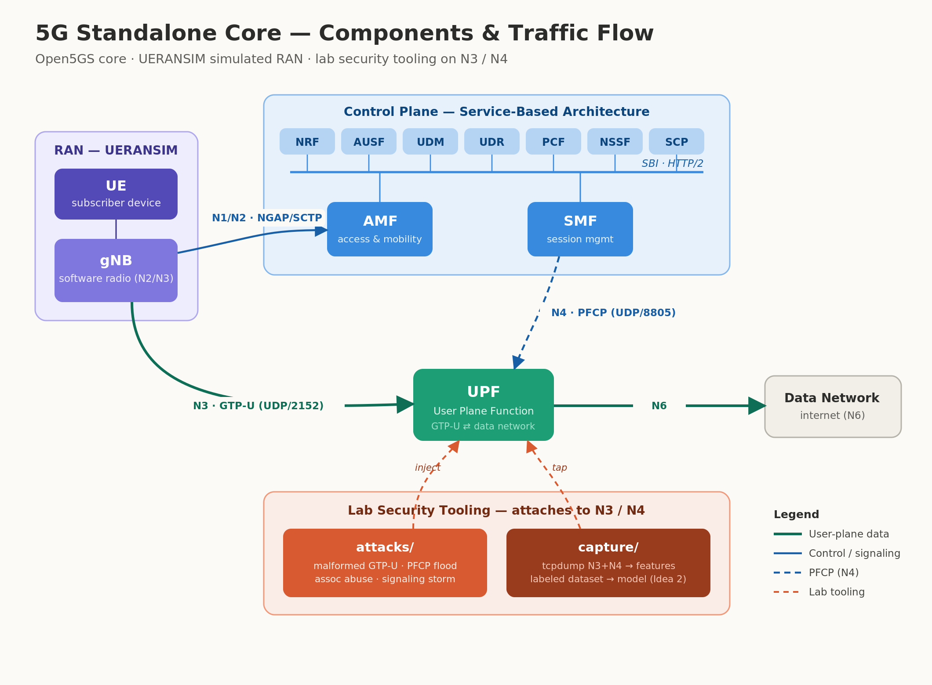
HOW IT FITS TOGETHER
Components & traffic flow
RAN → control plane → user-plane gateway → data network, with the lab tooling attached at the N3/N4 interfaces.

Slide 5
HOW IT WORKS
Getting a phone onto the network
1
2
3
4
5
Find the tower
Prove the SIM
Register
Open a session
Get an IP
In our lab this fully works. The simulated phone registered, authenticated, opened a session, and was assigned the address 10.45.0.2 — a working connection through the core.
✓
5G Core Lab-in-a-Box
5

Slide 6
THE PLUMBING
The pipes that matter
N2
N3
N4
The conversation
The data tunnel
The control link
Signaling between the tower and the core — “let this phone on.”
Your actual traffic, wrapped up and carried between tower and gateway.
The core telling the data gateway how to handle each session.
NGAP
GTP-U
PFCP
These three pipes — especially N3 and N4 — are exactly what the security tooling targets.
5G Core Lab-in-a-Box
6

Slide 7
THE POINT
Why build a 5G network just to attack it?
N3 and N4 are real-world attack surfaces. In a production network they're a known target — malformed tunnels, session floods, signaling storms. This lab lets you reproduce those attacks safely, against a system you own, and study how to detect them.
Generate
Capture
Detect
malformed / flood
traffic on N3 & N4
record everything
on the wire
train a model to
flag anomalies
Because the lab knows which attack is running, every recording is labeled automatically — clean training data.
5G Core Lab-in-a-Box
7

Slide 8
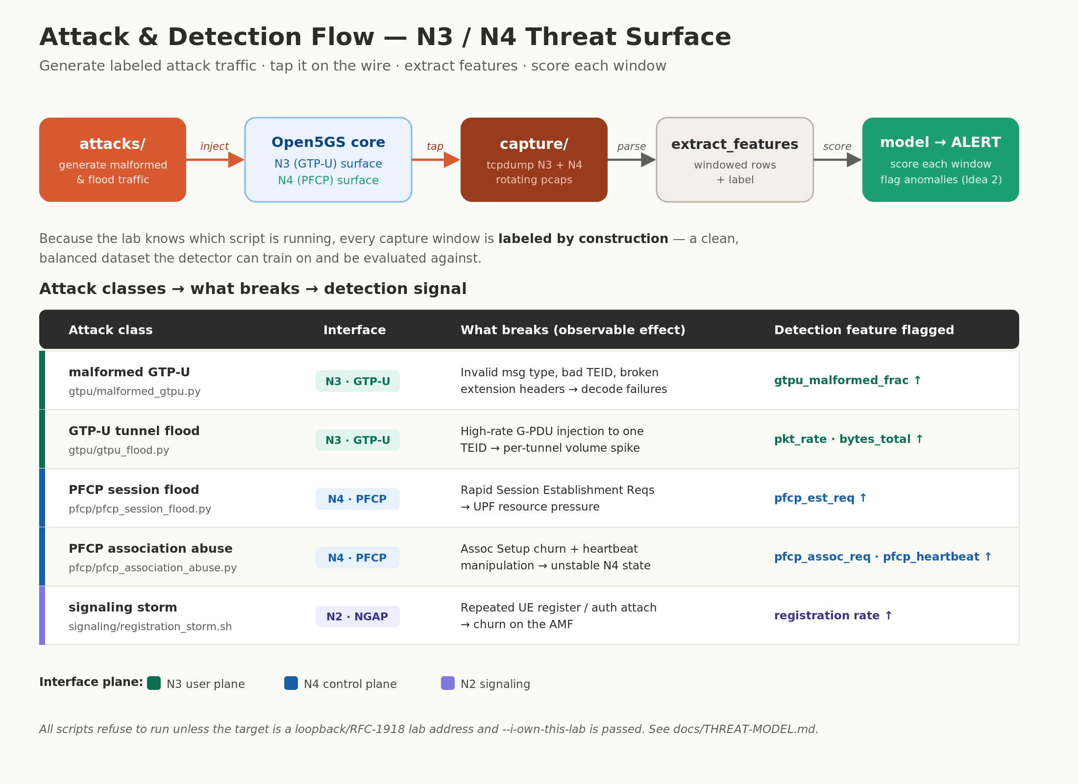
THE SECURITY WORKFLOW
Attack & detection flow
5G Core Lab-in-a-Box
8

Slide 9
STATUS
Where it stands today
Working
10.45.0.2
5G core
UE connected
Registration, auth, PDU session, N4 & N3 all verified end-to-end.
A simulated phone attached and got a working data session.
N3 + N4
Optional
Traffic flowing
Internet egress
User-plane and control-plane pipes carry live traffic to capture.
One host-networking quirk on a non-standard kernel; not needed for the lab work.
5G Core Lab-in-a-Box
9

Slide 10
FROM HERE
A credibility artifact — and a data engine
A full 5G core you can attack, capture, and learn from — the foundation for a GTP/PFCP anomaly detector and for 5G-security advisory work.
Lab
Labeled data
ML detector

