Slide 1
SECURITY LAB
cSRX Firewall Lab
A standalone flood-firewall testbed — a Juniper cSRX rate-limiting 5G attack traffic, all container-native.

Slide 2
THE IDEA
Firewall + AI: two layers, one defense
Add a firewall that enforces against the attacks the lab generates — alongside the ML detector that detects them. Each covers what the other can't.
cSRX firewall
ML detector
ENFORCES
DETECTS
Rate-limits the volumetric floods (GTP-U, PFCP) with DoS screens. Fast, deterministic, container-native.
Catches the malformed and protocol-abuse traffic the firewall can't inspect — and the novel, unseen stuff.
Defense in depth: the firewall stops the obvious; the AI catches the subtle.
cSRX Firewall Lab
2

Slide 3
HONEST SCOPE
What cSRX can — and can't — do
cSRX is a lightweight container firewall. Knowing its limits is the point:
✓ CAN do
✕ CAN'T do
Rate-limit GTP-U floods — UDP-flood screen on N3 (2152)
Deep GTP inspection — no GTP ALG — that's vSRX / SRX
Rate-limit PFCP floods — same screen on N4 (8805)
Drop malformed GTP-U — → the ML detector's job
Stateful firewall + policy — permit / deny by zone
Protocol-aware PFCP — → the ML detector's job
cSRX Firewall Lab
3

Slide 4
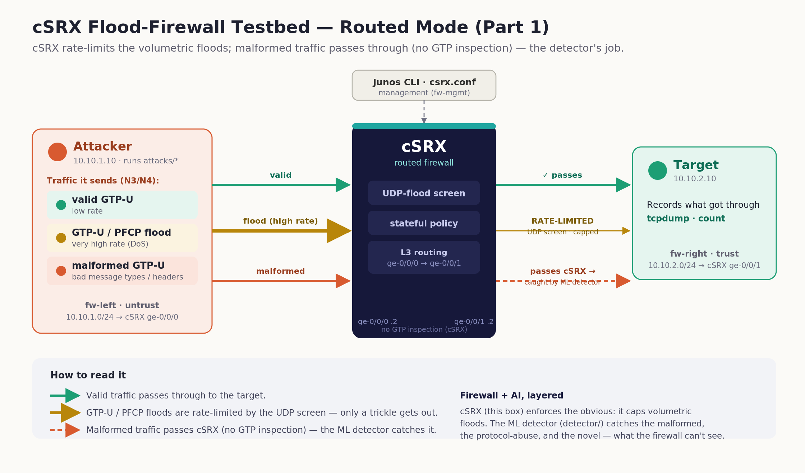
THE TESTBED
Three containers, one firewall in the middle
cSRX Firewall Lab
4

Slide 5
HOW IT'S BUILT
The setup
3 Docker networks
fw-left (untrust) · fw-right (trust) · fw-mgmt — explicit subnets so we control addressing.
cSRX in routed mode
ge-0/0/0 = 10.10.1.2 (untrust), ge-0/0/1 = 10.10.2.2 (trust). Routes untrust → trust.
Attacker 10.10.1.10
Runs the repo's attacks/ scripts; a static route sends target traffic through the cSRX.
Target 10.10.2.10
Just records what gets through, with tcpdump — sent vs. delivered.
cSRX config
Zones (untrust/trust), a UDP-flood screen (threshold 1000), and a permit policy.
cSRX Firewall Lab
5

Slide 6
THE METHOD
The demo — send, then measure
Fire four kinds of traffic from the attacker through the cSRX, and count what reaches the target.
valid GTP-U
GTP-U flood
PFCP flood
malformed GTP-U
low rate — should pass
high rate — should be capped
high rate — should be capped
should pass (detector's job)
Measuring: count packets arriving at the target with tcpdump. Because cSRX's own interface counters aren't populated, forwarding was verified from the host by tcpdump on the Docker bridges (br-<netid>).
cSRX Firewall Lab
6

Slide 7
LESSONS
What we learned (the hard way)
cSRX has no GTP ALG
Deep GTP inspection is a vSRX / SRX feature. cSRX does screens (rate-limiting) only.
!
Secure-wire can't hold zones
In wire mode you can't attach zones/screens to the interfaces — routed mode does.
!
Attacker needs plumbing
The container needed iproute2 + NET_ADMIN and a static route to the target via cSRX.
!
cSRX counters aren't populated
show interfaces stats are blank — observe forwarding by tcpdump on the host bridges instead.
!
cSRX Firewall Lab
7

Slide 8
THE PAYOFF
Results
The UDP-flood screen capped both floods (~80% dropped); valid passed, malformed sailed through.
Traffic
Sent
Reached target
Verdict
valid GTP-U
200
200
passes
GTP-U flood (N3)
20,000
4,000
RATE-LIMITED
PFCP session flood (N4)
20,000
4,000
RATE-LIMITED
malformed GTP-U
200
200
passes → detector
Every flood packet above the threshold was dropped by the firewall — the detector then handles the rest.
cSRX Firewall Lab
8

Slide 9
WHERE IT STANDS
Part 1 done: a firewall that caps the floods, container-native and demonstrated.
Part 1 ✓
Part 2 →
The story
Standalone cSRX flood firewall — validated.
Integrate cSRX inline on the live 5G N3/N4.
Firewall enforces the floods; the detector catches the rest.

