Slide 1
5G LAB-IN-A-BOX · SELF-SECURING CORE
Closing the Loop
From detection to autonomous, guardrailed mitigation on Juniper SRX — how the feedback path and decision layer turn an alarm into a self-securing 5G core.
DETECT
DECIDE
ENFORCE
VERIFY+LEARN
always-on ML sensor
agentic + guardrails
SRX policy
close the loop
Notes:
This deck explains the core innovation of the self-securing 5G core: the closed feedback loop from detection to SRX enforcement, the decision layer and guardrails that make autonomous action safe, and what is built versus what is next.

Slide 2
WHY THIS MATTERS
Detection alone is just an alarm
✕
Traditional IDS
✓
Self-securing loop
Sees an attack, raises an alert, and waits for a human to trace it and change a firewall rule — minutes to hours while service degrades.
Detects, decides a safe response, enforces it on the SRX, verifies the result, and learns — autonomously, in seconds.
The shift
Move the response inside the loop. The machine does the fast, repetitive containment; humans supervise and handle the high-impact calls.
Notes:
A conventional intrusion-detection system stops at an alert. The value here is autonomous response: closing the loop so containment happens at machine speed, with humans supervising rather than hand-configuring every firewall change.

Slide 3
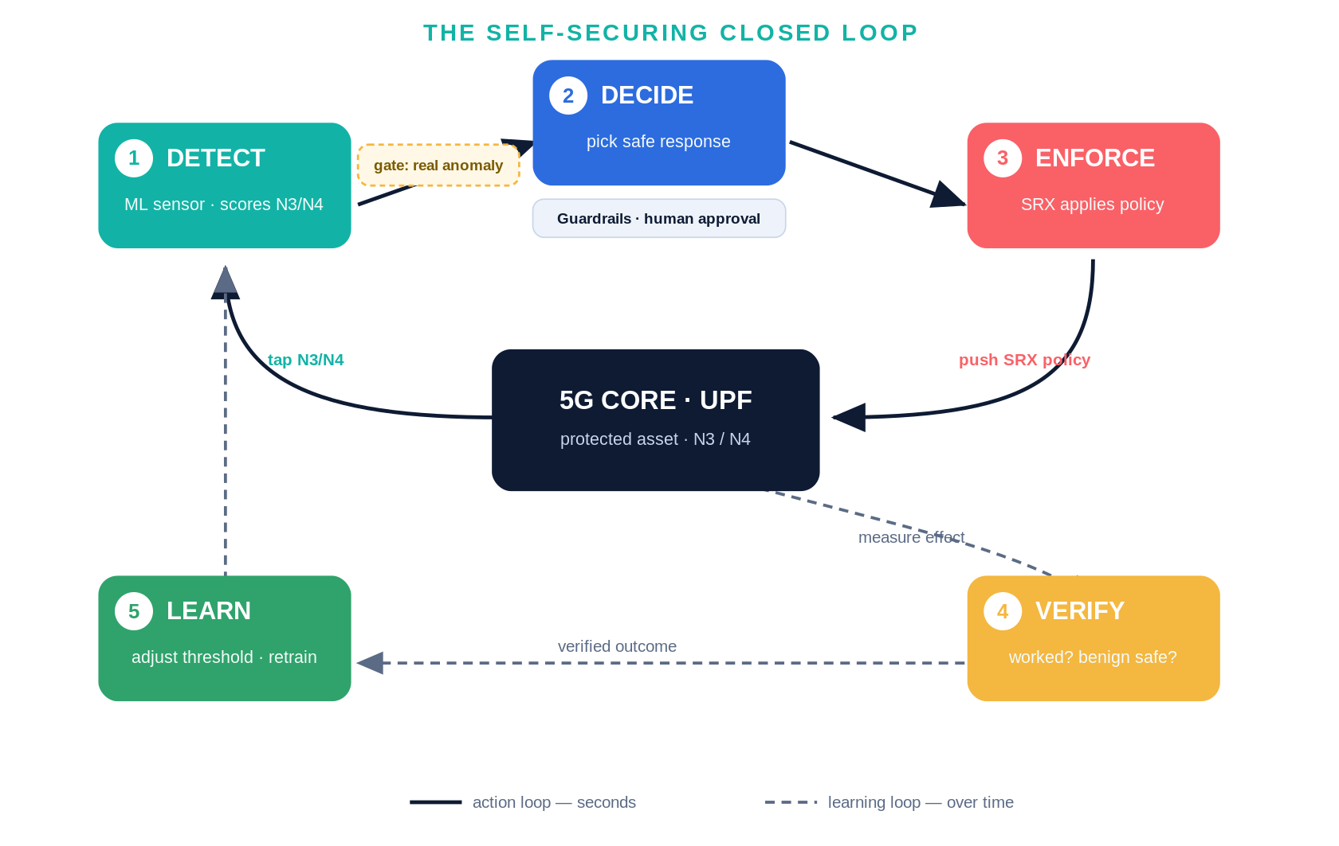
THE BIG IDEA
A closed loop: detect → decide → enforce → verify → learn
Notes:
The whole system is a control loop wrapped around the UPF. The solid action loop reacts in seconds; the dashed learning loop improves the model over time. The gate keeps it efficient (expensive reasoning only on real anomalies) and the guardrails keep autonomous enforcement safe.

Slide 4
1
STAGE 1 · THE SENSOR
DETECT — always-on anomaly scoring
Tap N3 (GTP-U) and N4 (PFCP) at the UPF; slice the stream into 1-second windows.
Each window becomes a row of features — packet rate, bytes, malformed fraction, TEID churn, PFCP message counts.
A semi-supervised model (autoencoder + Isolation Forest) trained only on benign traffic scores each window for “weirdness.”
Flag any window above the threshold (99th percentile of benign scores).
Proven
1.000
ROC-AUC (GPU autoencoder)
100% recall across all four attack classes; ~5% benign false-alarm.
Notes:
Stage 1 is the always-on sensor: tap N3/N4, window into features, score against a model of normal, flag windows over the threshold. This is built and validated — ROC-AUC 1.000 on the GPU autoencoder with 100% attack recall.

Slide 5
THE GATE
Cheap detection gates expensive reasoning
1
Every second
2
Anomaly?
3
Then reason
ML sensor scores the window
gate: only real anomalies pass
the agent wakes up to decide
~all traffic
a tiny fraction
rare events
Why it matters — token efficiency & calm
The non-LLM detector runs constantly at low cost; the costly agentic reasoning is invoked only when something is genuinely wrong. Orders of magnitude fewer tokens than always-on LLM monitoring — and far fewer needless actions.
Notes:
The gate is the efficiency mechanism: the cheap ML detector is always on, and the expensive agent is invoked only on a real anomaly. This is the answer to token-usage management and also keeps the system from over-reacting.

Slide 6
2
STAGE 2 · THE DECISION LAYER
DECIDE — choose a safe, graduated response
The agent classifies the anomaly (which attack, which interface) and selects a response.
Least-disruptive first: rate-limit before block before isolate — start gentle, escalate only if needed.
Maps a detection to a specific, pre-approved SRX action, not a free-form command.
Built on HPE’s agentic AIOps framework rather than from scratch.
Detection → action
gtpu_flood
→ rate-limit N3
malformed
→ drop + quarantine
pfcp_flood
→ rate-limit N4
assoc abuse
→ throttle + review
Notes:
Stage 2 is the decision layer that closes the loop. It classifies the anomaly and picks a graduated, least-disruptive response mapped to a pre-approved SRX action. This is the part that is in design, built on HPE's agentic framework.

Slide 7
SAFETY
Guardrails make autonomous action trustworthy
1
Action allow-list
2
Graduated response
the agent may issue only pre-approved SRX policy templates.
rate-limit → block → isolate; the gentlest effective fix first.
3
Human-in-the-loop
4
Verify & auto-rollback
high-impact moves (e.g., isolate a slice) need operator approval.
every action is measured and reverts if it fails or harms benign traffic.
Scoped per UPF / slice / edge, with a full audit trail.
Notes:
Guardrails are what make it safe to let software reconfigure a firewall: an allow-list of permitted actions, least-disruptive-first escalation, human approval for high-impact actions, and verify-and-rollback so a bad action undoes itself.

Slide 8
3
STAGE 3 · THE ENFORCER
ENFORCE — Juniper SRX applies the policy
The agent pushes the chosen policy to the SRX inline on N3/N4.
SRX is both the enforcement point and, via its flow telemetry, a natural sensor tap.
Enforcement platform-agnostic: physical SRX, vSRX, or cSRX.
Proven in the lab: SRX screens rate-limit volumetric GTP-U floods.
Graduated enforcement
1
rate-limit
cap the flood
↓
2
block
drop the source
↓
3
isolate
fence the slice/edge
Notes:
Stage 3 enforces on the SRX, which is inline on N3/N4 and also provides telemetry. Enforcement is graduated and platform-agnostic across SRX form factors. Lab-proven: SRX screens rate-limit volumetric floods.

Slide 9
STAGES 4 & 5 · CLOSING THE LOOP
VERIFY and LEARN — two feedback loops
4
Action loop
5
Learning loop
(seconds)
(over time)
Detect → decide → enforce.
VERIFY re-scores: did the anomaly fall, and did benign traffic keep flowing?
If not, escalate one rung; if it hurt benign, auto-rollback.
The verified outcome (signature + action + result) is logged.
LEARN feeds it back to adjust thresholds and retrain.
The loop gets sharper and produces fewer false alarms.
Notes:
Stage 4 verifies the enforcement worked without harming benign traffic (escalate or rollback otherwise). Stage 5 feeds the verified outcome back to improve the model. The fast action loop reacts; the slow learning loop improves.

Slide 10
END TO END
A GTP-U flood through the loop
1
DETECT
packet-rate spikes; reconstruction error crosses threshold → looks like gtpu_flood.
2
GATE
a real anomaly — wake the agent (a normal second would stop here).
3
DECIDE
map “N3 flood” → rate-limit screen; guardrail check: on allow-list, not high-impact → proceed.
4
ENFORCE
push the screen to the SRX; the flood toward the UPF is capped.
5
VERIFY
re-score: packet-rate back to normal, UE traffic still flowing — success (else escalate / rollback).
6
LEARN
log “this signature + this action worked”; tune threshold / retrain.
Notes:
A concrete thread: a gtpu_flood second is detected, passes the gate, the agent picks a rate-limit under guardrails, SRX enforces, verify confirms the flood is capped and benign traffic survived, and the outcome is logged for learning.

Slide 11
HONEST STATUS
What’s built, and what closes the loop
✓
Built & validated
→
In design (the loop-closer)
The DETECT sensor — ML anomaly detection on real N3/N4 traffic (ROC-AUC up to 1.000).
ENFORCE — SRX screens rate-limiting floods.
The full 5G lab, attacks, and GPU training pipeline.
The DECIDE agent that turns a detection into an SRX policy push.
Guardrail certification and verify/rollback wiring.
Integration on HPE’s agentic AIOps framework.
The two ends are proven; closing the middle is the focused next build — and the honest framing reviewers respect.
Notes:
Be honest: the two ends — detection and enforcement — are proven. The decision agent that automatically closes the loop is the primary remaining build. This framing is credible and matches the HPE abstract's Current status.

Slide 12
WHY IT MATTERS
A self-securing 5G core
The feedback path turns detection into autonomous, guardrailed mitigation — containment at machine speed.
One loop spans HPE’s security (SRX), AI-infrastructure, and consumption businesses.
Cheap ML gates costly reasoning: efficient, calm, and scalable to slices, edge, and MEC.
detect → decide (safely) → enforce → verify → learn
5G Lab-in-a-Box · self-securing core on Juniper SRX + AI automation
Notes:
The takeaway: the feedback path is what makes it self-securing, the guardrails make it safe, the gate makes it efficient, and it maps cleanly across HPE's businesses. Detect, decide safely, enforce, verify, learn.

