Slide 1

Sales Price Prediction using Ames Housing Data
Prepared by:
Esther Leung

Slide 2
Agenda
Problem statement
Data
Project approach
Data cleaning & EDA
Feature engineering
Model preparation
Modelling & model evaluation
Model iteration
Generating predictions
Conclusion

Slide 3
Problem statement
The focus of this project is to create a regression model based on the Ames Housing dataset to predict the price of a house at sale, given a set of characteristics of the house.

Slide 4


Potential Users of the model
Property agents
Sellers
Buyers

Slide 5
Data
The Ames Housing Dataset is used in this project. It is an exceptionally detailed and robust dataset with many different features related to houses.
The datasets from DSI-US-6 Regression Challenge were presented in 2 files:
train.csv (containing all of the training data for modelling)
test.csv (containing the test data for predictions)

Slide 6
Data
The data description was also provided.
Additional features created during feature engineering (in the later part of the project) include:
Feature | Description
Total Area | Total indoor and outdoor area (Gr Liv Area + Total Bsmt SF + Wood Deck SF + Open Porch SF + Enclosed Porch SF + 3-Ssn Porch + Screen Porch + Pool Area + Garage Area) (in square feet)
Age | Year Sold minus Year Built (in years)
New House | House with age no more than 25 years
Total Bath | Total number of bathrooms above grade and in basement (Half bath is considered as 0.5 bathroom)

Slide 7
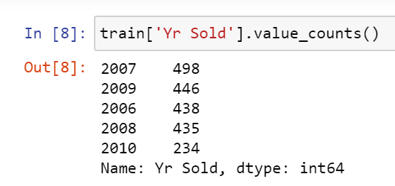
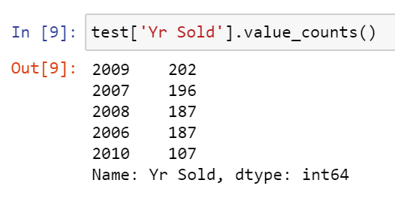
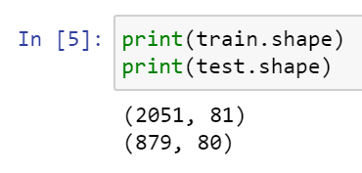
Data
Based on initial data exploration, it is noted that the datasets contain housing transaction record from year 2006 to 2010.
2051 records in the train dataset, and 879 records in the test dataset.

Slide 8
Data Cleaning

Slide 9
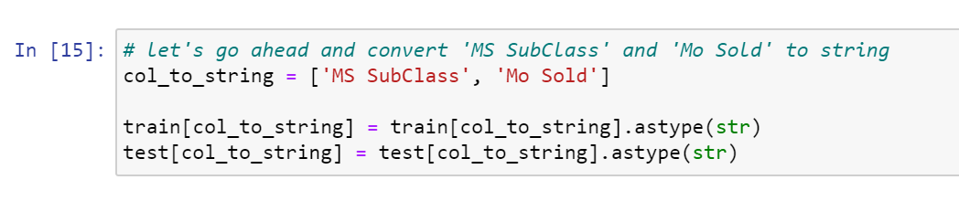
Data cleaning - Checking data types
‘MS SubClass’ and ‘Mo Sold’ should be nominal variables
Converted to string

Slide 10
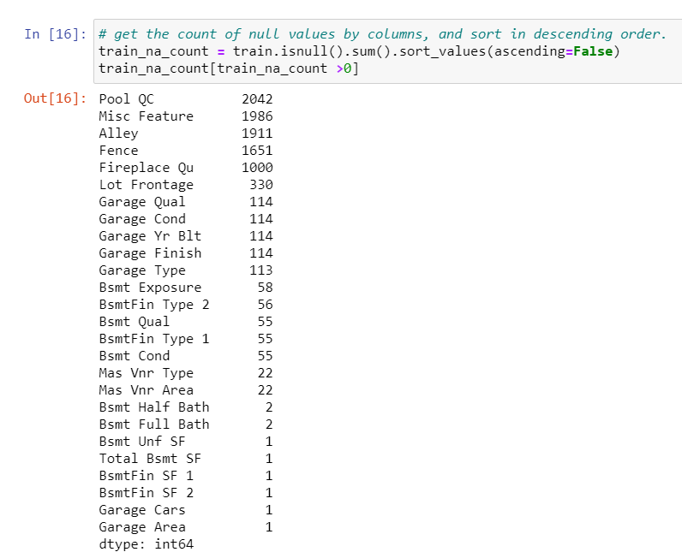
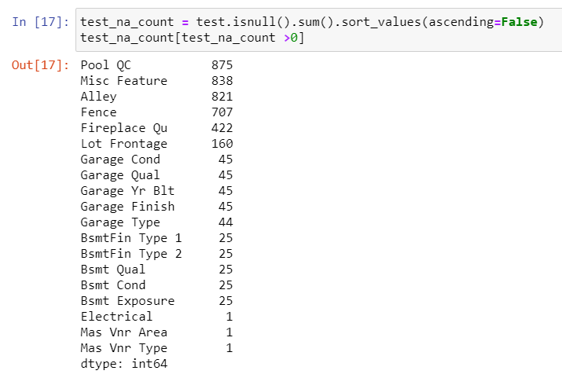
Data cleaning - Checking missing values

Slide 11
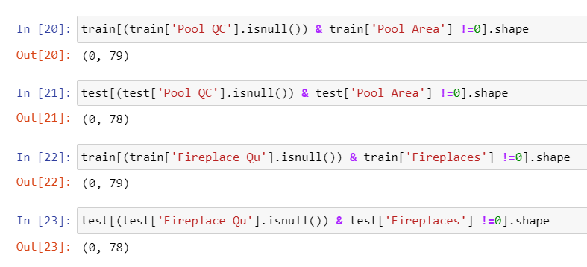
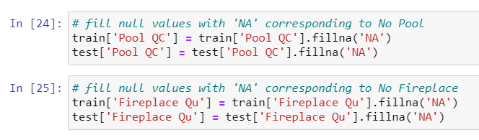
Data cleaning - Imputing missing values
E.g. Pool QC and Fireplace Qu
Null values correspond to houses with no pool and fireplace, so imputed with ‘NA’

Slide 12
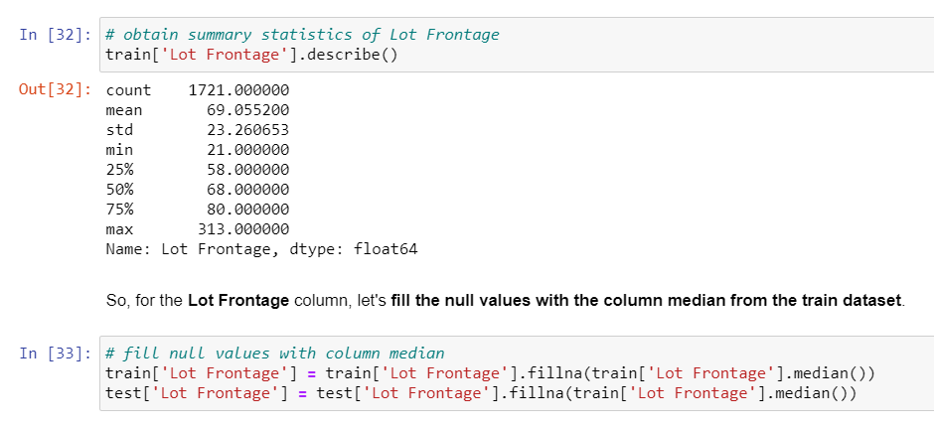
Data cleaning - Imputing missing values
E.g. Lot Frontage
Null values imputed with median

Slide 13
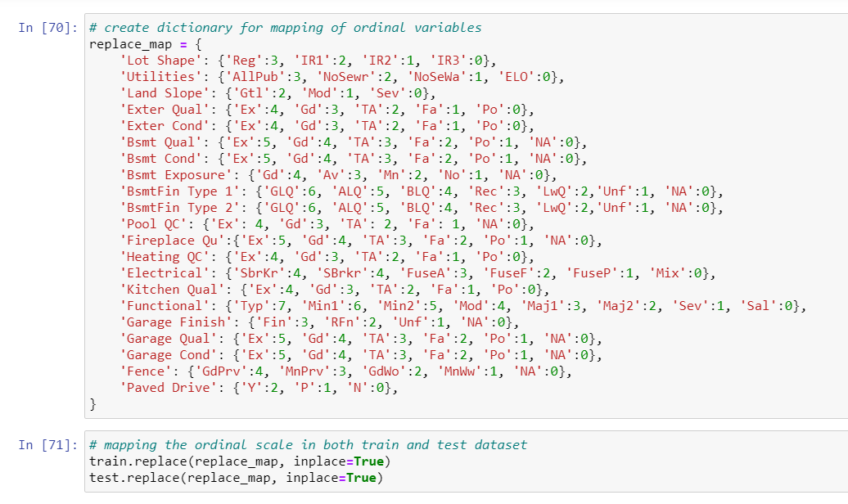
Data cleaning - Mapping ordinal variables

Slide 14
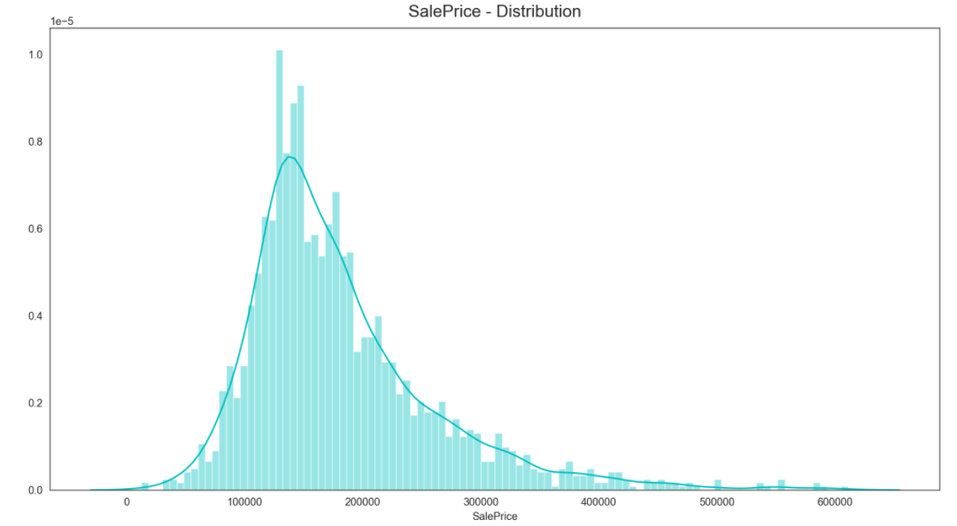
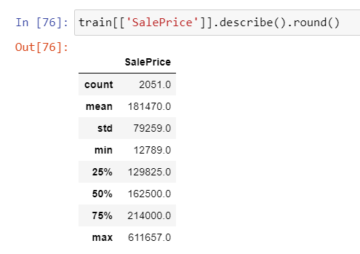
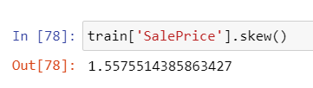
EDA – Sale Price
Mean Sale Price: $181,470
Positively skewed

Slide 15
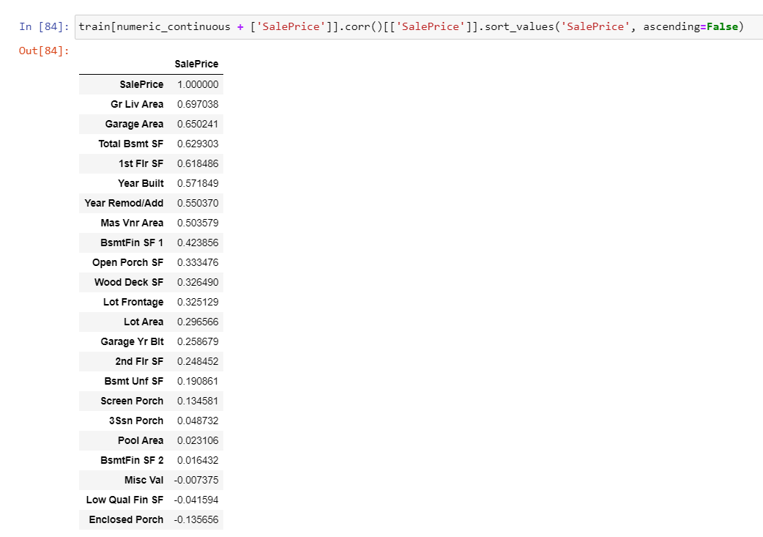
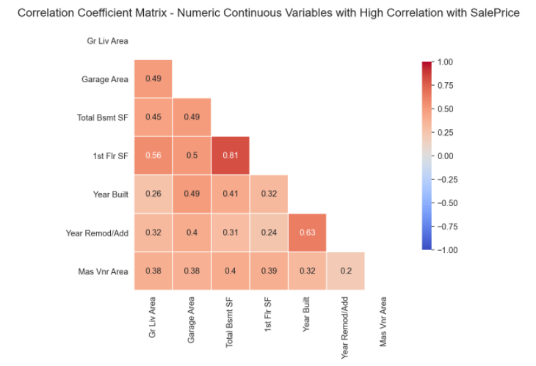
EDA – Numeric continuous Variables

