Slide 1
iPay
——Barcode-based mobile payment solution

Slide 2
Practical Problems
Consumer often encounter the phenomenon of waiting clearing in a line when shopping in supermarkets
Waiting will cost consumers a lot of time
Shopping experience will have a certain discount
Lack of good information in shopping

Slide 3
iPay
Mobile payment solution based on barcode
Quick shopping, payment system, committed to improving the shopping malls and banks’ service quality
Self-serve shopping software
Standard electronic wallet

Slide 4
view mall information Best sellers, Specials
optional
enter the mall, login
add to Cart
scan product bar codes, Access to product information
settlement, leave the mall

Slide 5

Barcode-based mobile payment solution

Slide 6
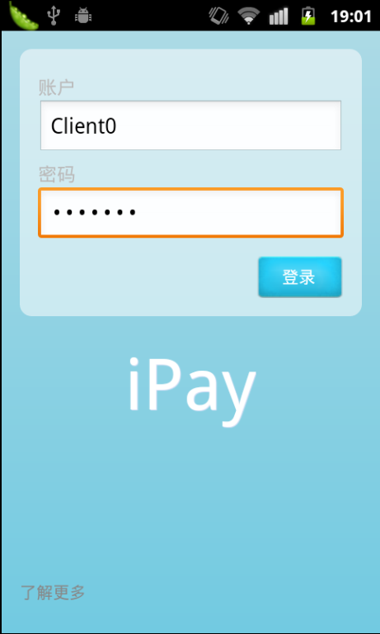
login
enter account and password , then click the login button to login

Slide 7
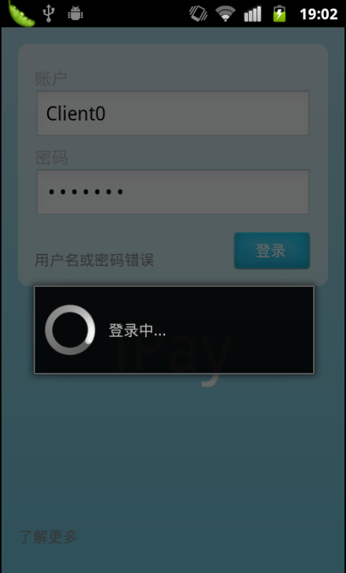
Log in uses HTTPS connection, to enhance security

Slide 8
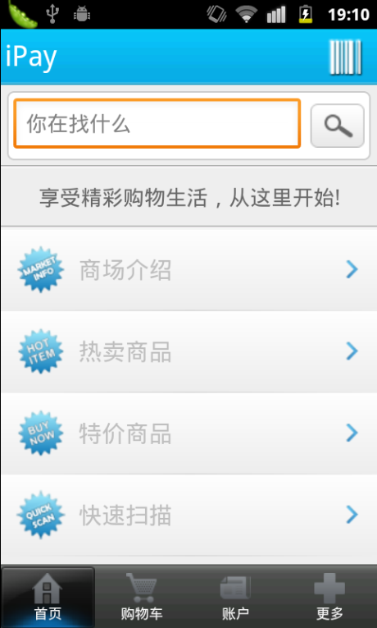
iPay Client Home
Provides the following features :
Shopping mall Information Best sellers Specials Quick Scan Product Search

Slide 9
Information Access
centralized, efficient

Slide 10
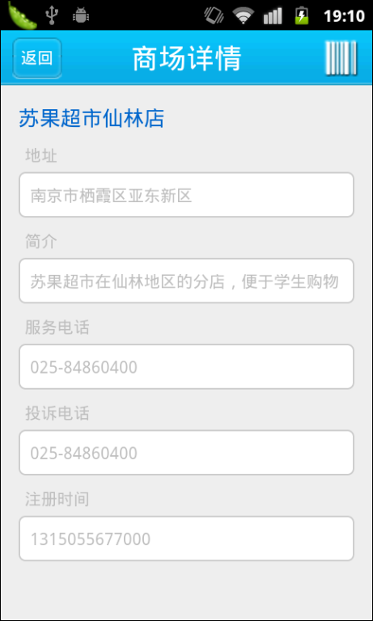
Shopping Mall Details Page
Help users understand the details of the shopping mall where they are such as: service telephone, complaints telephone

Slide 11
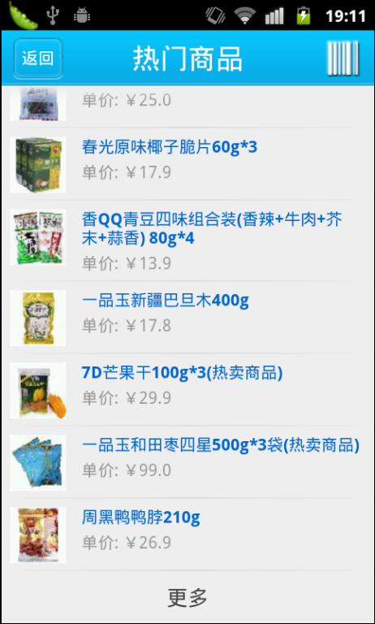
Popular products page
Access to list of current best sellers
Users can click on an item for details.

Slide 12
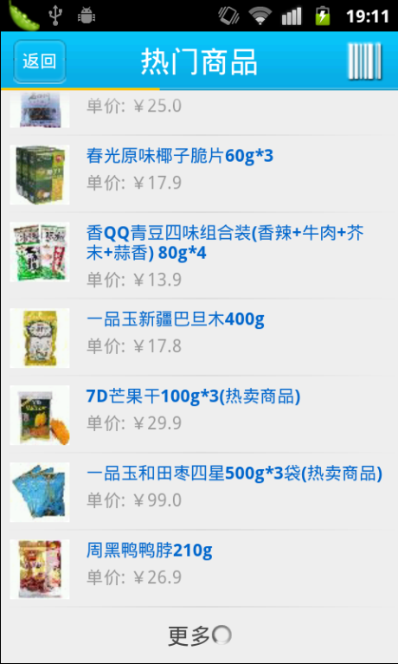
Dynamically extensible list implementation of the page
Click the "more" button on the bottom to get more goods.

Slide 13
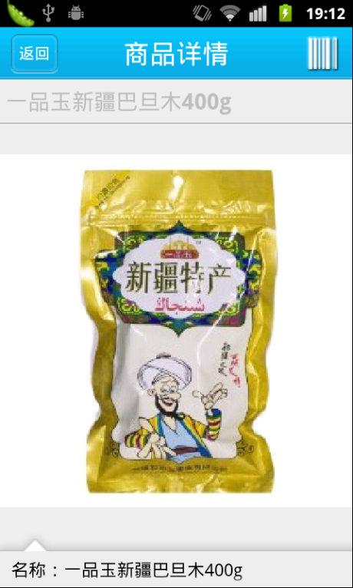
Product Details page
Users can view product details
include: name, price, producers and so on.

Slide 14
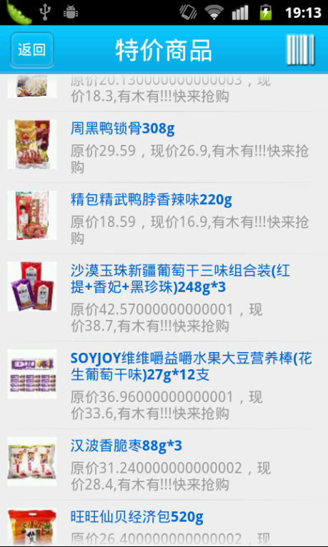
Specials page
And like popular goods , here are some shopping discounts of goods.

Slide 15
Barcode Recognition
iPay's core function

Slide 16
Barcode Recognition
iPay supports one-dimensional and two-dimensional code
User scans the bar code on the packaging for more information with the help of iPay.
Self-scanning eliminates the need for the traditional line clearing waiting time.

Slide 17
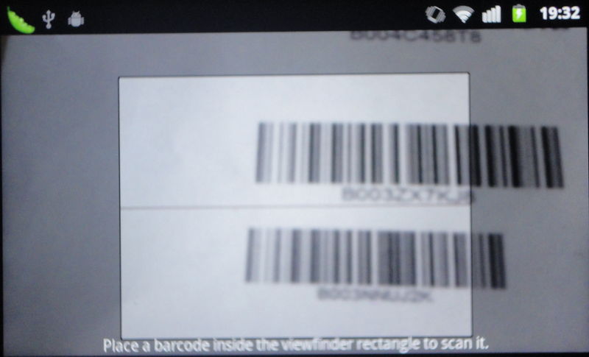
Barcode Recognition
supports one-dimensional and two-dimensional code
Quick identification and response

Slide 18
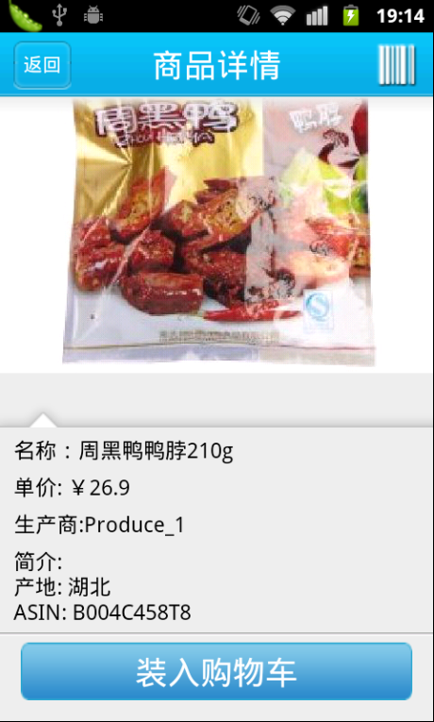
Barcode Recognition
Scan the bar code, the client will obtain the corresponding product information from the server, user can choose whether to purchase (i.e. Add to Cart)

Slide 19
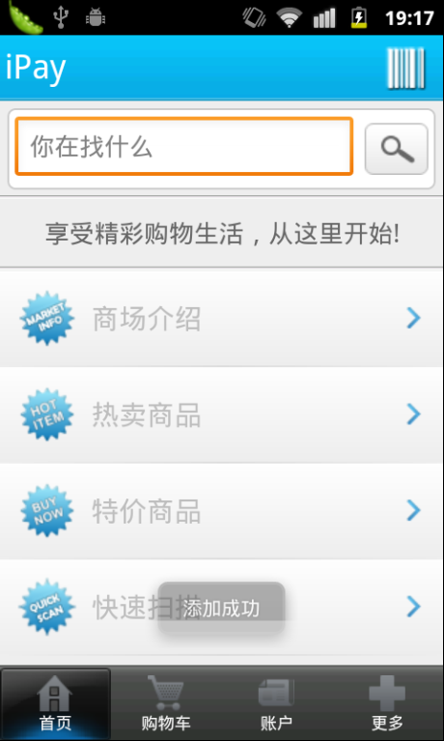
Shopping
The product was added to shopping cart, the user can continue scanning other bar codes of goods.
In the upper right corner of each page, iPay provides a shortcut button for the user at any time for bar code identification.

Slide 20
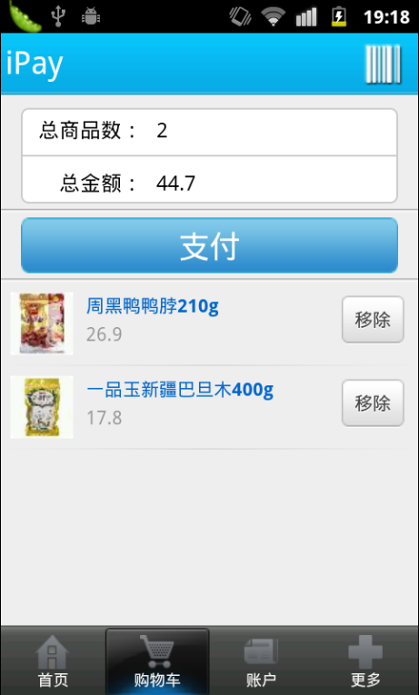
Shopping Cart
Shopping cart contains goods users want to buy, where users can adjust goods. Such as: View goods details, modify the goods quantity.

Slide 21
Payment
convenient, safe mobile payment experience

Slide 22
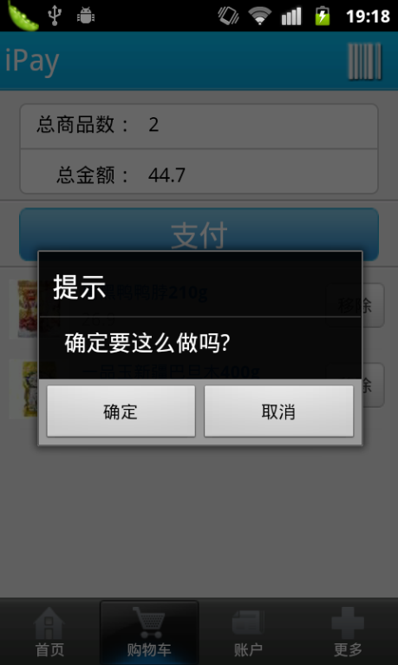
Shopping adjustment
Users can also remove their goods from the real and the virtual shopping cart adjust the shopping plan.

Slide 23
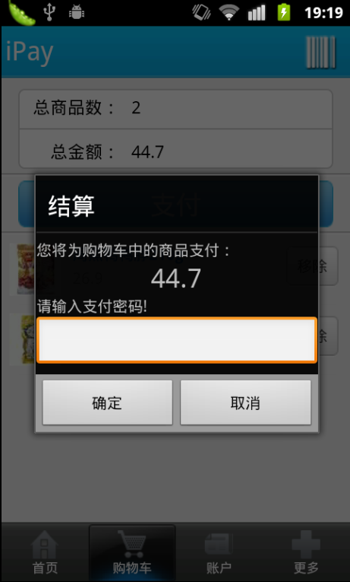
Settlement
iPay offers electronic billing, user account and bank card binding, reduce the trouble caused the traditional cash or credit card payment.
Phone as a wallet, giving users an unprecedented experience!

Slide 24
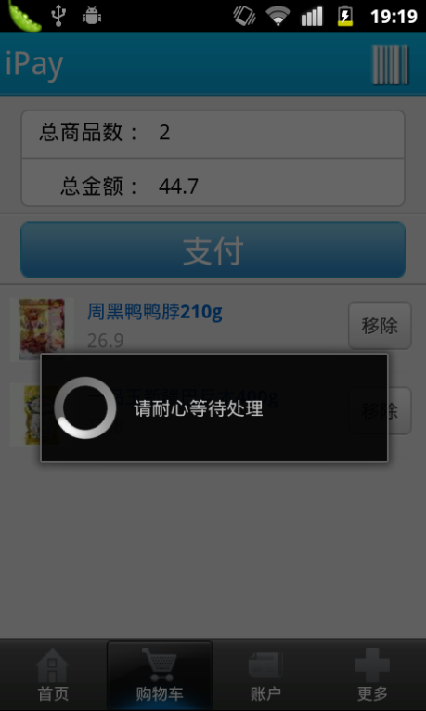
Security
iPay dose a lot of security considerations and payment is the most important part.
Connection during payment uses https encryption, and enhances payment security with the introduction of the RSA algorithm.

Slide 25
About Account

Slide 26
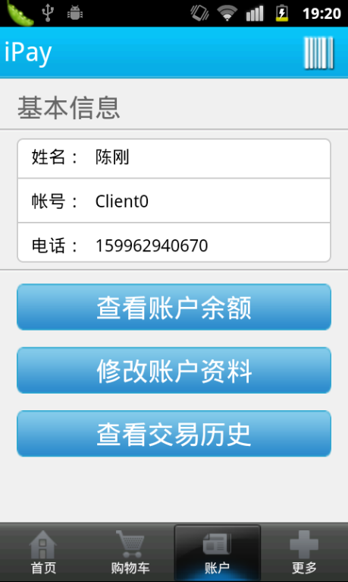
Account Information
Switch to the account tab to view account information
Check account balance
Modify account information
View transaction history

Slide 27
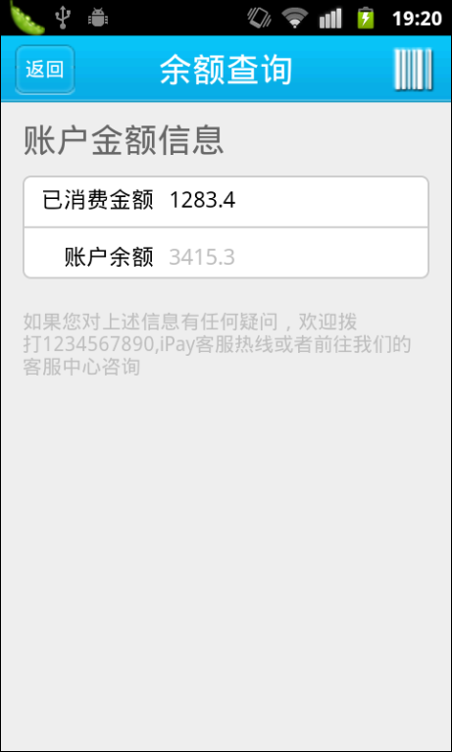
Balance Inquiry

Slide 28
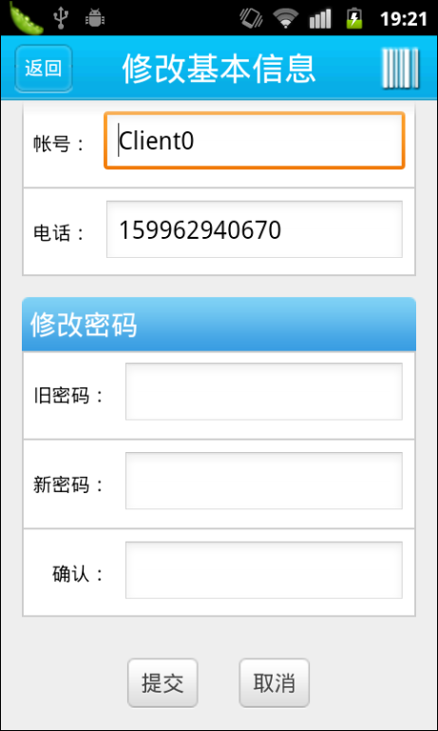
Modify the basic information
iPay also provides functions for users to modify their own contact information and password.

Slide 29
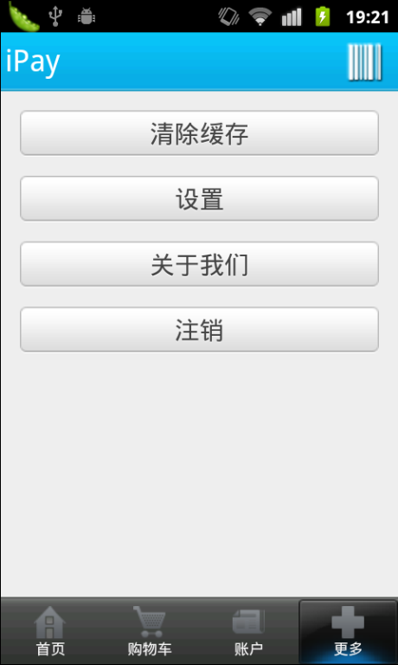
More
Clear cache: remove the goods, such as images, user information, the public key files and other data from the phone.
Settings: settings provide personalized
About Us: iPay Profile
Logout

Slide 30
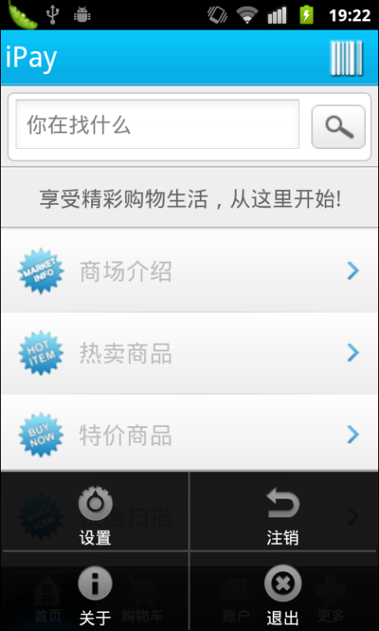
Menu

Slide 31
Outlook

Slide 32
Outlook
Mobile Payment Wallet Social network shopping Other areas to promote

Slide 33
Thank you appreciate
iPay
Produced by popcorn

