Slide 1
Course 2 Module 5 Programming Assignment Assignment is to ETL MIMIC data into the OMOP CONDITION_OCCURRENCE table
Detailed instructions with Slide Notes

Slide 2
ETL Steps
Assignment is to ETL MIMIC data into the OMOP CONDITION_OCCURRENCE table
Understand source/target data models
Profile source tables
Create ETL mappings
Write transformation code
Execute transformation
Perform data quality assessment
Package documentation
Notes:
This is an overview of the seven steps for ETL. The assignment focuses on Steps 1 thru 4 and Step 6
Place your finished deliverables into one or more slides. Add notes to provide additional information/context about what you have done

Slide 3
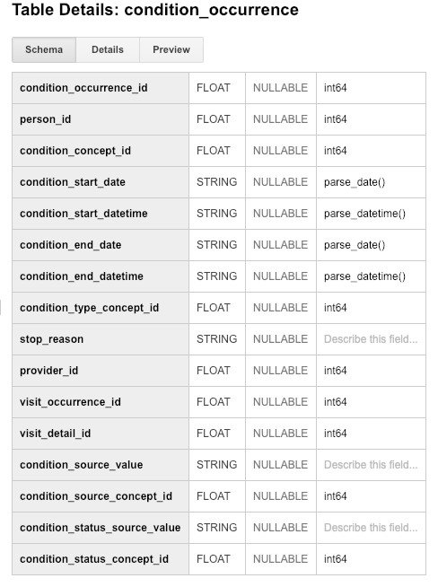
Step 1: Understand source/target data models
CONDITION_OCCURRENCE is the TARGET OMOP table.
Read the OMOP documentation about the type of data stored in CONDITION_OCCURRENCE and for three fields below that are in that table:
person_id
visit_occurrence_id
condition_source_value
Notes:
Paste into one or more slides, the key table or tables from MIMIC that hold data that can be used to fill in the OMOP CONDITION_OCCURRENCE table.
Choose the MIMIC table screenshots from this slide to indicate which MIMIC table or tables would be used in the ETL process. Delete the MIMIC tables that you will not use.

Slide 4
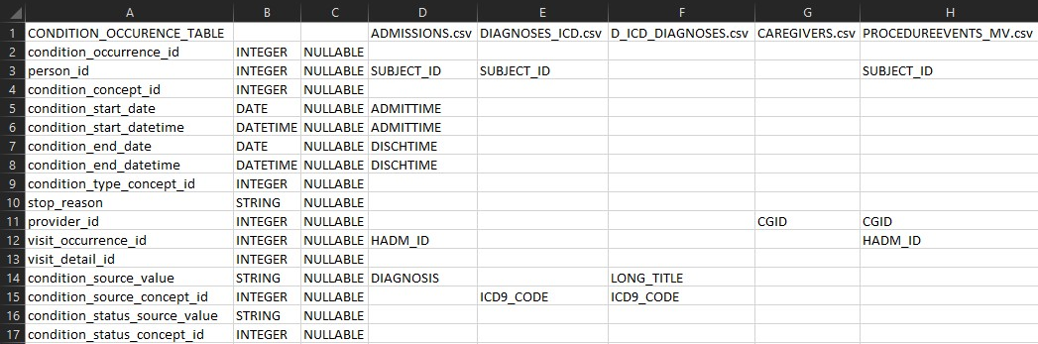
Step 1: My answer
Notes:
Paste into one or more slides, the key table or tables from MIMIC that hold data that can be used to fill in the OMOP CONDITION_OCCURRENCE table.
Choose the MIMIC table screenshots from this slide to indicate which MIMIC table or tables would be used in the ETL process. Delete the MIMIC tables that you will not use.

Slide 5
Step 2: Profile source table or tables
Using the White Rabbit profiling data from the 100 patient MIMIC database provided in the Assessment to comment on the distribution of the SUBJECT_ID field from one of the MIMIC tables selected in Step 1
MIMIC TableName
See rubric for the types of topics to include here
Notes:
Use the White Rabbit data profiling Excel spreadsheet that is linked to the assignment to describe key profiling findings from the table or tables you identified in ETL Step 1. See rubric for the types of topics to include here.

Slide 6
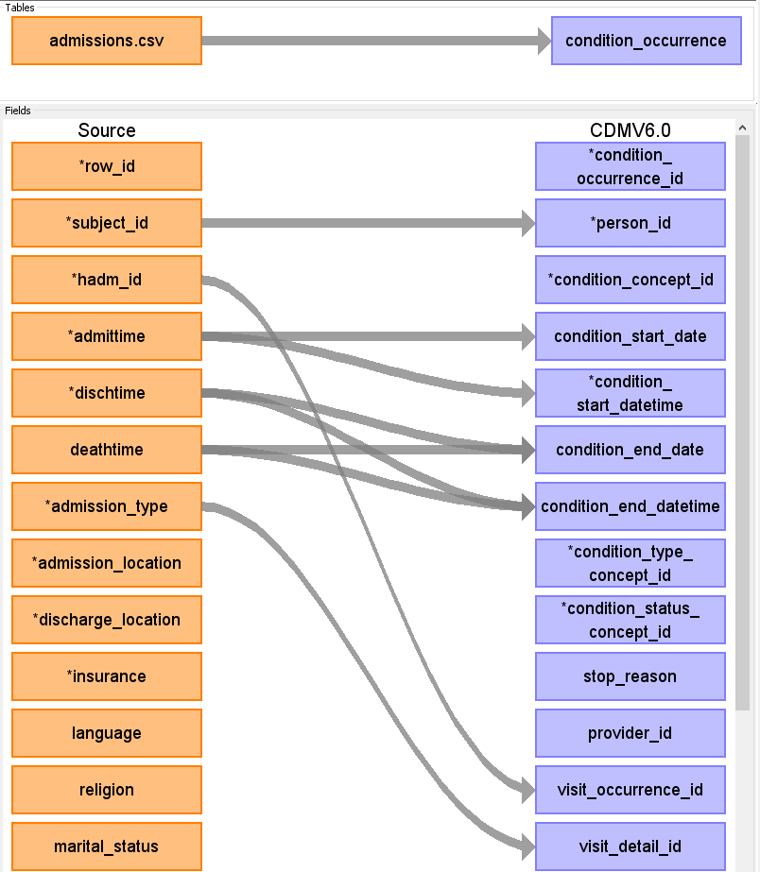
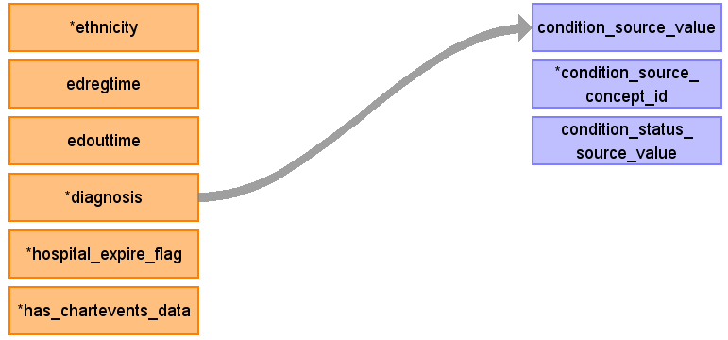
Step 3: My answer
subject_id map to person_id as both values are describing people
hadm_id map to visit_occurrence_id as both values related to hospital visit
diagnosis map to condition_source _value as the field described as ‘Condition as it appears in the source data’

Slide 7
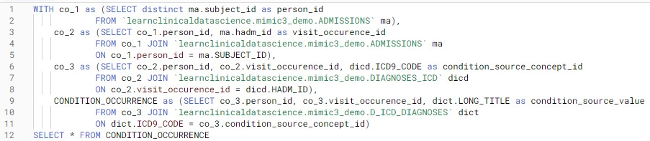
Step 4: My answer
Notes:
Paste the SQL statements that transform data in one or more MIMIC tables to the correct column or columns in OMOP CONDITION_OCCURRENCE into the Coursera Submission Site.

Slide 8
Step 5: Execute transformation code
Execute the ETL code from Step 4 but do not submit the output table.
Use the output table for Step 6.
There is no submission for this Step.
Notes:
Execute the ETL code from Step 4 but do not submit output table. Use output table for Step 6.
There is no submission for this Step.

Slide 9
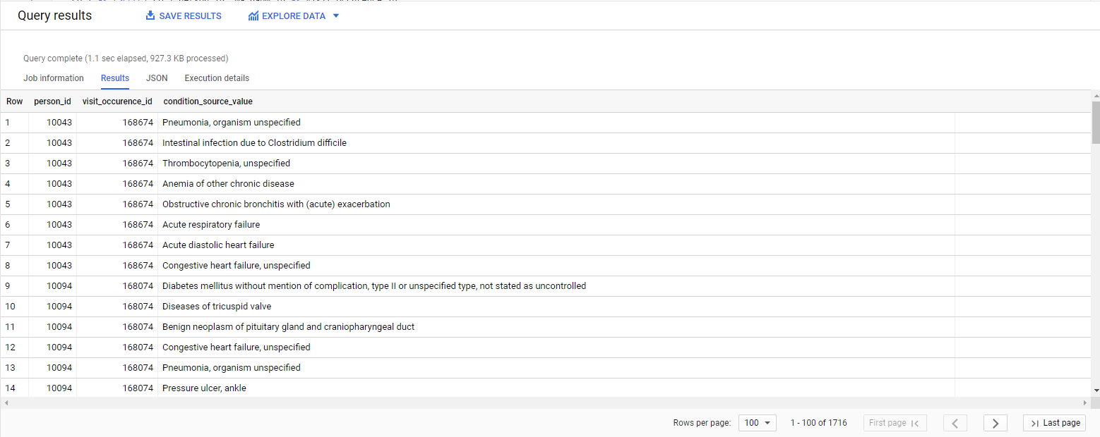
Step 6: My answer
Notes:
Paste the output from your data quality SQL executed on the OMOP CONDITION_OCCURRENCE table generated in Step 5 into this slide.
OK to paste link to a GoogleDoc instead.

Slide 10
Step 7: Package documentation
Congratulations! The materials in the previous slides constitute a complete ETL package.
There is no submission for this Step.

