Slide 1
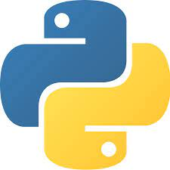
Python Applications in Real World
Dong Xu
EECS Department
C. S. Bond Life Sciences Center
University of Missouri http://digbio.missouri.edu

Slide 2
Uses of Python
shell tools
  system admin tools, command line programs
extension-language work
rapid prototyping and development
language-based modules
  instead of special-purpose parsers
graphical user interfaces
database access
distributed programming
Internet scripting

Slide 3
Python features
no compiling or linking | rapid development cycle
no type declarations | simpler, shorter, more flexible
automatic memory management | garbage collection
high-level data types and operations | fast development
object-oriented programming | code structuring and reuse, C++
embedding and extending in C | mixed language systems
classes, modules, exceptions | "programming-in-the-large" support
dynamic loading of C modules | simplified extensions, smaller binaries
dynamic reloading of C modules | programs can be modified without stopping
Lutz, Programming Python

Slide 4
Python features
universal "first-class" object model | fewer restrictions and rules
run-time program construction | handles unforeseen needs, end-user coding
interactive, dynamic nature | incremental development and testing
access to interpreter information | metaprogramming, introspective objects
wide portability | cross-platform programming without ports
compilation to portable byte-code | execution speed, protecting source code
built-in interfaces to external services | system tools, GUIs, persistence, databases, etc.
Lutz, Programming Python

Slide 5
Scientific Computing
Engineering
Sciences
Theory/Model Layer
Scientific
Computing
Algorithm Layer
Applied
Mathematics
Computer
Science
Hardware/Software
Natural
Sciences
Application Layer
  From scientific discipline viewpoint
  From operational viewpoint
High-Performance
Computing
Parallel
Computing
Scientific
Computing
  From Computing Perspective

Slide 6
Libraries and Packages
Libraries and packages generally used in performing various machine learning tasks as listed below:
  numpy - is used for its N-dimensional array objects
  pandas – is a data analysis library that includes dataframes
  matplotlib – is 2D plotting library for creating graphs and plots
  scikit-learn - the algorithms used for data analysis and data mining tasks
  seaborn – a data visualization library based on matplotlib

Slide 7
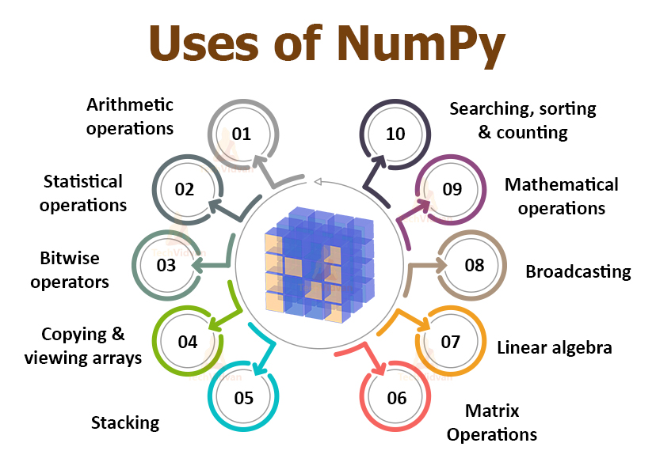
A library for the Python programming language
Support for large, multi-dimensional arrays and matrices,
A large collection of high-level mathematical functions to operate on arrays.

Slide 8
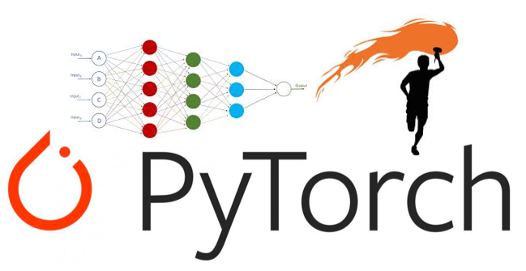
PyTorch
An open-source machine learning library based on the Torch library
Python interface
Used for applications such as computer vision and natural language processing
Primarily developed by Facebook's AI Research lab.
Free and open-source software released under the Modified BSD license

Slide 9
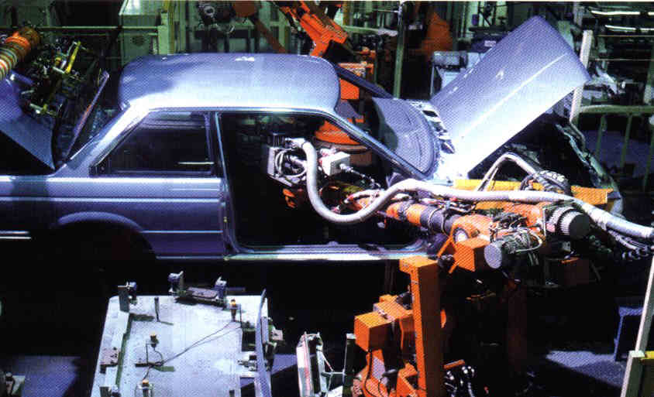
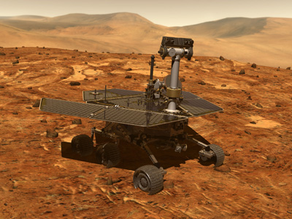
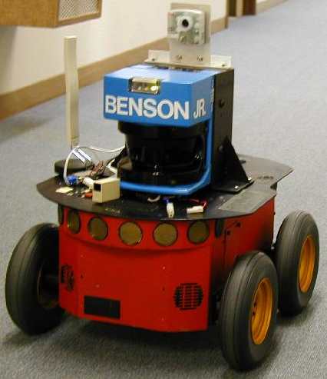
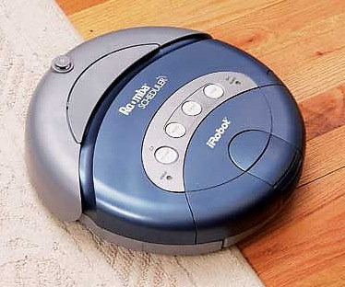
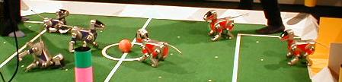
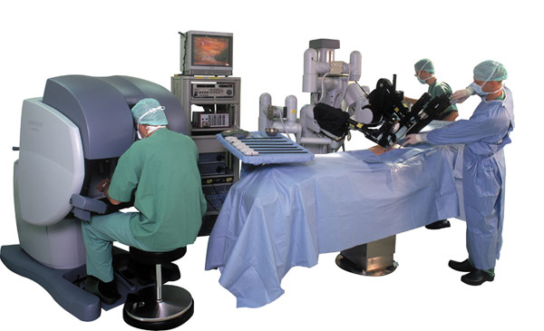

Robots
  toys, building cars,
  vacuums, surgery,
  search and rescue,
  elder care, exploration

Slide 10
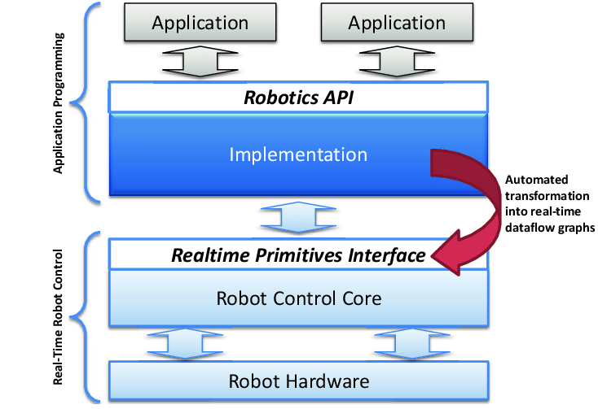
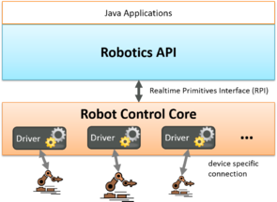
Robotics API
https://www.roboticsapi.org/

Slide 11
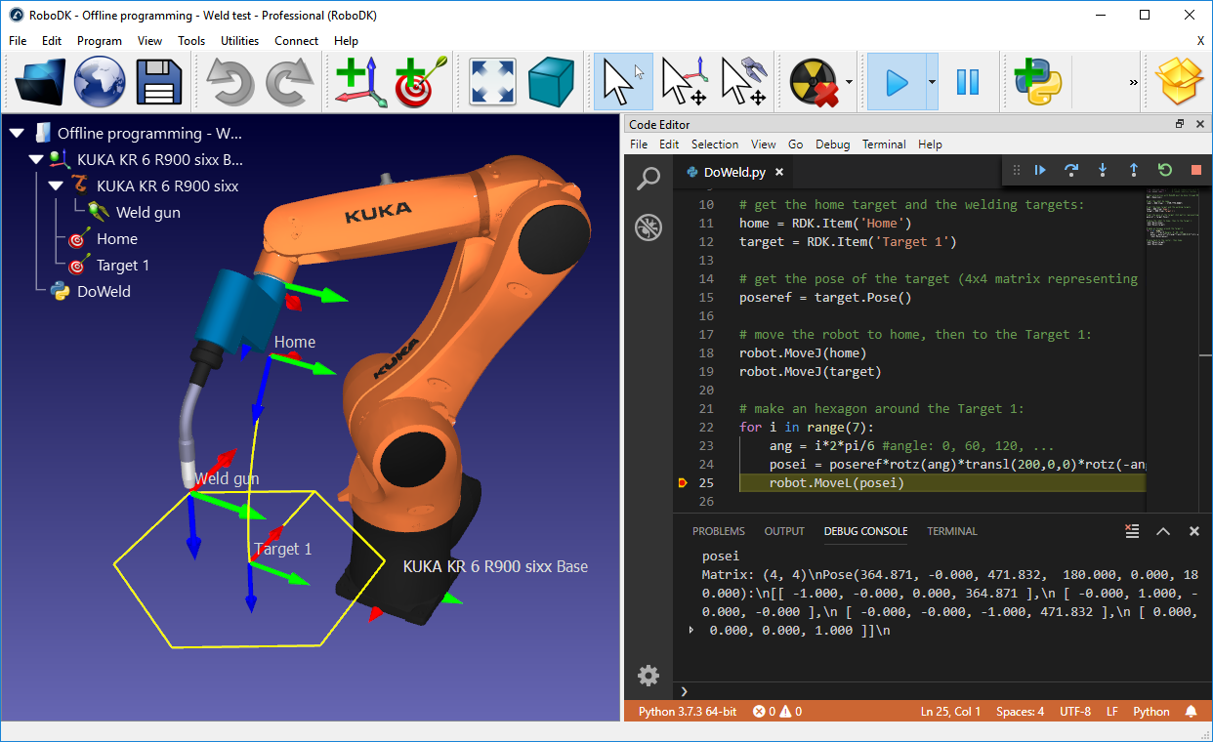
RoboDK
https://pypi.org/project/robodk/

Slide 12
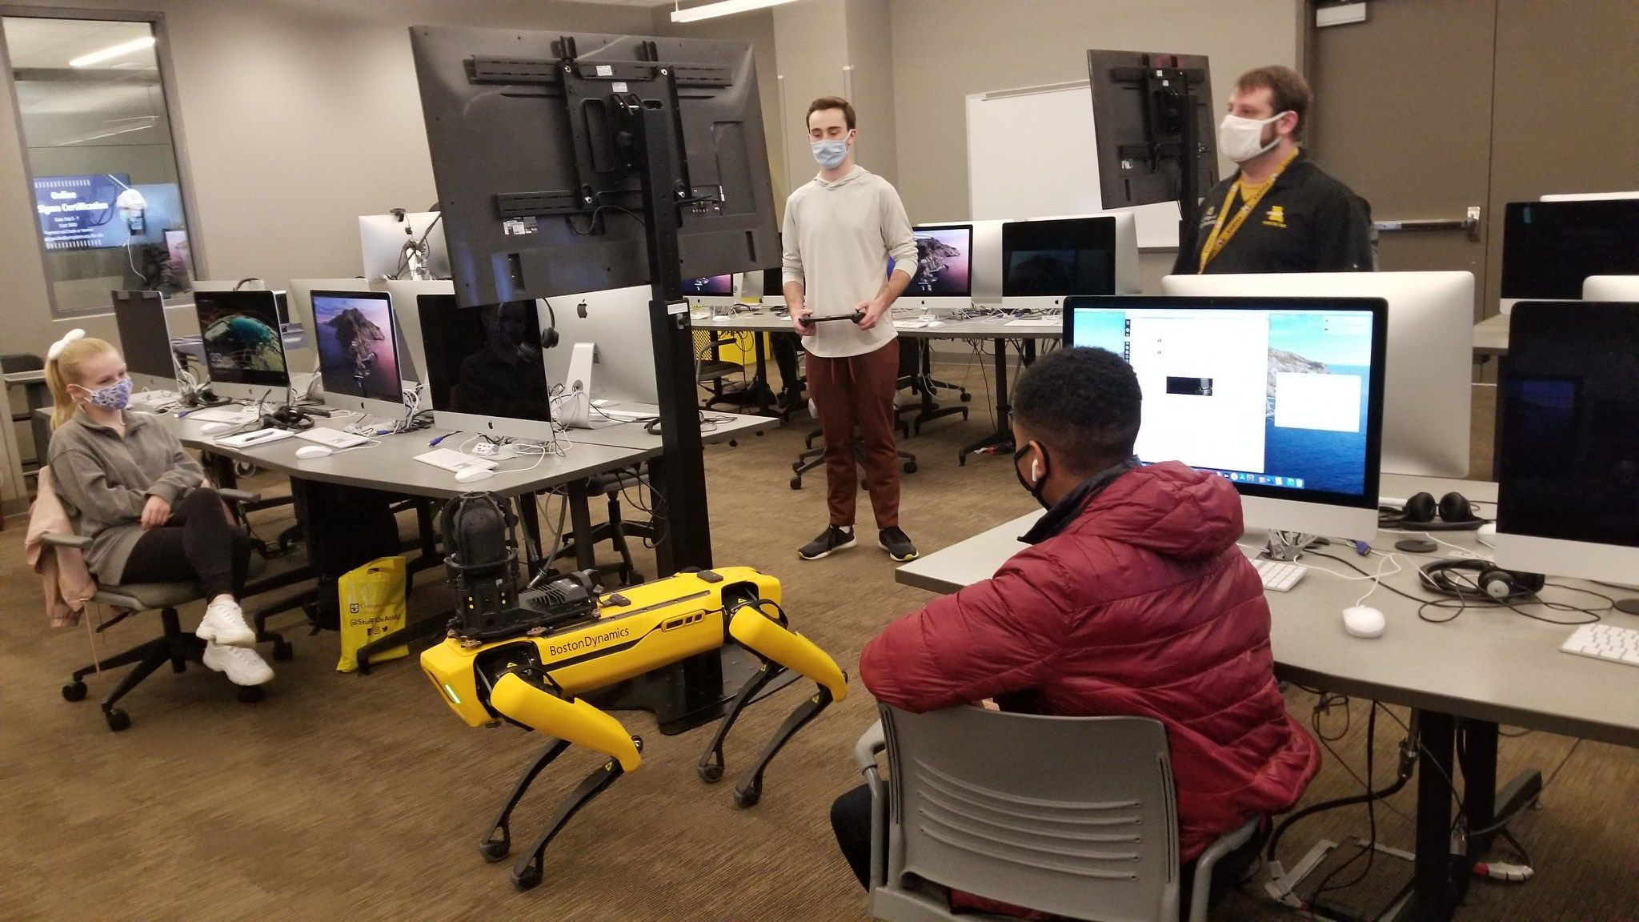
MU Development (Boston Dynamics)
https://www.linkedin.com/feed/hashtag/?keywords=mizzoumade

Slide 13
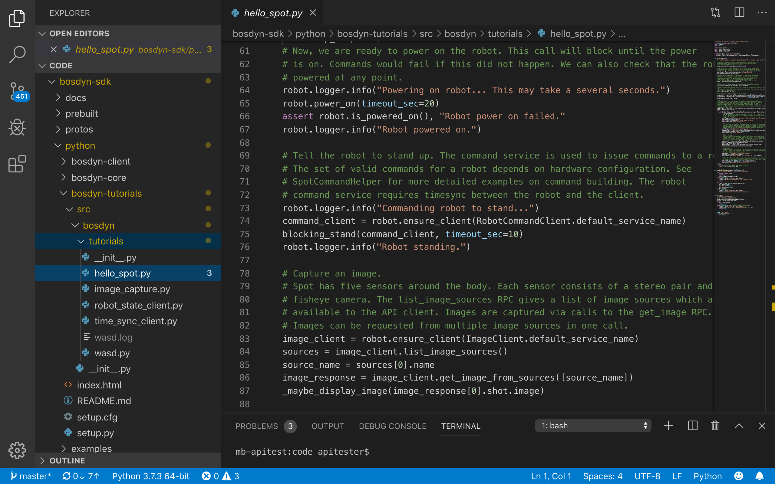
Boston Dynamics Open-Sources Spot SDK

Slide 14
Python Applications in Industry
Python as a powerful scripting language
  much better interactivity
    configuration
    rapid prototyping
Python as “Software Component Bus”
  interconnectivity with various kind of software components.
    histogramming with ROOT
    system integration
GRID
MPI
GUI
GUI
Python
shell
Geant4Py
PyROOT
math
...
Geat4
Classes
Root
Classes

Slide 15
Use-case of Pythonization
Execution Speed
large scale of mass production
a collection of short productions
with various running conditions
applications having interconnections with other software components
interactive analysis
free from compilation
rapid prototyping
- educational uses
Interactivity/Pythonization

Slide 16
Industrial Supervision and Scada Frameworks
Process visualization, data acquisition and supervisory control
Allow to control and monitor productive units around
Client/Sever distributed and open architecture
Real Time Information Portal
Collect “quality” data (both analogic and digital)
Alarms/Events management
Audit trails to maintain a tight control over their operation
Security and accountability

Slide 17
Summary
Easy to bring code to the data
Cross-platform
Apply Python across terabytes of data with minimal overhead or additional requirements
Many libraries and resources
A major language for scientific computing, data science
Robotics application
Industrial utilities

