Slide 1
Database Pogramming

Slide 2
DBMS Language
DDL
DML
DCL
SQL

Slide 3
Application development environment
PowerBuilder(SyBase)
JBuilder(Borland)
ADF(Oracle)

Slide 4
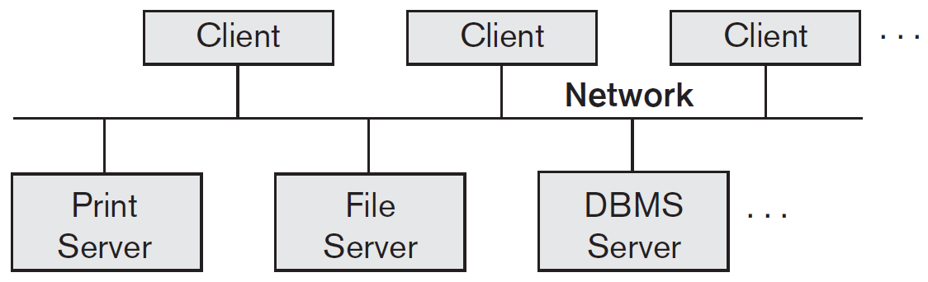
C/S architecture -logical

Slide 5
Two-tier C/S archi.
User interface & Application pro.
  API: ODBC,JDBC,CLI -reside on Client side.
SQL Svr(also called Query Svr / Tran. Svr)

Slide 6
Three-tier C/S archi.
User interface
(GUI/Web page)
Client
Presentation
App. svr
Web svr
App. pro.
Web script
Bissiness rules
DB svr
DBMS
Data Service

Slide 7
DB Access: languages
Java,C/C⁺⁺/C# + SQL
    Embedded, Host language
    PreComplier
Scripts: PHP,xSP,JavaScript + SQL
    Web-based
Special: PL/SQL(Oracle)

Slide 8
DB programming
Embedded
  E.g. embed SQL in C; SQLJ
  Impedance mismatch - CURSOR
API LIB: ODBC,JDBC,CLI
  A general-purpose program can connect to and communicate with a database server using a collection of functions (for procedural languages) or methods (for object-oriented languages). Dynamic SQL allows the program to construct an SQL query as a character string at runtime, submit the query, and then retrieve the result into program variables a tuple at a time. The dynamic SQL component of SQL allows programs to construct and submit SQL queries at runtime.
Special: PL/SQL(Oracle)

Slide 9
Typical interaction
1. Connect(SvrURL/User/pwd)
    Only one connection
    Two or more connection
2. Interact with DB(SQL)
3. Disconnect

