Slide 1
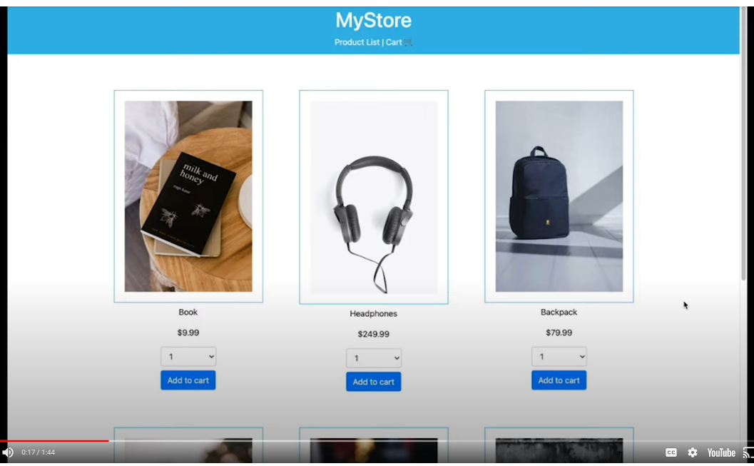
Navigate to Product List or Cart
Component „NavBar“
Component „ProductItem“
→ On click open Product Page
Button
→ On click add prod to cart and increase number of products by 1
Component „Products“
Number of products field → Dropdown allows to select number
API delivers list of products with product name, product description, price, URL to picture

Slide 2
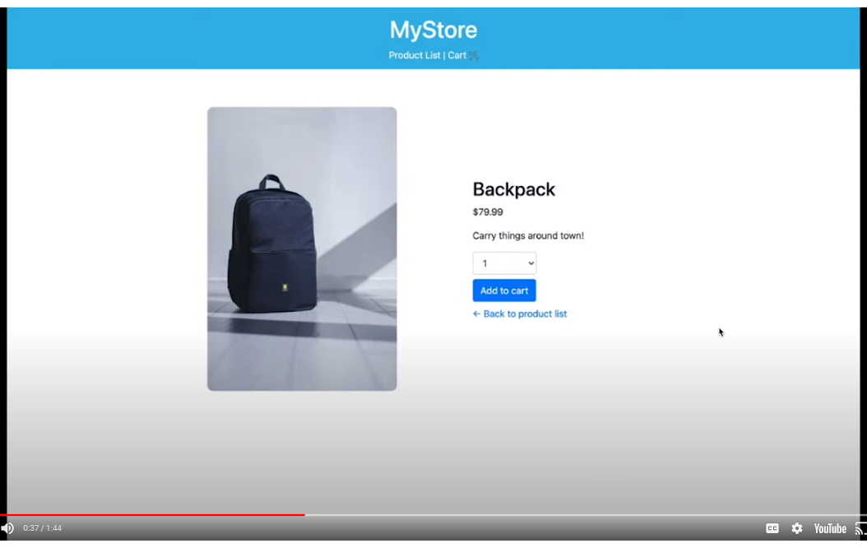
Component „NavBar“
Component „ProductDetails“
Button
→ On click add prod to cart and increase number of products by 1
Number of products field → Dropdown allows to select number
Open main page

Slide 3
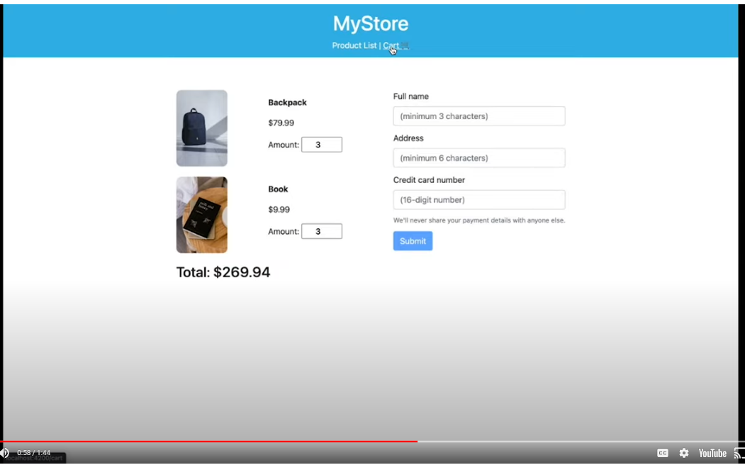
Component „CartItem“
Component „Cart“
Component „NavBar“
Component „Address“
Total Price Field

Slide 4
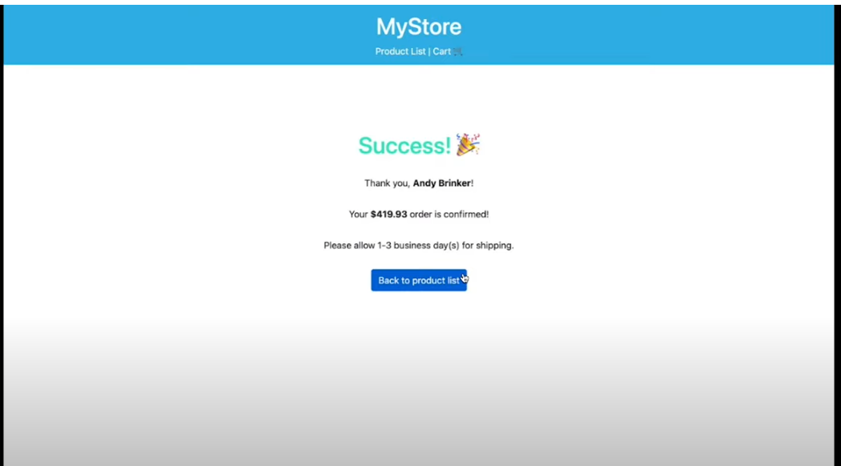
NavBar
Order Confirmation Component

