Slide 1
simple speech recognition

Slide 2
OUTLINE
PROBLEM
SOLUTION
DEMO

Slide 3
PROBLEM

Slide 4
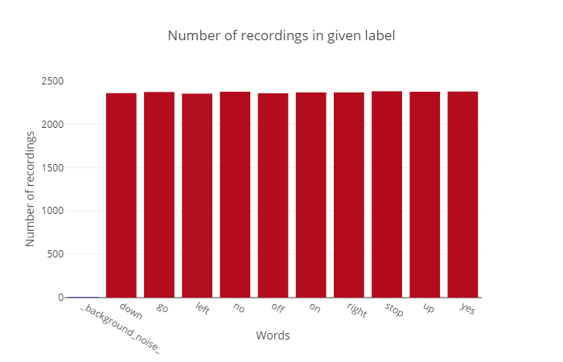

Slide 5
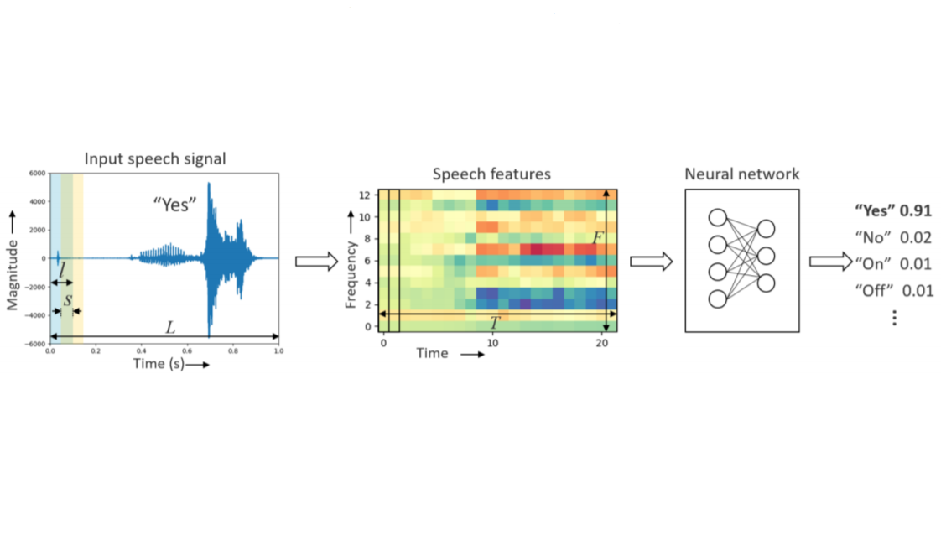
PIPELINE

Slide 6
SOLUTION

Slide 7
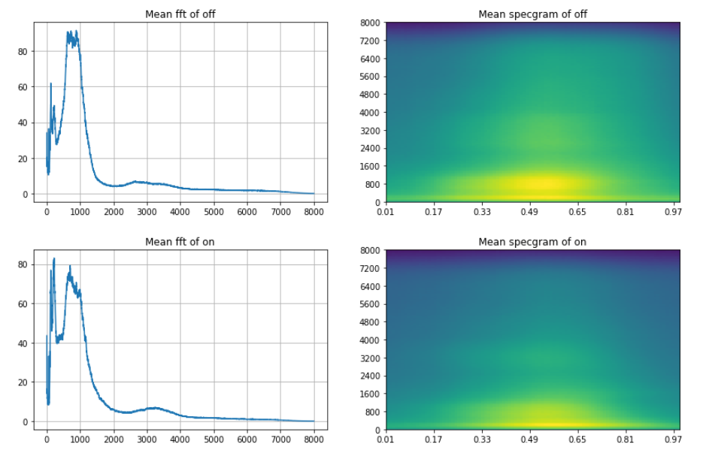

Slide 8
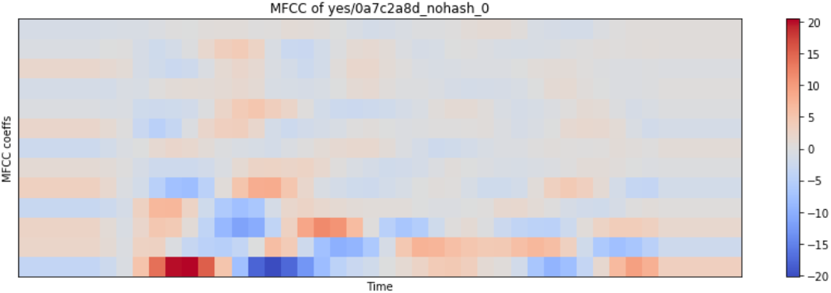
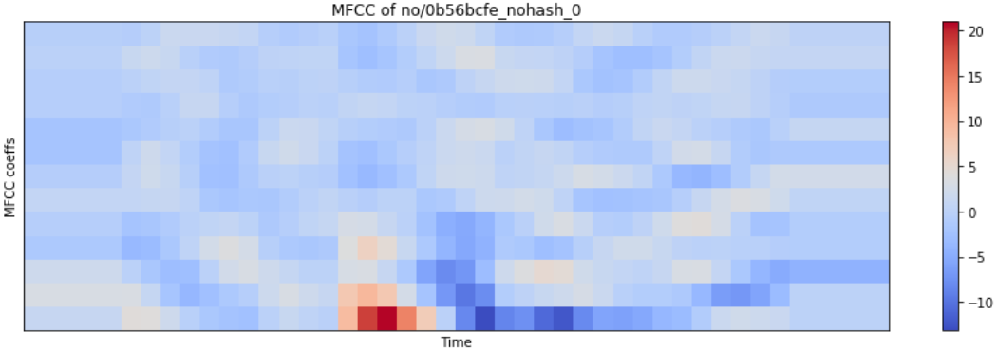

Slide 9
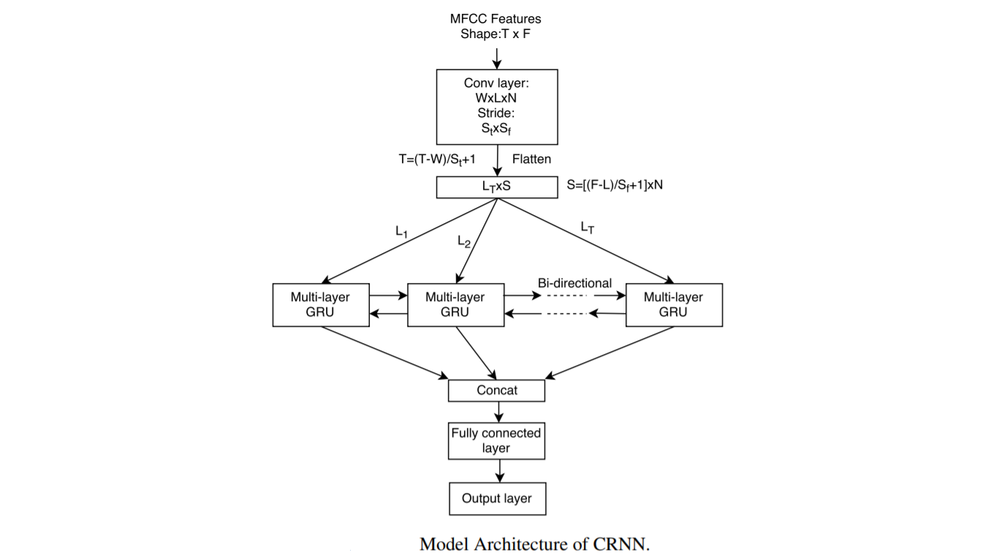

Slide 10
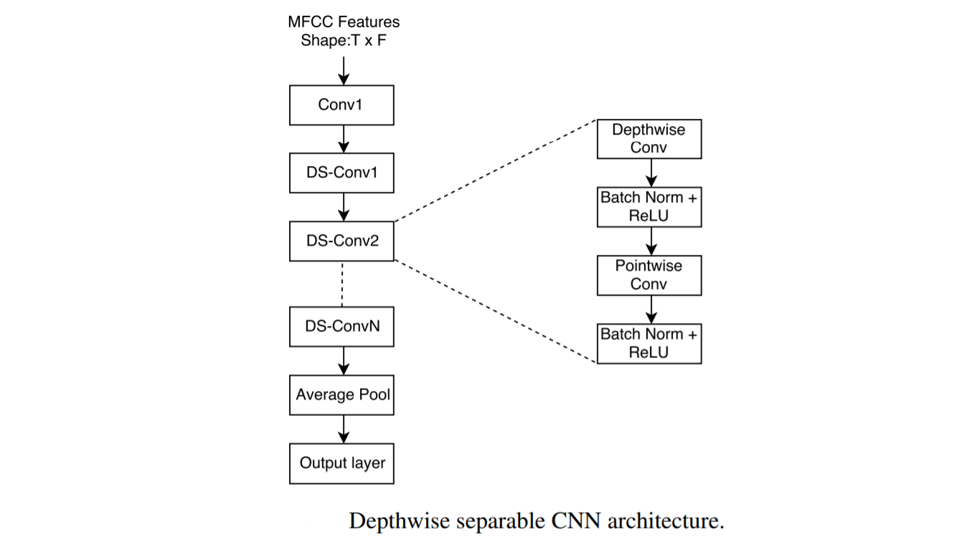

Slide 11
DEMO

Slide 12
thanks!

