Slide 1


Services > Room Booking
View our rooms

Slide 2
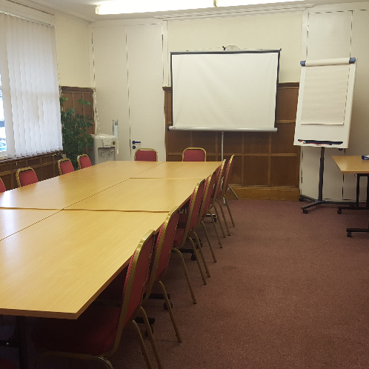

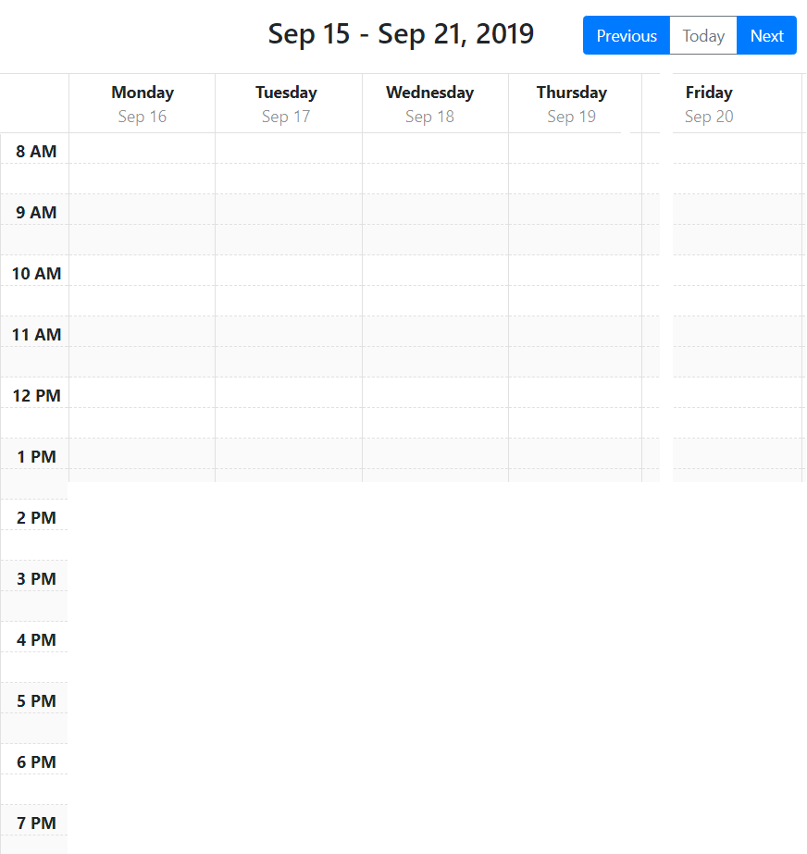
Services > Room Booking > Rooms
My Bookings
Services > Room Booking > Rooms
Conference Room
> My Bookings
The space:
This is a typical Victorian style, newly built house close to Ashford International Station, set over 3 floors. The top floor is available for use, with 2 double bedrooms and a small private shower room, all fully furnished.
Capacity: 20
Available extras:
Data Projector & Screen
Flip Chart Paper & Pens
Projector Screen Only
Refreshments HALF Day
Refreshments FULL Day
Buffet Lunch
Urn & Cups Only FULL Day
Urn & Cups Only HALF Day
Urn Only HALF Day
Urn Only FULL Day
Wifi - Free
Chilled Water - Free
Parking - Course Leader Only
Rate:
from
only £9 / hour
Availability:

Slide 3
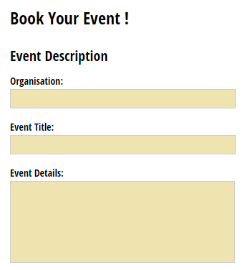
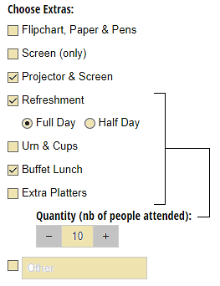
Services > Room Booking > Rooms
My Bookings
Services > Room Booking > Rooms
Conference Room
> My Bookings
Wednesday, Sep 17 2019
From: 2:00 PM to 6:30 PM
The space:
This is a typical Victorian style, newly built house close to Ashford International Station, set over 3 floors. The top floor is available for use, with 2 double bedrooms and a small private shower room, all fully furnished.
Capacity: 20
Available extras:
Data Projector & Screen
Flip Chart Paper & Pens
Projector Screen Only
Refreshments HALF Day
Refreshments FULL Day
Buffet Lunch
Urn & Cups Only FULL Day
Urn & Cups Only HALF Day
Urn Only HALF Day
Urn Only FULL Day
Wifi - Free
Chilled Water - Free
Parking - Course Leader Only
Date and Time:
Rate:
from
only £9 / hour
Availability:

Slide 4
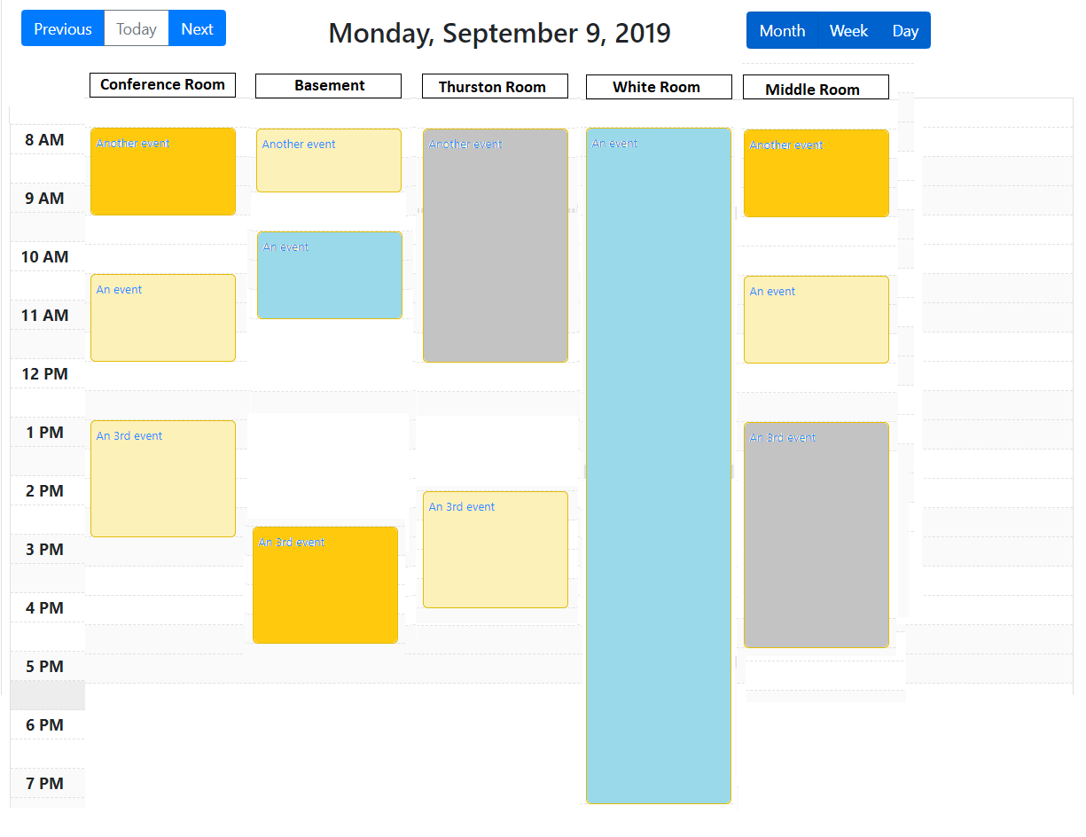
Services > Room Booking > Bookings Overview
My Bookings
Services > Room Booking > Rooms
Bookings Overview
> Booking Overview

