Slide 1
2. Multi-armed Bandits

Slide 2
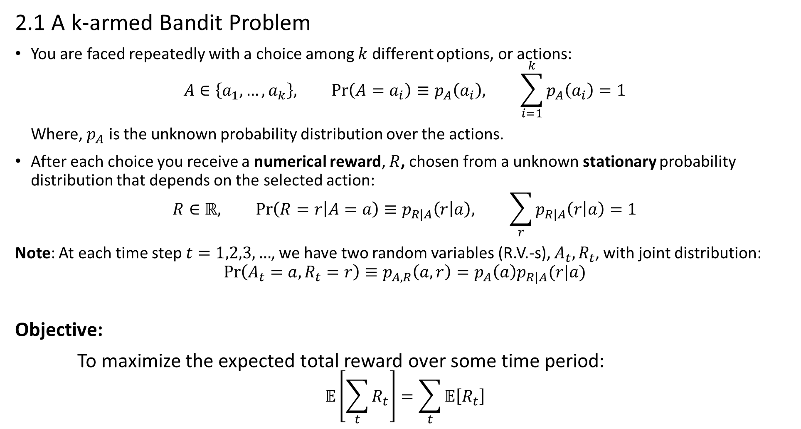
2.1 A k-armed Bandit Problem
You are faced repeatedly with a choice among $k$ different options, or actions:
$$A∈\left\{a_{1},…, a_{k}\right\}, Pr\left(A=a_{i}\right)≡p_{A}\left(a_{i}\right), \sum_{i=1}^{k}{p_{A}\left(a_{i}\right)}=1$$
Where, $p_{A}$ is the unknown probability distribution over the actions.
After each choice you receive a numerical reward, $R$, chosen from a unknown stationary probability distribution that depends on the selected action:
$$R∈ℝ, Pr\left(R=r | A=a\right)≡p_{R|A}\left(r | a\right), \sum_{r}{p_{R|A}\left(r | a\right)}=1$$
Note: At each time step $t=1,2,3,…$, we have two random variables (R.V.-s), $A_{t}, R_{t}$, with joint distribution:
$$Pr\left(A_{t}=a, R_{t}=r\right)≡p_{A,R}\left(a,r\right)=p_{A}\left(a\right)p_{R|A}(r|a)$$
Objective:
To maximize the expected total reward over some time period:
$$𝔼\left[\sum_{t}{R_{t}}\right]=\sum_{t}{𝔼\left[R_{t}\right]}$$

Slide 3
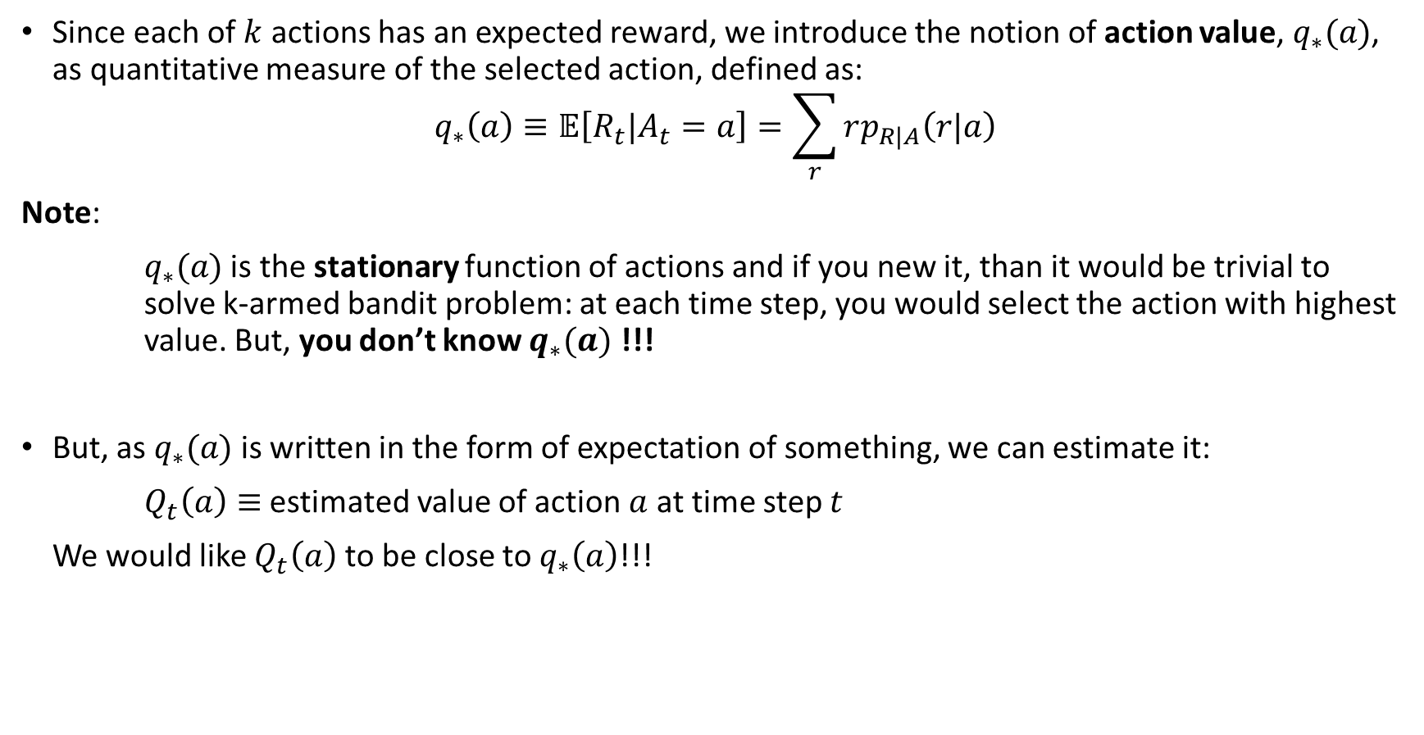
Since each of $k$ actions has an expected reward, we introduce the notion of action value, $q_{∗}(a)$, as quantitative measure of the selected action, defined as:
$$q_{∗}\left(a\right)≡𝔼\left[R_{t}|A_{t}=a\right]=\sum_{r}{rp_{R|A}\left(r|a\right)}$$
Note:
$q_{∗}(a)$ is the stationary function of actions and if you new it, than it would be trivial to solve k-armed bandit problem: at each time step, you would select the action with highest value. But, you don’t know $q_{∗}(a)$ !!!
But, as $q_{∗}(a)$ is written in the form of expectation of something, we can estimate it:
$Q_{t}\left(a\right)≡$ estimated value of action $a$ at time step $t$
We would like $Q_{t}\left(a\right)$ to be close to $q_{∗}\left(a\right)$!!!

Slide 4
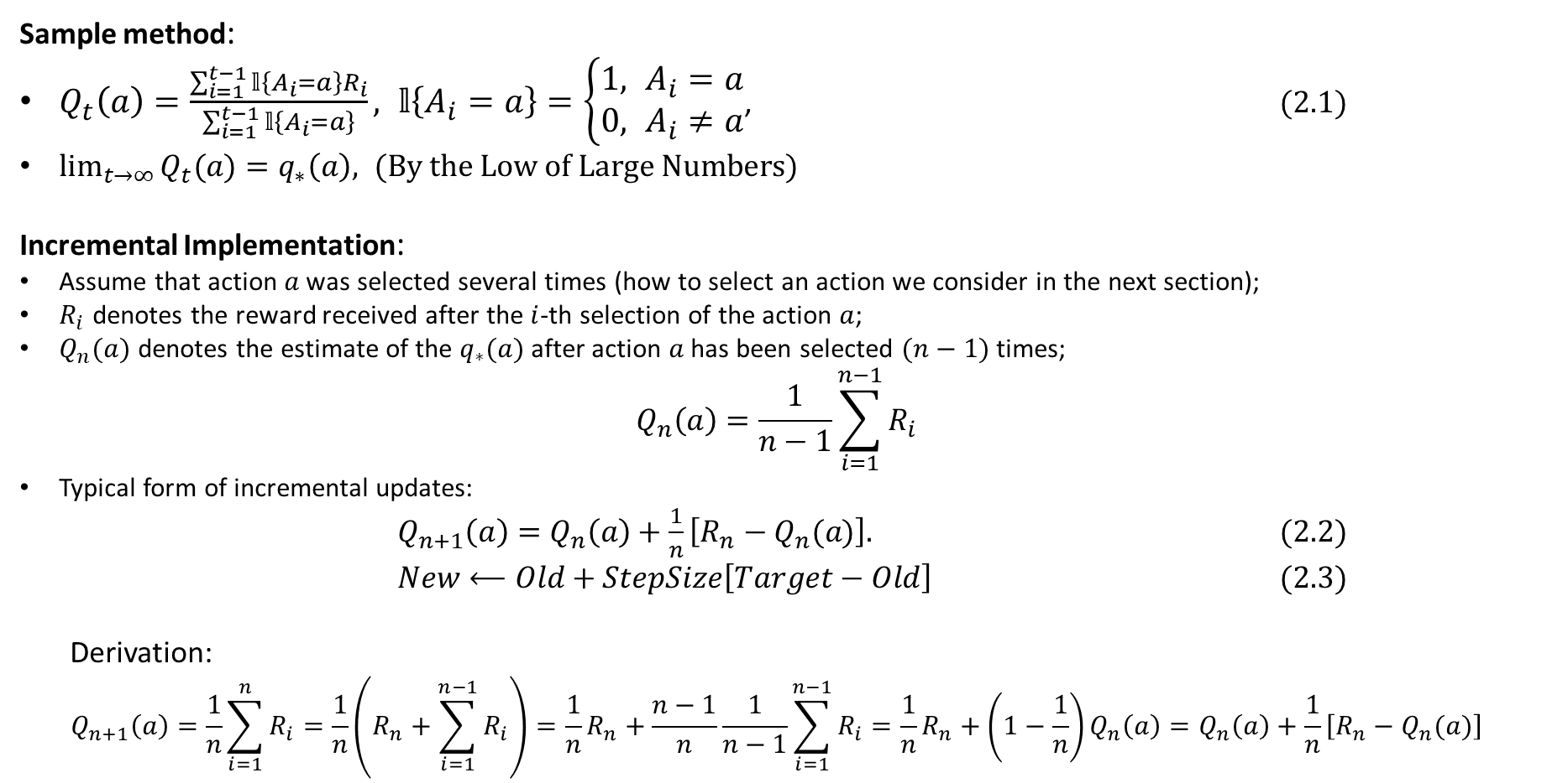
2.2 Stochastic Approximations of Action-value function for a given action
Sample method:
$Q_{t}\left(a\right)=\frac{\sum_{i=1}^{t−1}{𝕝\left\{A_{i}=a\right\}R_{i}}}{\sum_{i=1}^{t−1}{𝕝\left\{A_{i}=a\right\}}}, 𝕝\left\{A_{i}=a\right\}=\left\{\begin{matrix}1, A_{i}=a \\ 0, A_{i}≠a\end{matrix}\right.$, $(2.1)$
$\lim_{t→∞}{Q_{t}(a)}=q_{∗}\left(a\right), (By the Low of Large Numbers)$
Incremental Implementation:
Assume that action $a$ was selected several times (how to select an action we consider in the next section);
$R_{i}$ denotes the reward received after the $i$-th selection of the action $a$;
$Q_{n}(a)$ denotes the estimate of the $q_{∗}(a)$ after action $a$ has been selected $(n−1)$times;
$$Q_{n}\left(a\right)=\frac{1}{n−1}\sum_{i=1}^{n−1}{R_{i}}$$
Typical form of incremental updates:
$Q_{n+1}\left(a\right)=Q_{n}\left(a\right)+\frac{1}{n}\left[R_{n}−Q_{n}(a)\right].$ (2.2)
$New⟵Old+StepSize\left[Target−Old\right]$ $(2.3)$
Derivation:
$$Q_{n+1}\left(a\right)=\frac{1}{n}\sum_{i=1}^{n}{R_{i}}=\frac{1}{n}\left(R_{n}+\sum_{i=1}^{n−1}{R_{i}}\right)=\frac{1}{n}R_{n}+\frac{n−1}{n}\frac{1}{n−1}\sum_{i=1}^{n−1}{R_{i}}=\frac{1}{n}R_{n}+\left(1−\frac{1}{n}\right)Q_{n}\left(a\right)=Q_{n}\left(a\right)+\frac{1}{n}\left[R_{n}−Q_{n}(a)\right]$$

Slide 5
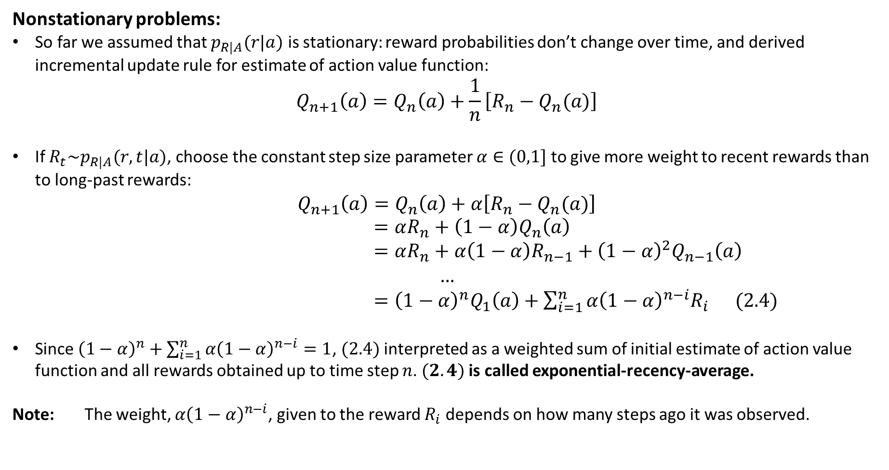
Nonstationary problems:
So far we assumed that $p_{R|A}(r|a)$ is stationary: reward probabilities don’t change over time, and derived incremental update rule for estimate of action value function:
$$Q_{n+1}\left(a\right)=Q_{n}\left(a\right)+\frac{1}{n}\left[R_{n}−Q_{n}(a)\right]$$
If $R_{t}\sim p_{R|A}(r,t|a)$, choose the constant step size parameter $α∈(0,1]$ to give more weight to recent rewards than to long-past rewards:
$$Q_{n+1}\left(a\right)=Q_{n}\left(a\right)+α\left[R_{n}−Q_{n}(a)\right]$$
$=αR_{n}+\left(1−α\right)Q_{n}\left(a\right)$
$=αR_{n}+α\left(1−α\right)R_{n−1}+{\left(1−α\right)}^{2}Q_{n−1}\left(a\right)$
$$…$$
$={\left(1−α\right)}^{n}Q_{1}\left(a\right)+\sum_{i=1}^{n}{α{\left(1−α\right)}^{n−i}R_{i}}$ $(2.4)$
Since ${\left(1−α\right)}^{n}+\sum_{i=1}^{n}{α{\left(1−α\right)}^{n−i}}=1$, $(2.4)$interpreted as a weighted sum of initial estimate of action value function and all rewards obtained up to time step $n$. $(2.4)$is called exponential-recency-average.
Note: The weight, $α{\left(1−α\right)}^{n−i}$, given to the reward $R_{i}$ depends on how many steps ago it was observed.

Slide 6


2.3 Action Selection Rules
Greedy action selection:
Always select action with highest estimated action value
$A_{t}=\underset{a}{argmax}{Q_{t}(a)}$. $(2.5)$
Pseudocode:
Initialize:
$Q_{1}\left(a\right)=0, N\left(a\right)=0, ∀a∈\{a_{1}, …, a_{k}\}$
Loop for $t=1,2,3,…$
$A_{t}=\underset{a}{argmax}{Q_{t}(a)}$
$N\left(A_{t}\right)=N\left(A_{t}\right)+1$
$R_{t}=bandit(A_{t})$
$Q_{t+1}\left(A_{t}\right)=Q_{t}\left(A_{t}\right)+\frac{1}{N(A_{t})}\left[R_{t}−Q_{t}(A_{t})\right]$

Slide 7


$ε$-Greedy action selection:
Behave greedily most of the time, but every once in a time, say with small probability $ε$, instead select randomly among all the actions with equal probability, independently of action value estimate
$A_{t}=\left\{\begin{matrix}\underset{a}{argmax}{Q_{t}(a)}, with probability (1−ε) \\ random action, with probability ε\end{matrix}\right.$ $(2.6)$
Pseudocode
Initialize:
$Q_{1}\left(a\right)=0, N\left(a\right)=0, ∀a∈\{a_{1}, …, a_{k}\}$
Loop for $t=1,2,3,…$
$A_{t}=\left\{\begin{matrix}\underset{a}{argmax}{Q_{t}(a)}, with probability (1−ε) \\ random action, with probability ε\end{matrix}\right.$
$N\left(A_{t}\right)=N\left(A_{t}\right)+1$
$R_{t}=bandit(A_{t})$
$Q_{t+1}\left(A_{t}\right)=Q_{t}\left(A_{t}\right)+\frac{1}{N(A_{t})}\left[R_{t}−Q_{t}(A_{t})\right]$

Slide 8
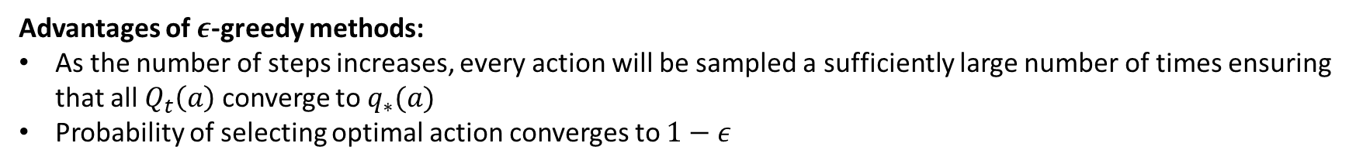
Note:
The function $bandit(A_{t})$ is assumed to take an action and return a corresponding reward
Downsides of greedy method:
Always exploits current knowledge to maximize immediate reward
Spends no time at all in sampling other actions to see if they might be really better.
Advantages of $ε$-greedy methods:
As the number of steps increases, every action will be sampled a sufficiently large number of times ensuring that all $Q_{t}\left(a\right)$ converge to $q_{∗}(a)$
Probability of selecting optimal action converges to $1−ε$

Slide 9
Gradient bandit algorithm:

Slide 10
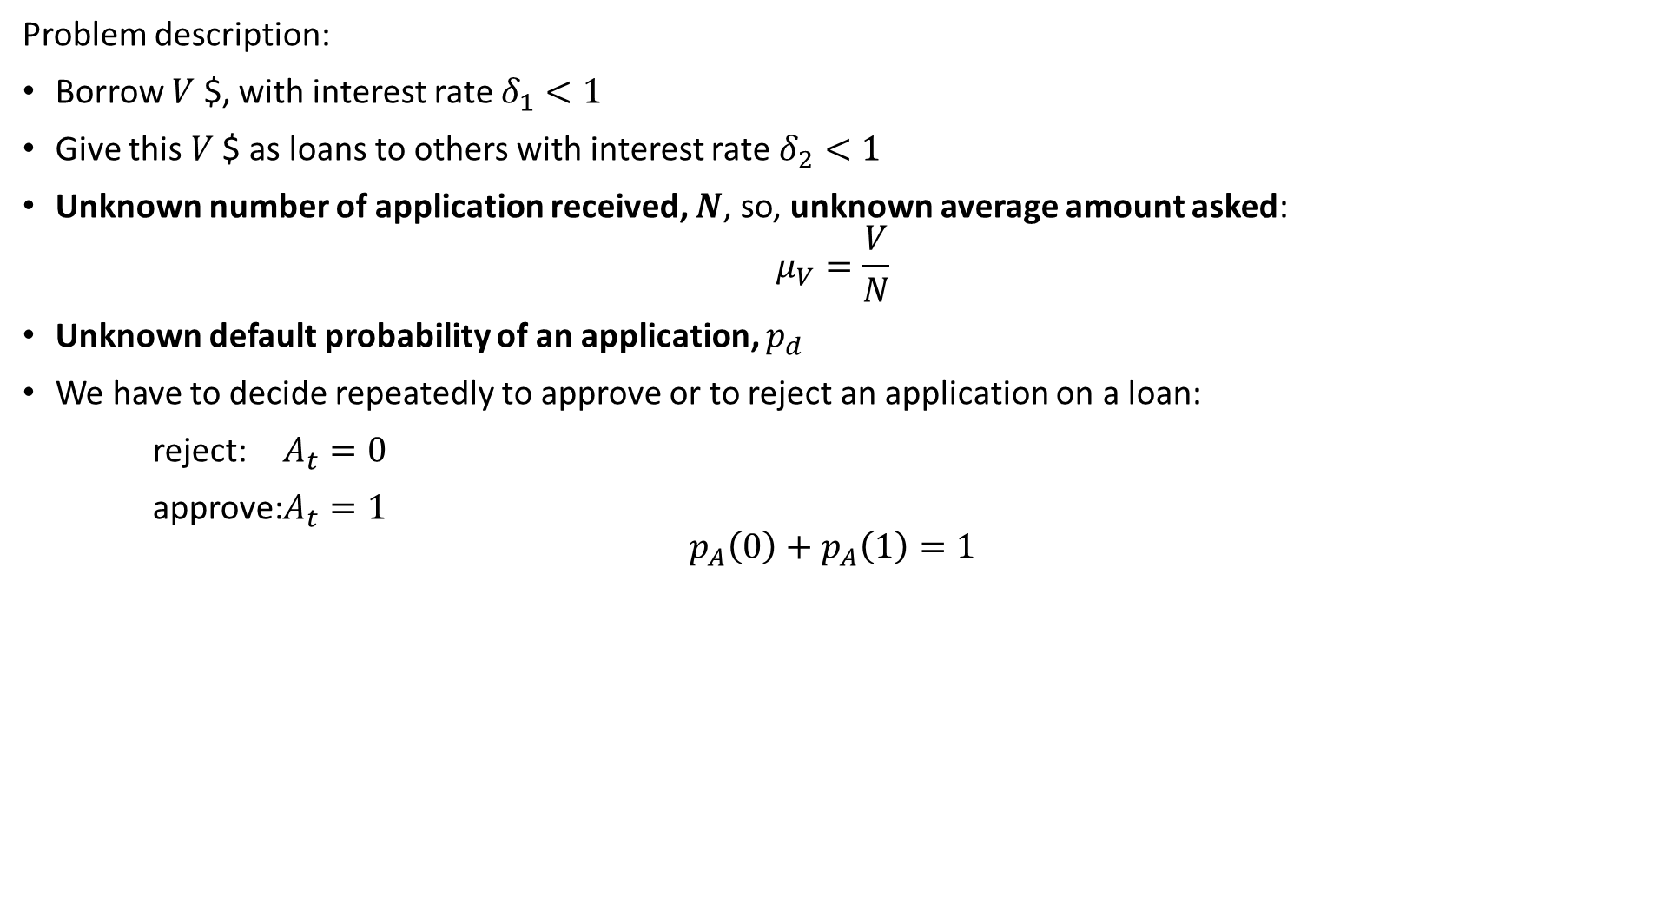
Problem description:
Borrow $V$ $, with interest rate $δ_{1}<1$
Give this $V$ $ as loans to others with interest rate $δ_{2}<1$
Unknown number of application received, $N$, so, unknown average amount asked:
$$μ_{V}=\frac{V}{N}$$
Unknown default probability of an application, $p_{d}$
We have to decide repeatedly to approve or to reject an application on a loan:
reject: $A_{t}=0$
approve: $A_{t}=1$
$$p_{A}\left(0\right)+p_{A}\left(1\right)=1$$

Slide 11
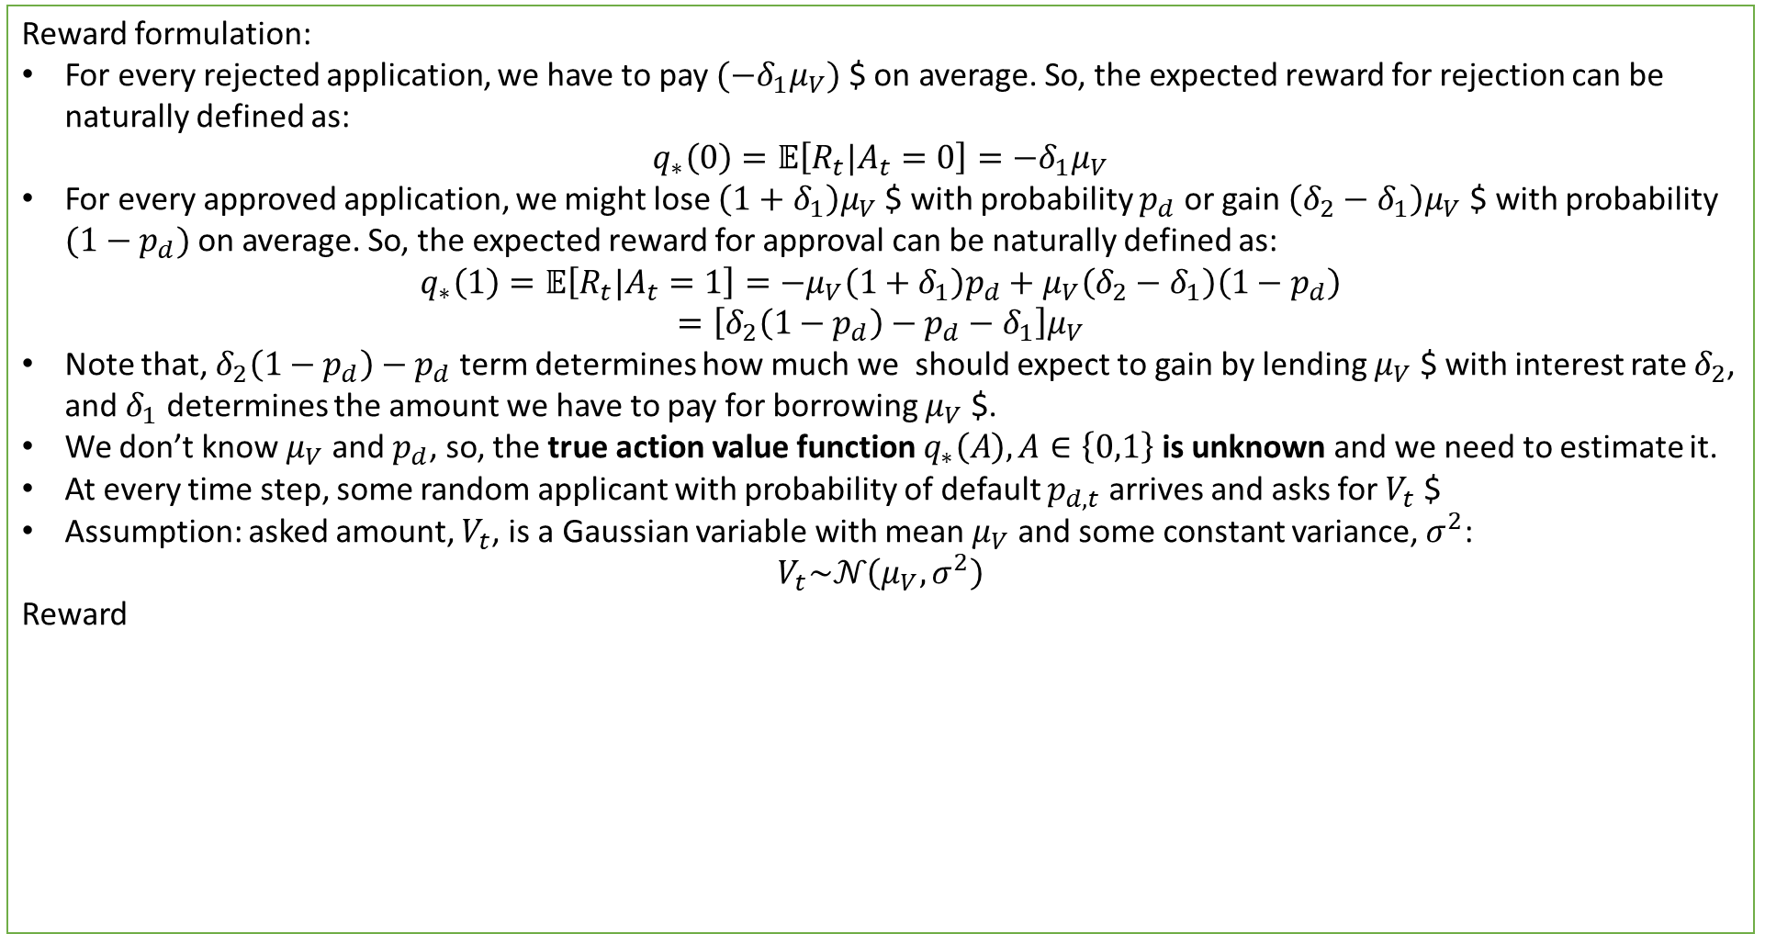
Reward formulation:
For every rejected application, we have to pay $(−δ_{1}μ_{V})$ $ on average. So, the expected reward for rejection can be naturally defined as:
$$q_{∗}\left(0\right)=𝔼\left[R_{t}|A_{t}=0\right]=−δ_{1}μ_{V}$$
For every approved application, we might lose $\left(1+δ_{1}\right)μ_{V}$ $ with probability $p_{d}$ or gain $\left(δ_{2}−δ_{1}\right)μ_{V}$ $ with probability $(1−p_{d})$ on average. So, the expected reward for approval can be naturally defined as:
$$q_{∗}\left(1\right)=𝔼\left[R_{t}|A_{t}=1\right]=−μ_{V}\left(1+δ_{1}\right)p_{d}+μ_{V}\left(δ_{2}−δ_{1}\right)\left(1−p_{d}\right)$$
$$=\left[δ_{2}\left(1−p_{d}\right)−p_{d}−δ_{1}\right]μ_{V}$$
Note that, $δ_{2}\left(1−p_{d}\right)−p_{d}$ term determines how much we should expect to gain by lending $μ_{V}$ $ with interest rate $δ_{2}$, and $δ_{1}$ determines the amount we have to pay for borrowing $μ_{V}$ $.
We don’t know $μ_{V}$ and $p_{d}$, so, the true action value function $q_{∗}\left(A\right), A∈\left\{0,1\right\}$ is unknown and we need to estimate it.
At every time step, some random applicant with probability of default $p_{d,t}$ arrives and asks for $V_{t}$ $
Assumption: asked amount, $V_{t}$, is a Gaussian variable with mean $μ_{V}$ and some constant variance, $σ^{2}$:
$$V_{t}\sim 𝒩\left(μ_{V}, σ^{2}\right)$$
Reward

Slide 12
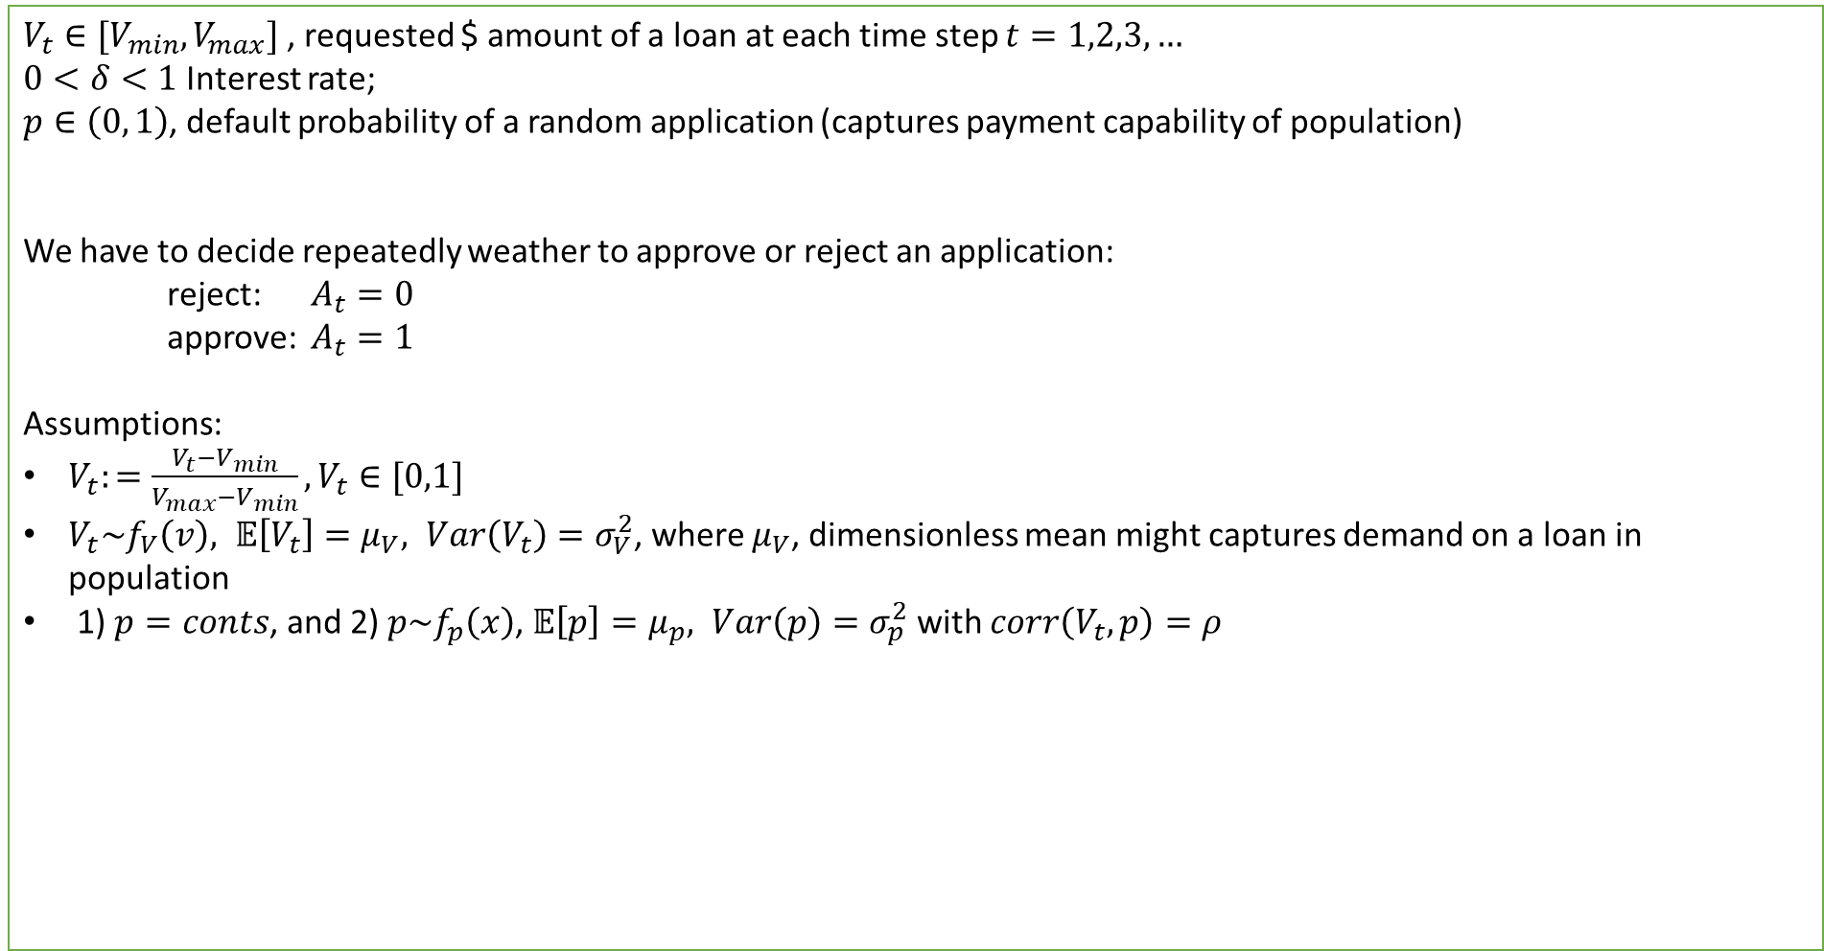
$V_{t}∈[V_{min}, V_{max}]$, requested $ amount of a loan at each time step $t=1,2,3,…$
$0<δ<1$ Interest rate;
$p∈\left(0, 1\right)$, default probability of a random application (captures payment capability of population)
We have to decide repeatedly weather to approve or reject an application:
reject: $A_{t}=0$
approve: $A_{t}=1$
Assumptions:
$V_{t}:=\frac{V_{t}−V_{min}}{V_{max}−V_{min}}, V_{t}∈[0,1]$
$V_{t}\sim f_{V}\left(v\right), 𝔼\left[V_{t}\right]=μ_{V}, Var\left(V_{t}\right)=σ_{V}^{2}$, where $μ_{V}$, dimensionless mean might captures demand on a loan in population
1) $p=conts$, and 2) $p\sim f_{p}\left(x\right)$, $𝔼\left[p\right]=μ_{p}, Var\left(p\right)=σ_{p}^{2}$ with $corr\left(V_{t}, p\right)=ρ$

Slide 13


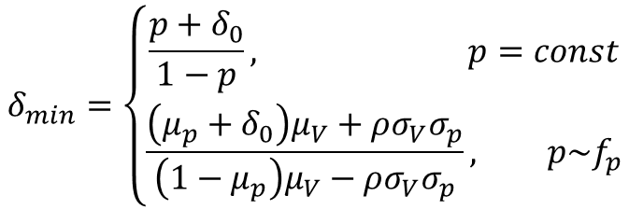
Reward definition
For every rejected application, we have to pay $(−δ_{0}V_{t})$, where $0<δ_{0}<1$ is the interest rate we have to pay to our depositors. So, the reward and action value for rejection can be naturally defined as:
$$R_{t}=−δ_{0}V_{t}$$
$$q_{∗}\left(0\right)=𝔼\left[R_{t}|A_{t}=0\right]=−δ_{0}μ_{V}$$
For every approved application, we might lose $\left(1+δ_{0}\right)V_{t}$ with probability $p$, or gain $\left(δ−δ_{0}\right)V_{t}$ with probability $(1−p)$. So, the reward and action value for approval can be naturally defined as:
$$R_{t}=−\left(1+δ_{0}\right)pV_{t}+\left(δ−δ_{0}\right)\left(1−p\right)V_{t}$$
$$q_{∗}\left(1\right)=𝔼\left[R_{t}|A_{t}=1\right]=\left\{\begin{aligned}δ\left(1−p\right)μ_{V}−\left(δ_{0}+p\right)μ_{V}, p=const \\ δ\left[\left(1−μ_{p}\right)μ_{V}−ρσ_{V}σ_{p}\right]−\left(δ_{0}+μ_{p}\right)μ_{V}−ρσ_{V}σ_{p}, p\sim f_{p}\end{aligned}\right.$$
Note: Minimum interest rate, $δ_{min}$, can be determined from the condition $q_{∗}(1)≥0$:
$$δ_{min}=\left\{\begin{aligned}\frac{p+δ_{0}}{1−p}, p=const \\ \frac{\left(μ_{p}+δ_{0}\right)μ_{V}+ρσ_{V}σ_{p}}{\left(1−μ_{p}\right)μ_{V}−ρσ_{V}σ_{p}}, p\sim f_{p}\end{aligned}\right.$$

Slide 14



Risk Adjusted Action values:
$V_{t}\sim F, 𝔼\left[V_{t}\right]=μ_{V}, Var\left(V_{t}\right)=σ_{V}^{2}$
1) $p=conts$, and 2) $p\sim f_{p}\left(x\right)$, $𝔼\left[p\right]=μ_{p}, Var\left(p\right)=σ_{p}^{2}$ with $corr\left(V_{t}, p\right)=ρ$
$q_{∗}\left(0\right)=𝔼\left[R_{t}|A_{t}=0\right]=−δ_{2}μ_{V}$
$q_{∗}\left(1\right)=𝔼\left[R_{t}|A_{t}=1\right]−λVar\left(R_{t} | A_{t}=1\right)$, $λ$ is called risk aversion parameter
For $p=const$:
$$Var\left(R_{t} | A_{t}=1\right)=Var\left(\left[δ\left(1−p\right)−δ_{0}−p\right]V_{t}\right)={\left[δ\left(1−p\right)−δ_{0}−p\right]}^{2}σ_{V}^{2}$$
For $p\sim f_{p}$:
$$Var\left(R_{t} | A_{t}=1\right) =Var\left({\left(δ−δ_{0}\right)V}_{t}−\left(1+δ\right)pV_{t}\right)$$
$$={\left(δ−δ_{0}\right)}^{2}Var\left(V_{t}\right)+{\left(1+δ\right)}^{2}Var\left(pV_{t}\right)−2\left(δ−δ_{0}\right)\left(1+δ\right)Cov\left(pV_{t}, V_{t}\right)$$
$$={{\left(δ−δ_{0}\right)}^{2}σ}_{V}^{2}+{\left(1+δ\right)}^{2}\left\{𝔼\left[p^{2}V_{t}^{2}\right]−𝔼{\left[pV_{t}\right]}^{2}\right\}−2\left(δ−δ_{0}\right)\left(1+δ\right)\left\{𝔼\left[pV_{t}^{2}\right]−μ_{V}𝔼\left[pV_{t}\right]\right\}$$

Slide 15


Risk Adjusted Action values:
$$𝔼\left[f(X,Y)\right]≈f\left(μ_{X},μ_{Y}\right)+\frac{1}{2}\frac{∂^{2}f\left(μ_{X}, μ_{Y}\right)}{∂X^{2}}Var\left(X\right)+\frac{1}{2}\frac{∂^{2}f\left(μ_{X}, μ_{Y}\right)}{∂Y^{2}}Var\left(Y\right)+\frac{∂^{2}f\left(μ_{X}, μ_{Y}\right)}{∂X∂Y}Cov\left(X,Y\right)$$
$$𝔼\left[p^{2}V_{t}^{2}\right]≈μ_{p}^{2}μ_{V}^{2}+μ_{V}^{2}σ_{P}^{2}+μ_{p}^{2}σ_{V}^{2}+4μ_{p}μ_{V}ρσ_{p}σ_{V}$$
$$𝔼\left[pV_{t}^{2}\right]≈μ_{P}μ_{V}^{2}+μ_{p}σ_{V}^{2}+2μ_{V}ρσ_{p}σ_{V}$$
$$𝔼\left[pV_{t}\right]=ρσ_{V}σ_{p}+μ_{V}μ_{p}$$
$$Var\left(pV_{t}\right)=𝔼\left[p^{2}V_{t}^{2}\right]−𝔼{\left[pV_{t}\right]}^{2}=\left(μ_{p}^{2}−ρ^{2}σ_{p}^{2}\right)σ_{V}^{2}+2μ_{V}μ_{p}ρσ_{p}σ_{V}+μ_{V}^{2}σ_{p}^{2}$$
$$Cov\left(pV_{t}, V_{t}\right)=𝔼\left[pV_{t}^{2}\right]−𝔼\left[pV_{t}\right]𝔼\left[V_{t}\right]=μ_{V}ρσ_{V}σ_{p}+μ_{p}σ_{V}^{2}$$

Slide 16
$$q_{∗}\left(1\right)=𝔼\left[R_{t}|A_{t}=1\right]−λVar\left(R_{t}|A_{t}=1\right)=bδ−aδ^{2}−c$$
$$a=λ\left\{{\left(1−μ_{p}\right)}^{2}σ_{V}^{2}+μ_{V}^{2}σ_{p}^{2}−ρσ_{p}σ_{V}\left[2μ_{V}\left(1−μ_{p}\right)+ρσ_{p}σ_{V}\right]\right\}$$
$$b=\left(1−μ_{p}\right)\left[μ_{V}−2λ\left(δ_{0}+μ_{p}\right)σ_{V}^{2}\right]+ρσ_{p}σ_{V}\left\{2λ\left[{ρσ_{p}σ_{V}+μ}_{V}\left(1−2μ_{p}−δ_{0}\right)\right]−1\right\}−2λμ_{V}^{2}σ_{p}^{2}$$
$$c=\left(δ_{0}+μ_{p}\right)\left[μ_{V}+λσ_{V}^{2}\left(δ_{0}+μ_{p}\right)\right]+λμ_{V}^{2}σ_{p}^{2}+ρσ_{V}σ_{p}\left[1+λ\left(2μ_{V}\left(δ_{0}+μ_{p}\right)−ρσ_{V}σ_{p}\right)\right]$$

