Slide 1
Predicting Customer churn with machine learning
by Leo Evancie

Slide 2
Agenda
Problem and solution
Data science method
Data wrangling
Exploratory analysis
Preprocessing
Modeling
Conclusions and next steps

Slide 3
The Problem
Customer acquisition costs more than customer retention
Some customers leave, or “churn”
Failing to predict churn -> loss of revenue

Slide 4
The Solution
Apply the data science method
Analyze thousands of telecom customers (demo and behavior)
Logistic regression model to classify 1 (“churn”) or 0 (“no churn”)
Churn analysis and prediction could:
Guide interventions
Shape sales and marketing

Slide 5
Data wrangling

Slide 6
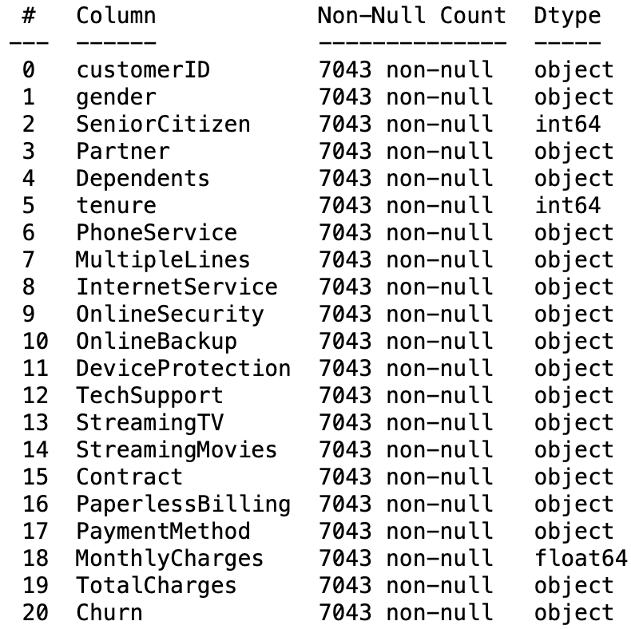
Raw Data
Over 7,000 TelCo customers (IBM sample dataset via Kaggle)
Demographic, behavioral, and purchasing
Minimal data quality issues

Slide 7
Exploratory analysis

Slide 8
Target variable
26.65% of 7,000 customers churned

Slide 9
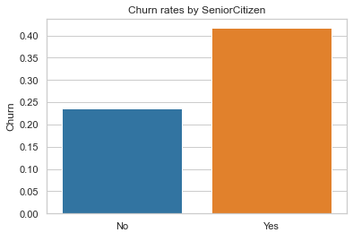
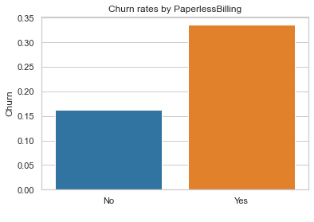
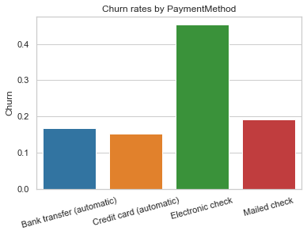
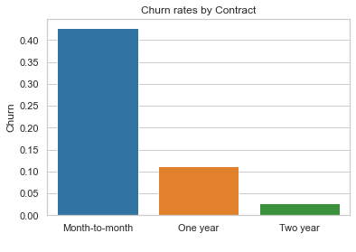
Categorical features
Showing four of several key features
PhoneService and MultipleLines showed no clear relationship to churn

Slide 10
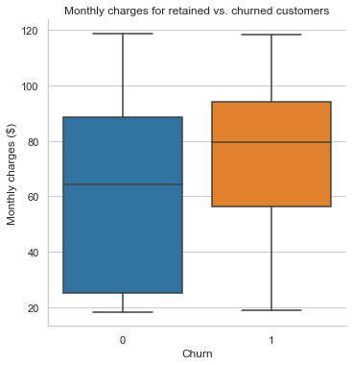
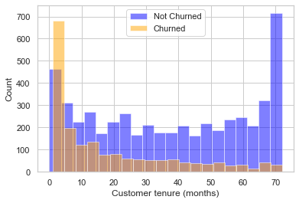
Numerical features

Slide 11
Preprocessing

Slide 12
Encode ‘Churn’ as 0 or 1
1
Create dummies for categorical features
2
Train/test split
3
Rescale numerical features to between 0 and 1
4

Slide 13
modeling

Slide 14

Built models with default parameters for initial comparison:
Logistic regression
Random forest classifier
Support vector classifier
Hyperparameter tuning for LR model
Default LR outperformed tuned LR:
penalty=l2, C=1.0, solver=‘lbfgs’

Slide 15
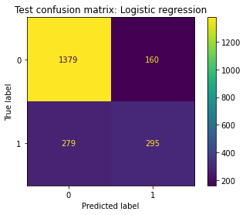
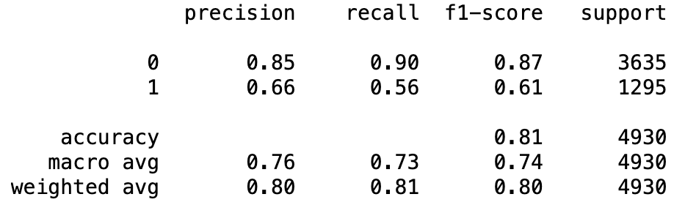
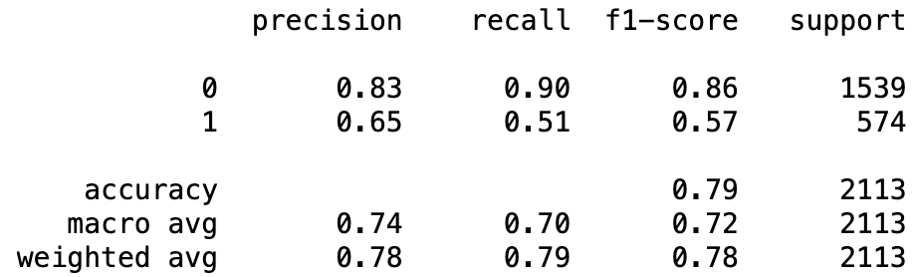
training scores
testing scores

Slide 16
Conclusions and next steps

Slide 17
Bivariate analyses revealed patterns between churn and certain variables
Churn happens early in tenure
Senior citizens are more likely to churn, however,
Customers using more internet-based services also churned more often
Lower monthly costs associated with less churn
Customers paying month-to-month were far likelier to churn
Qualified success using logistic regression model to predict churn
Even limited predictive power could save resources: Targeted intervention to at-risk customers and strategic promotion of low-churn services and products

