Slide 1
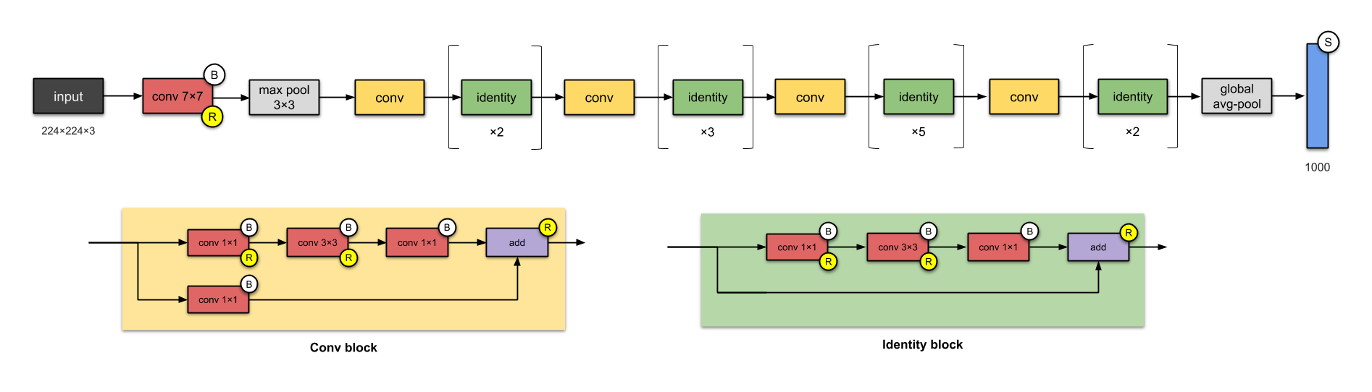
ResNet-50 (2015)
26M parameters
Popularised skip connections (they weren’t the first to use skip connections).
Designing even deeper CNNs (up to 152 layers) without compromising model’s generalisation power

Slide 2
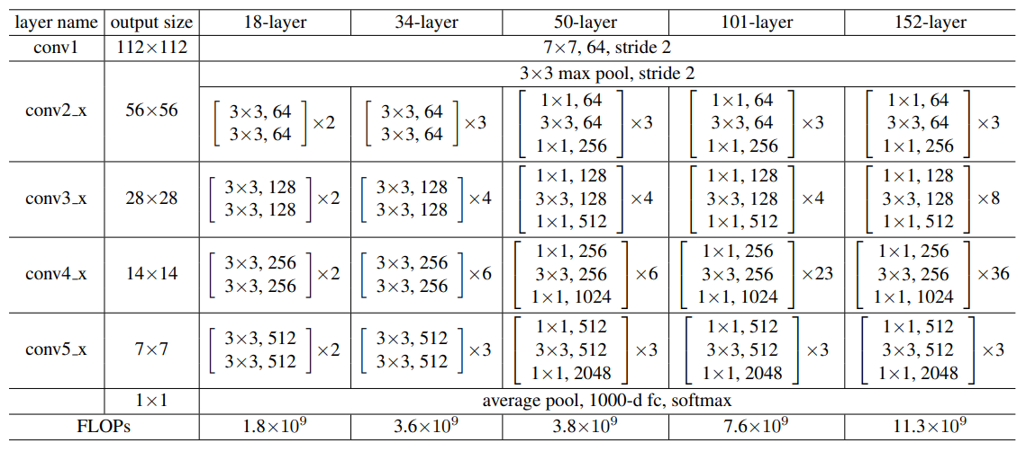
ResNet-50 (2015)

Slide 3
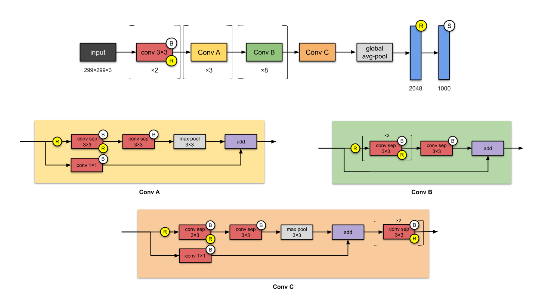
Xception (2016)
Introduced CNN based entirely on depthwise separable convolution layers.

Slide 4
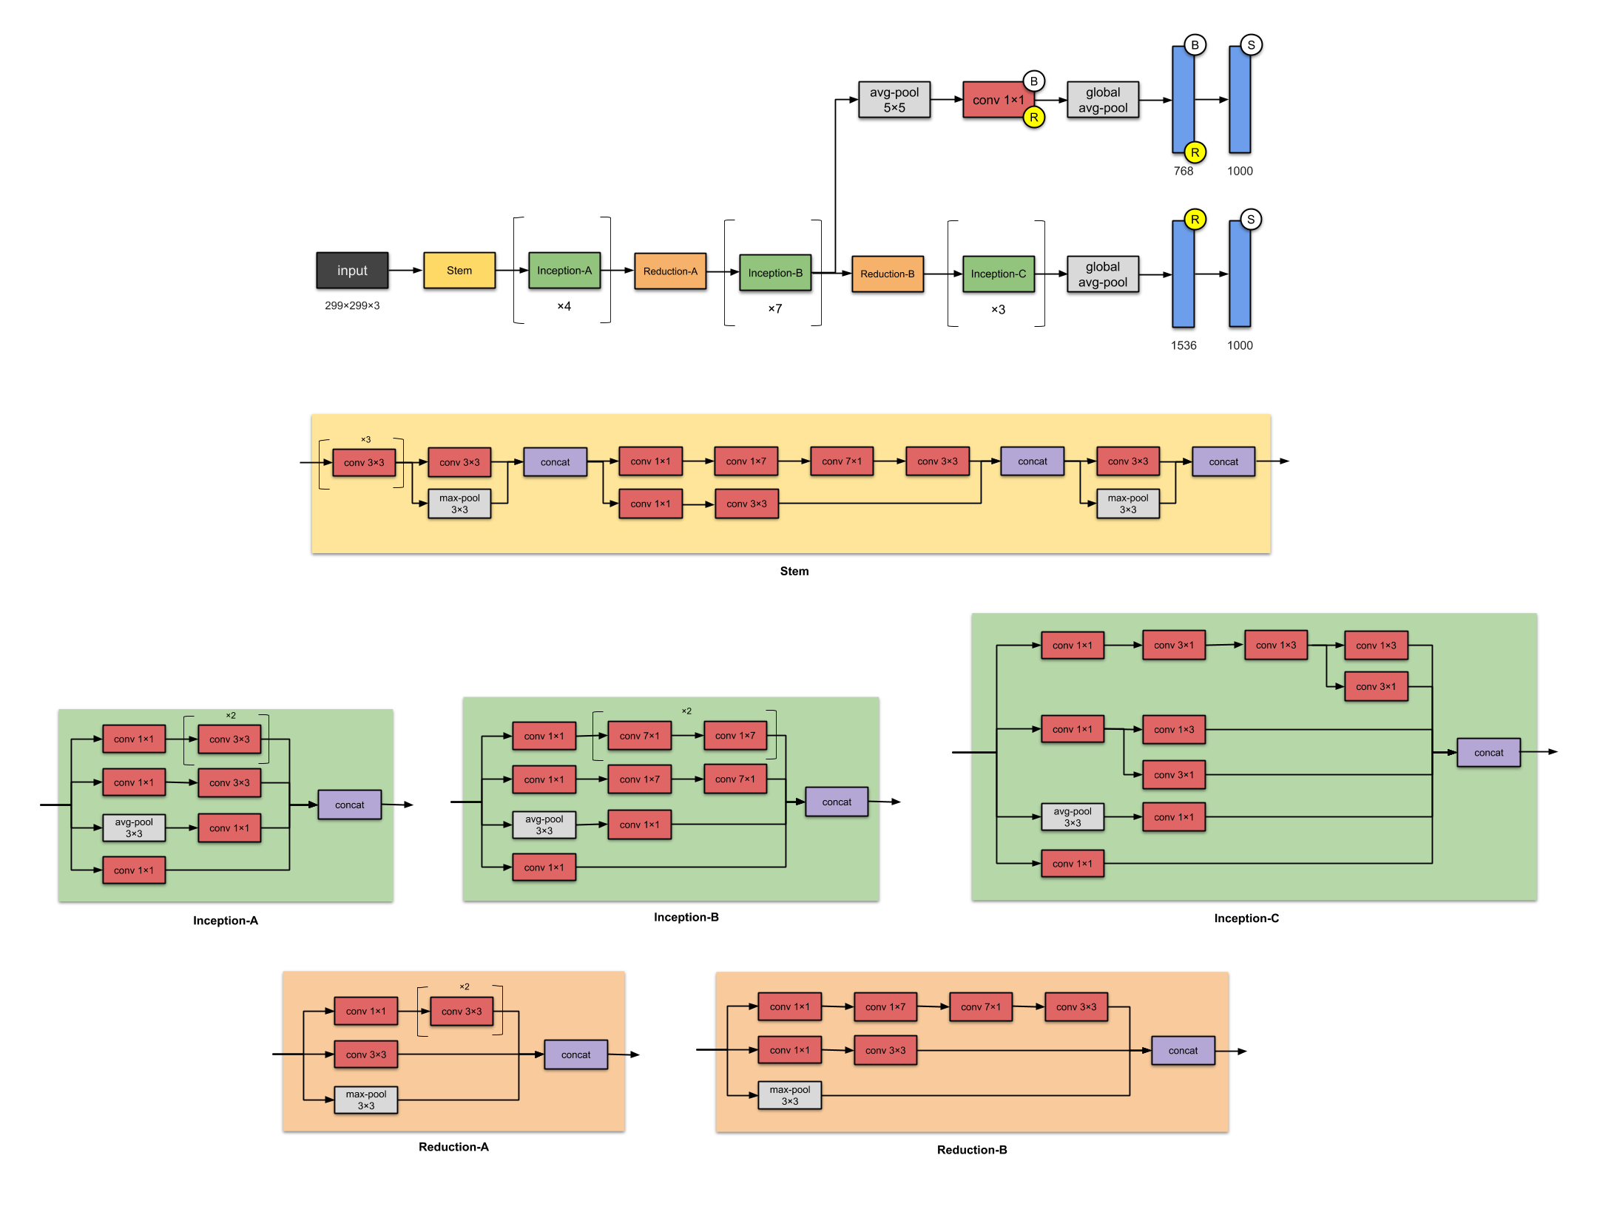
Inception-v4 (2016)

