Slide 1

Functional Programming .js
Levan Roinishvili

Slide 2

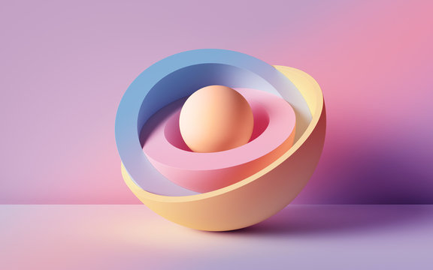

Theory | Practice

Slide 3
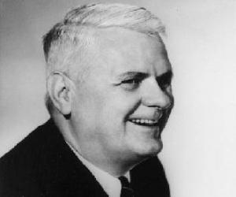
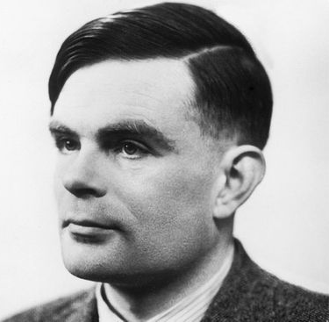
Theory | Practice
λ-calculus
Alonzo Church
Speed
Maintainability
“Safe” functions
Testable
Declarative vs Imperative
Composable style

Slide 4
Functional Programming
Even if you are not a Functional Programmer
Small example (with primes, non-blocking)

Slide 5
Functional Programming
Important ideas
Pure functions
Stateless functions

Slide 6
Pure Functions
function add() {
sum = a + b
}
let a = 1, b = 7, sum
add()
function add(x, y) {
return x + y
}
const a = 1, b = 7
const sum = add(a, b)

Slide 7
Pure Functions
const username = 'N/A'
function friend() {
username = prompt('What is your name?')
console.log('Thanks', username)
}

Slide 8
Functional Programming
Important ideas
Pure functions
Stateless functions
Immutability

Slide 9
Immutability
function incrementAges(ages) {
const b = []
for (let i = 0; i < ages.length; ++i)
b.push( ages[i] + 1 )
return b
}
const ages = [21, 37, 25, 48, 58, 17]
const agesNextYear = incrementAges(ages)
. . .
// [21, 37, 25, 48, 58, 17]
// |
// V
// [22, 38, 26, 49, 59, 18]
function incrementAges(ages) {
for (let i = 0; i < ages.length; ++i)
++ages[i]
}
ages.map( . . . )
const agesNextYear = ages.map( . . . )
function increment(n) {
return n + 1
}
const agesNextYear = ages.map(increment)
const agesNextYear = ages.map(age => age + 1)
Or even better! . . ☺

Slide 10
Functional Programming
Important ideas
Pure functions
Stateless functions
Immutability
Higher-order functions

Slide 11
Higher-order functions
tester
add
subtract
polite
compose

Slide 12
Higher-order functions
function isPrime(n) {
for ( let i = 2; i * i <= n; ++i )
if ( n % i === 0 ) return false
return 1 < n
}
/** Not a pure function */
function countPrimes(min, max) {
let count = 0
for ( let n = min; n <= max; ++n ) {
count += isPrime(n)
}
return count
}
countPrimes(1, 100)
function isPrime(n) {
for ( let i = 2; i * i <= n; ++i )
if ( n % i === 0 ) return false
return 1 < n
}
// Slightly more functional
function counter(min, max, f) {
let count = 0
for (let i = min; i <= max; ++i) {
count += f(i)
}
return count
}
counter(1, 100, isPrime)

Slide 13
Functional Programming
Important ideas
Pure functions
Stateless functions
Immutability
Higher-order functions
Closure

Slide 14
Closure
function constant(k) {
return function (x) {
return k
}
}
const g = constant(3) // returns a function
g(1) // returns 3
g(2) // returns 3
g(3) // returns 3
g(4) // returns 3
. . .
g(10) // returns 3
. . .
// How is this useful?
ages = ages.map(constant(0))

Slide 15
Closure
function add(a) {
return function (b) {
const sum = a + b
return sum
}
}
const g = add(17) // returns a function
g(1) // returns 18
g(10) // returns 27
// remember this?
const agesNextYear = ages.map(age => age + 1)
Or even better! . . ☺
let ages = sages = [25, 38, 41, 18]
ages = ages.map(add(1))

Slide 16
Closure
function isPrime(n) {
for ( let i = 2; i * i <= n; ++i )
if ( n % i === 0 ) return false
return 1 < n
}
/** Not a pure function */
function countPrimes(min, max) {
let count = 0
for ( let n = min; n <= max; ++n ) {
count += isPrime(n)
}
return count
}
countPrimes(1, 100)
counter(1, 100, isPrime)
function isPrime(n) {
. . .
}
function makeCounterFrom(f) {
return function countFs(min, max) {
let count = 0
for ( let i = min; i <= max; ++i )
count += f(i)
return count
}
}
const countPrimes = makeCounterFrom(isPrime)
countPrimes(1, 100)
return

Slide 17
Closure
Closure
function memorize() {}
function add(x, y) {
return x + y
}
cache = {
'1,2': 3,
'1,7': 8,
'2,9': 11,
'7,8': 15,
}
add(7,8) // -> 15
add(1,7) // -> 8
add(1,2) // -> 3
add(2,9) // -> 11
Lets’ do it

Slide 18
Functional Programming
Important ideas
Pure functions
Stateless functions
Immutability
Higher-order functions
Closure
Curried functions

Slide 19
Currying
add(1)
function add(a) {
return function(b) {
return a + b
}
}
function add(a, b) {
return a + b
}
function incrementAges(ages) {
return ages.map(age => age + 1)
}
function incrementAges(ages) {
return ages.map( add(1) )
}
const incrementAges = ages.map(add(1))

Slide 20
Functional Programming
The lambdas or λ-functions
function add(a, b) {
return a + b
}
const add = (a, b) => a + b
function double(n) {
return 2 * n
}
const double = n => a * b

Slide 21
λ-calculus
Identity Function
function I(f) {
return f
}
I = f => f
Konstante Function
function K(f) {
return function(g) {
return f }
}
K = f => g => f
Mockingbird
function M(f) {
return f(f)
}
M = f => f(f)
Recursion, Halting

Slide 22
λ-calculus
Cardinal Function
function C(f) {
return function(a) {
return function(b) { return f(b)(a)
} }
}
I = f => a => b => f(b)(a)
C := λfab.fba

Slide 23
λ-calculus
Boolean: True and False
bool ? a : b
T = a => b => a
T === K
F = a => b => b
F === K(I) KI

Slide 24
λ-calculus
Boolean: NOT
T = a => b => a
F = a => b => b
NOT = b => b(F)(T) = b => b( x => y => y )( x => y => x )
AND = p => q => p(q)(p)
OR = p => q => p(p)(q)

Slide 25
λ-calculus
Numbers
one = f => a => f(a)
two = f => a => f(f(a))
three = f => a => f(f(f(a)))
four = f => a => f(f(f(f(a))))
SUCCESSOR = n => f => a => f(n(f)(a))
ADD = n => m => f => a => n(f)(m(f)(a))

Slide 26
λ-calculus
Numbers: Subtraction
This is hidden ;)

Slide 27
The End
This is where the Live presentation ended
The rest of the slides were not used

Slide 28
λ-calculus | Functional Programming
Only functions
Variables fixed
Only one param f(x)
No f(x, y, z)
fx
“Bound variables”
Pure
Stateless
Higher-order functions
“Immutability”
Curried functions
Closure
Pure Functions
Stateless Functions

Slide 29
λ-calculus | Functional Programming
Only functions
Variables fixed
Only one param f(x)
No f(x, y, z)
fx
“Bound variables”
Pure
Stateless
Higher-order functions
“Immutability”
Curried functions
Closure
Pure Functions
Stateless Functions

Slide 30
λ-calculus | Functional Programming
Only functions
Variables fixed
Only one param f(x)
No f(x, y, z)
fx
“Bound variables”
Pure
Stateless
Higher-order functions
“Immutability”
Curried functions
Closure
Pure Functions
Stateless Functions

Slide 31
Functional Programming
Higher Order Functions
function person(name) {
return function say(word) {
return name + ' says ' + word
}
}

Slide 32
Functional Programming
More Examples tester polite composition memorize memorize recursive

Slide 33
Theory | Practice
Very Old
λ-calculus 1930
Lisp – 1958
Recently – new life

Slide 34
λ-calculus | Functional Programming
Everything is a function
No
True, False, 0, 1, 2,…
and, or, !
=, +, -
Can get complicated
Theory helps
A lot!

Slide 35
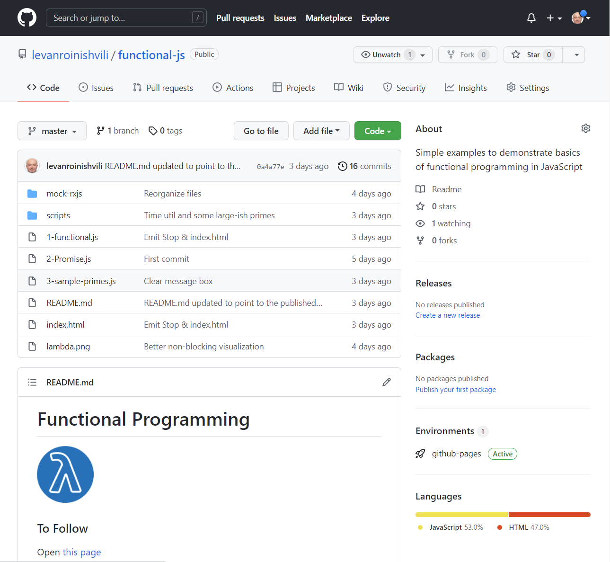
The Plan
Code
https://github.com/levanroinishvili/functional-js
Play along
https://levanroinishvili.github.io/functional-js
Presentation

Slide 36
Audience
Beginners & Masters
Aimed at Beginners ~ 1 year experience
Language: JavaScript
No familiarity with JavaScript assumed
Why JavaScript?
The most used language
General purpose language
Can do Functional Programming

