Slide 1

BUILDING GAME on RPi with OpenSUSE
“The Journey of Text Adventure Games”
By Levay - GLiB
Yogyakarta 02.10.2016

Slide 2
[?]
- GNU/LINUX Bogor (GLiB)
- Local Committee Gnome Asia 2015
- Failed Programmer
- An ISP ‘Cable Guy’
- Freelancer
- Gamer, MUD Hunter
- A Retro

Slide 3
[Agenda]
- History
- Concept
- How to?
- Let’s Play!
- Q + A

Slide 4
[H I S T O R Y]

Slide 5
1975
William Crowther writes a simulation of Bedquilt Cave
(a real cave in Kentucky) on a PDP-10 in FORTRAN for his
two daughters and names it "Advent"
(also known as "Adventure").
1977
Inspired by Adventure, a group of students at MIT in the
summer of 1977 wrote a game for the PDP-10 minicomputer;
called Zork (1st Infocom Game), it became quite popular
on the ARPANET.
1978
In 1978 Roy Trubshaw, a student at Essex University-UK,
started working on a multi-user adventure game in the
MACRO-10 assembly language for a DEC PDP-10.
He named the game MUD (Multi-User Dungeon).

Slide 6
1983
Gilsoft releases The Quill, by Graeme Yeandle. It’s a
commercial program for the Sinclair Spectrum and (later)
the Commodore 64. In the USA Quill was marketed under the
name "Adventure Writer". It is the first widely-available
program for writing text adventures.
1995
The first interactive fiction competition officially
begins, though many of the entries had been available
earlier. Twelve games are entered: six TADS games, and
six Inform games.

Slide 7
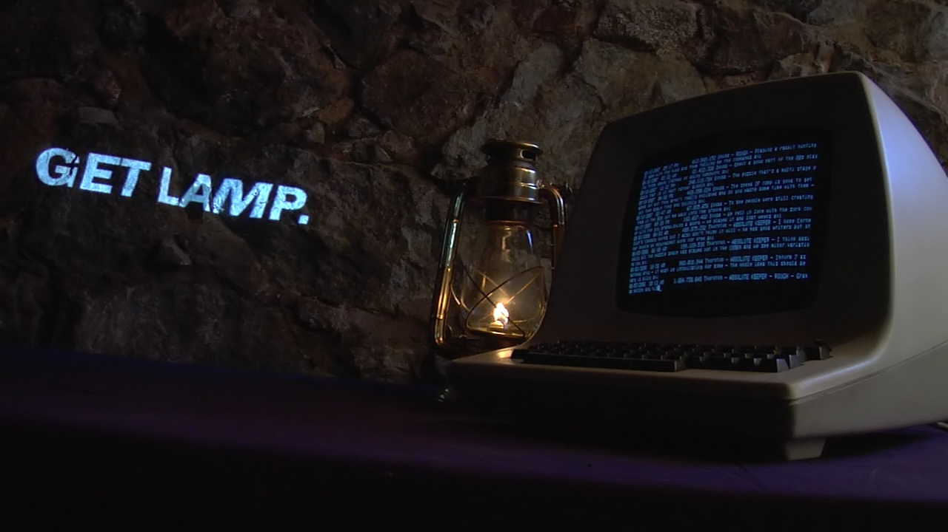
http://www.getlamp.com/
http://www.textfiles.com/adventure/
http://www.ifarchive.org/

Slide 8
[C O N C E P T]

Slide 9
TEXT ADVENTURE
- Single Player
- Simple Commands
- Text based (not ASCII art)
- Freely Explore
- Inventory
- No Stats or Levels
- Puzzle Based and
- Role-Playing Story Elements

Slide 10
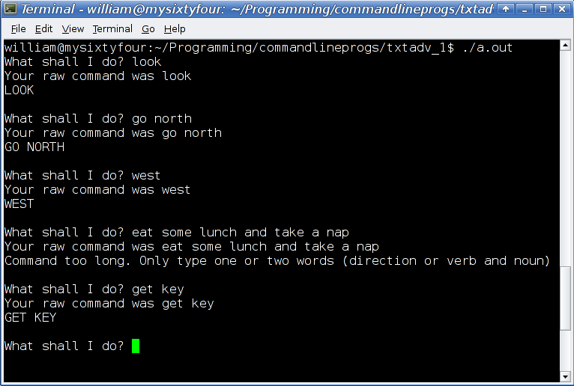

Slide 11
MUD(Multi User Dungeon/Dimension)
- Multiplayer
- Real-time
- Controllable Player
- Text Based (Not ASCII Art)
- Advanced Stats/Levels
- Puzzle Based and
- Role-Playing Story Elements

Slide 12
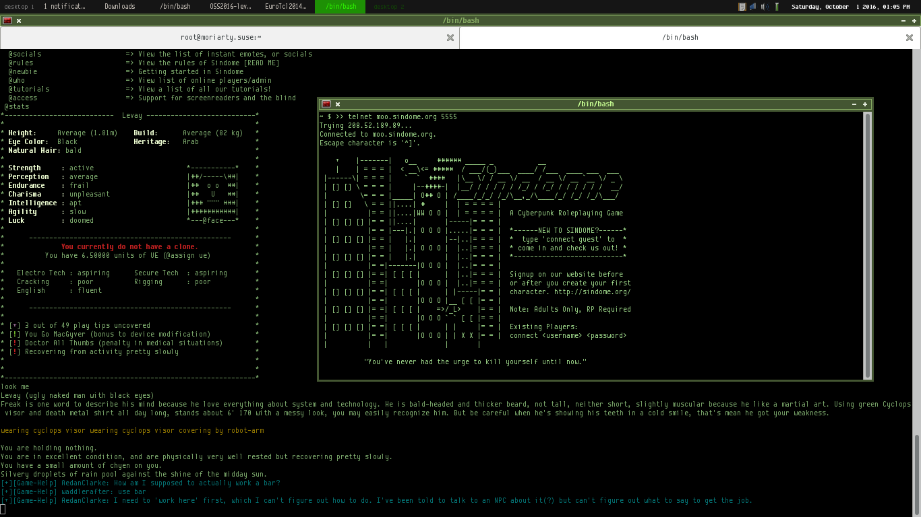

Slide 13
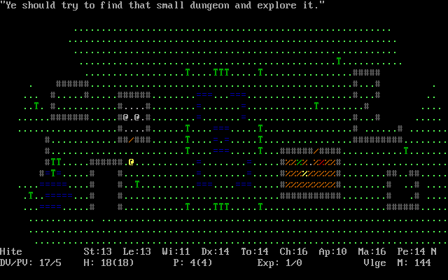
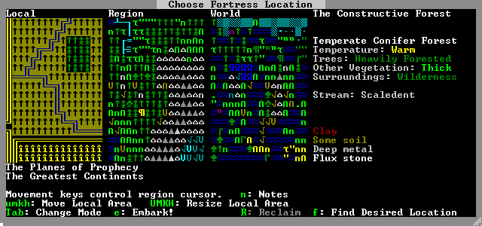
Other Text Style Games
- Roguelikes
- Dwarf
Fortress

Slide 14
MUD GAME STYLE
- Hack and Slash
- PvP
- Role-playing
- Social MUD’s
- Talkers
- Educational MUD’s
- Graphical MUD’s

Slide 15
[H O W TO ?]

Slide 16
MATERIALS
- Raspberry Pi
- SD-Card (8Gb or above)
- Ethernet Cable
- Power Adapter
- WiFi Dongle (optional)
- Monitor (optional)
- Keyboard (optional)

Slide 17
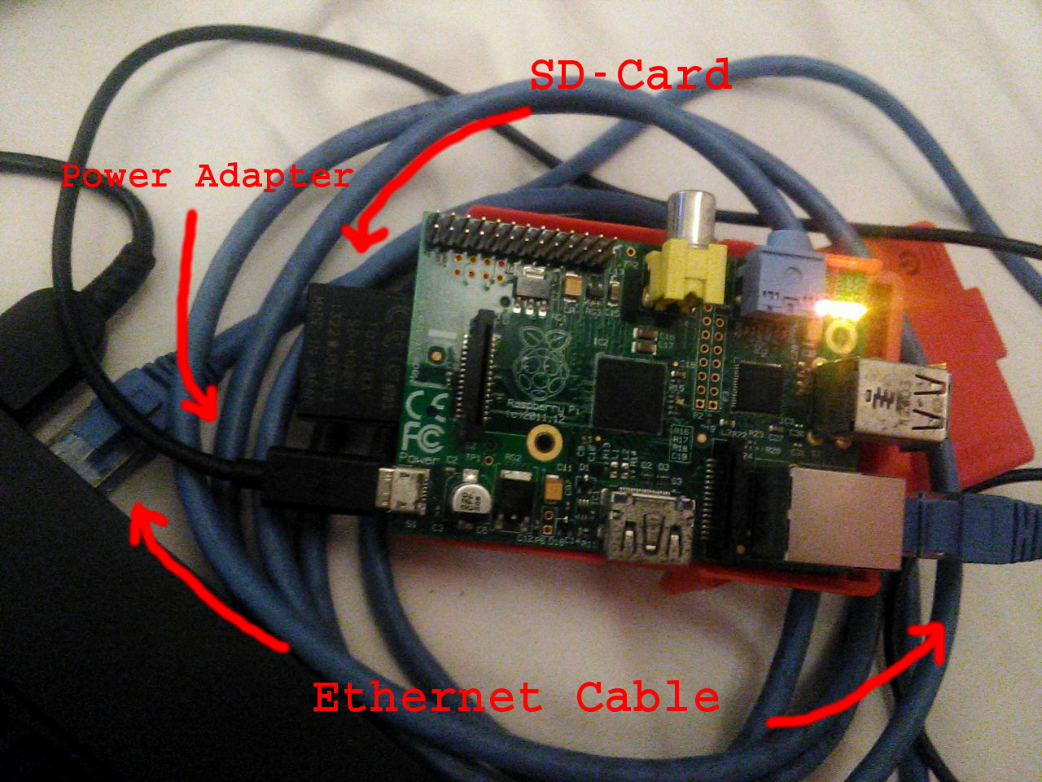

Slide 18
SYSTEMS
- Install OpenSUSE
https://en.opensuse.org/HCL:Raspberry_Pi
# ping <ip_server/rpi>
# ssh <ip_server/rpi>
1. HERITAGE
2. EVENNIA

Slide 19
GAME ENGINE
>> text adventure
# HERITAGE
Heritage Equals Retro Interpreting Text Adventure Game Engine
JAVASCRIPT
Ext .heritage
Simple
Easy
Powerfull
GNU GPL v3.0

Slide 20
- Requirements :
Browser
Web Server
- Setup Web Server :
zypper in -t pattern lamp_server
chkconfig --add apache2
chkconfig apache2 on
service apache2 restart
cd /srv/www/htdocs/
git clone https://github.com/TheLastProject/HERITAGE.git

Slide 21
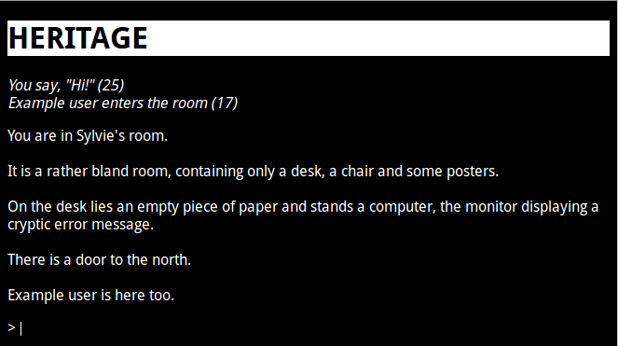
https://heritage.readthedocs.io/

Slide 22
GAME ENGINE
>> MUD/MUX/MUSH/MU*
# EVENNIA
Evennia is a modern library for creating online multiplayer
text games (MUD, MUSH, MUX, MUCK, MOO etc) in pure Python
Based on PYHTON
HTML 5 Websocket, AJAX, DJANGO
Full Guide
Full Support
Powerfull
BSD License

Slide 23
- Requirements :
Python; GIT; python-virtualenv
- Installation :
mkdir /home/mud
cd /home/mud && virtualenv pyenv
source pyenv/bin/activate
git clone git@github.com:evennia/evennia.git
pip install -e evennia
evennia --init mygame
cd mygame
evennia migrate
evennia start
# on Web Browser
http://localhost:8000
# on Telnet/Mud Client
localhost:4000
### localhost should be Server IP Addr

Slide 24
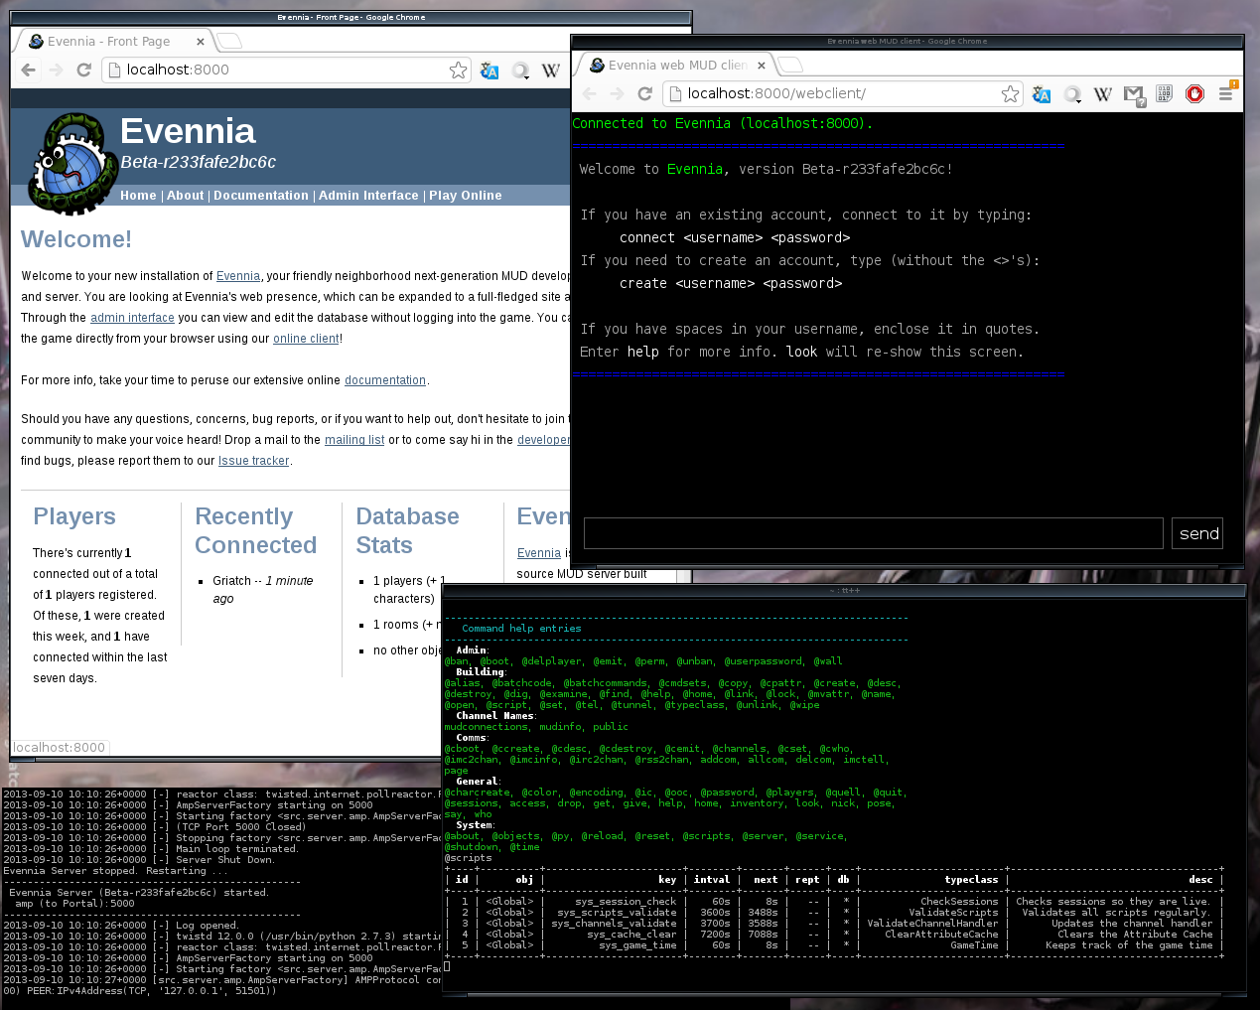
http://www.evenia.com

Slide 25
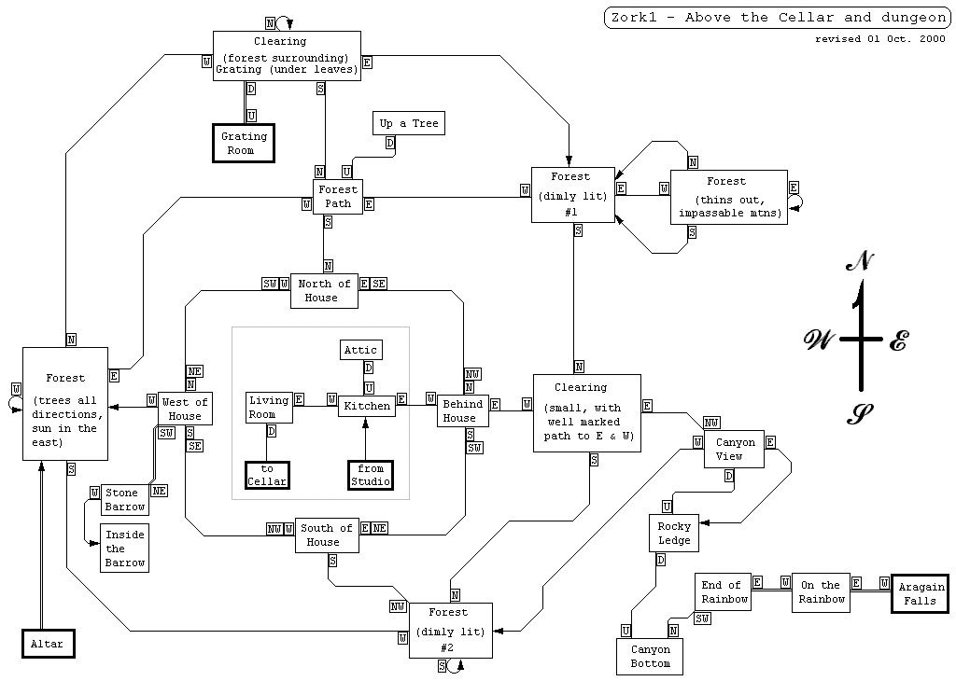
GAMEPLAY

Slide 26
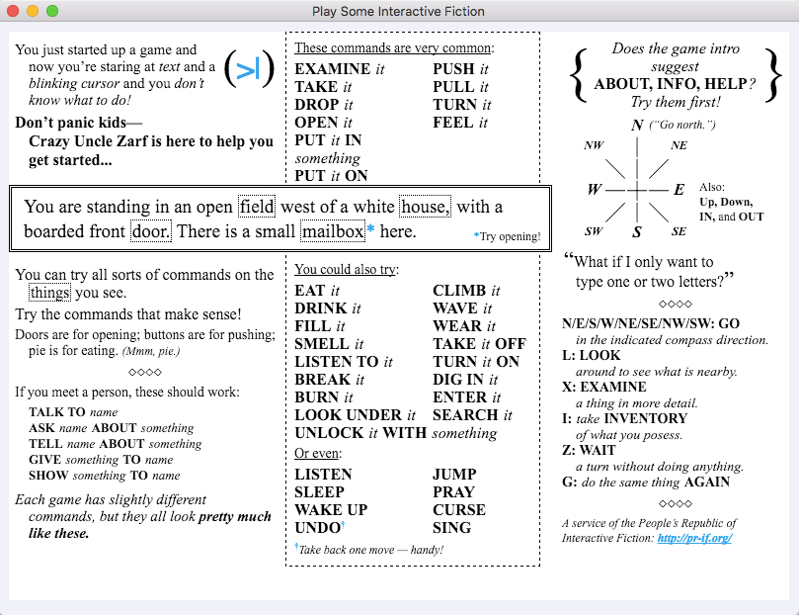
BASIC COMMAND

Slide 27
[L E T’s P L A Y !]

Slide 28


HOW TO CONTRIBUTE?

Slide 29
[ T H A N K Y O U ]
github.com/levay08
levay@glibogor.or.id
http://www.levay.cf

