Slide 1

Blockchain For Everyone
(Explain Like I’m 5)

Slide 2


Intro: Why I am interested
Opportunity?
Curiosity

Slide 3
Overview of the Blockchain World
Development
Bitcoin, Ethereum, EOS, Ripple …
cross chain networks: Cosmos, Polkadot, Fusion …
Investment (Coinbase, Huobi)
Business (Hyperledger, Libra? …)
Government (DCEP - Digital Currency Electronic Payment)
NO killer app YET…

Slide 4
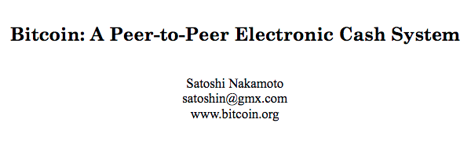
Bitcoin & Blockchain
Bitcoin White Paper
Bitcoin White Paper Made Simple
Github Repo

Slide 5
Bitcoin & Blockchain
Problem
- Intermediaries / Trusted parties
- Double-spending
Solution
Blockchain

Slide 6
Anonymous 匿名性
Buzzwords 热词
Immutable 不可篡改 & Encrypted 加密
Mining 挖矿, a.k.a PoW (Proof of Work)
Decentralized 去中心化 / Distributed 分布式
Consensus 共识
Node 节点 & 51% attack (double-spending attack)

Slide 7
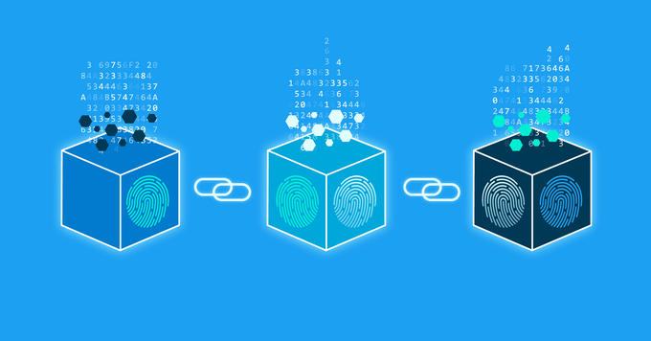
What is a blockchain
A chain of blocks that contains information.
信息块组成的链条
Linked List & Git

Slide 8
PoW (Proof of Work)
Mining Difficulty
- update every 2 weeks
- based on the hashing power of the computers in the network
Hash Rate / Hashing Power
How many hashes can a computer produce per second
Miner v.s. Node
- a miner is always also a full node
- a node, however, is not necessarily a miner

Slide 9
Outro: More To Explore
Ethereum & Smart Contract
Hyperledger
CoinMarketCap.com
block explorer & etherscan.io & ether converter
metamask.io (wallet tool)
ZeroNet

Slide 10
Resources:
How does a blockchain work - Simply Explained (video)
Blockchain Explained (video)
If Bitcoin Is Anonymous, How Do You Catch Criminals? (video)
Blockchain: What are nodes and masternodes? (article)
Blockchain explained: how a 51% attack works (double spend attack) (article)
What Is a 51% Attack? Explained for beginners (video)
blockchain 101 (video)
blockchain demo (github)

