Slide 1



2dengine
…imagine you are God…2d-God…
…walk into…

Slide 2


Concept
You are a Hero, who is looking for truth and justice.
To do this, You need power and health.
This can be found in the world created by You (textures 80*80 px).
You should only create it.

Slide 3

Reality
You can only draw textures and create locations, which can be discovered by you.
Locations can be only outdoor, but without trees.
There are no things like sacks and, of course, no containers
You can create a save, but it doesn’t mean anything

Slide 4
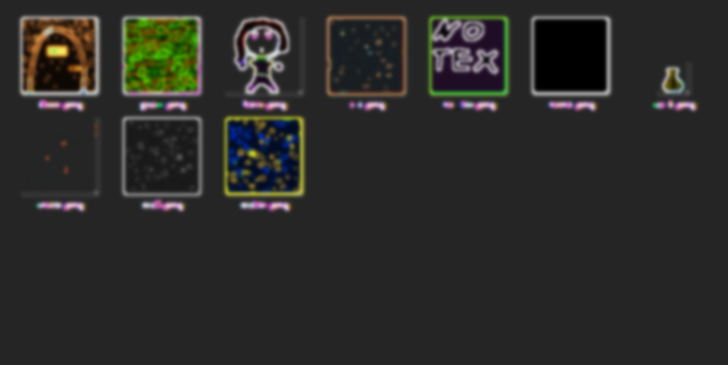
Contains:
lib/ - there you can find files which determine what the world looks like (place-maps, save example)
saves/ - obviously
sound/ - for sounds in the future (maybe)
tex/ - textures for game
g.py – GUI file
game.py – file with game itself
In further slides you can find more info about files.

Slide 5
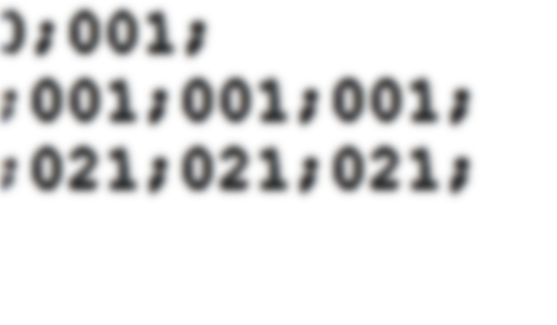
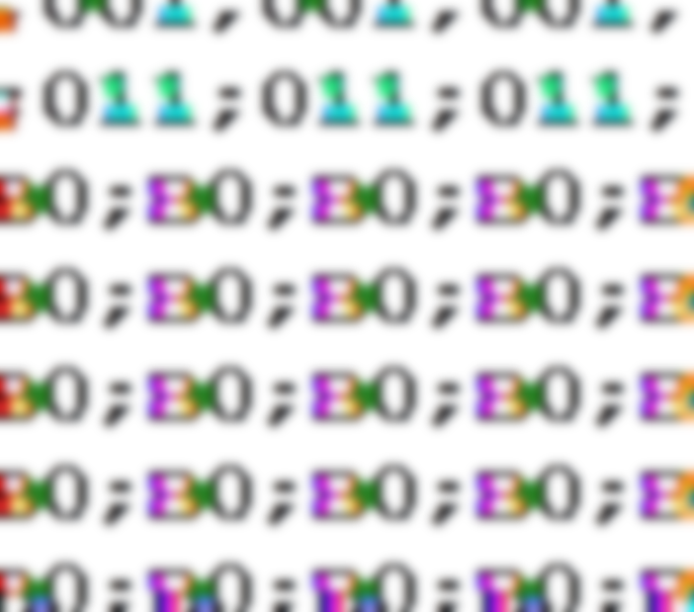
Lib
save.json – save-example. When you create a character, it copies in its folder
.txt – files which describe the world. Each cell is a number which means the type of a cell (they all are separated with ‘;’)

Slide 6
g.py
The files with several GUI-classes in it. There are a button, a text field, different types of labels.
GUI_Label_Uncountable, GUI_Label_Countable, GUI_Button, GUI_Changeable_Label, GUI_Text_Field

Slide 7

game.py
This file contains def-s for starting-ending game and classes for objects in it.

Slide 8
Short description
You choose from creating a new game or exiting it
You type your nickname
You walk by pressing WASD! But you can’t walk through some types of tiles (you can customize it)

Slide 9
https://github.com/uraniarutherfordium/2dengine

