Slide 1
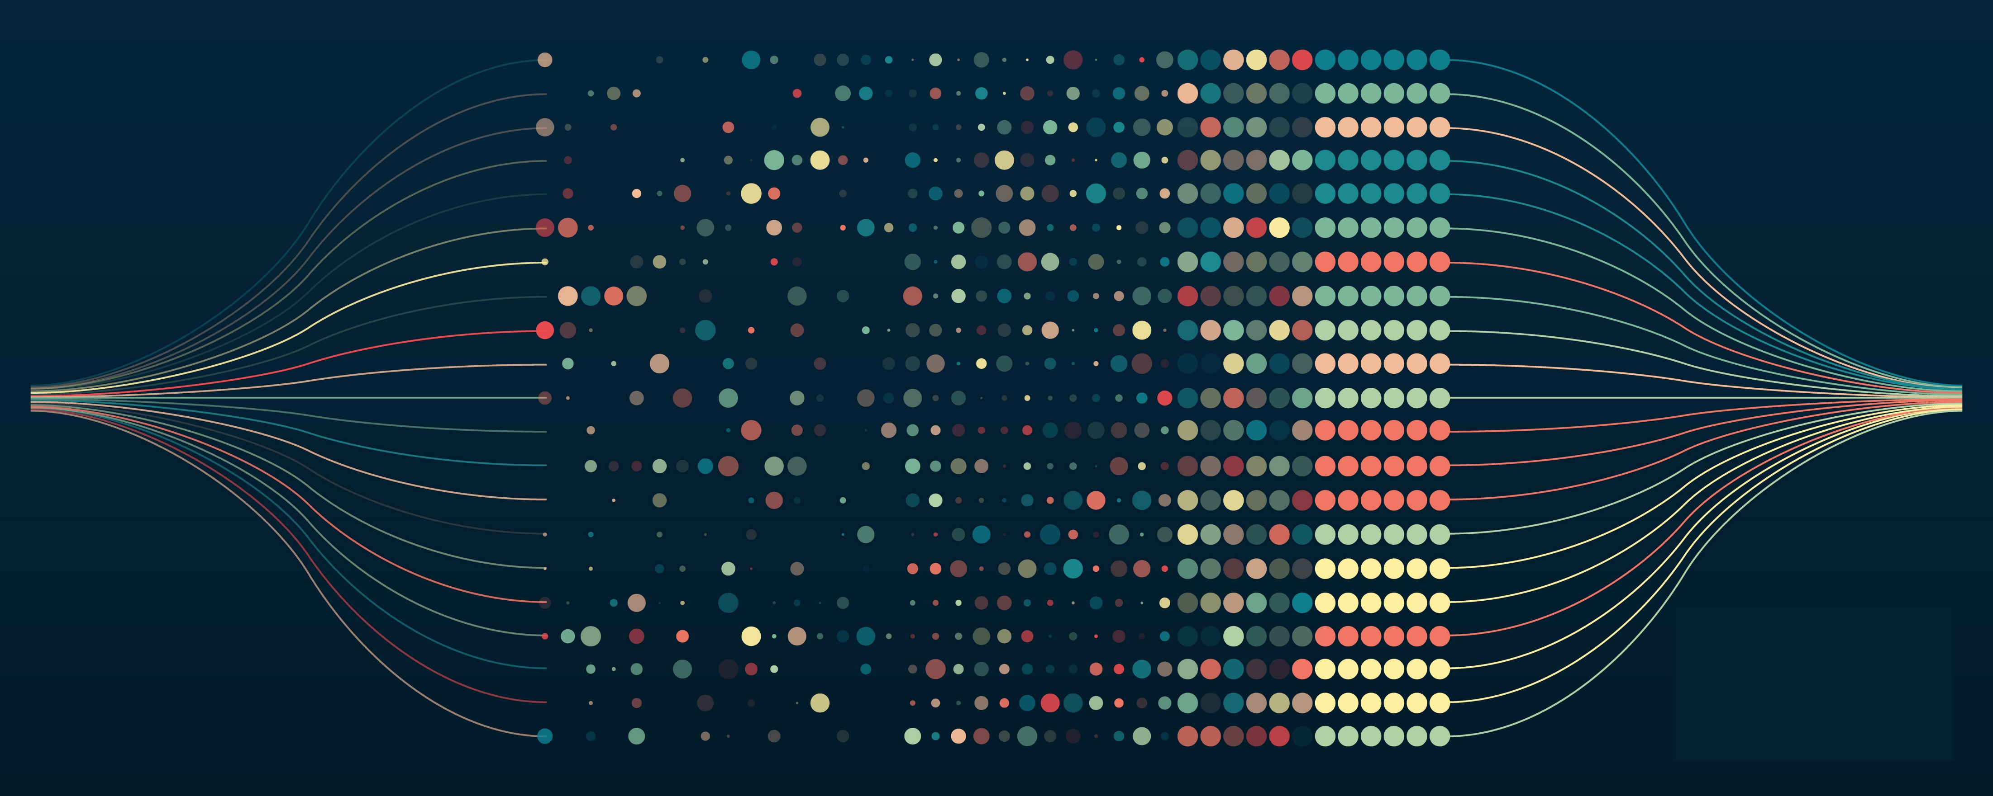
PROJECT PRESENTATION
Levente Sélley
Gergő Zalaváry
Fabó Leon Tompos

Slide 2


PREVIOUS SUCCESSFUL PROJECTS
SPOTIFY
has hundreds of millions of users and billions of tracks & playlists
heavily uses data analytics and machine learning to enhance user experience
Spotify Wrapped turns listening data into engaging visual stories
Personalization increases premium subscriptions and engagement
TESLA
leverages 3B+ miles driving data, giving a significant advantage over other competitors with less data
the data improves Autopilot via OTA AI updates, continiously analyzing drivers
Tesla monetizes driver data (braking, acceleration etc) by accessing risks, and offering personalized insurance rates

Slide 3
POTENTIAL PROJECT IDEA
Customer churn prediction for a subscription service
Fictional video streaming company
Problem: Every month some users unsubscribe
Goal: Predict which users are likely to churn
→ the company can offer targeted retention actions (discounts, emails, recommendations)

Slide 4
USABLE DATASETS
Streaming Service Data
https://www.kaggle.com/datasets/akashanandt/streaming-service-data
Customer_ID: A unique identifier for each customer (object type).
Age: The age of the customer (float64), with some missing values.
Gender: The gender of the customer (object type).
Subscription_Length: The length of time (in months) the customer has been subscribed (int64).
Region: The region where the customer is located (object type).
Payment_Method: The method used by the customer to make payments (object type).
Support_Tickets_Raised: The number of support tickets raised by the customer (int64).
Satisfaction_Score: A score indicating customer satisfaction (float64), with some missing values.
Discount_Offered: The discount offered to the customer (float64).
Last_Activity: The number of days since the customer last interacted with the service (int64).
Monthly_Spend: The amount spent by the customer per month (float64).
Churned: Indicates whether the customer has churned (1 = yes, 0 = no) (int64).

