Slide 1
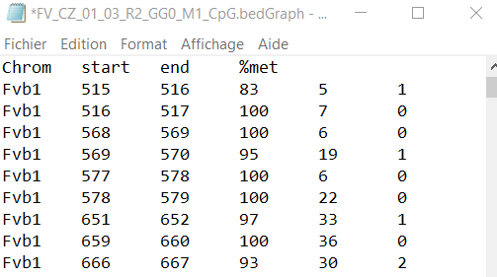
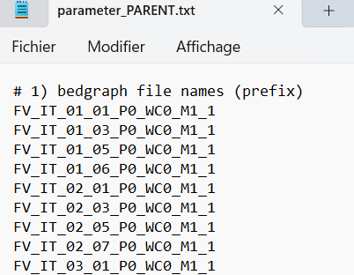
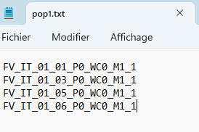
Pipeline
Files_methylation + parameter_PARENT.txt + parameter_CLONE.txt + pop<x>.txt
x = number population
1) Bind
Genotype_parent_<pop>.csv
Genotype_clone_<pop>.csv
Print: number sites (total, fixed, fixed met, fixed unmet)
3) kinship
Kinship_final_parent_<pop>.csv
Kinship_final_clone_<pop>.csv
2) Convert
<pop>_parent.vcf
<pop>_clone.vcf
4) Vcftools analyses
pi_summary_<pop>_parent.csv
pi_summary_<pop>_clone.csv
dl_mean_<pop>_parent.txt
dl_mean_<pop>_clone.txt
fst_summary_<pop>_parent.csvfst_summary_<pop>_clone.csv
<pop>_taj_parent_sorted<x>.Tajima
<pop>_taj_clone_sorted<x>. Tajima

Slide 2
Parameters of pipeline
"-P", "--parameter", default=parameter_PARENT.txt, name of parameter file for parents
"-C", "--clone", default=parameter_CLONE.txt, name of parameter file for clone
"-D", "--directory", default=/, path of the files
"-V", "--vcftools", default=vcftools, name of the software vcftools in servor
"-N", "--Pop_nb", default=7, number of populations in analysis
"-n", "--name_analysis", default=CG, name of the analysis
"-T", "--met_treshold", default=50, Methylation % by position to be considered as methylated
"-dl", "--dl_windows_size", default=30000, size between 2 SMP to be considered in DL estimation

Slide 3
Parameters of pipeline
"-b", "--bind", default=T, skip the step of binding if false
-cv", "--convert", default=T, skip the step of conversion to vcf format if false
"-k", "--kinship", default=T, skip the step of kinship if false
"-p", "--population_analysis", default=T, skip the step of analysis by vcftools if false
"-cs", "--conservation", default=T, skip the step of conservation if false

Slide 4
Softwares and module require
Vcftools v0.1.15
Python 3.10.3
MODULES:
os
sys
argparse
math
panda

