Slide 1
PQTree

Slide 2
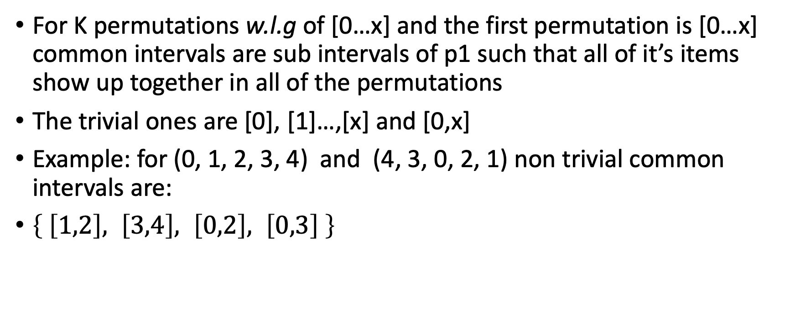
Common Intervals
For K permutations w.l.g of [0…x] and the first permutation is [0…x] common intervals are sub intervals of p1 such that all of it’s items show up together in all of the permutations
The trivial ones are [0], [1]…,[x] and [0,x]
Example: for (0, 1, 2, 3, 4) and (4, 3, 0, 2, 1) non trivial common intervals are:
$\left\{ \left[1,2\right], \left[3,4\right], \left[0,2\right], \left[0,3\right] \right\}$

Slide 3
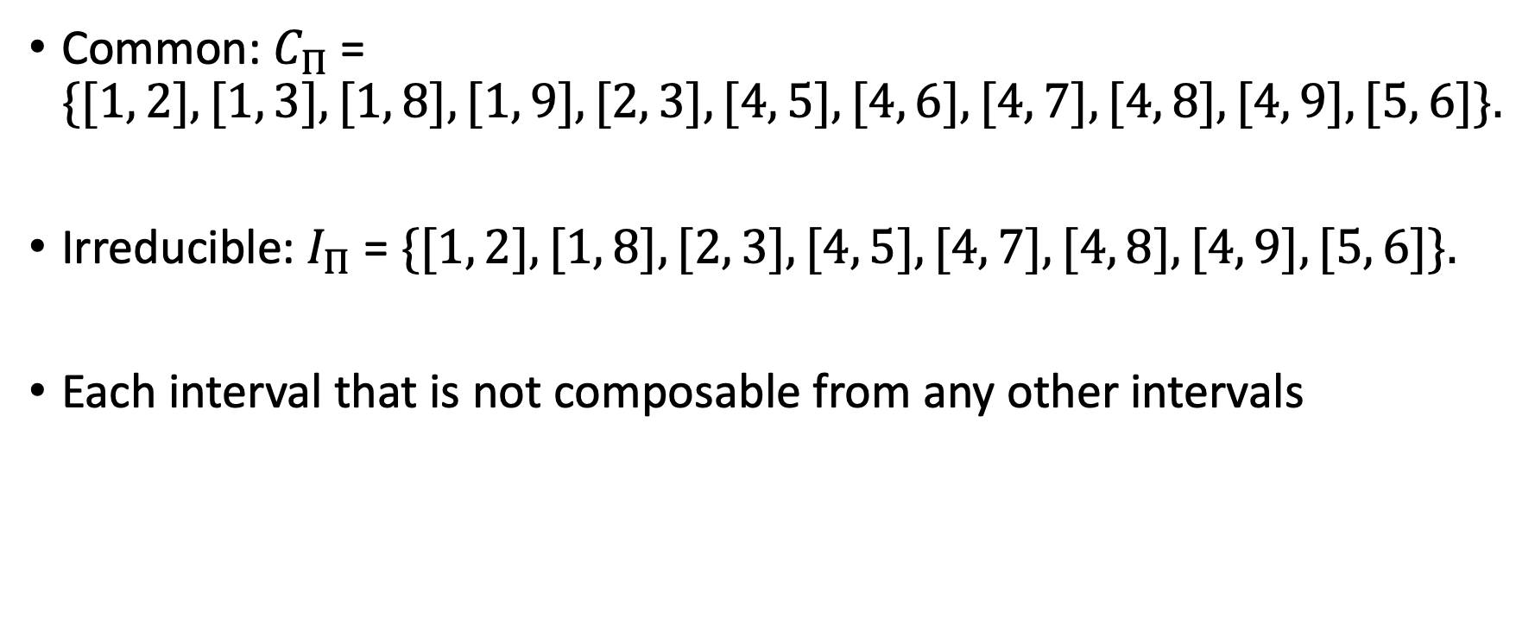
Irreducible intervals
Common: $C_{Π}$= $\{[1, 2], [1, 3], [1, 8], [1, 9], [2, 3], [4, 5], [4, 6], [4, 7], [4, 8], [4, 9], [5, 6]\}.$
Irreducible: $I_{Π}$= $\{[1, 2], [1, 8], [2, 3], [4, 5], [4, 7], [4, 8], [4, 9], [5, 6]\}.$
Each interval that is not composable from any other intervals

Slide 4
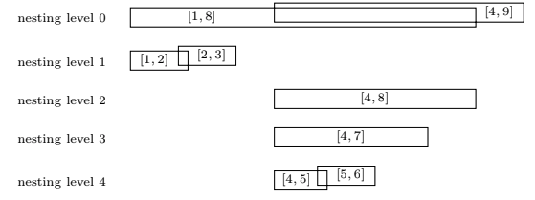

S –data structure
Sort $I_{Π}$such that $∀i∈I_{Π}, NestingLevel\left(i\right)=\left|\left\{j∈I_{Π}:j≠i∧i⊂j\right\}\right|$
$i⊂j ⟺\left[start\left(i\right),end\left(i\right)\right]⊂[start\left(j\right),end\left(j\right)]$
Bottom up order: (4,5), (5,6), (4,7),(4,8),(1,2),(2,3), (1,8), (4,9)

Slide 5
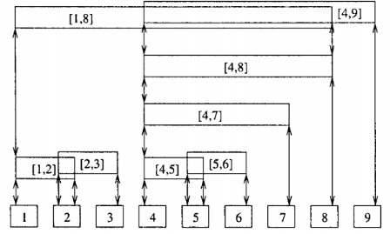
Iteration Cases
Case a – a trivial interval (of length 1)
Case b – start of a chain of overlapping intervals
Case c – Not start of a chain – but not trivial

Slide 6
Case a
Each such ”Trivial” interval will represent a leaf in the built PQTree

Slide 7
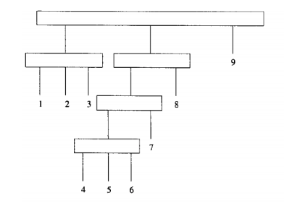

Case b
Will be represented as a Qnode in the tree
In the Ex. (1,3)
Intersection of two intervals – will show up as a child of such Qnode
For ex. $\left[1,8\right]∩\left[4,9\right]=\left[4,8\right].$ In the tree will show up as:

Slide 8
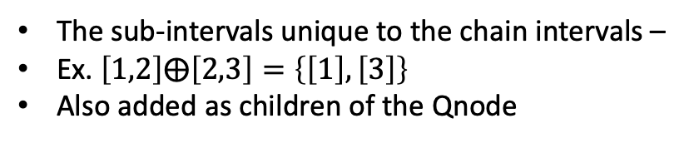
Case b – cont.
The sub-intervals unique to the chain intervals –
Ex. $\left[1,2\right]⨁\left[2,3\right]=\left\{\left[1\right], \left[3\right]\right\}$
Also added as children of the Qnode

Slide 9
Case c
An interval that is not a part of chain and not a leaf – will be converted to a Pnode
Note that in our example the Pnode has only 2 children – thus its converted to Qnode

Slide 10
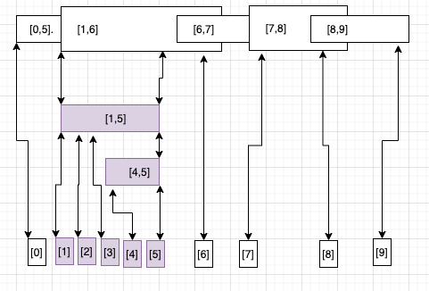
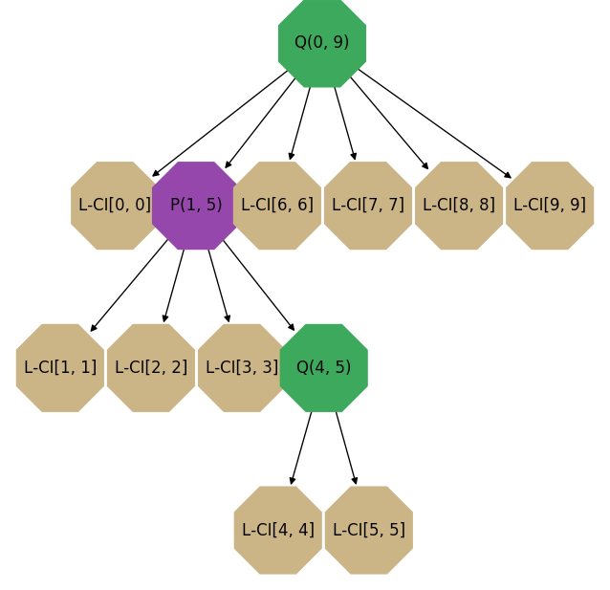
Case c - Pnode
We can see that when we have more than 2 children the tree will yield a Pnode

