Slide 1
Pegasus
Track 03
Levi Dial

Slide 2
Pegasus
PegaSARs
Track 03
Levi Dial

Slide 3
Pega{SAR}s
Synthetic Aperture Radar
Search and Rescue

Slide 4
Pega{SAR}s
Synthetic Aperture Radar
Search and Rescue
Suspicious Activity Reports
Using Pegasus

Slide 5
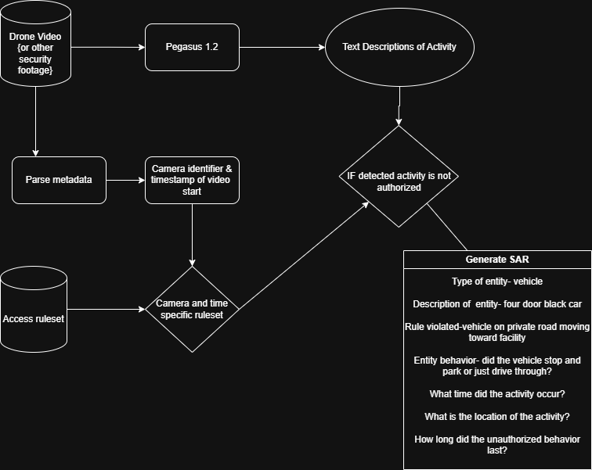

Slide 6
Performance
2 SARs were generated out of 4 total vehicles violating access authorization 50%
One of these SAR descriptions mentioned two vehicles violating access authorization 75%?
Two vehicles entered the campus on the roadway that was defined as approved access and no SARs were generated for these vehicles!
Overall 4/6 (66.67%) or 5/6 (83.33%) activities correctly identified.

Slide 7
Limitations
Current ruleset is rudimentary
Natural language from pegasus <-> natural language ruleset <-> what happens in the video could potentially be improved with Merango
Structuring the output from pegasus for fields of interest is a critical step of the process
Relies on resolution of information available in video

Slide 8
Key Characteristics
Trajectory based rules leverage video
Vehicles should not be heading TOWARD headquarters
Vehicles should only be inbound on the access road
Natural language rulesetting enables high frequency iteration
Not required to build a large CV dataset of annotated activities for each look angle

Slide 9
Key Characteristics
Text output from flagged and unflagged activities can be used to revise authorization ruleset
Scalable compared to manpower
Many feeds from many sites could be monitored at once
Human only required to review SARs

Slide 10
Thank you!

