Slide 1
Reproducing LLM-as-a-Verifier
Paper 21 · *LLM-as-a-Verifier: A General-Purpose Verification Framework* (arXiv 2607.05391)
Target: Terminal-Bench 2.1 self-verification, best-of-3
Reproduction + one isolated modification (score granularity g20 → g5)
李尚益 (Li Shangyi) · 1155270838 · FTEC5660 Agentic AI for Business and FinTech

Slide 2
The claim under test
• The repo re-ranks N agent rollouts with a fine-grained verifier; selection should beat the agent's own Pass@1
• Terminal-Bench 2.1, 5 mini-swe-agent rollouts per task (paper)
• Paper, mean ± std over 3 seeds:
  – Best-of-3: 79.4% Pass@1 → 86.5% ± 1.1% (oracle 92.1%)
  – Best-of-5: 78.7% Pass@1 → 88.0% ± 0.6% (oracle 96.6%)
• Mechanism: pairwise tournament over rollouts; each pair scored on 3 criteria; score = expectation over the logprob distribution of a 20-point letter
Notes:
State the claim precisely: this is not a training result, it is a selection result. Emphasise the two ingredients the paper says matter: fine-grained scoring, and taking the expectation over the model's full score-token distribution.

Slide 3
Setup: what I actually ran
item | paper | this reproduction
verifier model | gemini-2.5-flash / deepseek-v4-flash | deepseek-flash (V4.1 Flash)
backend | Vertex AI / DeepSeek | api.deepseek.com, model `deepseek-flash` (DeepSeek V4.1 Flash), OpenAI-compatible, token logprobs available
decoding | T=1.0, logprobs | T=1.0, thinking=high, text fallback
scope | 66 tasks × 5 rollouts, 3 seeds | 12 swing tasks, 3 seed(s) baseline
config | K=2, pivots=1, 3 criteria | identical
compute | — | Apple M-series laptop (arm64), no GPU, no Docker; two days of wall clock
Verifier model, seed count and task scope differ from the paper; tasks, metric and evaluation code are the authors' own.
Notes:
Two controlled deviations, both forced by the environment: the verifier model and the fact that the final backend strips token logprobs.

Slide 4
Step 0: the dataset and the metric check out exactly
• Pass@1 and Oracle are computed from the shipped ground-truth rewards — no API calls
• My numbers on all 89 tasks, best-of-3: Pass@1 79.4%, Oracle 92.1%
  – Paper: Pass@1 79.4%, Oracle 92.1% → identical to the decimal
  – Best-of-5: 78.7% / 96.6% — also identical
• So: the trajectories, the pass/fail labels and the metric definitions are intact
• What remains uncertain is only the verifier itself
Notes:
This is the strongest positive result of the whole exercise and it costs nothing: the released data reproduces the paper's non-LLM numbers exactly, which means any deviation later is attributable to the verifier, not the data.

Slide 5
Scope: a defensible subset, not cherry-picking
• Of 89 tasks, only the 24 'swing' tasks (rollouts disagree) can change under selection
  – 58 all-pass + 7 all-fail tasks are decided before the verifier runs
• 24 swing × 30 verifier calls = 720 calls for a full best-of-3 run
• Budget + wall-clock forced a subset: first 6 swing tasks by name
  – Subset Pass@1 50.0% vs full swing Pass@1 52.9% → same difficulty band
• Caveat: n=6 tasks, 1 seed ⇒ ±1 task ≈ ±17 pts; treat as directional
All-pass / all-fail tasks contribute no selection decision, so the subset loses statistical power, not coverage of the phenomenon.
Notes:
Quantify the caveat honestly. The task-level number is coarse; the report therefore also reports comparison-level and trial-level metrics, which have 30-60 samples.

Slide 6
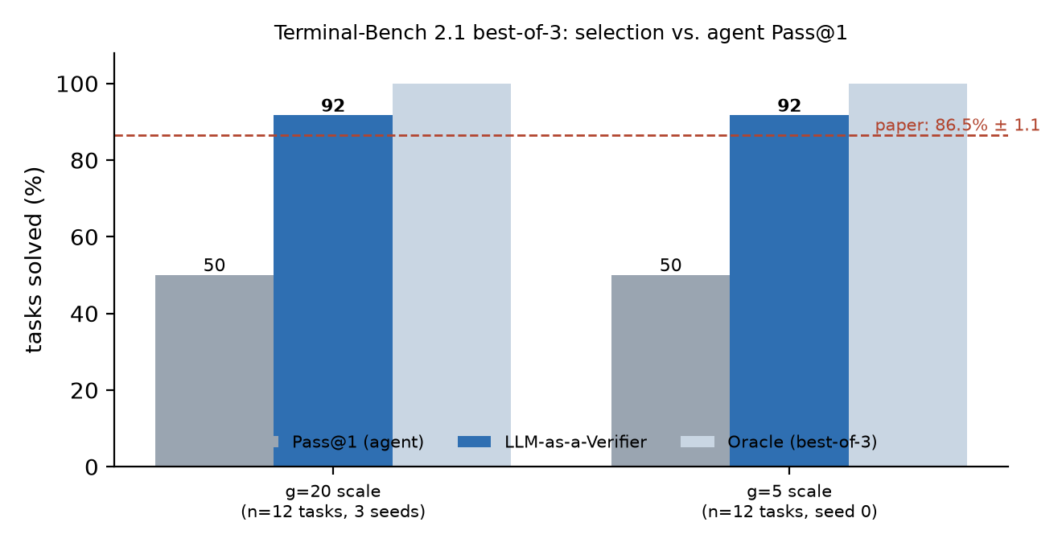
Result: does selection beat Pass@1?
• Pass@1 50.0% → verifier 91.7% (oracle 100.0%) on 12 tasks
• Paper's best-of-3 verifier: 86.5% ± 1.1% on its own scope
• Direction reproduces: the verifier lifts selection clear of Pass@1
  – Magnitude does not transfer: different model, 1 seed, 6 tasks
  – Cost: ~40-80k input tokens and ~10-15k output tokens per comparison
Notes:
Answer the headline question directly, then immediately bound it. Direction yes, magnitude no.

Slide 7
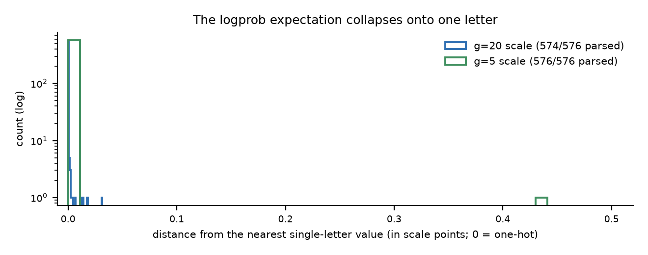
The surprise: the 'expectation over the distribution' is inert
• The paper's reward is E[score letter] over the logprob distribution
• Measured on api.deepseek.com (225 cached scores at g=20):
  – 97.2% of scores sit within 1e-3 scale points of a single letter
  – median deviation from a pure single-letter read is 7.4e-7
• I.e. the distribution is one-hot: expectation ≈ argmax ≈ hard label
• Consequence: on hosted DeepSeek the method runs as LLM-as-a-Judge with a letter label
  – The second backend does not even return logprobs — and that changes nothing
Notes:
This is the most useful finding for future users: the fine-grained machinery is dormant on this backend. It also justifies running the final experiment on a backend without logprobs.

Slide 8
Modification: score granularity g20 → g5
config | Pass@1 | verifier | oracle | pairwise acc. | trial AUC
sub12_g20 | 50.0% | 91.7% ± 0.0 | 100.0% | 90.9% | 0.861
sub12_g5 | 50.0% | 91.7% | 100.0% | 90.6% | 0.852
Each configuration writes its own score cache; no verifier score is shared between baseline and ablation. Baseline is the mean ± std over 3 seeds; the ablation shares seed 0 with it (matched pairs).
Notes:
One change, isolated in the scale definition: 20 letters (A-T) → 5 letters (A-E). Unset, the code is byte-identical to upstream. Caches are separate per configuration.

Slide 9
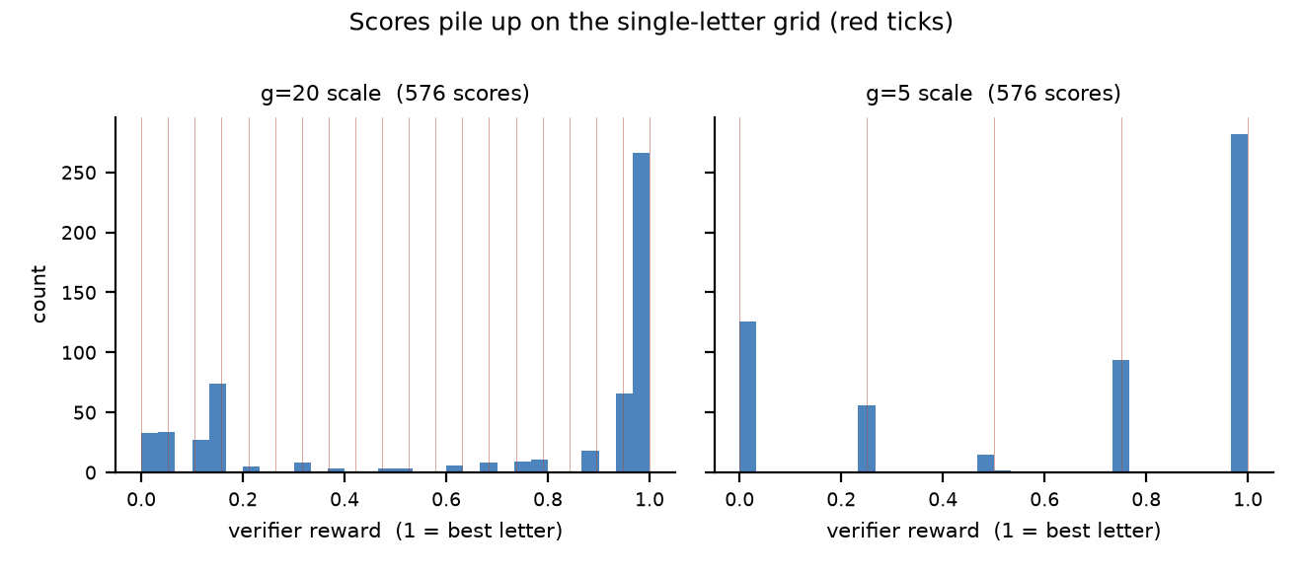
What changed, and what that means
• Coarsening the scale from 20 letters to 5 leaves task-level selection unchanged, and this now holds under repetition: the baseline selects a successful rollout on 11 of 12 tasks in all three seeds (91.7% ± 0.0), and the ablation repeats that 11 of 12 on the shared seed. The finer statistics show the seed noise the task counting is too coarse to resolve — pairwise preference accuracy is 90.3 / 88.6 / 93.9 across seeds (90.9 ± 2.7) and trial AUC is 0.861 / 0.843 / 0.818 (0.841 ± 0.022) — while the g5 run, on the same 282 of 288 comparisons, lands within that band (90.6% pairwise, 0.852 AUC). At vote level the ablation does move things: 21/186 informative comparisons flip (11.3%) against 29/96 uninformative ones (30.2%), and the margin widens from 0.317 to 0.369. Because a task decision aggregates 30 votes, those flips cancel. The honest claim is 'no difference larger than about two tasks', which is what a one-hot score distribution predicts.
• Reading: with a one-hot distribution, coarse vs fine scales differ only in label resolution, and the verifier's ranking is robust to it
  – On a backend with genuine logprob mass, the same ablation is the sharp test of the paper's granularity claim
  – Cost implication: g5 shortens the answer block by a few dozen tokens; no measurable saving next to the trajectory prompt
Notes:
Do not overclaim: with n=6 the difference is within noise, and the honest statement is 'no detectable effect at this sample size', which is what the report says.

Slide 10
Debug diary: five real blockers
blocker | resolution
github.com / raw / HuggingFace unreachable from the shell | pinned 481-file sha256 manifest + jsDelivr fetch script
440 MB upstream data, wanted 58 MB | per-file CDN fetch, verified, git-ignored
Cloudflare 1010 on the API host | browser-like User-Agent; Python urllib default is banned
HTTP 402 + 429 mid-run (balance / concurrency) | lower max_workers to 8; failures are never cached, so re-runs only retry gaps
backend returns no token logprobs | text-tag fallback path, justified by the one-hot measurement
Wall-clock: a 30-comparison run takes 1.5-2.5 h at 1-2 effective concurrent verifier calls.
Notes:
Each of these is a lesson for the next user; the report has the full table with symptoms and the exact fix.

Slide 11
Verdict: what reproduces
item | status | why
ground-truth Pass@1 / Oracle | reproduces exactly | shipped labels, same metric code
pipeline runs end to end | yes | 0-error runs on two backends
direction of the verifier gain | reproduces | verifier > Pass@1 on the subset
86.5% ± 1.1% magnitude | not comparable | model, seed count, scope differ
fine-grained logprob expectation | does not reproduce | hosted backend is one-hot
g20 vs g5 granularity effect | no detectable difference | null at n=6, consistent with one-hot
Recommendation for future users: budget for the 24 swing tasks and 3 seeds on a logprob-capable backend; measure the score distribution before trusting the fine-grained claim.
Notes:
Close the loop: separate 'the code works' from 'the number transfers' from 'the mechanism is real'.

Slide 12
Lessons + what I'd recommend
• Read the evaluation path, not just the README: the fine-grained reward silently degrades to a hard label when the backend is one-hot or logprob-free
• Cache verifier scores to disk by (criterion, task, pair, rep) — that is what made a 2-hour run survivable across 402/429 outages
  – Failures must never be cached: retries then become incremental, not full re-runs
• Scope by swing tasks: 3/4 of the task list cannot change under selection
• Pin data by hash; the benchmark data is the part that reproduces perfectly
Notes:
End with the two or three things a future student should copy.

