Slide 1


Verilog HDL Final Project
Levi Stalsworth

Slide 2
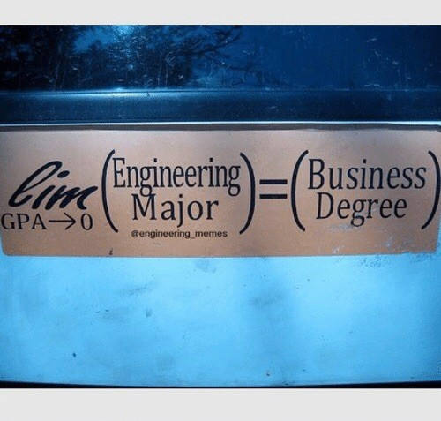
Top level diagram

Slide 3

Execution engine

Slide 4



Module structure
Describing of models

Slide 5

Interesting code

Slide 6

Thank you

