Slide 1



Verilog HDL Final Project
Levi Stalsworth

Slide 2
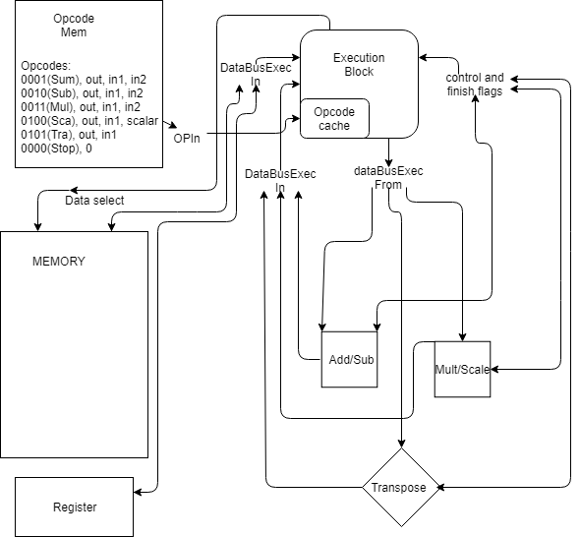
Top level diagram

Slide 3



Execution Engine
The execution engine...
Data bus flow goes through the execution engine.
Opcode Structure for Execution engine
XXXX | XX | XXXXXXXX | X | XXXXXXXX | X | XXXXXXXX
OP | Reg/Mem | Addr | Reg/Mem | Addr | Reg/Mem | Addr
Exceptions: Stop; 000000000000000000000000000000000000000 Scalar; second Reg/Mem bit not used

Slide 4
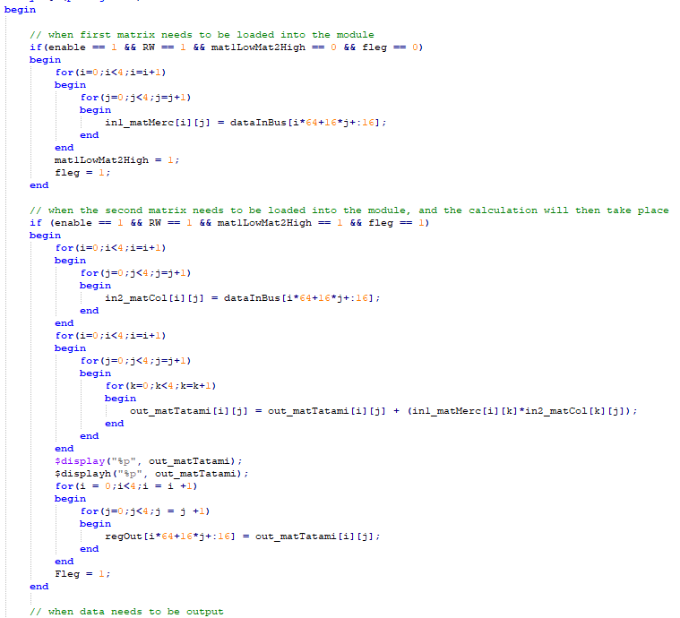
Module structure

Slide 5
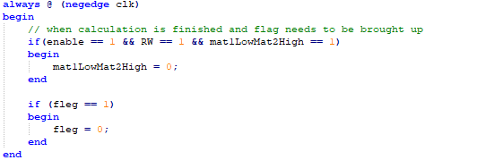
Interesting code
Negative edge is flag reset.

Slide 6
output

Slide 7

Thank you

