Slide 1


Verilog HDL Final Project
Levi Stalsworth

Slide 2
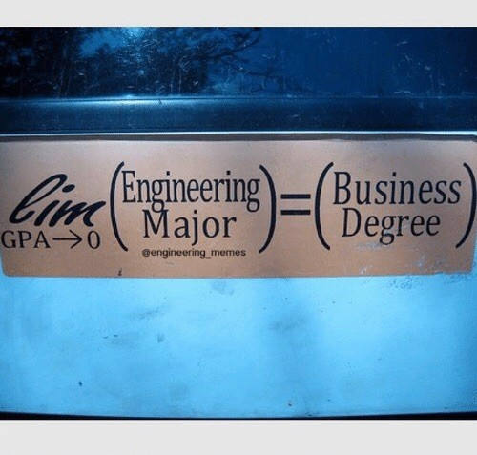
Top level diagram

Slide 3

Execution engine

Slide 4



Module structure

Slide 5
Interesting code

Slide 6
Thank you

