Slide 1


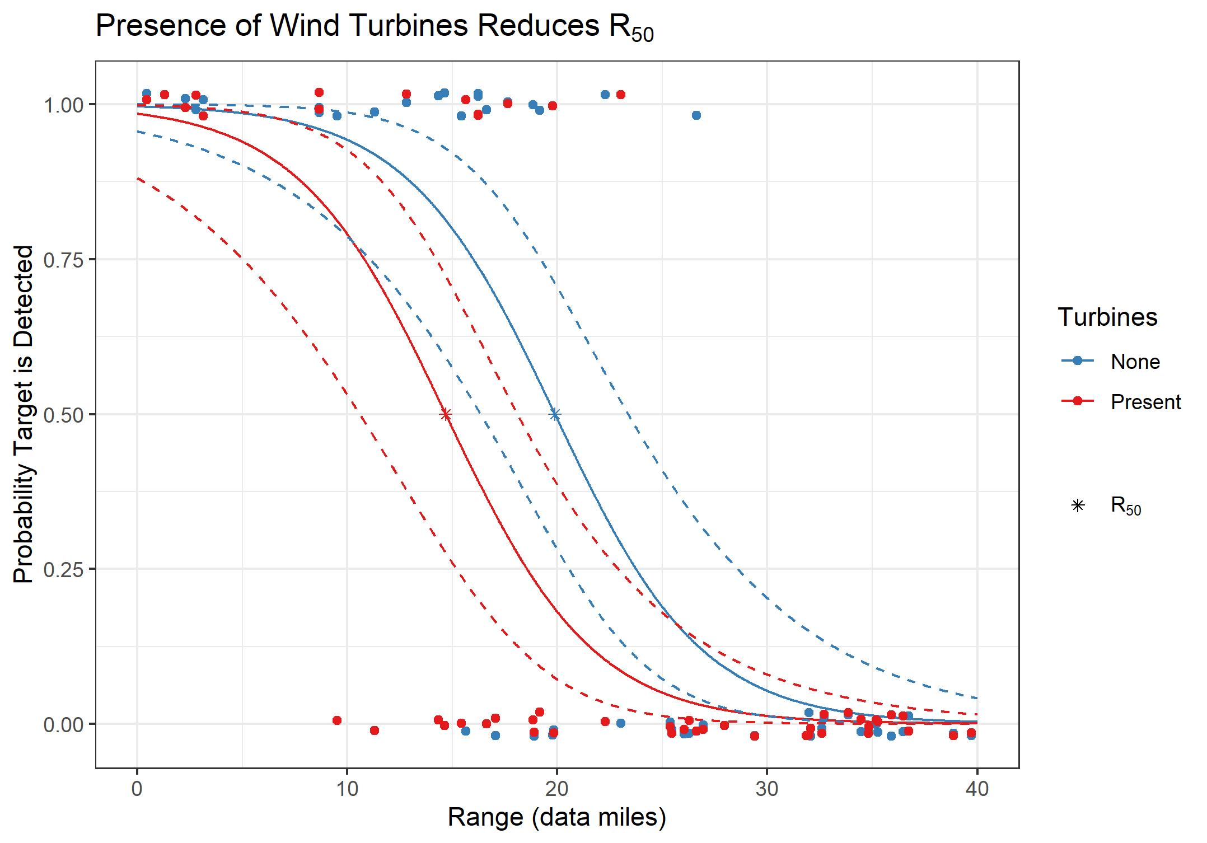
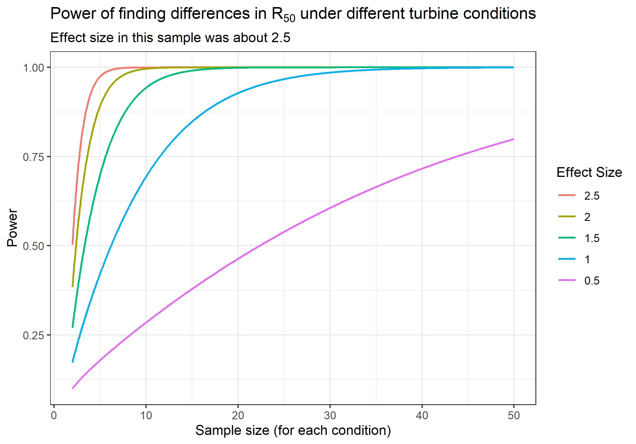
R₅₀ Estimation and Comparison
Levi Baguley
Background and Objectives
Results
In the Air Force, the movement generated by wind farms makes target detection through radar difficult. Some of these radars are designed to report only if a target has been detected or not. Many studies are designed to identify impact of detection capability on radar targeting systems. This project focused on the impact of wind turbine movement on the statistic R₅₀, which is defined as the range at which 50% of the target opportunities will be detected.
Objectives
Develop a model for estimating R₅₀.
Identify impact of target conditions on R₅₀ and estimating impact by formally comparing the R₅₀ under different test conditions.
Develop a means of estimating power and confidence for test resourcing and precision capability.
R₅₀ Estimation and Confidence Intervals
Turbines | R₅₀ | Lower | Upper
None | 19.88 | 16.35 | 23.37
Present | 14.68 | 10.59 | 18.09
Approach
Goals Accomplished
A logistic model was used to model the probability that a target will be detected given the range of the target. Using this model, an estimate of R₅₀ was numerically solved for as the range where there is a 50% probability a target will be detected. Confidence intervals were also solved for using the model.
The impact of wind turbines on R₅₀ was determined from analyzing the significance of the turbines variable in the model. Since the term was significant and it represents a horizontal shift in the two curves, (see results) the estimated R₅₀ was significantly different under the two conditions.
To calculate power it was necessary to estimate the standard deviation of R₅₀. The standard deviation was calculated using the confidence intervals of R₅₀ assuming there are two standard deviations from R₅₀ to the interval bounds. t-test power calculations were the most appropriate for this situation
By the end of this project, a model and a method for estimating R₅₀ was developed and the confidence intervals of R₅₀ were estimated. The impact of the presence of wind turbines on R₅₀ was identified and the power of finding this impact was estimated for different sample sizes and effect sizes. If desired the code for this project can be found here.

