Slide 1


MD-Informed Microfields of HED Plasmas for Line Shape Calculations
APS DPP 2026
6 Nov 2026
Levi Webb
LLNL DSTI Scholar; ISU Physics GA
LLNL-PRES-RR0204906
Notes:
- Line shapes are important in many subfields of plasma physics, but I will motivate my project through stellar and laboratory plasma lenses

Slide 2
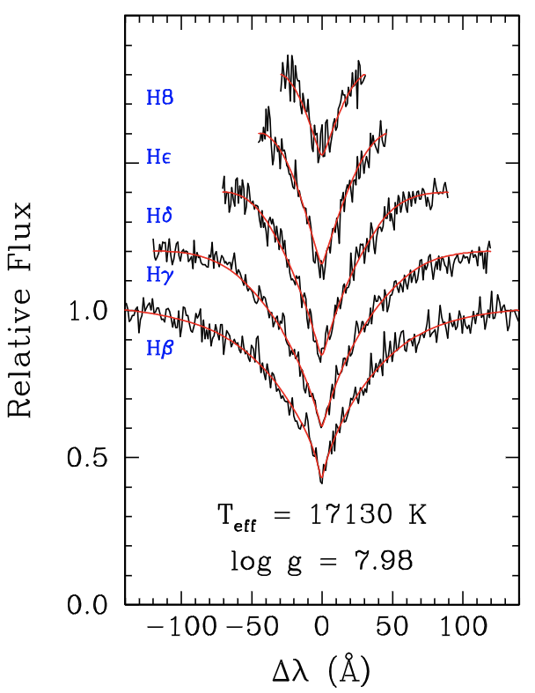
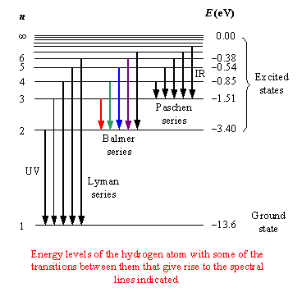
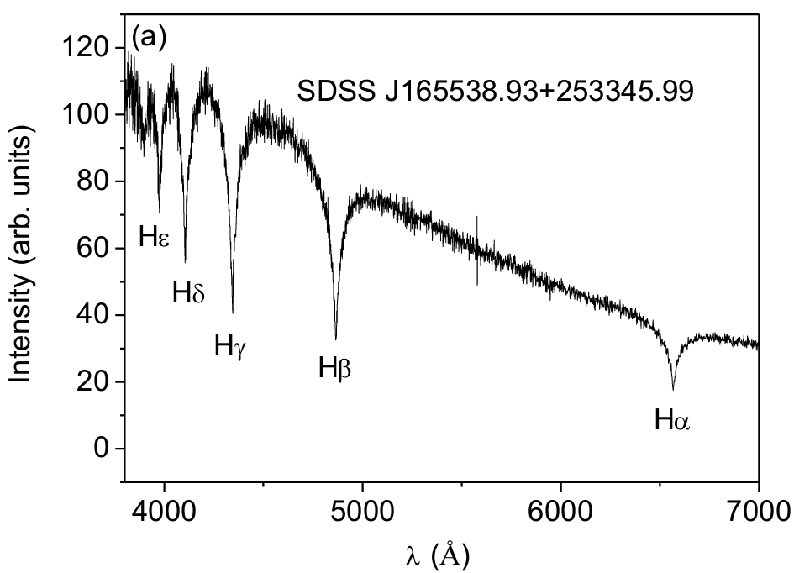
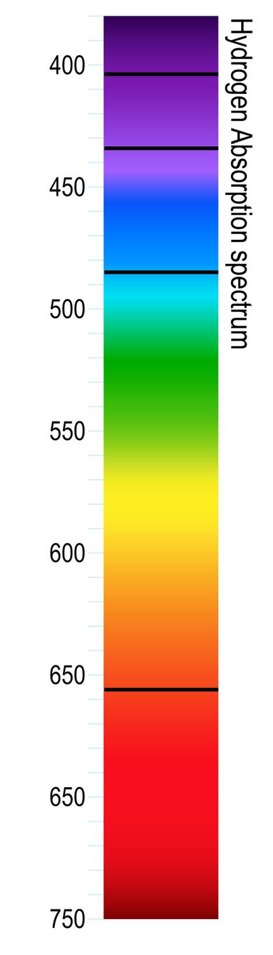
White dwarf (WD) spectra are dominated by Balmer and Lyman lines, which should be simple to model
Genest-Beaulieu 2019
Rosato 2019
LLNL-PRES-RR0204906
L. Webb, APS DPP 2026
Notes:
We learn a lot of information about stars from their spectra, such as their temperature and density, so it’s important that we are able to accurately model them
In particular, WD spectra…

Slide 3
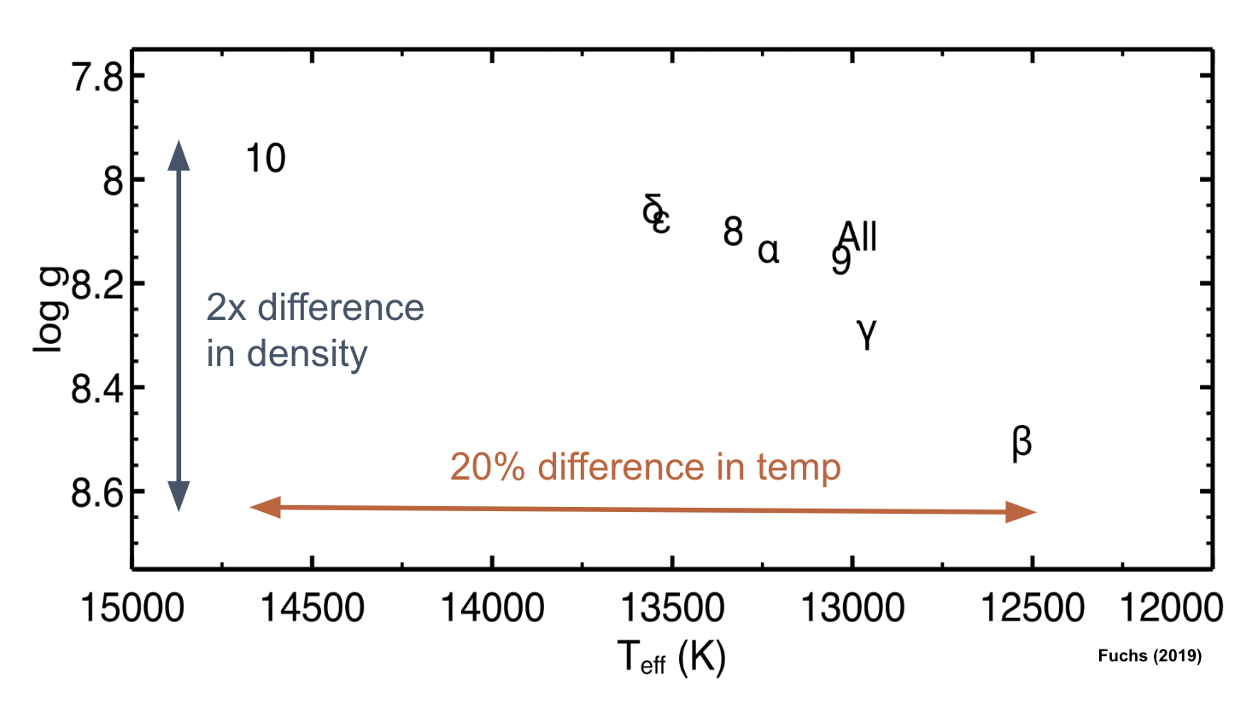
But, fits to these lines from a single WD…
Fuchs 2017
Genest-Beaulieu 2019
Rosato 2019
LLNL-PRES-RR0204906
L. Webb, APS DPP 2026

Slide 4
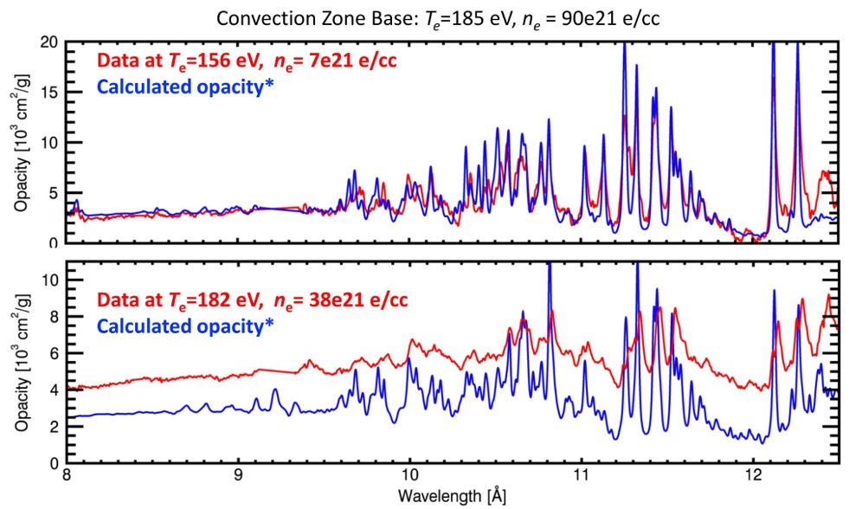
…give vastly different values for its temp. and density
Fuchs 2017
Genest-Beaulieu 2019
LLNL-PRES-RR0204906
L. Webb, APS DPP 2026
Rosato 2019
Bailey et al. 2015

Slide 5
We notice discrepancies between the observed and calculated line shapes of iron opacities
Discrepancies at higher temperatures & densities
Bound-free and bound-bound do not match
Bailey et al. 2015
LLNL-PRES-RR0204906
L. Webb, APS DPP 2026
Fuchs 2017
Genest-Beaulieu 2019
Notes:
-We notice some unfortunate discrepancies at higher temperatures. In particular, current computational models at high temperatures do not match observed laboratory spectra of iron plasmas.
-Iron is important due to its effect on stellar spectra and its abundance in stars
-Specifically, this shows that we have disagreement both in the bound-bound lines AND

Slide 6
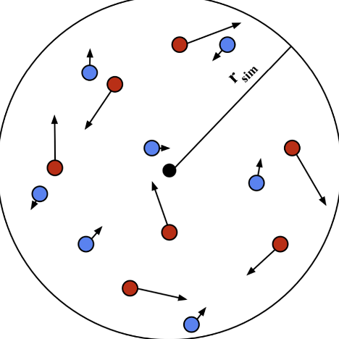
We notice discrepancies between the observed and calculated line shapes of iron opacities
Discrepancies at higher temperatures & densities
Bound-free and bound-bound do not match
Bailey et al. 2015
electrons
ions
radiator
velocity
LLNL-PRES-RR0204906
L. Webb, APS DPP 2026
Notes:
The bound free
-A potential source of these discrepancies may be that…

Slide 7
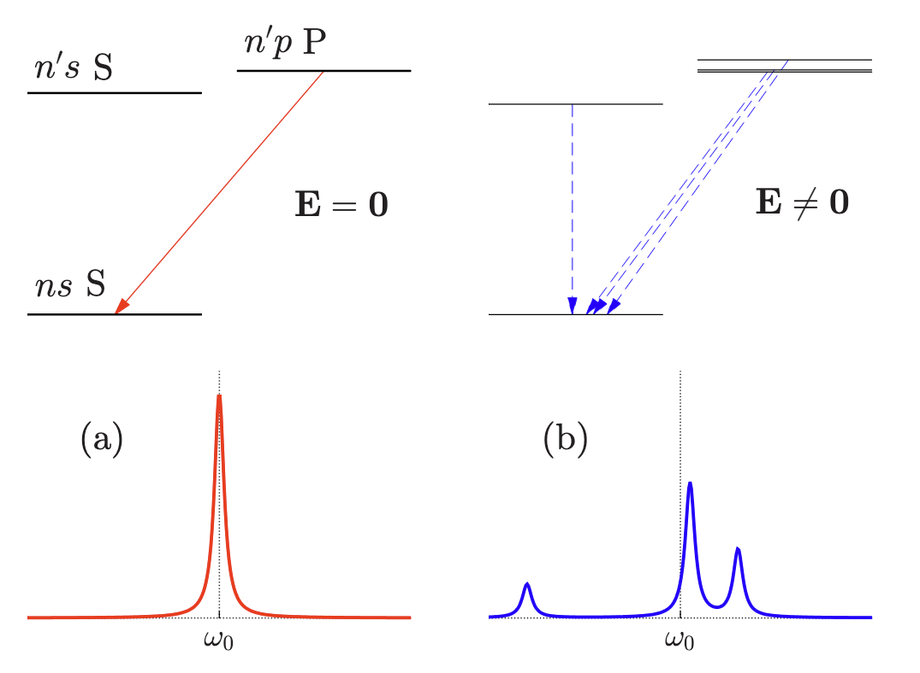
Existing opacity models, such as the line shape code Xenomorph, rely on semi-empirical methods
Gigosos 2014
Simulates straight-line trajectories
Calculates microfields & uses them to create a time-dependent Hamiltonian
Evolves with small timesteps
Uses Fourier transform to calculate line shape
Bailey et al. 2015
electrons
ions
radiator
velocity
Diagram credit:
Jackson White
LLNL-PRES-RR0204906
L. Webb, APS DPP 2026
Notes:
-Current plasma lineshape codes such as, Xenomorph, do not have accurate molecular dynamics simulations informing their outputs for HED plasmas
-This is important because…

Slide 8
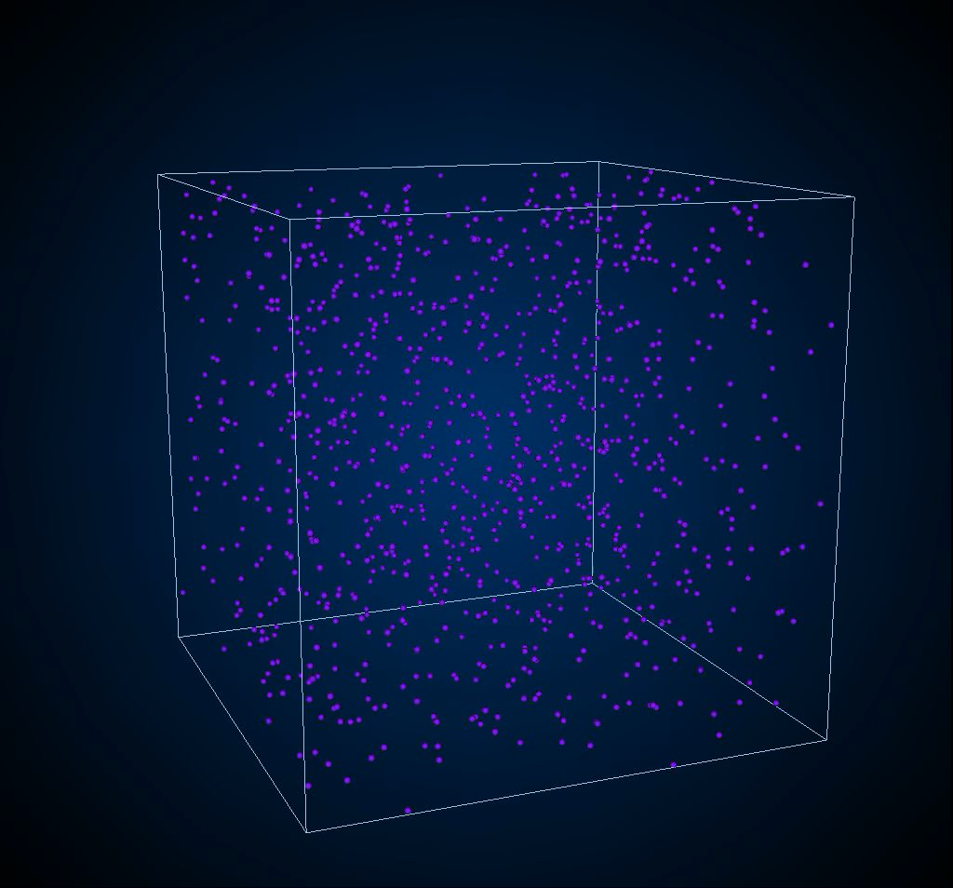
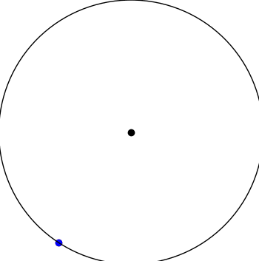
The presence of local electric fields (microfields) is known to affect line shapes
Strongly coupled, dense plasmas have stochastic local electric fields
Line broadening (Stark effect)
Line merging
Pressure ionization
Gigosos 2014
LLNL-PRES-RR0204906
L. Webb, APS DPP 2026
electron
ion
radiator
electrons
ions
radiator
velocity
Notes:
-In a plasma, particles’ motions are largely influenced by nearby ions = stochastic microfields. This largely effects the spectra.
-Illustration: stark broadening in a stationary electric field (analogous to the Zeeman effect for a magnetic field) where you have a regular transition on the left, and the P and S states become coupled due to the presence of an electric field on the right
-It can also cause line merging and pressure ionization, both of which affect the continuum opacity
-Incorporating accurate microfield physics into Xenomorph will therefore improve line shape models and hopefully reconcile the opacity discrepancies introduced earlier. We do this with…

Slide 9
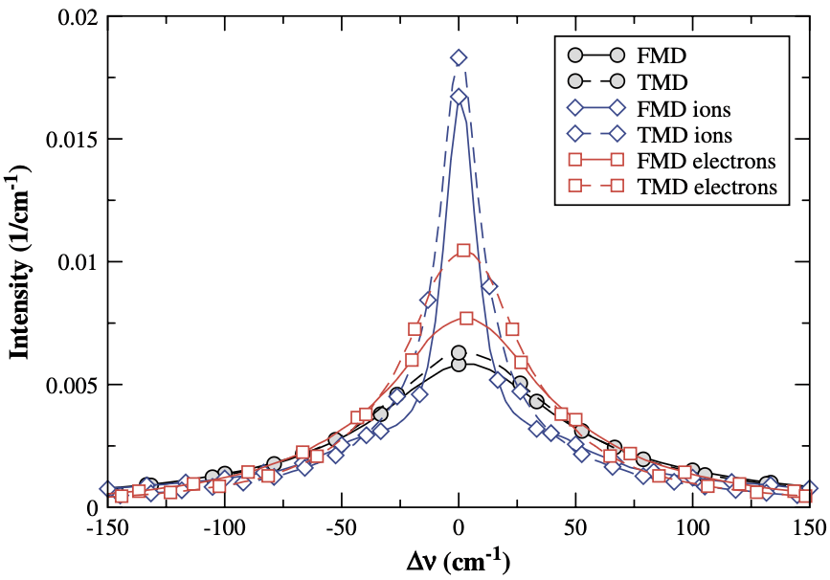
We use LAMMPS to simulate a 1 eV, 10¹⁸ e/cc HED plasma with full MD
electron
ion
radiator
Diagram credit:
Jackson White
LLNL-PRES-RR0204906
L. Webb, APS DPP 2026
Stambulchik et al. 2007
Notes:
Full MD……..
We use these conditions because…

Slide 10
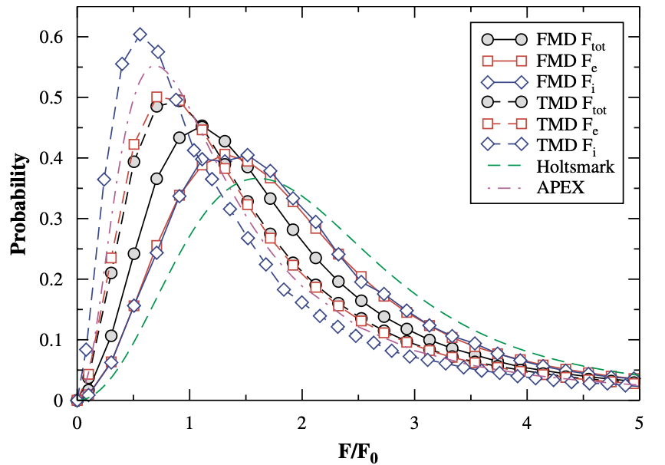
Physically-motivated microfield generators may alleviate these spectral discrepancies
electron
ion
radiator
Stambulchik et al. 2007
LLNL-PRES-RR0204906
L. Webb, APS DPP 2026
Stambulchik et al. 2007
Notes:
In fact, there was already a study that compared trivial MD simulations with straight-line trajectories and full MD simulations with complete modeling of particle interactions

Slide 11

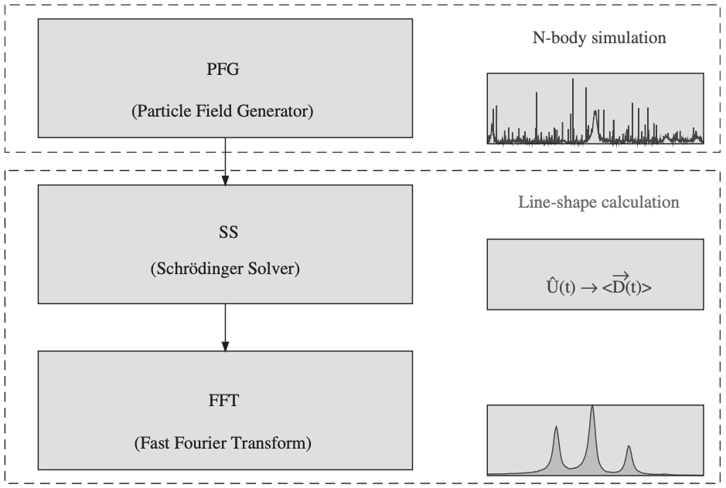
Physically-motivated microfield generators may alleviate these spectral discrepancies
Stambulchik et al. 2007
Stambulchik et al. 2007
LLNL-PRES-RR0204906
L. Webb, APS DPP 2026
Stambulchik & Maron 2006
Notes:
In fact, there was already a study that compared trivial MD simulations with straight-line trajectories and full MD simulations with complete modeling of particle interactions

Slide 12
Physically-motivated microfield generators may alleviate these spectral discrepancies
Stambulchik et al. 2007
Stambulchik et al. 2007
Stambulchik & Maron 2006
LLNL-PRES-RR0204906
L. Webb, APS DPP 2026
Notes:
In fact, there was already a study that compared trivial MD simulations with straight-line trajectories and full MD simulations with complete modeling of particle interactions

Slide 13
Physically-motivated microfield generators may alleviate these spectral discrepancies
Stambulchik et al. 2007
Stambulchik et al. 2007
Stambulchik & Maron 2006
LLNL-PRES-RR0204906
L. Webb, APS DPP 2026
Notes:
They found that the differences between trivial and full MD were insignificant enough that TMD is sufficiently accurate; however, they use a Coulomb potential, which leads to non-physical dynamics at close approach such that electrons inspiral onto ions.
There are many ways to avoid this so-called Coulomb catastrophe, one of which being quantum-statistical corrections to the Coulomb potential. We use…

Slide 14
We use an improved Kelbg potential to correct Coulomb at small r
Pure Coulomb
Quantum-statistical Kelbg potential correction with fitting parameter γ_{ij} from Filinov et al. 2003
LLNL-PRES-RR0204906
L. Webb, APS DPP 2026
Stambulchik et al. 2007
Stambulchik et al. 2007
Stambulchik & Maron 2006
Notes:
-…the improved Kelbg potential with fitting parameter gamma-i-j from Filinov et al. 2003
-The fits we use for gamma were published earlier this year…

Slide 15

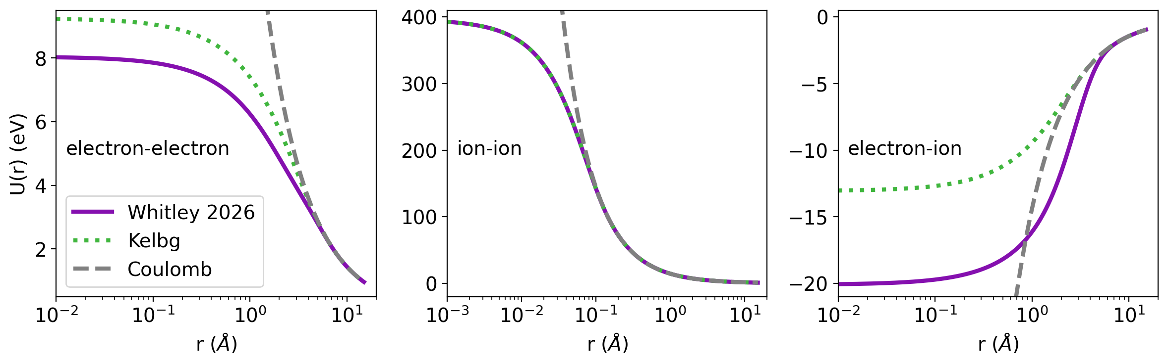
We use an improved Kelbg potential to correct Coulomb at small r
where
Whitley et al. 2026
LLNL-PRES-RR0204906
L. Webb, APS DPP 2026
Stambulchik et al. 2007
Stambulchik et al. 2007
Stambulchik & Maron 2006
Notes:
-…by Whitley et al., who propose these physically-motivated fits for each pair interaction. And here is what these look like…

Slide 16
We use an improved Kelbg potential to correct Coulomb at small r
where
Whitley et al. 2026
LLNL-PRES-RR0204906
L. Webb, APS DPP 2026
Notes:
-…when applied to the Coulomb potential
-After incorporating these corrections into our LAMMPS simulations…
[Whitley also uses a Pauli term in the electron-electron potential, and I think I made this plot before realizing that, so it’s off. They use Deutsch and we use low-density-lado]

Slide 17
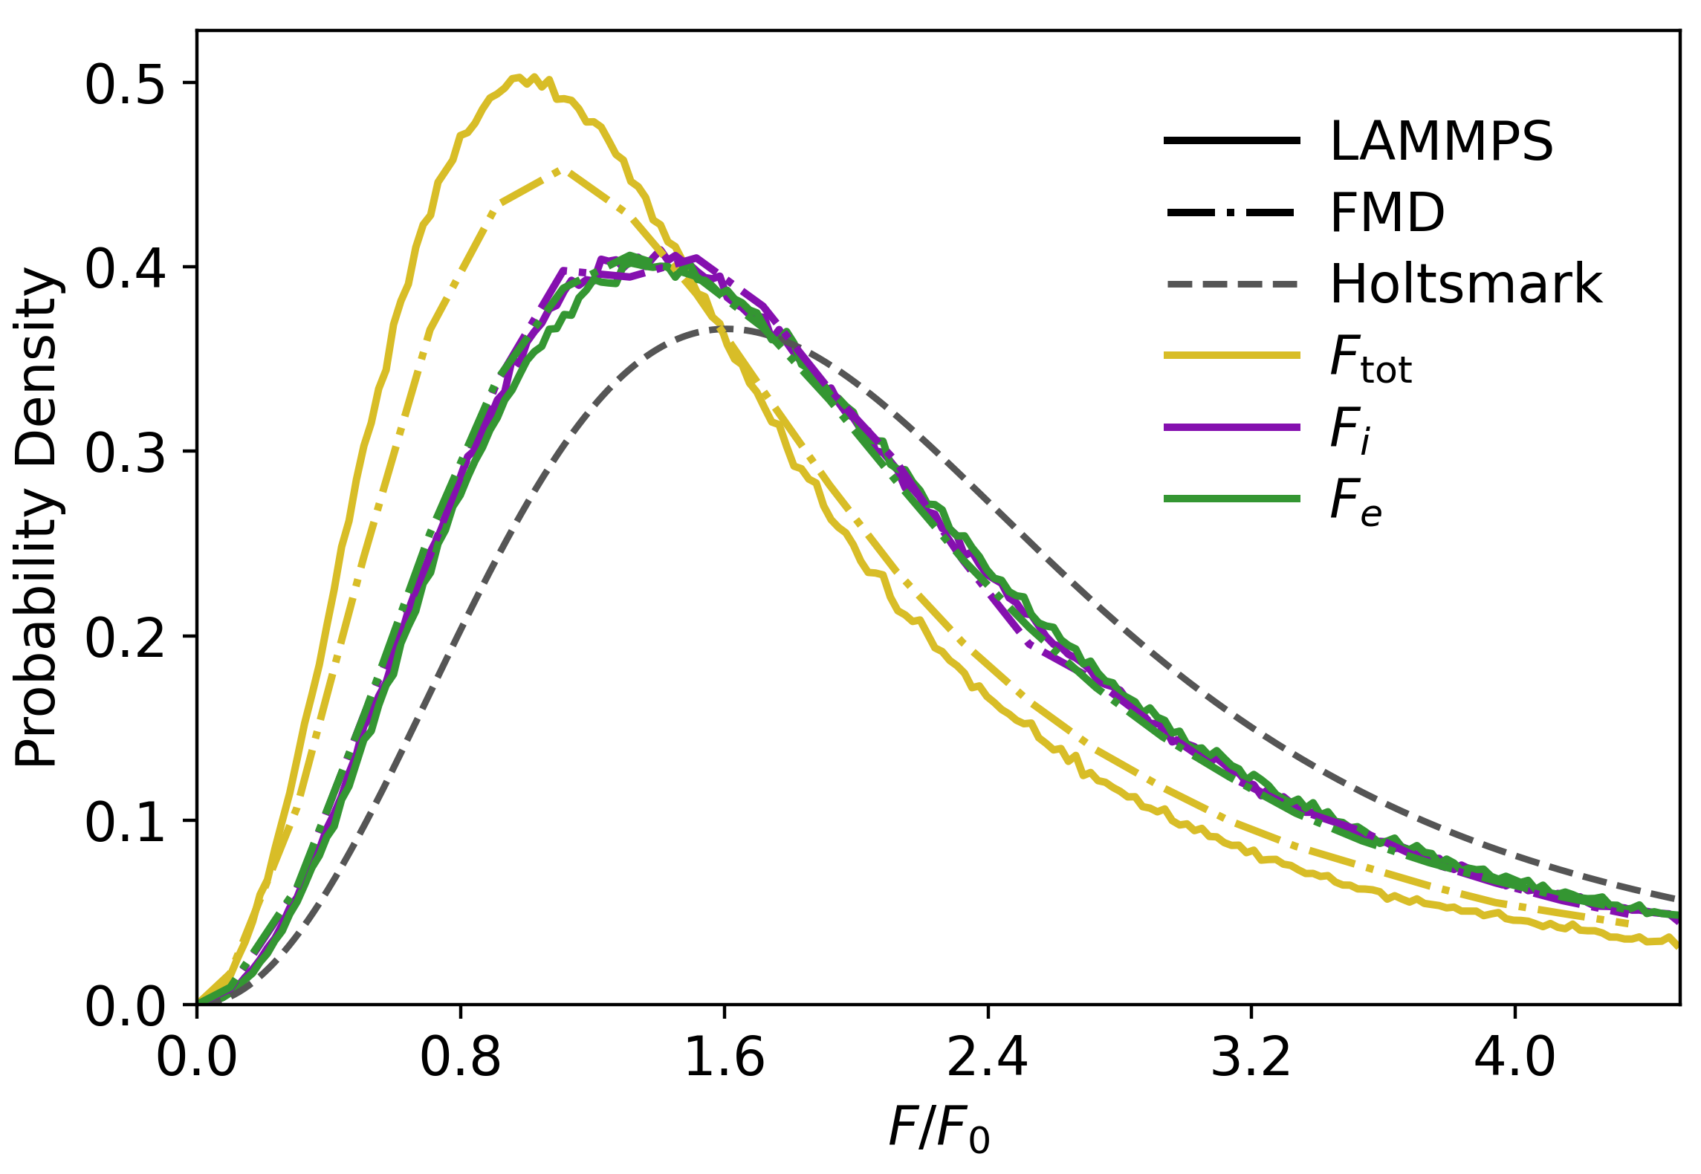
Summer results disagree with the original Stambulchik et al. 2007 work
where
Whitley et al. 2026
Webb et al. (in prep.)
LLNL-PRES-RR0204906
L. Webb, APS DPP 2026
Notes:
-…we get an initial microfield distribution that disagrees with the original Stambulchik paper’s full MD
-However… we have agreement when energy is not conserved

Slide 18
Summer results disagree with the original Stambulchik et al. 2007 work
Agreement when energy is not conserved
Disagreement otherwise, but conservation is imperfect
Webb et al. (in prep.)
LLNL-PRES-RR0204906
L. Webb, APS DPP 2026
Notes:
-We are still investigating exactly why this disagreement occurs. There are many possibilities---the obvious being that we are using an essentially completely different potential---that we will discuss in the paper… once we have the corresponding line shapes from Xenomorph to assess the physical accuracy of our simulations

Slide 19
Summer results disagree with the original Stambulchik et al. 2007 work
Agreement when energy is not conserved
Disagreement otherwise, but conservation is imperfect
Next step is to calculate line shapes from Xenomorph
Working on other conditions
  Charged tracers
  Higher temperature
Webb et al. (in prep.)
LLNL-PRES-RR0204906
L. Webb, APS DPP 2026
Notes:
-These results are sampled from simulated neutral, non-interacting tracer particles around the plasma, but we also want to investigate the impact of measuring the microfields with charged tracer particles, as well as demonstrating effects at higher temperatures
-Keep an eye out for our upcoming paper to see more results… and thank you

Slide 20
Thank you for your attention.
References:
Bailey et al. 2015 Nature 517 14048
Dimitrijevic & Konjevic 1980 JQSRT 24 451-459
Fuchs, Joshua 2017 UNC Chapel Hill, Dissertation
Filinov et al 2003 J. Phys. A: Math. Gen. 36 5957
Genest-Beaulieu, Cynthia 2019 ApJ 871:169
Gigosos, Marco Antonio 2014 J. Phys. D: Appl. Phys. 47 343001
Gomez, Thomas 2013 UT Austin, MS Thesis
Rosato, Joël 2019 Eur. Phys. J. D 73, 7
Stambulchik & Maron 2006 JQSRT 99 730-749
Stambulchik et al. 2007 Science Direct: HEDP 3 272-277
Thompson et al. 2022 Comp Phys Comm 271 10817
LLNL-PRES-RR0204906
L. Webb, APS DPP 2026

