Slide 1

2D Collision
Knox Game Design
February 2022
Levi D. Smith

Slide 2
Collision between two points
x₁ = x₂, y₁ = y₂
Useful for grid style games
rows = y
columns = x
Tolerance value (especially for non-integers)
Screen coordinates
x increases left to right
y increases top to bottom

Slide 3
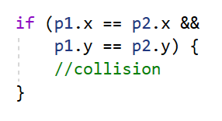
x
0
SCREEN_WIDTH
0
x₂, y₂
y
x₁, y₁
SCREEN_HEIGHT

Slide 4
x
x
0
0
0
0
5 ≠ 1
2 ≠ 4
❌
5 ≠ 1
4 = 4
❌
(5, 2)
❌
✔️
y
(1, 4)
(1, 4)
(5, 4)
y
x
x
0
0
0
1 = 1
2 ≠ 4
0
✔️
1 = 1
4 = 4
✔️
(1, 2)
❌
✔️
y
(1, 4)
y
(1, 4)
(1, 4)

Slide 5
Collision between point and line
line is defined by two points (x₁, y₁) - (x₂, y₂)
y = mx + b
m: slope, rise over run (y₂ - y₁) / (x₂ - x₁)
Watch out for integer rounding!
b: Apply line point and slope values and solve
b = y₁ - (m * x₁)
Can use either line end point, should get the same result
Plug in point to test for collision into equation to test for validity

Slide 6
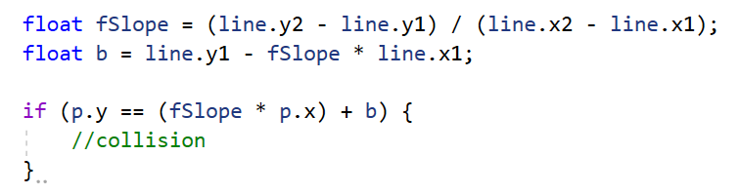
x
0
SCREEN_WIDTH
0
line(x₁, y₁)
y
x₂, y₂
line(x₂, y₂)
SCREEN_HEIGHT

Slide 7
y = mx + b
m = (1 - 5) / (6 - 4)
= -4 / 2
= -2
b = y - mx
= 1 - (-2 * 6)
= 1 - (-12)
= 13
y = -2x + 13
x
3 = (-2 * 2) + 13
3 = (-4) + 13
3 ≠ 9
0
0
❌
(2,3)
(6, 1)
y
(4, 5)
x
0
3 = (-2 * 5) + 13
3 = (-10) + 13
3 = 3
0
✔️
(6, 1)
(5,3)
y
(4, 5)

Slide 8
Collision between line and line
Two lines: y = m₁x+b₁ , y = m₂x+b₂
Determine where the lines cross:
m₁x+b₁ = m₂x+b₂
Solve for x
x = (-b₁ + b₂)/(m₁ - m₂)
Verify that x falls between min and max x values for both segments
x >= line1_{min(x)}
x <= line1_{max(x)}
x >= line2_{min(x)}
x <= line2_{max(x)}
Alternatively, use determinants

Slide 9
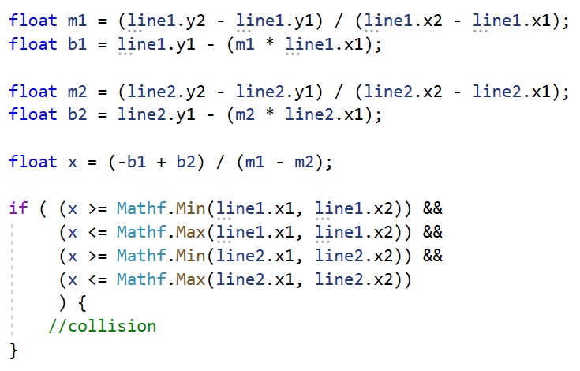
x
0
SCREEN_WIDTH
0
line2(x₁, y₁)
line1(x₁, y₁)
y
line2(x₂, y₂)
line1(x₂, y₂)
SCREEN_HEIGHT

Slide 10
m₁ = (1 - 5) / (6 - 4)
= -2
b₁ = 1 - (-2 * 6)
= 13
m₂ = (3 - 4)/(2-3)
= 1
b₂ = 4 - (1 * 3)
= 1
x = (-13 + 1) / (-2 - 1)
= -12 / -3
= 4
4 >= 4
4 <= 6
4 >= 2
4 > 3
x
0
0
(6, 1)
✔️
(2,3)
✔️
y
(3,4)
✔️
(4, 5)
❌
m₁ = (1 - 5) / (6 - 4)
= -2
b₁ = 1 - (-2 * 6)
= 13
m₂ = (1 - 7)/(3 - 6)
= 2
b₂ = 1 - (2 * 3)
= -5
x = (-13 + -5) / (-2 - 2)
= -18 / -4
= 4.5
4.5 >= 4
4.5 <= 6
4.5 >= 3
4.5 <= 6
x
0
0
(3,1)
✔️
(6, 1)
✔️
y
✔️
(4, 5)
✔️
(6,7)

Slide 11
Collision between point and rectangle
Point: p_{x}, p_{y}
Rectangle: r_{x}, r_{y}, r_{w}, r_{h}
p_{x} >= r_{x}
p_{x} <= r_{x} + r_{w}
p_{y} >= r_{y}
p_{y} <= r_{y} + r_{h}
All rules must be valid for collision

Slide 12
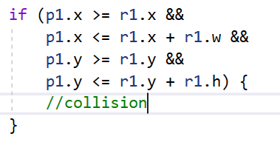
x
0
SCREEN_WIDTH
0
r_{x}, r_{y}
r_{x+w}, r_{y}
y
p_{x},p_{y}
r_{x}, r_{y+h}
r_{x+w}, r_{y+h}
SCREEN_HEIGHT

Slide 13
x
x
0
0
0
(2, 1)
4
1 < 2
1 < 2 + 4
3 > 1
3 < 1 + 3
❌
0
(2, 1)
4
5 > 2
5 < 2 + 4
3 > 1
3 < 1 + 3
✔️
✔️
✔️
3
✔️
3
✔️
(1,3)
(5,3)
✔️
✔️
y
y
x
0
0
(2, 1)
4
7 > 2
7 > 2 + 4
5 > 1
5 > 1 + 3
✔️
❌
3
✔️
❌
y
(7,5)
Note - ✔️and ❌signify whether it broke the rule; does not signify if it is a valid statement

Slide 14
Collision between two rectangles
Easier to test when rectangles don't collide, then NOT the result
r2.x + r2.w < r1.x (to the left)
r2.x > r1.x + r1.w (to the right)
r2.y + r2.h < r1.y (above)
r2.y > r1.y + r1.h (below)
DeMorgan's Theorem
(NOT a) AND (NOT b) = NOT (a OR b)
Note - Square is a special instance of rectangle where r_{w} = r_{h}

Slide 15
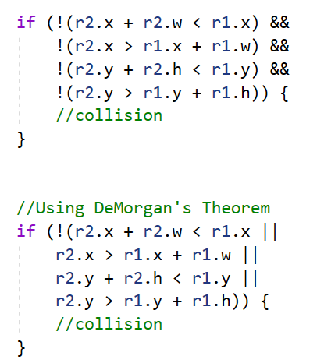
x
0
SCREEN_WIDTH
0
r1_{x+w}, r1_{y}
r1_{x}, r1_{y}
r2_{x}, r2_{y}
r2_{x+w}, r2_{y}
y
r1_{x}, r1_{y+h}
r1_{x+w}, r1_{y+h}
r2_{x}, r2_{y+h}
r2_{x+w}, r2_{y+h}
SCREEN_HEIGHT

Slide 16
x
(3, 0)
x
0
0
6
0
(4, 1)
4
left:
right:
above:
below:
1 + 1 < 4
1 < 4 + 4
2 + 1 > 1
2 < 1 + 3
not all
✔️
0
(1, 2)
(4, 1)
4
left:
right:
above:
below:
3 + 6 > 4
3 < 4 + 4
0 + 5 > 1
0 < 1 + 3
not all
❌
1
❌
❌
1
3
❌
❌
❌
3
5
❌
y
❌
y
✔️
x
0
x
0
(4, 1)
4
left:
right:
above:
below:
1 + 5 > 4
1 < 4 + 4
2 + 1 > 1
2 < 1 + 3
not all
❌
0
(1, 2)
0
(4, 1)
left:
right:
above:
below:
1 + 2 < 4
1 < 4 + 4
8 + 1 > 1
8 > 1 + 3
not all
✔️
5
❌
4
❌
❌
1
3
✔️
❌
3
❌
y
✔️
(1, 8)
2
y
❌
1
Any ✔️ signifies that it satisfied the rule, meaning that it does not collide. Must break all rules (all ❌) to confirm collision.

Slide 17
Collision between two circles
Pythagorean Theorem
a² + b² = c²
Using a triangle to detect collision between circles doesn't seem intuitive
Find distance between the centers of the two circles
If the distance is less than the sum of the two radius values, then the two circles collide
Note - Collision between point an circle, use circle for point with radius equal to zero
Theoretically, could test collision between two points using Pythagorean Theorem and check for distance of zero
Does not work for ovals, sorry!

Slide 18
x
0
SCREEN_WIDTH
0
c1_{x}, c1_{y}
y
c1_{r}
c2_{x}, c2_{y}
c2_{r}
SCREEN_HEIGHT

Slide 19
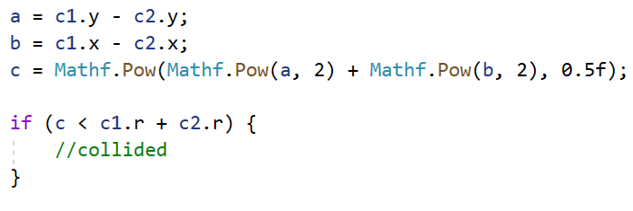
x
a = c1_{y} - c2_{y}
b = c1_{x} - c2_{x}
c = (a² + b²)^{1/2}
0
SCREEN_WIDTH
0
if c < (c1r + c2r)
then collided
c1_{x}, c1_{y}
y
c1_{r}
c
a
c2_{x}, c2_{y}
b
c2_{r}
SCREEN_HEIGHT

Slide 20
0
x
a = 3 - 4
= -1
b = 2 - 7
= -5
c = (-1² + -5²)^{1/2}
= 5.01
5.01 > 2 + 1
0
2
(2,3)
1
(7,4)
y
❌
0
x
a = 3 - 4
= -1
b = 2 - 3
= -1
c = (-1² + -1²)^{1/2}
= 1.41
1.41 < 2 + 1
0
2
(2,3)
1
y
(3,4)
✔️

Slide 21
Built in collision functions
GameMaker
place_meeting
https://manual.yoyogames.com/#t=GameMaker_Language%2FGML_Reference%2FMovement_And_Collisions%2FCollisions%2FCollisions.htm
Unity
OnCollisionEnter2D
https://docs.unity3d.com/ScriptReference/Collision2D.html
Godot
CollisionShapes, collide
https://docs.godotengine.org/en/latest/tutorials/physics/collision_shapes_2d.html

