Slide 1
ATLAS PHASE 2 · PAYROLL
Computational Basis
How computations are created, assigned to clients, and consumed across payroll and connected modules
Define
Test & Version
Assign
Consume & Trace
Working prototype · finance-user walkthrough · every application screen in this deck is live evidence
Notes:
Presenter note: explain this slide from a finance-user perspective and distinguish setup-time governance from transaction-time execution.
[Sources]
- Live ATLAS prototype and ATLAS_Phase2_Computational_Basis_Demo_v2.pptx
- Evidence captured 24 August 2026 in the local ATLAS application.

Slide 2
LEARNING PATH
What finance users will understand
1
Purpose
Why Computational Basis exists and which objects it governs.
2
Create
How to build a computation from approved variables and operators, then test it.
3
Assign
How client assignments define type, reference table, employee group, frequency and status.
4
Consume
What payroll and other modules must provide before they can execute a computation.
5
Trace
How versions, reference sources, transaction trails, payslips and reports preserve the result.
Notes:
Presenter note: explain this slide from a finance-user perspective and distinguish setup-time governance from transaction-time execution.
[Sources]
- Live ATLAS prototype and ATLAS_Phase2_Computational_Basis_Demo_v2.pptx
- Evidence captured 24 August 2026 in the local ATLAS application.

Slide 3
THE IDEA IN ONE PICTURE
A computation moves through five controlled stages
1
2
3
4
5
Define
Build & test
Publish version
Assign
Consume & trace
Give the computation a code, name, category and business purpose.
Combine approved variables and operators; prove the result with sample inputs.
Set the effective date and change note so history remains reproducible.
Match the code to a client use case, employee group and payroll frequency.
A module supplies real inputs, invokes the code and records the result chain.
Creation makes the formula governed. Assignment makes it eligible. A consuming module call makes it execute.
Source · live ATLAS prototype and application computation catalog / payroll engine
Notes:
Presenter note: explain this slide from a finance-user perspective and distinguish setup-time governance from transaction-time execution.
[Sources]
- Live ATLAS prototype and ATLAS_Phase2_Computational_Basis_Demo_v2.pptx
- Evidence captured 24 August 2026 in the local ATLAS application.

Slide 4
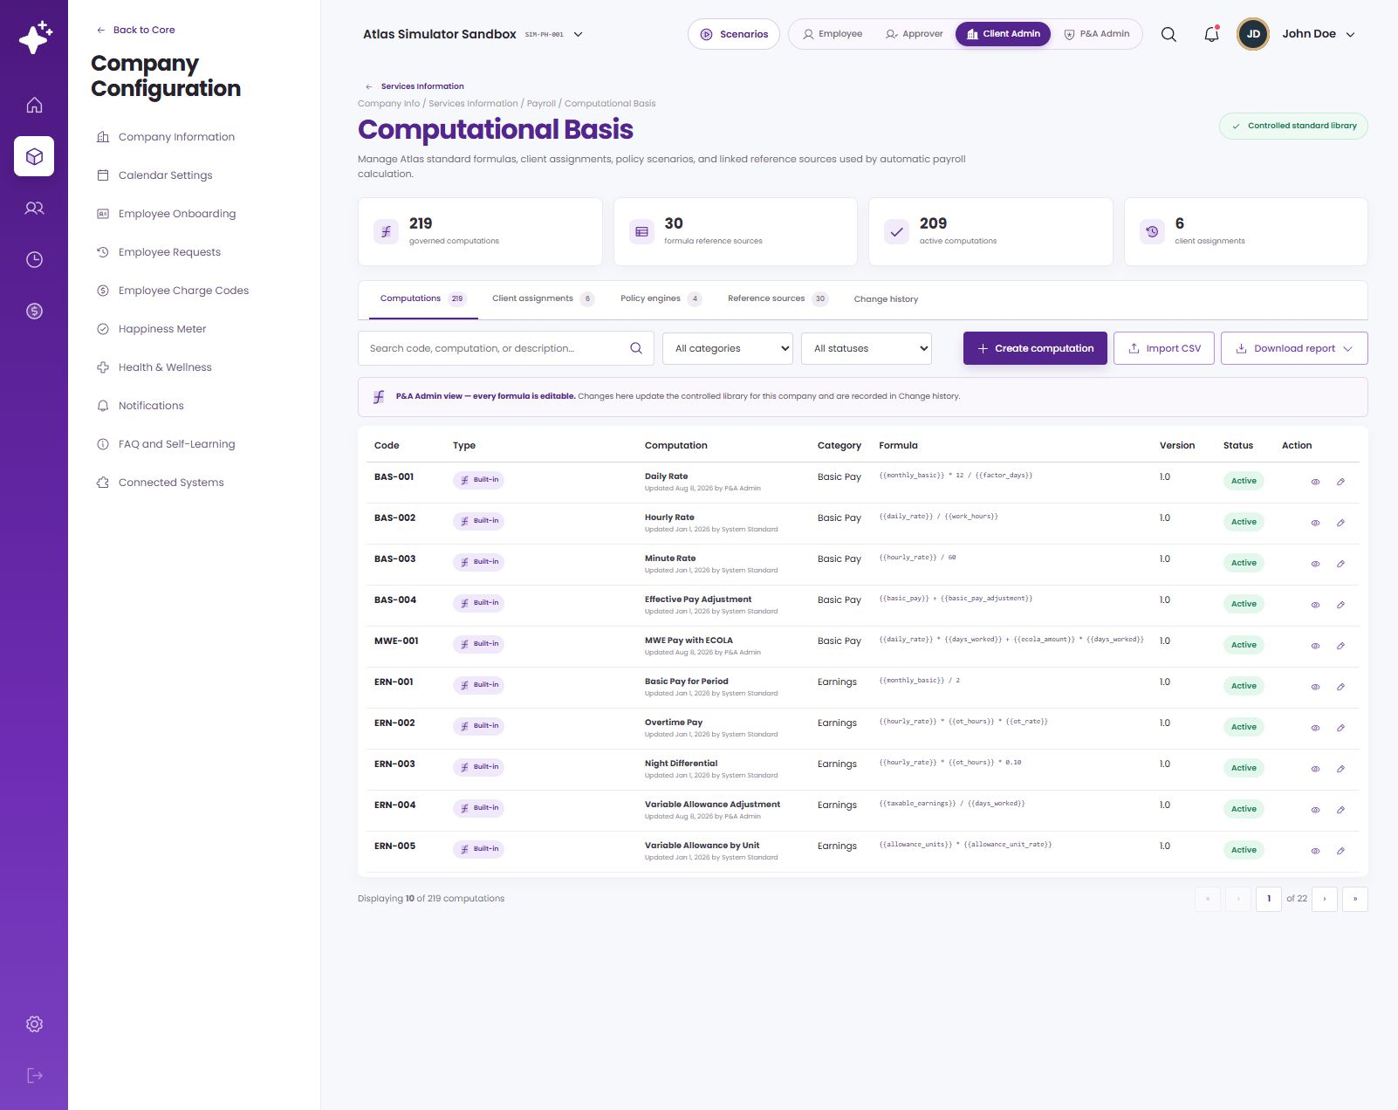
ORIENTATION
Where Computational Basis sits
One governed workspace
Computations, client assignments, policy engines, reference sources and change history share one controlled area.
Payroll service context
The workspace belongs under Payroll because its outputs become payroll inputs, calculations and audit evidence.
Reached from
Company Info → Services Information → Payroll → Computational Basis.
Computational Basis — live application view
Source · requested information architecture and live ATLAS prototype
Notes:
Presenter note: explain this slide from a finance-user perspective and distinguish setup-time governance from transaction-time execution.
[Sources]
- Live ATLAS prototype and ATLAS_Phase2_Computational_Basis_Demo_v2.pptx
- Evidence captured 24 August 2026 in the local ATLAS application.

Slide 5
CORE CONCEPTS
What each object means
Computational variable
Consumer
An approved input token, such as allowance_units, salary or overtime_hours.
Payroll or another module that supplies actual inputs and invokes the computation code.
Expression
Version
The readable formula assembled from approved variables and operators.
An effective-dated formula state retained so historical transactions can be reproduced.
Computation code
Policy engine
The stable identifier a consuming module calls, for example CUS-900 or ERN-002.
An existing specialized consumer for policy families; it is context, not the focus of this walkthrough.
Client assignment
Trace
The applicability rule linking a code to a type, reference table, employee group and frequency.
The evidence chain from source fields and assignment through formula, result and output.
Reference source
An effective-dated rate, ceiling, table or business ordering used by formula inputs.
Notes:
Presenter note: explain this slide from a finance-user perspective and distinguish setup-time governance from transaction-time execution.
[Sources]
- Live ATLAS prototype and ATLAS_Phase2_Computational_Basis_Demo_v2.pptx
- Evidence captured 24 August 2026 in the local ATLAS application.

Slide 6
THE LIBRARY
Every computation has an identity and lifecycle
Standard and custom codes
The same catalog exposes governed standard codes and finance-created custom computations.
Searchable metadata
Code, name, category, status and description help users find the right computation before assigning it.
Open one record
Review its expression, mapped fields, test state, effective version and change history.
Computations register — live application view
Source · live ATLAS Computational Basis → Computations
Notes:
Presenter note: explain this slide from a finance-user perspective and distinguish setup-time governance from transaction-time execution.
[Sources]
- Live ATLAS prototype and ATLAS_Phase2_Computational_Basis_Demo_v2.pptx
- Evidence captured 24 August 2026 in the local ATLAS application.

Slide 7
COMPUTATION · DEMO
Create a variable-based computation from start to finish
Watch the governed creation flow
1 · Enter code, name, category, status and business description.
2 · Build the expression from approved fields.
3 · Test sample inputs, add effectivity and publish the version.
Animated walkthrough — plays automatically in Slide Show
Notes:
Presenter note: explain this slide from a finance-user perspective and distinguish setup-time governance from transaction-time execution.
[Sources]
- Live ATLAS prototype and ATLAS_Phase2_Computational_Basis_Demo_v2.pptx
- Evidence captured 24 August 2026 in the local ATLAS application.

Slide 8
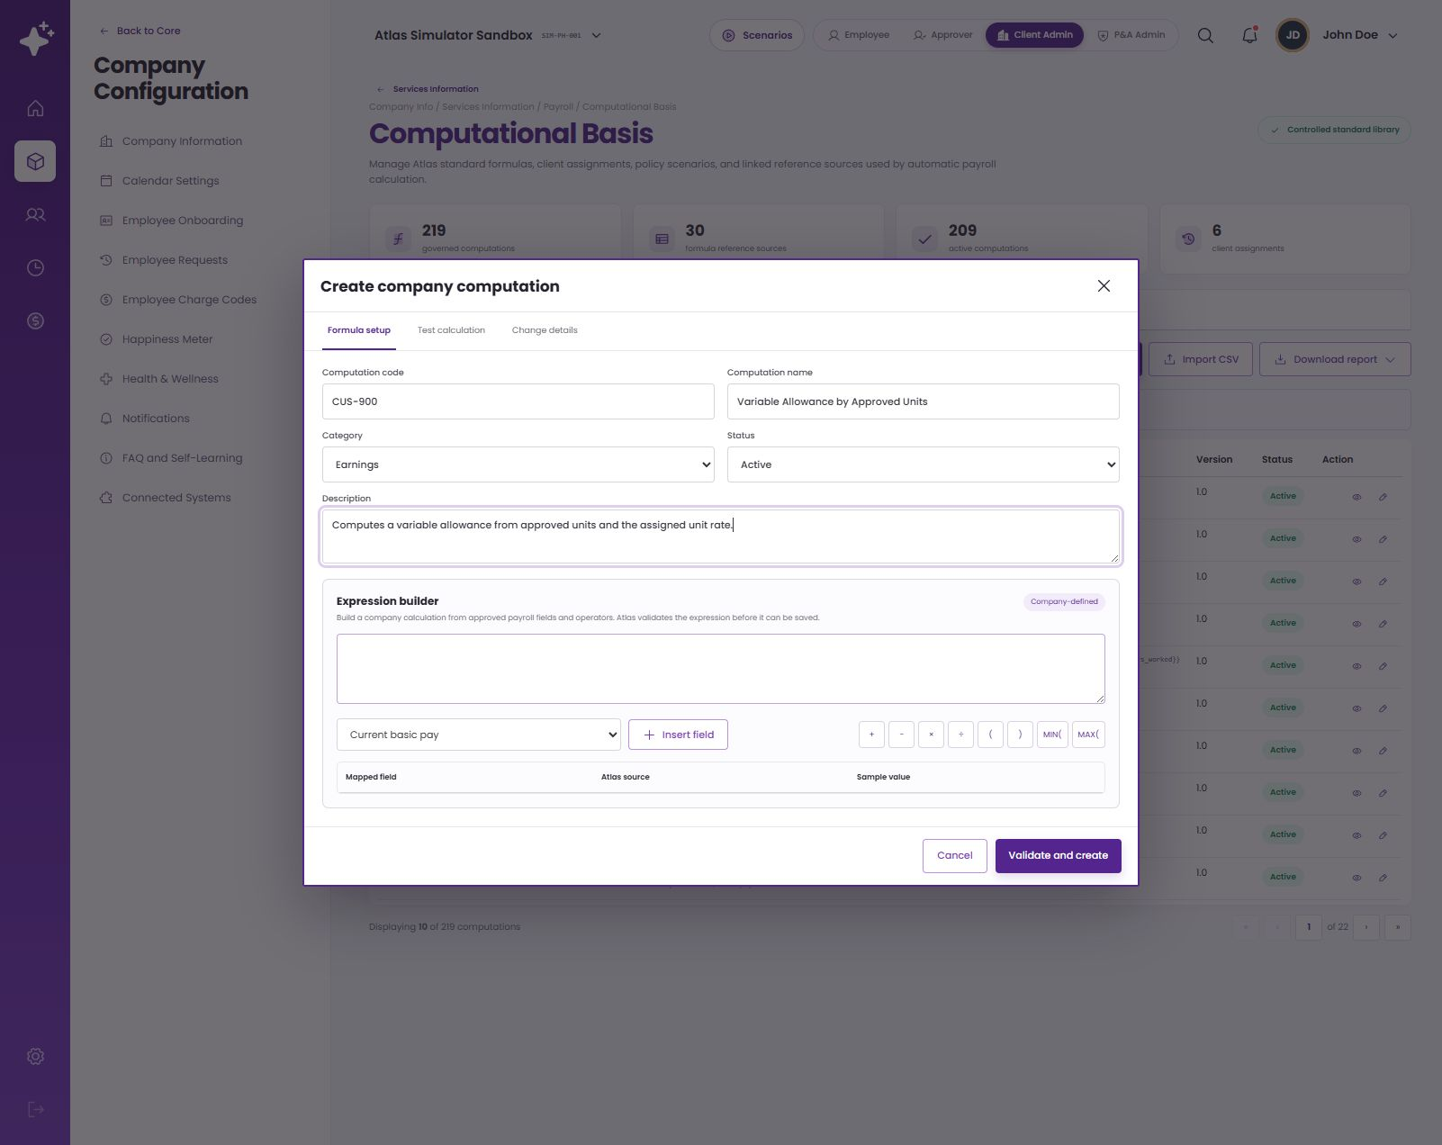
CREATING A COMPUTATION
Step 1 — define its business identity
Metadata is the control surface
CUS-900 · Variable Allowance by Approved Units · Earnings · Active
Use a stable code and a plain-language description so finance, implementers and auditors agree on what the formula is intended to calculate.
Source · live create-computation workflow; demonstration code CUS-900
Notes:
Presenter note: explain this slide from a finance-user perspective and distinguish setup-time governance from transaction-time execution.
[Sources]
- Live ATLAS prototype and ATLAS_Phase2_Computational_Basis_Demo_v2.pptx
- Evidence captured 24 August 2026 in the local ATLAS application.

Slide 9
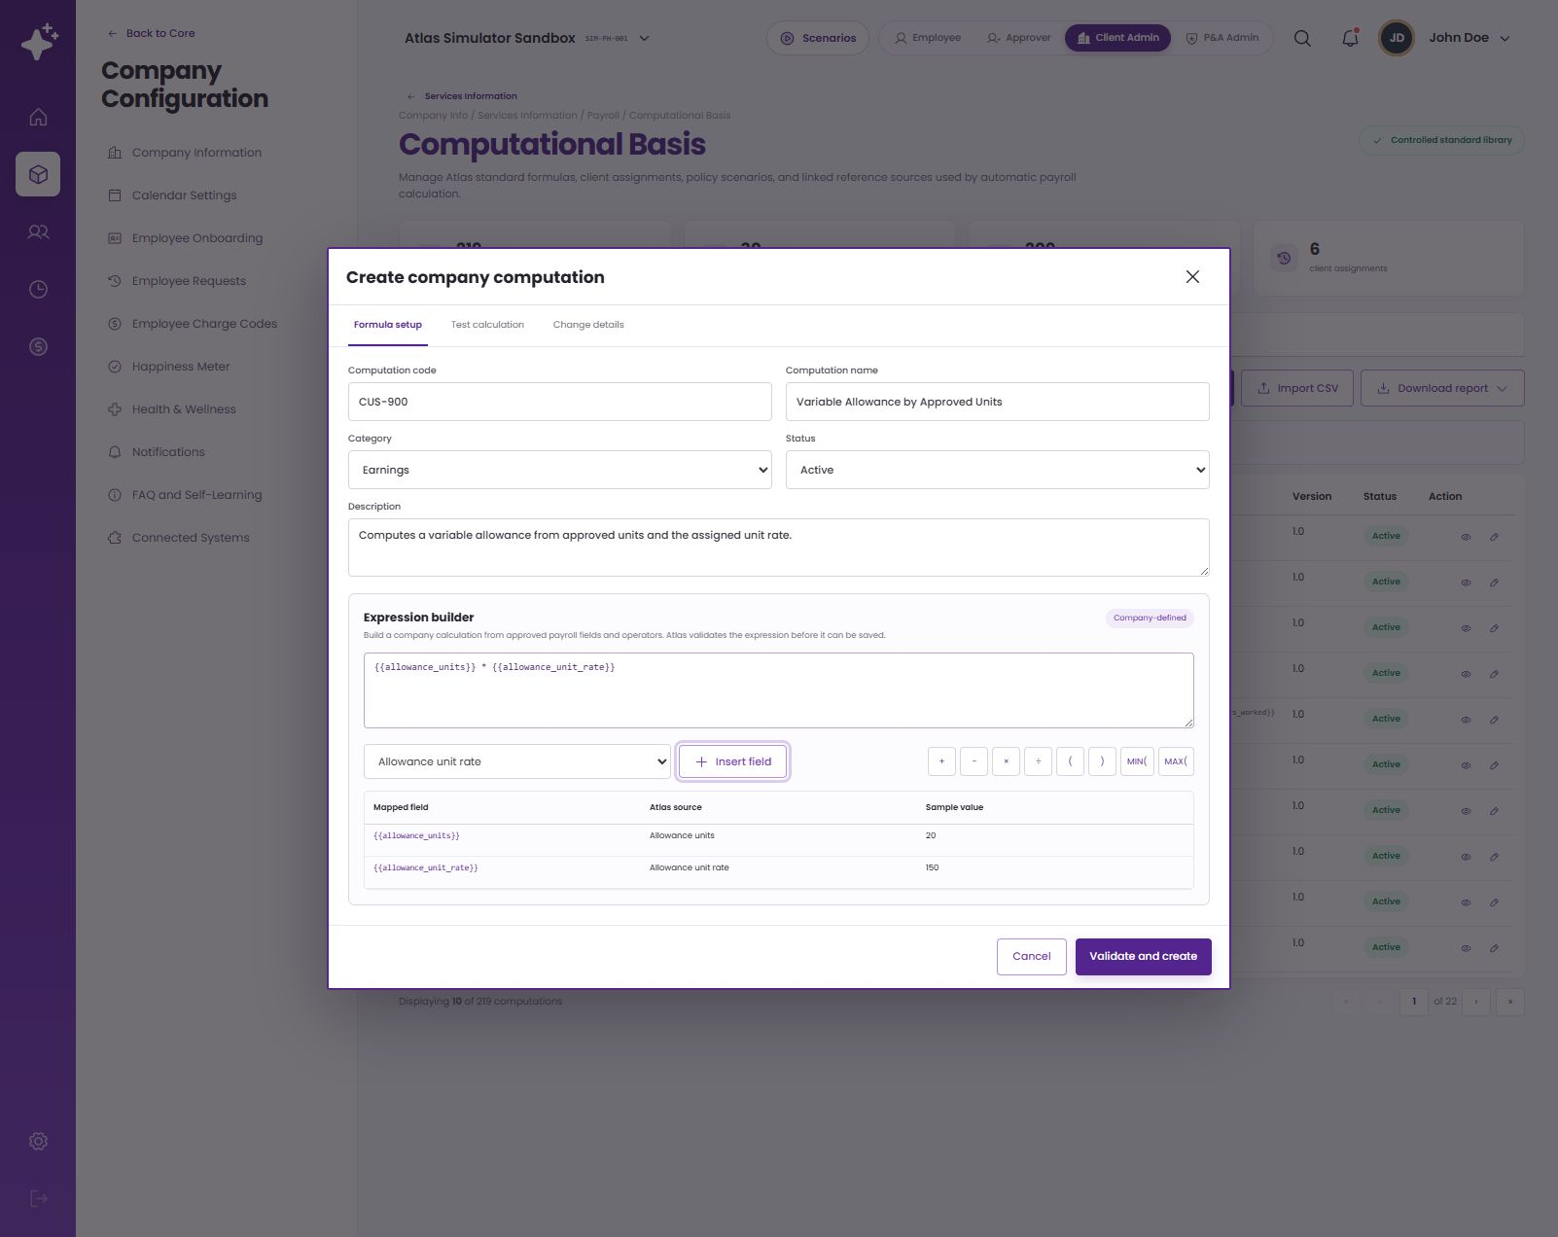
CREATING A COMPUTATION
Step 2 — assemble approved variables
Build, do not free-type dependencies
{{allowance_units}} × {{allowance_unit_rate}}
The palette exposes approved fields and operators. Mapped fields make every dependency visible before the formula reaches a transaction.
Source · computation catalog and live expression-builder workflow
Notes:
Presenter note: explain this slide from a finance-user perspective and distinguish setup-time governance from transaction-time execution.
[Sources]
- Live ATLAS prototype and ATLAS_Phase2_Computational_Basis_Demo_v2.pptx
- Evidence captured 24 August 2026 in the local ATLAS application.

Slide 10
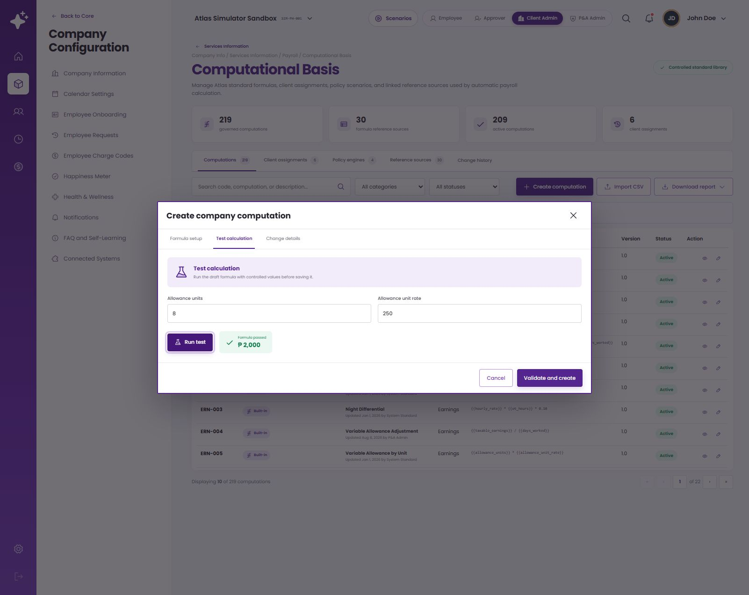
CREATING A COMPUTATION
Step 3 — test, date and publish the version
1 · Test
Run controlled sample inputs; 8 approved units × ₱250 per unit = ₱2,000.
2 · Date
Set the effective date that consuming transactions use for version selection.
3 · Publish
Record the change note and retain history; later changes should create a new version.
Source · live test calculation and change-history workflow
Notes:
Presenter note: explain this slide from a finance-user perspective and distinguish setup-time governance from transaction-time execution.
[Sources]
- Live ATLAS prototype and ATLAS_Phase2_Computational_Basis_Demo_v2.pptx
- Evidence captured 24 August 2026 in the local ATLAS application.

Slide 11
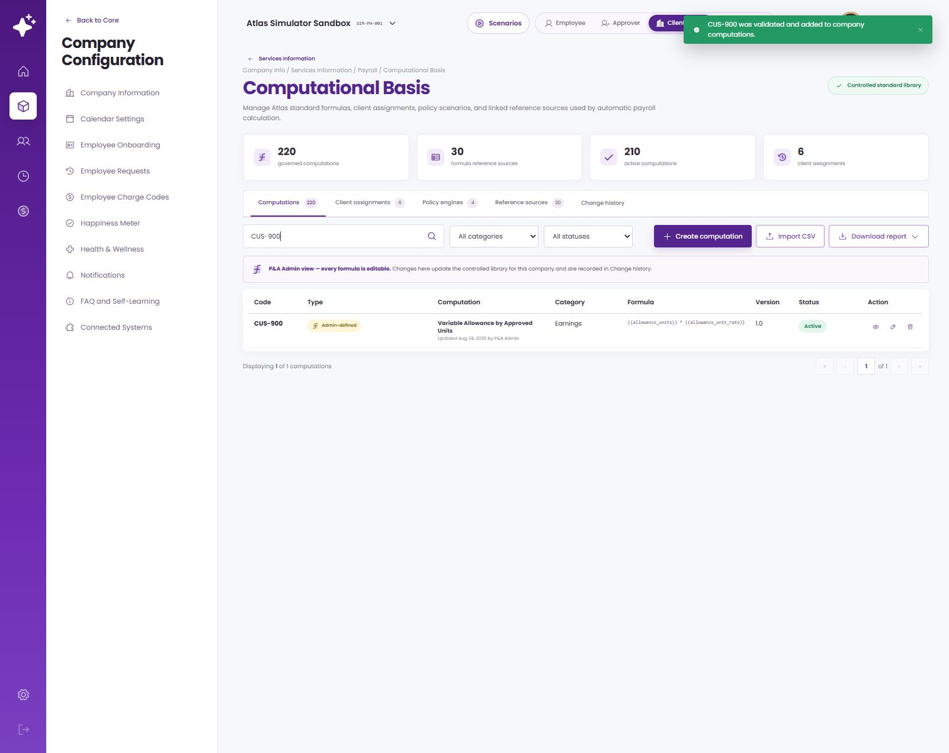
THE GOVERNANCE BOUNDARY
Created and assigned does not automatically mean executed
Creation result
The code is active, searchable, testable, versioned and available for assignment.
Execution contract
A payroll or other module must still call CUS-900 and supply allowance_units and allowance_unit_rate at the right business event.
Why this matters
Assignments govern eligibility and traceability; they are not a hidden replacement for module integration logic.
CUS-900 in the governed computations register
Source · live prototype behavior and payrollEngine.js integration review
Notes:
Presenter note: explain this slide from a finance-user perspective and distinguish setup-time governance from transaction-time execution.
[Sources]
- Live ATLAS prototype and ATLAS_Phase2_Computational_Basis_Demo_v2.pptx
- Evidence captured 24 August 2026 in the local ATLAS application.

Slide 12
CLIENT ASSIGNMENT · DEMO
Connect a computation to its intended company use
1 · Choose context
Select assignment type and its reference table.
2 · Define scope
Choose the computation code, employee group and frequency.
3 · Confirm governance
Set active status, review the applicability contract and save.
Animated walkthrough — plays automatically in Slide Show
Notes:
Presenter note: explain this slide from a finance-user perspective and distinguish setup-time governance from transaction-time execution.
[Sources]
- Live ATLAS prototype and ATLAS_Phase2_Computational_Basis_Demo_v2.pptx
- Evidence captured 24 August 2026 in the local ATLAS application.

Slide 13
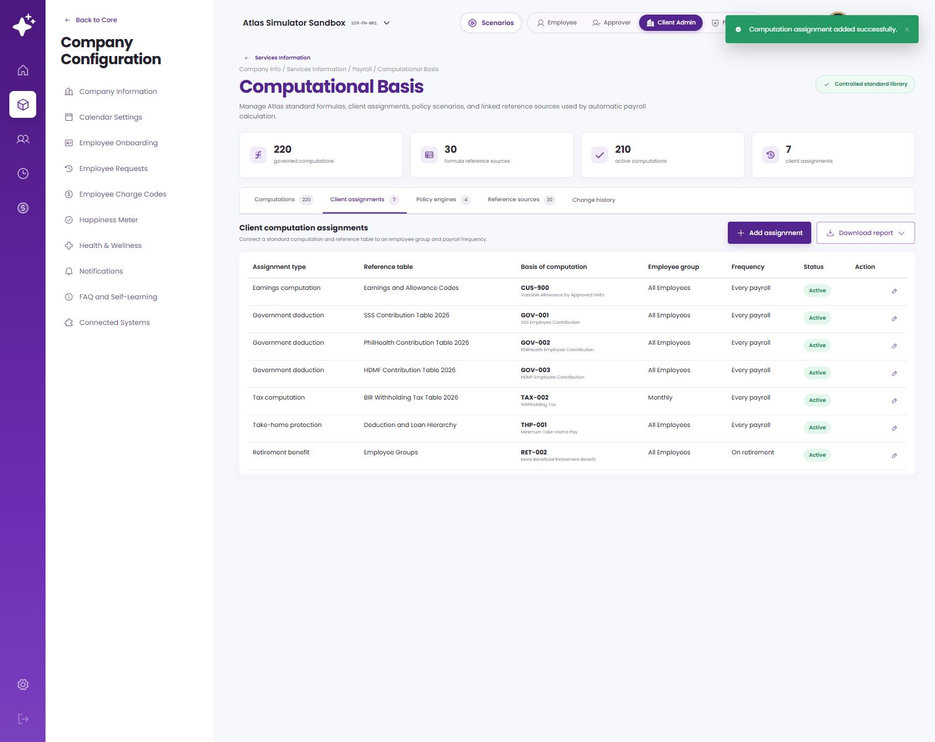
CLIENT ASSIGNMENTS
The assignment is an applicability contract
1 · Business context
Type · reference table · computation code · employee group · frequency · status.
2 · Transaction match
Resolve the active assignment for company, employee group, event/frequency and effective date.
3 · Conflict validation
Reject overlapping applicability or effective periods unless explicit precedence is configured.
Source · live ATLAS Computational Basis → Client assignments
Notes:
Presenter note: explain this slide from a finance-user perspective and distinguish setup-time governance from transaction-time execution.
[Sources]
- Live ATLAS prototype and ATLAS_Phase2_Computational_Basis_Demo_v2.pptx
- Evidence captured 24 August 2026 in the local ATLAS application.

Slide 14
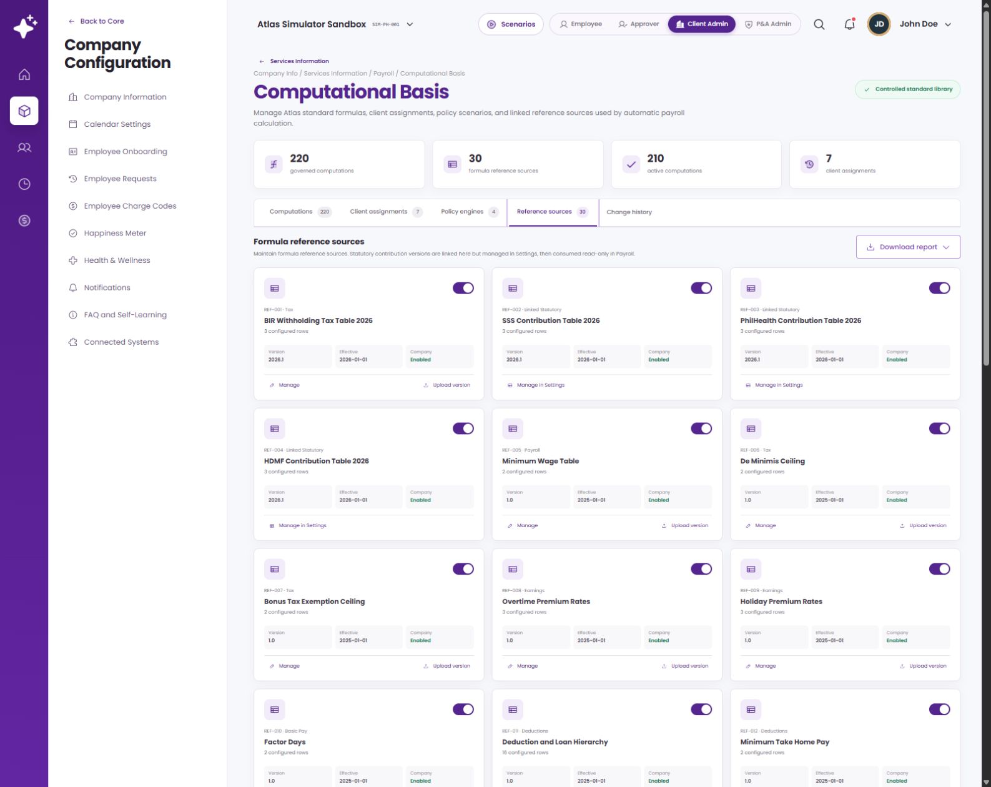
CONNECTED DATA
Reference sources keep changeable values outside formulas
Named dependencies
Rates, brackets, ceilings, balances and orderings are maintained as sources instead of buried inside an expression.
Effective selection
The transaction date selects the version in force, preserving historical reproducibility.
Shared maintenance
A governed source can serve many computations without duplicating the same value in every formula.
Formula reference sources — live application view
Source · live reference-source register and formula reference catalog
Notes:
Presenter note: explain this slide from a finance-user perspective and distinguish setup-time governance from transaction-time execution.
[Sources]
- Live ATLAS prototype and ATLAS_Phase2_Computational_Basis_Demo_v2.pptx
- Evidence captured 24 August 2026 in the local ATLAS application.

Slide 15
THE CONSUMPTION CONTRACT
What a module needs before it can use a computation
Consumer provides
System returns
Code + input fields
Invoke an approved code and supply every mapped variable with typed transaction values.
Calculated value plus evaluated expression and input evidence.
Applicable scope
Resolve active client assignment by employee group, type, reference and frequency.
Eligible computation set, with conflicts blocked before calculation.
Effective date
Use transaction date to select the formula and reference-source versions in force.
A reproducible historical result even after later versions are published.
Business event
Call the code at the correct point in HRM, timekeeping, payroll preparation or processing.
A downstream line item, balance, payslip value, report field and audit trace.
Notes:
Presenter note: explain this slide from a finance-user perspective and distinguish setup-time governance from transaction-time execution.
[Sources]
- Live ATLAS prototype and ATLAS_Phase2_Computational_Basis_Demo_v2.pptx
- Evidence captured 24 August 2026 in the local ATLAS application.

Slide 16
MODULE DEPENDENCIES
How Computational Basis connects across ATLAS
Module supplies
Computation affects
HRM / Employee Masterfile
Salary, dates, employee group, status, plan and profile attributes.
Eligibility, bases, group-specific assignment and employee-level trace.
Timekeeping
Hours, days, shifts, overtime, absences and approved quantity units.
Payable quantities used by earnings, premium and attendance computations.
Payroll setup / registers
Earning, deduction, loan and bonus codes; rates; balances; ceilings; reference tables.
Formula inputs, caps, priorities, taxable treatment and carried balances.
Payroll processing / outputs
Run date, employee scope, applicable assignment and transaction context.
Payroll lines, net pay, statutory/tax results, payslip, reports and computation trail.
Notes:
Presenter note: explain this slide from a finance-user perspective and distinguish setup-time governance from transaction-time execution.
[Sources]
- Live ATLAS prototype and ATLAS_Phase2_Computational_Basis_Demo_v2.pptx
- Evidence captured 24 August 2026 in the local ATLAS application.

Slide 17
CUSTOM COMPUTATION · WORKED EXAMPLE
CUS-900 proves the full create-and-assign pattern
Approved units
8
Unit rate
₱250
Expression
8 × ₱250
Computed result
₱2,000
Demonstration only: a consuming earnings flow must still call CUS-900 with actual approved units and the effective unit rate.
Employee scope
All Employees
Source · live CUS-900 test and client-assignment walkthrough
Frequency
Every payroll
Notes:
Presenter note: explain this slide from a finance-user perspective and distinguish setup-time governance from transaction-time execution.
[Sources]
- Live ATLAS prototype demonstration CUS-900; computation-creation and client-assignment captures
- Evidence captured 24 August 2026 in the local ATLAS application.

Slide 18
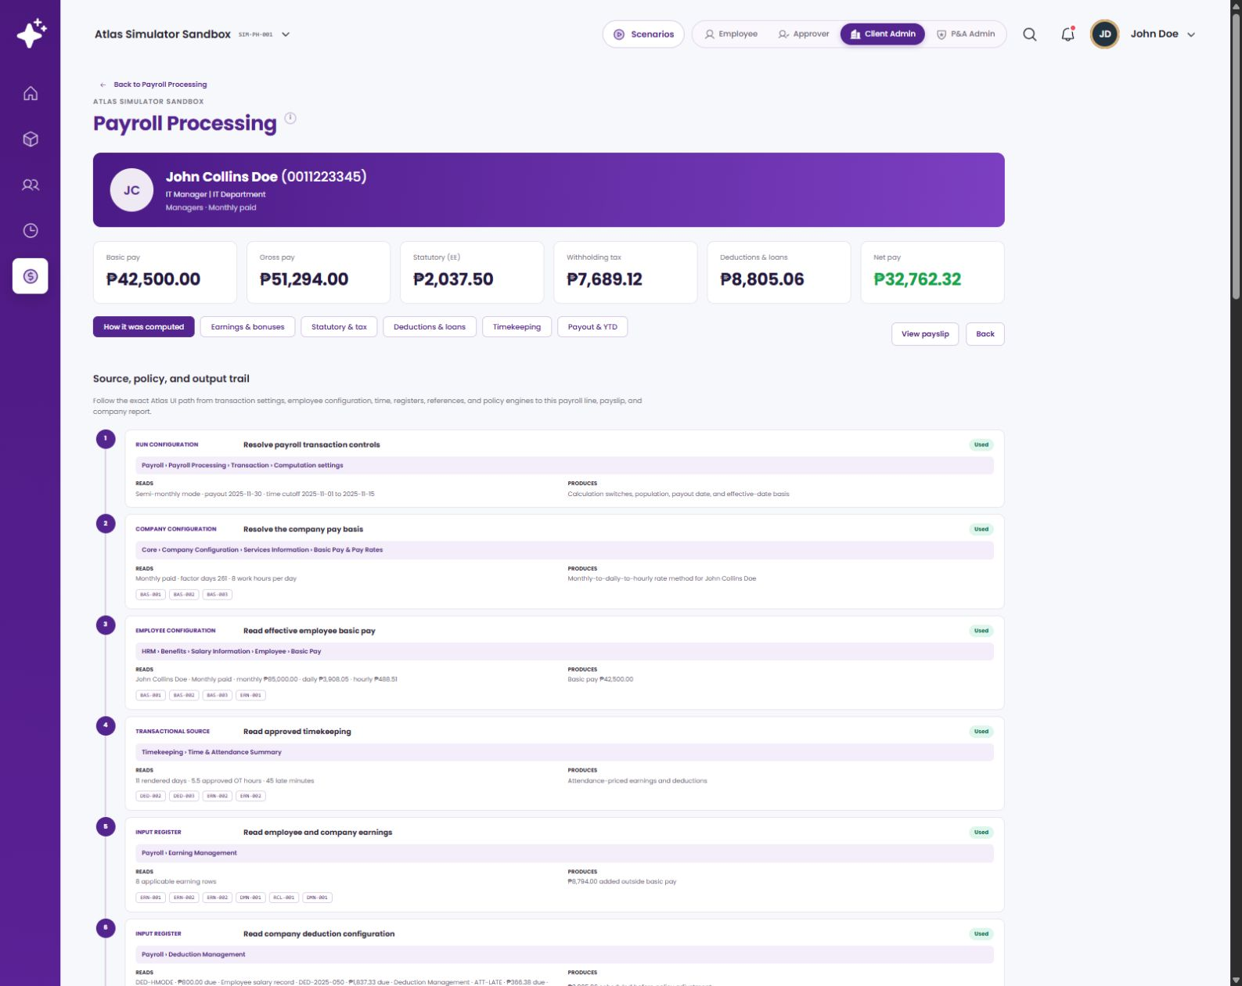
TRANSACTION TRACE
A posted payroll shows where governed computations are consumed
Upstream evidence
Transaction settings, company configuration, employee salary, timekeeping and earning/deduction/loan registers establish the inputs.
Governed execution
Applicable assignments and computation codes are resolved before formulas and statutory/tax/policy steps run.
Downstream proof
Each payroll line can flow to the payslip and reports with the calculation trail preserved.
Payroll computation trail — live application view
Source · posted payroll PR-2025-11-E2E → John Collins Doe → How it was computed
Notes:
Presenter note: explain this slide from a finance-user perspective and distinguish setup-time governance from transaction-time execution.
[Sources]
- Live ATLAS prototype and ATLAS_Phase2_Computational_Basis_Demo_v2.pptx
- Evidence captured 24 August 2026 in the local ATLAS application.

Slide 19
E N D - T O - E N D F L O W
How a finance-defined computation becomes a transaction result
Use this map to separate design-time governance from transaction-time execution.
SETUP PATH
Company
Info
Services
Information
Payroll
Computational
Basis
1
Define variable
2
Create computation
3
Test + publish
4
Assign client scope
5
Consume + trace
Choose an approved field or add a governed business variable with a clear owner and source.
Set metadata and assemble an expression from approved variables and operators.
Prove sample outputs, set effectivity, record the change note and retain the version.
Link code to type, reference table, employee group, frequency and active status.
The module resolves scope/date, supplies actual inputs, executes the code and writes the result to transaction outputs.
HRM
TIME
PAY
OUT
CREATE COMPUTATION
1 Metadata
2 Expression
3 Test + version
4 Assign
INTEGRATION GUARDRAILS
Unique stable code
Approved inputs
No assignment conflict
History preserved
Consumers integrate to the code, not a display name.
Every mapped field has a defined module owner and data type.
Overlapping scope or effective periods are rejected before use.
Used versions are not rewritten; a new effective version carries the change.
Source · live ATLAS workflow, computation catalog and payroll trace
Notes:
Presenter note: explain this slide from a finance-user perspective and distinguish setup-time governance from transaction-time execution.
[Sources]
- Live ATLAS prototype and ATLAS_Phase2_Computational_Basis_Demo_v2.pptx
- Evidence captured 24 August 2026 in the local ATLAS application.

Slide 20
INTEGRATION CHECKPOINTS
What must be decided before a custom computation goes live
Saving the formula and assignment establishes governance. These five decisions establish operational execution.
1
Which module invokes the code
Name the consumer and exact pipeline step; arbitrary new custom codes are not executed automatically.
Consumer contract
2
Which business event applies
Define payroll frequency or the HRM/timekeeping event that supplies the real inputs.
Trigger and frequency
3
How conflicts are resolved
Reject overlapping employee scope, assignment type, reference and effective periods unless precedence is explicit.
Assignment validation
4
When a version becomes immutable
Once a payroll transaction uses a version, changes should publish a new effective version.
Historical integrity
5
Who owns approval
Define finance owner, reviewer and deployment evidence for formula, assignment and reference-source changes.
Governance workflow
Notes:
Presenter note: explain this slide from a finance-user perspective and distinguish setup-time governance from transaction-time execution.
[Sources]
- Live ATLAS prototype and ATLAS_Phase2_Computational_Basis_Demo_v2.pptx
- Evidence captured 24 August 2026 in the local ATLAS application.

Slide 21
APPENDIX A
Evidence and traceability
Reference deck
Visual system, explanatory pacing, live-screen pattern and end-to-end traceability structure reused for this new deck.
ATLAS Phase 2 Computational Basis Demo v2
Live prototype
Computations, client assignments, reference sources, change history and payroll computation-trail screens captured directly from the running app.
ATLAS local application · 24 August 2026
Application source
Used to distinguish governed creation/assignment behavior from actual transaction-time invocation.
ComputationalBasis.jsx · computationCatalog.js · payrollEngine.js
Demonstration record
Sample values created only for this walkthrough; they are not production payroll values.
CUS-900 · 8 units × ₱250 = ₱2,000
Notes:
Presenter note: explain this slide from a finance-user perspective and distinguish setup-time governance from transaction-time execution.
[Sources]
- Reference deck; live ATLAS prototype; ComputationalBasis.jsx; computationCatalog.js; payrollEngine.js
- Evidence captured 24 August 2026 in the local ATLAS application.

Slide 22
What this demonstrates
1
Finance users can create readable, tested and effective-dated computations without changing application code.
2
Client assignments make applicability explicit by use case, reference, employee group, frequency and status.
3
Payroll and connected modules consume a computation only through a defined code, inputs, scope, date and business event.
4
Versions, reference sources and transaction trails preserve the overall picture from setup to payslip and reports.
Notes:
Presenter note: explain this slide from a finance-user perspective and distinguish setup-time governance from transaction-time execution.
[Sources]
- Live ATLAS prototype and ATLAS_Phase2_Computational_Basis_Demo_v2.pptx
- Evidence captured 24 August 2026 in the local ATLAS application.

