Slide 1
ATLAS PHASE 2 · PAYROLL
Computational Basis
A practical guide to creating computations, assigning them to a client, and seeing where ATLAS uses the result
Create
Test
Assign
Use & trace
Finance-user walkthrough · detailed field guide · live ATLAS screens
Notes:
Presenter note: walk through this page in the language payroll and finance teams use. Explain what the user enters, where ATLAS gets the data, and what the downstream module does with the result.
[Sources]
- ATLAS_Phase2_Computational_Basis_Demo_v2.pptx
- Live ATLAS prototype captured 24 August 2026
- ComputationalBasis.jsx, computationCatalog.js and payrollEngine.js where relevant.

Slide 2
TODAY'S WALKTHROUGH
What we will cover
1
Start with the basics
What a computation is, where it lives, and why finance owns the setup.
2
Create one properly
Every field in the register and Create Computation screen, including the formula builder and test.
3
Assign it to the client
Every assignment field, how scope is chosen, and how conflicts should be checked.
4
Connect it to ATLAS
Detailed examples across HRM, Timekeeping, payroll setup, payroll processing, payslips and reports.
5
Keep the history intact
Reference versions, change history, transaction evidence and the point where a used version must stop changing.
Notes:
Presenter note: walk through this page in the language payroll and finance teams use. Explain what the user enters, where ATLAS gets the data, and what the downstream module does with the result.
[Sources]
- ATLAS_Phase2_Computational_Basis_Demo_v2.pptx
- Live ATLAS prototype captured 24 August 2026
- ComputationalBasis.jsx, computationCatalog.js and payrollEngine.js where relevant.

Slide 3
THE WHOLE JOB
A computation has a life before, during and after payroll
1
2
3
4
5
Describe the rule
Build and test it
Publish the version
Assign the client scope
Run and keep the evidence
Give it a permanent code, a clear name and a business explanation people can understand later.
Use approved ATLAS fields, run sample values and check that the answer matches the finance calculation.
Set the effective date and explain the change so the correct version can be found later.
Say what the computation is for, who it applies to and how often it may be used.
The consuming module supplies real employee or payroll data, saves the result and shows it in the trail.
Saving puts the rule under control. Assignment makes it available for the right case. Integration is what actually runs it.
Source · live ATLAS prototype and application computation catalog / payroll engine
Notes:
Presenter note: walk through this page in the language payroll and finance teams use. Explain what the user enters, where ATLAS gets the data, and what the downstream module does with the result.
[Sources]
- ATLAS_Phase2_Computational_Basis_Demo_v2.pptx
- Live ATLAS prototype captured 24 August 2026
- ComputationalBasis.jsx, computationCatalog.js and payrollEngine.js where relevant.

Slide 4
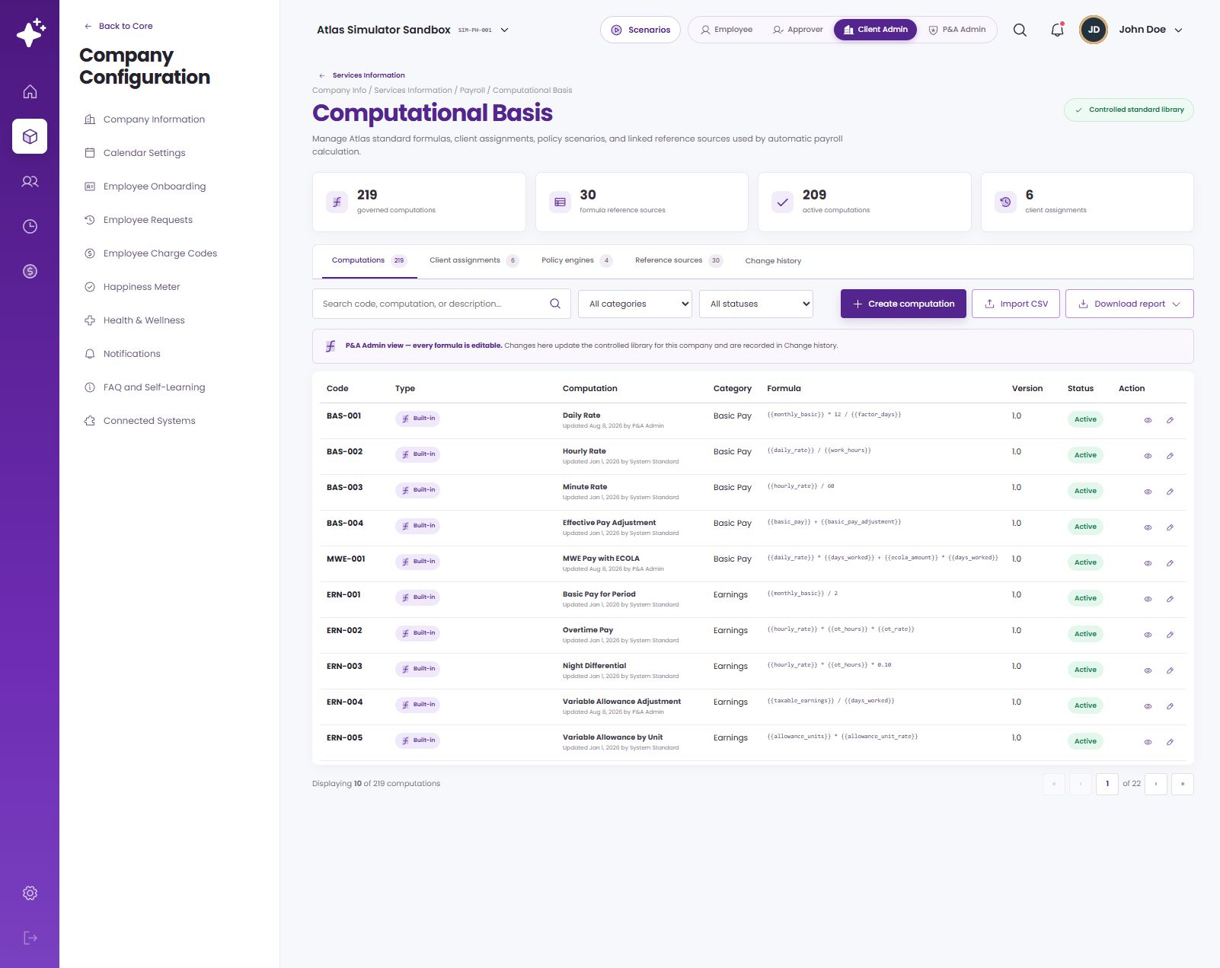
WHERE TO FIND IT
Computational Basis sits inside Payroll service setup
Company setup
Services Information now contains HRM, Timekeeping and Payroll tabs instead of appearing as a separate left-menu item.
Payroll tab
Computational Basis belongs here because its results are used by payroll and by the data that feeds payroll.
Screen path
Company Info → Services Information → Payroll → Computational Basis
Computational Basis — live ATLAS screen
Source · requested navigation and live ATLAS prototype
Notes:
Presenter note: walk through this page in the language payroll and finance teams use. Explain what the user enters, where ATLAS gets the data, and what the downstream module does with the result.
[Sources]
- ATLAS_Phase2_Computational_Basis_Demo_v2.pptx
- Live ATLAS prototype captured 24 August 2026
- ComputationalBasis.jsx, computationCatalog.js and payrollEngine.js where relevant.

Slide 5
USEFUL TERMS
The words finance users will see
Variable
Reference source
A named input ATLAS can supply, such as basic_pay, overtime_hours or allowance_units.
An effective-dated table, ceiling, rate or code list read by a computation.
Formula expression
Version
The arithmetic written with approved variables and operators.
A dated copy of the rule kept so an old payroll can still be explained.
Computation code
Consumer
The permanent ID another module calls, such as CUS-900 or ERN-002.
The HRM, Timekeeping or Payroll step that supplies real data and asks for the calculation.
Mapped field
Policy engine
A formula variable with a known ATLAS source and sample value.
An existing specialist payroll feature that may consume computations; it remains in its current tab.
Client assignment
The company rule that says what the code is for, who it covers and how often it applies.
Notes:
Presenter note: walk through this page in the language payroll and finance teams use. Explain what the user enters, where ATLAS gets the data, and what the downstream module does with the result.
[Sources]
- ATLAS_Phase2_Computational_Basis_Demo_v2.pptx
- Live ATLAS prototype captured 24 August 2026
- ComputationalBasis.jsx, computationCatalog.js and payrollEngine.js where relevant.

Slide 6
WORKSPACE
Five tabs, one place to follow the setup
Computations
Create and maintain the formula library.
Client assignments
Choose the company use, employee group and frequency.
Supporting records
Policy engines, reference sources and change history complete the evidence.
Computational Basis — live ATLAS screen
Source · live ATLAS Computational Basis workspace
Notes:
Presenter note: walk through this page in the language payroll and finance teams use. Explain what the user enters, where ATLAS gets the data, and what the downstream module does with the result.
[Sources]
- ATLAS_Phase2_Computational_Basis_Demo_v2.pptx
- Live ATLAS prototype captured 24 August 2026
- ComputationalBasis.jsx, computationCatalog.js and payrollEngine.js where relevant.

Slide 7
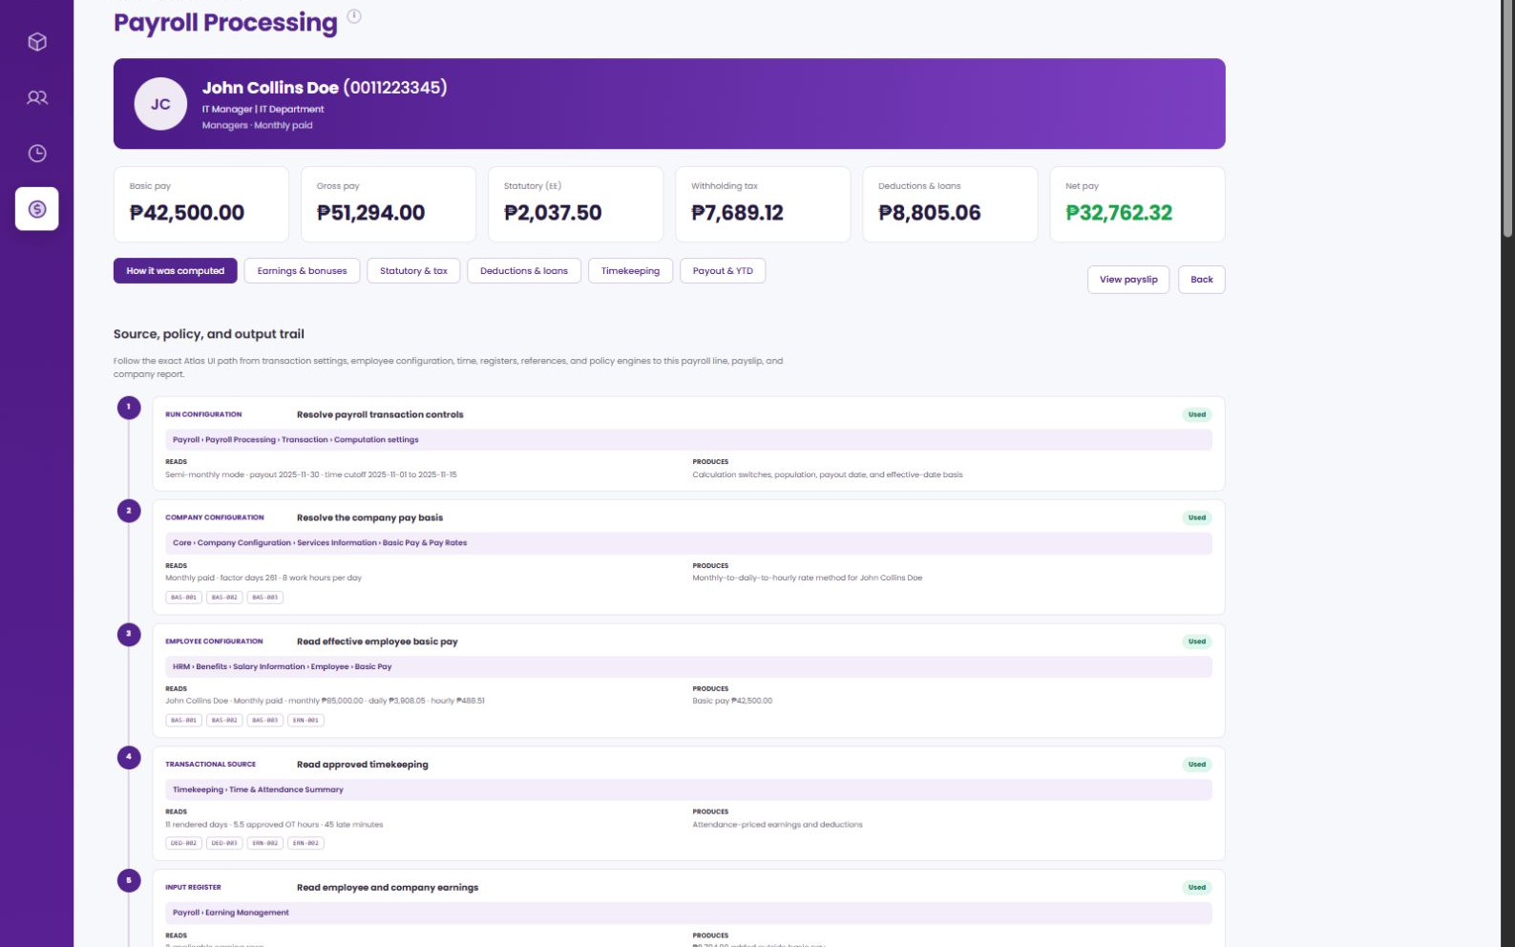
COMPUTATION REGISTER
The register is the finance user's starting point
Find the right record
Search by code, computation name or description, then filter by category and status.
Check before opening
The row already shows source type, formula, version and whether it is available.
Use the row action
View details first; edit or delete only when the record is allowed to change.
Computations register — live ATLAS screen
Source · live ATLAS Computational Basis → Computations
Notes:
Presenter note: walk through this page in the language payroll and finance teams use. Explain what the user enters, where ATLAS gets the data, and what the downstream module does with the result.
[Sources]
- ATLAS_Phase2_Computational_Basis_Demo_v2.pptx
- Live ATLAS prototype captured 24 August 2026
- ComputationalBasis.jsx, computationCatalog.js and payrollEngine.js where relevant.

Slide 8
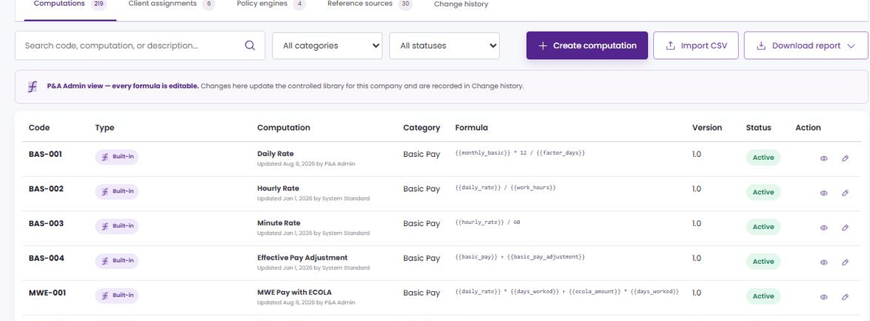
COMPUTATION REGISTER · FIELD GUIDE 1 OF 2
Identity and formula columns
1
Code
The permanent ID used by integrations. Keep it short, unique and unchanged after release.
2
Type
Built-in means an ATLAS standard. Company-defined means finance created it for this company.
1
2
3
Computation
3
4
The business name. It should describe the amount being calculated, not the implementation.
5
4
Category
Groups similar rules—earnings, deductions, tax and so on—so users can filter and assign correctly.
5
Formula
A quick read of the current expression. Open the record when the full mapped-field detail is needed.
Notes:
Presenter note: walk through this page in the language payroll and finance teams use. Explain what the user enters, where ATLAS gets the data, and what the downstream module does with the result.
[Sources]
- ATLAS_Phase2_Computational_Basis_Demo_v2.pptx
- Live ATLAS prototype captured 24 August 2026
- ComputationalBasis.jsx, computationCatalog.js and payrollEngine.js where relevant.

Slide 9
COMPUTATION REGISTER · FIELD GUIDE 2 OF 2
Version, status and row actions
1
Version
Identifies the current published rule. A payroll trail should point back to the exact version it used.
2
Status
1
Active records can be selected for new use. Inactive records remain visible for history but should not be newly assigned.
2
3
3
View
Opens the description, expression, mapped fields, test result, effectivity and update information.
4
4
Edit / delete
Company-defined records can be maintained. Delete is blocked while an assignment still points to the code; used payroll versions should be replaced by a new version, not rewritten.
Notes:
Presenter note: walk through this page in the language payroll and finance teams use. Explain what the user enters, where ATLAS gets the data, and what the downstream module does with the result.
[Sources]
- ATLAS_Phase2_Computational_Basis_Demo_v2.pptx
- Live ATLAS prototype captured 24 August 2026
- ComputationalBasis.jsx, computationCatalog.js and payrollEngine.js where relevant.

Slide 10
CREATE A COMPUTATION · DEMO
Watch CUS-900 go from a blank form to a tested version
The example
Variable Allowance by Approved Units
Enter the business details, build {{allowance_units}} × {{allowance_unit_rate}}, test 8 × ₱250, then publish version 1.0.
Animated walkthrough — plays automatically in Slide Show
Notes:
Presenter note: walk through this page in the language payroll and finance teams use. Explain what the user enters, where ATLAS gets the data, and what the downstream module does with the result.
[Sources]
- ATLAS_Phase2_Computational_Basis_Demo_v2.pptx
- Live ATLAS prototype captured 24 August 2026
- ComputationalBasis.jsx, computationCatalog.js and payrollEngine.js where relevant.

Slide 11
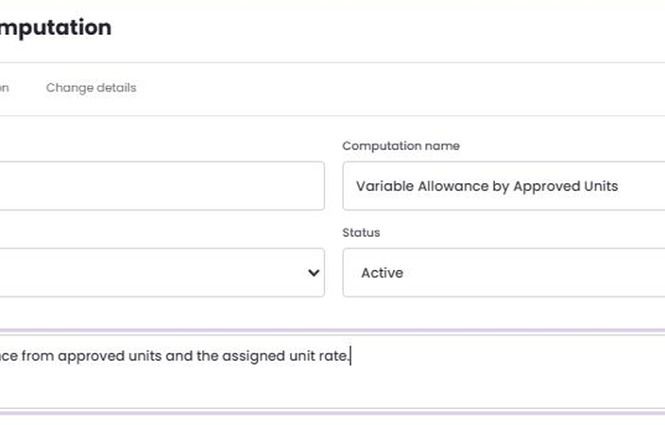
CREATE COMPUTATION · FIELD GUIDE 1 OF 6
Business details at the top of the form
1
Computation code
Required. Enter a unique code such as CUS-900. ATLAS converts it to uppercase and locks it when editing.
2
Computation name
1
2
Required. Use the wording payroll users expect to see when choosing the computation.
3
Category
3
Select the finance category that best describes the result. This controls where users look and filter.
4
Status
Use Active only when the formula is ready to be assigned. Use Inactive while retaining a record that should no longer be selected.
4
5
5
Description
6
Required. State the business rule, intended use and important exclusions in plain language.
6
Validate and create
ATLAS checks the expression again before saving. A formula error sends the user back to Formula setup.
Notes:
Presenter note: walk through this page in the language payroll and finance teams use. Explain what the user enters, where ATLAS gets the data, and what the downstream module does with the result.
[Sources]
- ATLAS_Phase2_Computational_Basis_Demo_v2.pptx
- Live ATLAS prototype captured 24 August 2026
- ComputationalBasis.jsx, computationCatalog.js and payrollEngine.js where relevant.

Slide 12
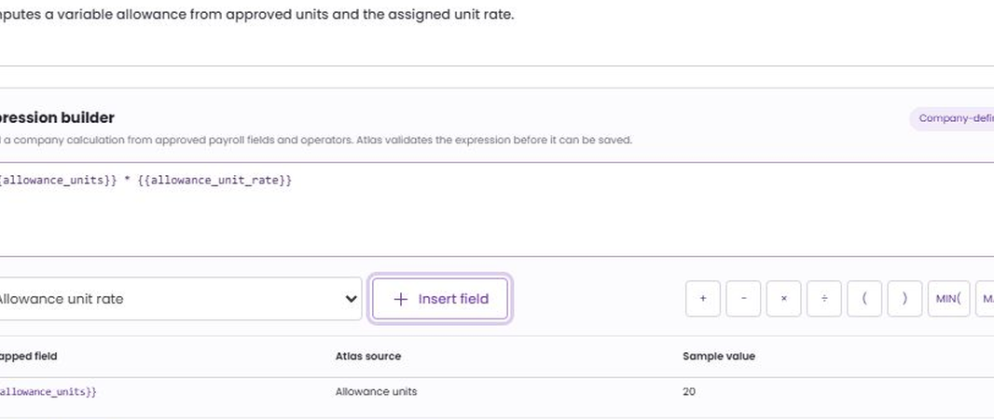
CREATE COMPUTATION · FIELD GUIDE 2 OF 6
How the expression builder works
1
Formula expression
The calculation ATLAS evaluates. Variables appear in double braces so they are easy to distinguish from numbers and operators.
2
Approved field
1
Choose an ATLAS field whose owner and meaning are already known. This prevents a misspelled or unsupported variable.
2
3
3
Insert field
Adds the selected token at the cursor and creates its mapped-field row below.
4
4
Operator palette
Use +, −, ×, ÷, parentheses, MIN and MAX. Build the rule in the same order finance checks it on paper.
Notes:
Presenter note: walk through this page in the language payroll and finance teams use. Explain what the user enters, where ATLAS gets the data, and what the downstream module does with the result.
[Sources]
- ATLAS_Phase2_Computational_Basis_Demo_v2.pptx
- Live ATLAS prototype captured 24 August 2026
- ComputationalBasis.jsx, computationCatalog.js and payrollEngine.js where relevant.

Slide 13
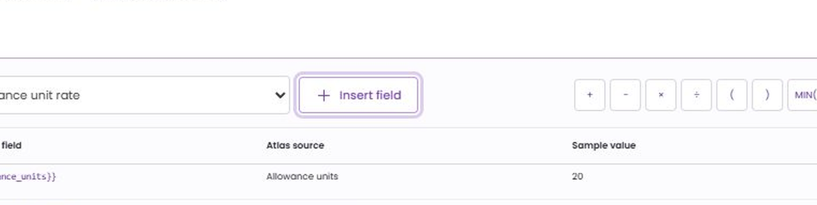
CREATE COMPUTATION · FIELD GUIDE 3 OF 6
Mapped fields explain every dependency
1
Mapped field
The token used in the expression, for example allowance_units. This is the exact input name the consumer must provide.
2
ATLAS source
Shows which module or register owns the value. A missing owner is an integration gap, not a formula problem.
1
2
3
4
3
Sample value
A controlled example used during setup. It helps reviewers understand the scale and expected result.
4
Why this table matters
Before release, every formula token should have an owner, data type, unit of measure and rule for missing data.
Notes:
Presenter note: walk through this page in the language payroll and finance teams use. Explain what the user enters, where ATLAS gets the data, and what the downstream module does with the result.
[Sources]
- ATLAS_Phase2_Computational_Basis_Demo_v2.pptx
- Live ATLAS prototype captured 24 August 2026
- ComputationalBasis.jsx, computationCatalog.js and payrollEngine.js where relevant.

Slide 14
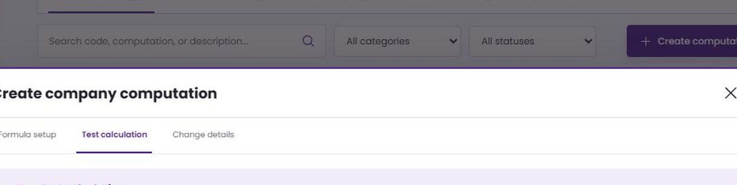
CREATE COMPUTATION · FIELD GUIDE 4 OF 6
Test the calculation before publishing
1
Input fields
ATLAS creates one numeric input for every mapped variable. Use values that finance can recompute independently.
2
Run test
Evaluates the draft expression without creating a payroll transaction or changing employee records.
1
2
3
4
3
Formula passed
Confirms the expression could be evaluated with the supplied inputs. It does not prove the business policy is correct.
4
Result
Compare the peso answer with the expected manual result. Here, 8 units × ₱250 returns ₱2,000.
Notes:
Presenter note: walk through this page in the language payroll and finance teams use. Explain what the user enters, where ATLAS gets the data, and what the downstream module does with the result.
[Sources]
- ATLAS_Phase2_Computational_Basis_Demo_v2.pptx
- Live ATLAS prototype captured 24 August 2026
- ComputationalBasis.jsx, computationCatalog.js and payrollEngine.js where relevant.

Slide 15
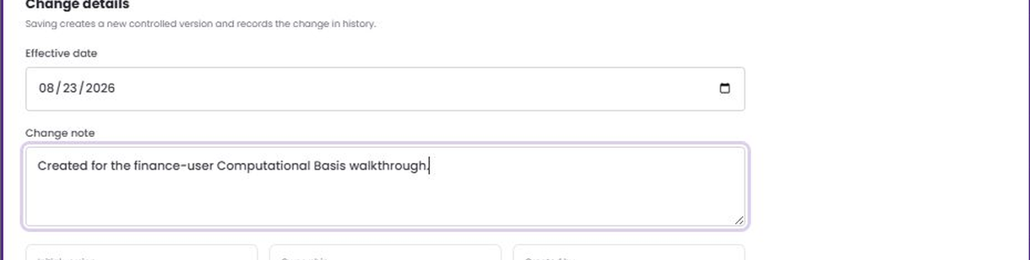
CREATE COMPUTATION · FIELD GUIDE 5 OF 6
Date and explain the version
1
Effective date
Required. A transaction should use the version in force on its payroll or business date.
2
Change note
Required. Write what changed and why—use wording another payroll reviewer can understand months later.
1
2
3
4
3
Version
A new record starts at 1.0. Later edits should move to the next version rather than replacing a result already used.
4
Ownership and user
The summary identifies Company ownership and the Client Admin who created or changed the record.
Notes:
Presenter note: walk through this page in the language payroll and finance teams use. Explain what the user enters, where ATLAS gets the data, and what the downstream module does with the result.
[Sources]
- ATLAS_Phase2_Computational_Basis_Demo_v2.pptx
- Live ATLAS prototype captured 24 August 2026
- ComputationalBasis.jsx, computationCatalog.js and payrollEngine.js where relevant.

Slide 16
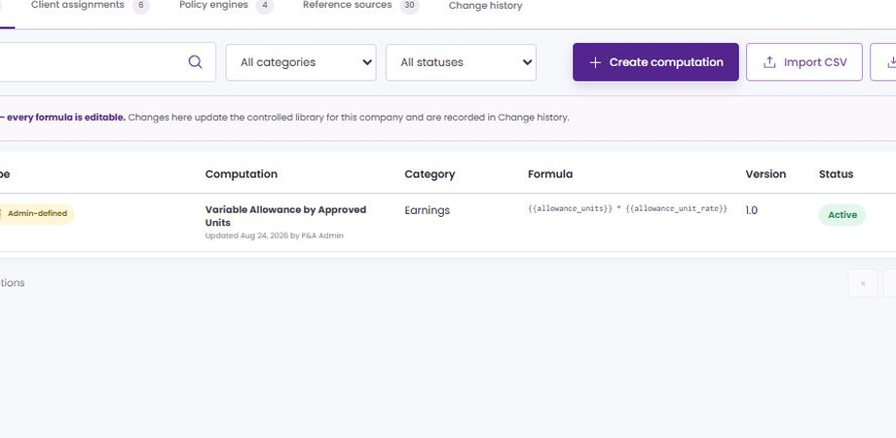
CREATE COMPUTATION · FIELD GUIDE 6 OF 6
What the saved record tells you
1
Record details
Category, source type, status, effective date and updated-by information establish who owns the rule and when it applies.
1
2
Expression and mapped fields
Review these together. The expression shows the math; mapped fields show where the real values must come from.
2
3
3
Standard test result
A quick confidence check retained with the record. Transaction results still depend on actual employee and payroll data.
4
4
Row controls
Built-in formulas are maintained in Settings. Company-defined formulas can be edited; assigned records must be unassigned before deletion.
Notes:
Presenter note: walk through this page in the language payroll and finance teams use. Explain what the user enters, where ATLAS gets the data, and what the downstream module does with the result.
[Sources]
- ATLAS_Phase2_Computational_Basis_Demo_v2.pptx
- Live ATLAS prototype captured 24 August 2026
- ComputationalBasis.jsx, computationCatalog.js and payrollEngine.js where relevant.

Slide 17
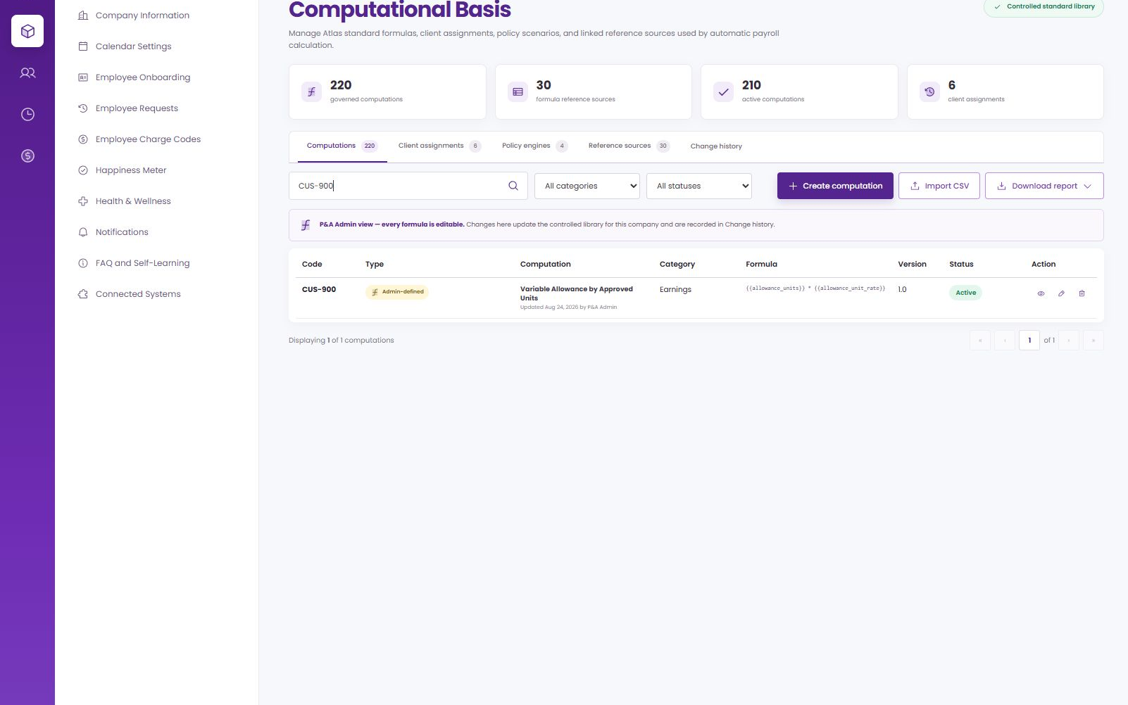
IMPORTANT DISTINCTION
Saving a formula does not put money on a payslip
After save
CUS-900 is active, searchable, tested, dated and available in the assignment list.
Before execution
A consumer still has to supply allowance_units and allowance_unit_rate at the correct business event.
Current integration boundary
The prototype stores assignments for governance; the payroll pipeline must explicitly resolve and invoke the code.
CUS-900 in the governed register
Source · live prototype behavior and payrollEngine.js review
Notes:
Presenter note: walk through this page in the language payroll and finance teams use. Explain what the user enters, where ATLAS gets the data, and what the downstream module does with the result.
[Sources]
- ATLAS_Phase2_Computational_Basis_Demo_v2.pptx
- Live ATLAS prototype captured 24 August 2026
- ComputationalBasis.jsx, computationCatalog.js and payrollEngine.js where relevant.

Slide 18
CLIENT ASSIGNMENT · DEMO
Connect CUS-900 to the client's earnings setup
1 · Choose the purpose
Earnings computation and Earnings and Allowance Codes.
2 · Choose the scope
CUS-900 · All Employees · Every payroll.
3 · Switch it on
Set Active, review the row and save.
Animated walkthrough — plays automatically in Slide Show
Notes:
Presenter note: walk through this page in the language payroll and finance teams use. Explain what the user enters, where ATLAS gets the data, and what the downstream module does with the result.
[Sources]
- ATLAS_Phase2_Computational_Basis_Demo_v2.pptx
- Live ATLAS prototype captured 24 August 2026
- ComputationalBasis.jsx, computationCatalog.js and payrollEngine.js where relevant.

Slide 19
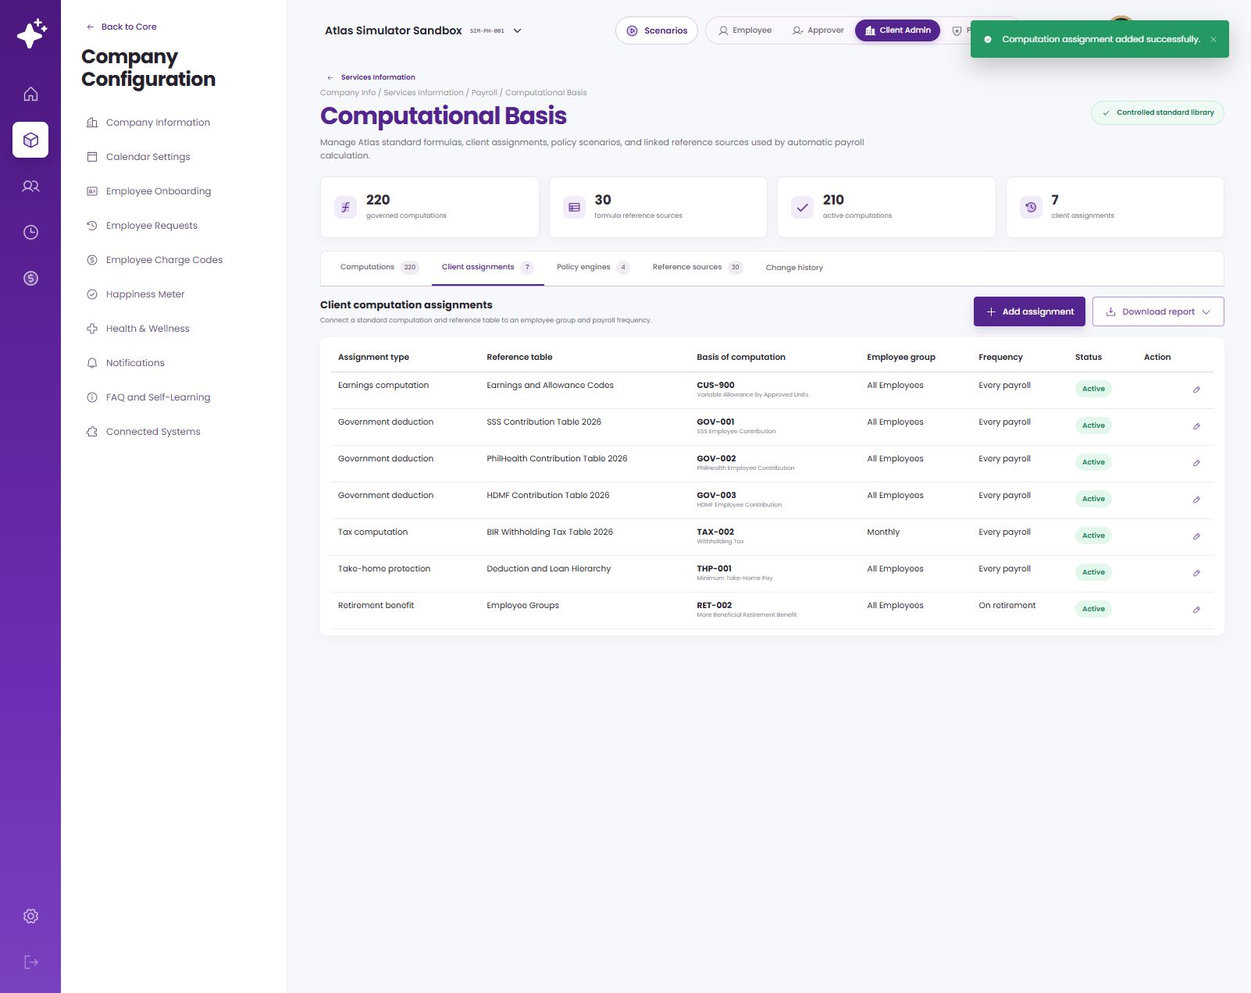
CLIENT ASSIGNMENTS
The assignment tells ATLAS where the formula belongs
Business use
Assignment type and reference table explain the payroll context.
Scope
Employee group and frequency say when the rule may be considered.
Basis
The computation code is the stable link between setup and the consuming module.
Source · live ATLAS Computational Basis → Client assignments
Notes:
Presenter note: walk through this page in the language payroll and finance teams use. Explain what the user enters, where ATLAS gets the data, and what the downstream module does with the result.
[Sources]
- ATLAS_Phase2_Computational_Basis_Demo_v2.pptx
- Live ATLAS prototype captured 24 August 2026
- ComputationalBasis.jsx, computationCatalog.js and payrollEngine.js where relevant.

Slide 20
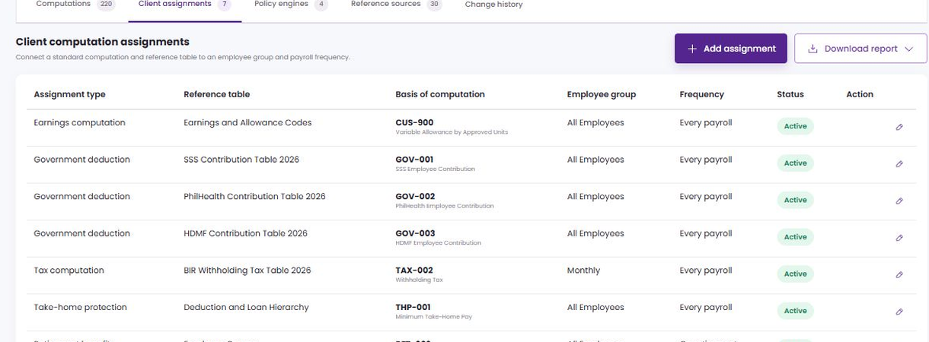
CLIENT ASSIGNMENT REGISTER · FIELD GUIDE 1 OF 2
Purpose, source and computation
1
1
Assignment type
Names the business job: government deduction, tax, bonus, earnings, take-home protection or retirement benefit.
2
Reference table
The enabled company table or code list that gives the assignment its business context.
2
3
3
Basis of computation
The active computation code and name ATLAS should use when this assignment is selected.
Notes:
Presenter note: walk through this page in the language payroll and finance teams use. Explain what the user enters, where ATLAS gets the data, and what the downstream module does with the result.
[Sources]
- ATLAS_Phase2_Computational_Basis_Demo_v2.pptx
- Live ATLAS prototype captured 24 August 2026
- ComputationalBasis.jsx, computationCatalog.js and payrollEngine.js where relevant.

Slide 21
CLIENT ASSIGNMENT REGISTER · FIELD GUIDE 2 OF 2
Scope, timing and maintenance
1
Employee group
Restricts the assignment to All Employees, Monthly, Rank and File, Managers or Retirement Eligible.
2
Frequency
Defines the event: every payroll, monthly, quarterly, annually or on retirement.
1
2
3
Status
Active makes the assignment eligible for matching. Inactive retains the setup without using it for new transactions.
3
4
4
Action
Edit opens the same fields for maintenance. A change that would overlap another active assignment should be rejected.
Notes:
Presenter note: walk through this page in the language payroll and finance teams use. Explain what the user enters, where ATLAS gets the data, and what the downstream module does with the result.
[Sources]
- ATLAS_Phase2_Computational_Basis_Demo_v2.pptx
- Live ATLAS prototype captured 24 August 2026
- ComputationalBasis.jsx, computationCatalog.js and payrollEngine.js where relevant.

Slide 22
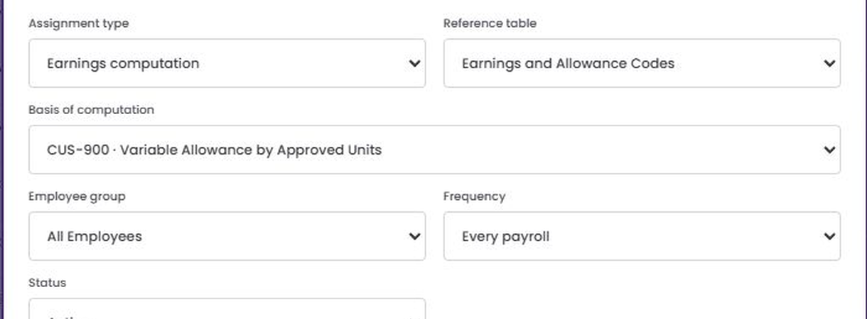
ADD ASSIGNMENT · FIELD GUIDE 1 OF 2
Choose the business context first
1
Assignment type
Start with what payroll is trying to calculate. This choice is clearer to finance than starting from a formula code.
2
Reference table
Choose from enabled sources only. For CUS-900, Earnings and Allowance Codes identifies the earning being valued.
1
2
3
4
3
Basis of computation
Select an active computation. The list shows code and name so the integration link is explicit.
4
How the three work together
Type says why, reference says which business item, and basis says how the amount is calculated.
Notes:
Presenter note: walk through this page in the language payroll and finance teams use. Explain what the user enters, where ATLAS gets the data, and what the downstream module does with the result.
[Sources]
- ATLAS_Phase2_Computational_Basis_Demo_v2.pptx
- Live ATLAS prototype captured 24 August 2026
- ComputationalBasis.jsx, computationCatalog.js and payrollEngine.js where relevant.

Slide 23
ADD ASSIGNMENT · FIELD GUIDE 2 OF 2
Finish the scope and timing
1
Employee group
Choose the smallest group that truly shares the rule. Broad scopes are easier to create but harder to govern.
1
2
Frequency
Match the real business event. An annual bonus formula should not be eligible every payroll by mistake.
2
3
3
Status
Use Active only after the formula, reference source and consuming-module mapping have all been reviewed.
Notes:
Presenter note: walk through this page in the language payroll and finance teams use. Explain what the user enters, where ATLAS gets the data, and what the downstream module does with the result.
[Sources]
- ATLAS_Phase2_Computational_Basis_Demo_v2.pptx
- Live ATLAS prototype captured 24 August 2026
- ComputationalBasis.jsx, computationCatalog.js and payrollEngine.js where relevant.

Slide 24
ASSIGNMENT VALIDATION
ATLAS should stop two active rules from claiming the same case
Before Save, compare the new assignment with every active assignment for the same company.
1
Business purpose
Check assignment type and reference table. Two rules for different earning codes may coexist.
Match keys
2
Employee scope
Check whether groups intersect. All Employees overlaps every narrower group unless priority is defined.
Population overlap
3
Frequency or event
Every payroll conflicts with another every-payroll rule for the same purpose and group.
Event overlap
4
Effective period
If date ranges overlap, reject the save or require an explicit replacement / precedence decision.
Date overlap
5
Existing payroll use
If a payroll already used the version, create a new dated version and keep the old transaction reference unchanged.
History rule
Notes:
Presenter note: walk through this page in the language payroll and finance teams use. Explain what the user enters, where ATLAS gets the data, and what the downstream module does with the result.
[Sources]
- ATLAS_Phase2_Computational_Basis_Demo_v2.pptx
- Live ATLAS prototype captured 24 August 2026
- ComputationalBasis.jsx, computationCatalog.js and payrollEngine.js where relevant.

Slide 25
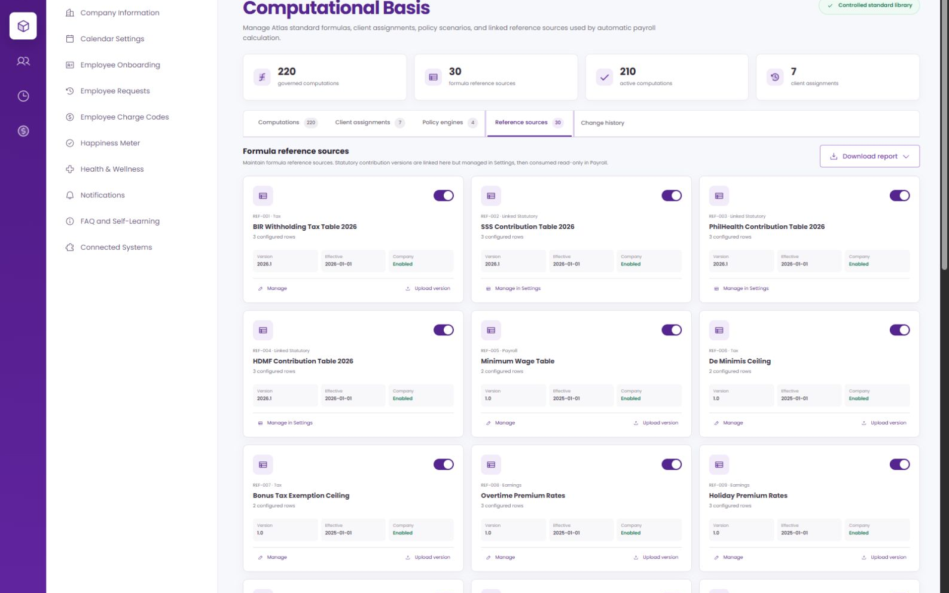
REFERENCE SOURCES
Keep changing rates and tables outside the formula
One maintained source
A contribution table, tax table, ceiling or code list can support more than one computation.
Date-aware selection
Payroll should read the source version in force for the transaction date.
History stays explainable
Later uploads do not change the table that an old posted payroll used.
Reference sources — live ATLAS screen
Source · live ATLAS Computational Basis → Reference sources
Notes:
Presenter note: walk through this page in the language payroll and finance teams use. Explain what the user enters, where ATLAS gets the data, and what the downstream module does with the result.
[Sources]
- ATLAS_Phase2_Computational_Basis_Demo_v2.pptx
- Live ATLAS prototype captured 24 August 2026
- ComputationalBasis.jsx, computationCatalog.js and payrollEngine.js where relevant.

Slide 26
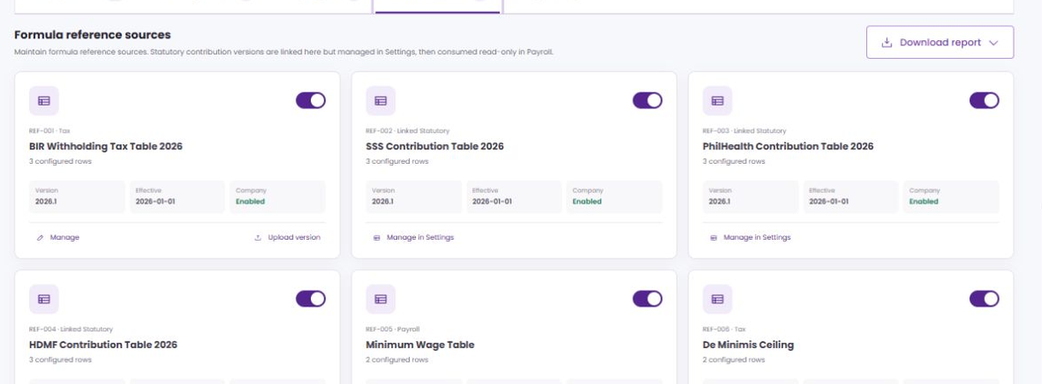
REFERENCE SOURCE · FIELD GUIDE 1 OF 2
What each source card tells finance
1
Code and category
The stable identifier and business family used when mapping a source to computations or assignments.
2
Name
The finance-facing title of the rate, table, ceiling or code list.
1
2
3
4
3
Configured rows
A quick count of records loaded into the current version. Unexpected changes deserve review.
4
Version and effective date
Together they identify which dataset is valid for a payroll date and which historical copy must be retained.
Notes:
Presenter note: walk through this page in the language payroll and finance teams use. Explain what the user enters, where ATLAS gets the data, and what the downstream module does with the result.
[Sources]
- ATLAS_Phase2_Computational_Basis_Demo_v2.pptx
- Live ATLAS prototype captured 24 August 2026
- ComputationalBasis.jsx, computationCatalog.js and payrollEngine.js where relevant.

Slide 27
REFERENCE SOURCE · FIELD GUIDE 2 OF 2
Enable, maintain and replace a source
1
Company status
Enabled sources can be selected by this company. Disabled sources remain visible but should not be newly assigned.
2
Manage
Opens company-maintained rows. Linked statutory sources are managed in Settings so the standard table stays controlled.
1
2
3
4
3
Upload version
Adds a new effective dataset instead of overwriting the version used by earlier payroll transactions.
4
Downstream effect
A new source version can change every computation that reads it, so test affected assignments before its effective date.
Notes:
Presenter note: walk through this page in the language payroll and finance teams use. Explain what the user enters, where ATLAS gets the data, and what the downstream module does with the result.
[Sources]
- ATLAS_Phase2_Computational_Basis_Demo_v2.pptx
- Live ATLAS prototype captured 24 August 2026
- ComputationalBasis.jsx, computationCatalog.js and payrollEngine.js where relevant.

Slide 28
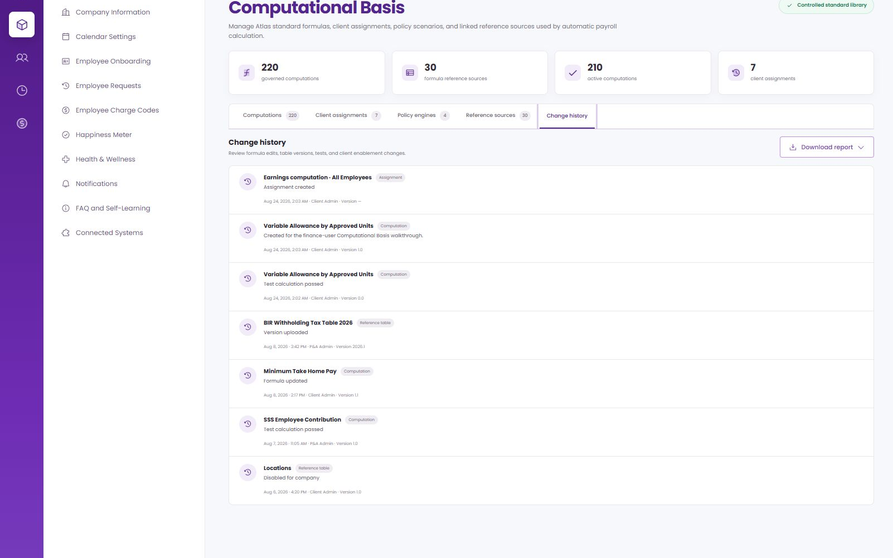
CHANGE HISTORY
The history answers who changed what and when
Formula work
Records formula edits, versions and tests.
Source work
Records table uploads, effectivity and enablement changes.
Assignment work
Shows client enablement and maintenance so the payroll setup can be reconstructed.
Change history — live ATLAS screen
Source · live ATLAS Computational Basis → Change history
Notes:
Presenter note: walk through this page in the language payroll and finance teams use. Explain what the user enters, where ATLAS gets the data, and what the downstream module does with the result.
[Sources]
- ATLAS_Phase2_Computational_Basis_Demo_v2.pptx
- Live ATLAS prototype captured 24 August 2026
- ComputationalBasis.jsx, computationCatalog.js and payrollEngine.js where relevant.

Slide 29
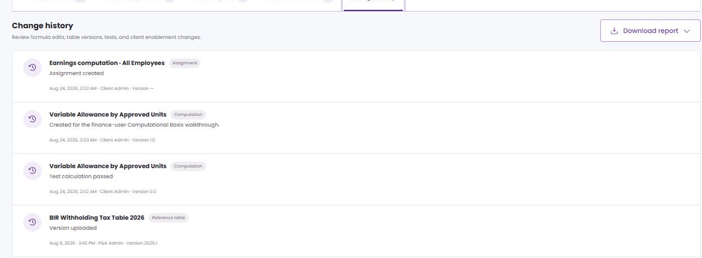
CHANGE HISTORY · FIELD GUIDE
How to read the audit columns
1
Item and type
Identifies the computation, source or assignment that changed and the kind of record it belongs to.
1
2
Action, date and user
2
Shows what happened, when it happened and who performed it.
3
3
Version
Links the event to the exact formula or source version used by a transaction.
Notes:
Presenter note: walk through this page in the language payroll and finance teams use. Explain what the user enters, where ATLAS gets the data, and what the downstream module does with the result.
[Sources]
- ATLAS_Phase2_Computational_Basis_Demo_v2.pptx
- Live ATLAS prototype captured 24 August 2026
- ComputationalBasis.jsx, computationCatalog.js and payrollEngine.js where relevant.

Slide 30
THE HANDOFF
A computation passes through three different states
State
What is true / what still has to happen
1 · Created
Code, mapped fields, test, effectivity and version exist.
It is ready to assign, but no transaction has called it.
2 · Assigned
Purpose, employee scope and frequency are recorded.
The runtime still has to match this assignment.
3 · Executed
A consumer supplied real values and called the code.
The result and evidence are saved in a transaction.
Do not confuse them
A saved assignment is governance, not an automatic payroll call.
Integration must resolve and invoke the computation.
Notes:
Presenter note: walk through this page in the language payroll and finance teams use. Explain what the user enters, where ATLAS gets the data, and what the downstream module does with the result.
[Sources]
- ATLAS_Phase2_Computational_Basis_Demo_v2.pptx
- Live ATLAS prototype captured 24 August 2026
- ComputationalBasis.jsx, computationCatalog.js and payrollEngine.js where relevant.

Slide 31
HOW IT CONNECTS TO ATLAS
Each module supplies something different
ATLAS area
Supplies / affects
HRM / Employee Masterfile
Salary, dates, group, status, plan and employee attributes.
Variables, eligibility and assignment scope.
Timekeeping
Approved hours, days, shifts, overtime, absences and units.
Payable quantities for earnings and deductions.
Payroll setup and registers
Codes, balances, rates, ceilings, tables and transaction settings.
Business context and effective reference values.
Payroll processing and outputs
Company, employee, event and transaction date.
Payroll lines, trail, payslip and reports.
Notes:
Presenter note: walk through this page in the language payroll and finance teams use. Explain what the user enters, where ATLAS gets the data, and what the downstream module does with the result.
[Sources]
- ATLAS_Phase2_Computational_Basis_Demo_v2.pptx
- Live ATLAS prototype captured 24 August 2026
- ComputationalBasis.jsx, computationCatalog.js and payrollEngine.js where relevant.

Slide 32
ATLAS CONNECTION · HRM
Examples of employee data that can feed a computation
Basic salary
Used by daily-rate, hourly-rate, retirement, final-pay and percentage-based computations.
Employee Masterfile / compensation record
Employee group
Used to choose the client assignment—e.g. Managers may have a different bonus basis than Rank and File.
Employment or payroll classification
Hire / retirement date
Used to calculate service and determine whether a retirement assignment is eligible.
Employment dates
Status and plan membership
Used to exclude inactive employees or choose a company-plan computation.
Employment profile
Notes:
Presenter note: walk through this page in the language payroll and finance teams use. Explain what the user enters, where ATLAS gets the data, and what the downstream module does with the result.
[Sources]
- ATLAS_Phase2_Computational_Basis_Demo_v2.pptx
- Live ATLAS prototype captured 24 August 2026
- ComputationalBasis.jsx, computationCatalog.js and payrollEngine.js where relevant.

Slide 33
ATLAS CONNECTION · TIMEKEEPING
Examples of approved quantities the formula can value
Overtime hours
ERN-002 can multiply hours by the employee's hourly rate and the applicable premium.
Approved overtime record
Days worked
Can be used for prorated salary or an allowance that depends on approved days.
Processed attendance
Late / undertime minutes
Can feed a deduction formula after approval and before payroll finalization.
Attendance exceptions
Allowance units
CUS-900 uses the approved unit count rather than letting payroll re-key the quantity.
Approved quantity from the business process
Notes:
Presenter note: walk through this page in the language payroll and finance teams use. Explain what the user enters, where ATLAS gets the data, and what the downstream module does with the result.
[Sources]
- ATLAS_Phase2_Computational_Basis_Demo_v2.pptx
- Live ATLAS prototype captured 24 August 2026
- ComputationalBasis.jsx, computationCatalog.js and payrollEngine.js where relevant.

Slide 34
ATLAS CONNECTION · PAYROLL SETUP
Registers give the computation its business meaning
Earning code
Links CUS-900 to the payroll line that should receive the ₱2,000 result.
Earnings and Allowance Codes
Deduction / loan code
Identifies which balance or scheduled payment a deduction computation is evaluating.
Deduction and Loan Hierarchy
Reference table
Supplies effective values without hard-coding them in every expression.
Tax, contribution, rate or ceiling source
Payroll settings
Tell ATLAS which assignment and effective version are applicable for the run.
Frequency, cutoff and transaction date
Notes:
Presenter note: walk through this page in the language payroll and finance teams use. Explain what the user enters, where ATLAS gets the data, and what the downstream module does with the result.
[Sources]
- ATLAS_Phase2_Computational_Basis_Demo_v2.pptx
- Live ATLAS prototype captured 24 August 2026
- ComputationalBasis.jsx, computationCatalog.js and payrollEngine.js where relevant.

Slide 35
ATLAS CONNECTION · PAYROLL PROCESSING
What should happen inside a payroll run
1 · Match
ATLAS finds the one active, non-conflicting client assignment for the employee and event.
Company + employee group + purpose + reference + frequency
2 · Select versions
ATLAS selects the computation and reference-source versions effective on that date.
Payroll date
3 · Supply inputs
The consumer maps actual values to every required token.
Employee, timekeeping and payroll registers
4 · Save the answer
The amount, code, version, inputs and source versions become part of the computation trail.
Payroll transaction
Notes:
Presenter note: walk through this page in the language payroll and finance teams use. Explain what the user enters, where ATLAS gets the data, and what the downstream module does with the result.
[Sources]
- ATLAS_Phase2_Computational_Basis_Demo_v2.pptx
- Live ATLAS prototype captured 24 August 2026
- ComputationalBasis.jsx, computationCatalog.js and payrollEngine.js where relevant.

Slide 36
ATLAS CONNECTION · OUTPUTS
Where the computed amount appears after processing
Payroll line
The result is posted to the correct code—not as an unexplained manual amount.
Earning, deduction, tax or employer share
Payslip
The employee sees the amount; deferred or staggered items can show original due and remaining balance.
Employee-facing line and, where needed, formula context
Reports and GL feeds
Downstream totals use the same saved transaction amount rather than recomputing the formula differently.
Payroll registers, summaries and accounting outputs
Audit trail
Finance can trace the output back to assignment, version, inputs and reference sources.
How it was computed
Notes:
Presenter note: walk through this page in the language payroll and finance teams use. Explain what the user enters, where ATLAS gets the data, and what the downstream module does with the result.
[Sources]
- ATLAS_Phase2_Computational_Basis_Demo_v2.pptx
- Live ATLAS prototype captured 24 August 2026
- ComputationalBasis.jsx, computationCatalog.js and payrollEngine.js where relevant.

Slide 37
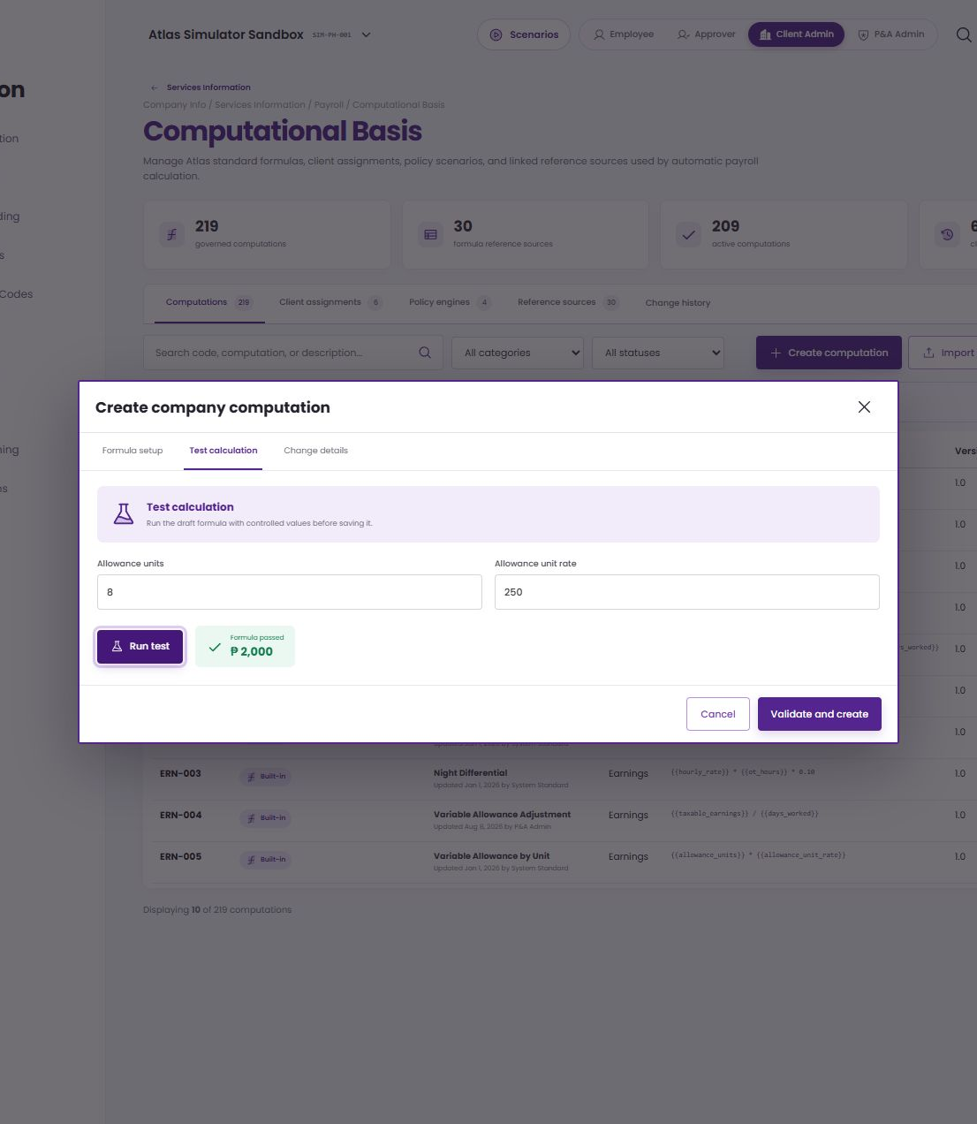
WORKED EXAMPLE 1 · CUS-900
Variable allowance from creation to payroll
Approved units
8
Unit rate
₱250
Formula
8 × ₱250
Payroll earning
₱2,000
The consumer must map approved quantity and effective unit rate, then post the answer to the assigned earning code.
Assignment
Earnings computation · Earnings and Allowance Codes
Source · live CUS-900 creation, test and client-assignment walkthrough
Scope
All Employees · Every payroll
Notes:
Presenter note: walk through this page in the language payroll and finance teams use. Explain what the user enters, where ATLAS gets the data, and what the downstream module does with the result.
[Sources]
- ATLAS_Phase2_Computational_Basis_Demo_v2.pptx
- Live ATLAS prototype captured 24 August 2026
- ComputationalBasis.jsx, computationCatalog.js and payrollEngine.js where relevant.

Slide 38
WORKED EXAMPLE 2 · ERN-002
Overtime pay shows a cross-module calculation
Step
Input / result
Timekeeping
2 approved overtime hours.
The quantity is available only after attendance approval.
HRM / payroll
Hourly rate ₱125; premium factor 1.25.
Both values must be effective for the payroll date.
Computation
125 × 2 × 1.25
ERN-002 returns ₱312.50.
Payroll output
Post ₱312.50 to the overtime earning line.
Keep code, version, inputs and sources in the trail.
Notes:
Presenter note: walk through this page in the language payroll and finance teams use. Explain what the user enters, where ATLAS gets the data, and what the downstream module does with the result.
[Sources]
- ATLAS_Phase2_Computational_Basis_Demo_v2.pptx
- Live ATLAS prototype captured 24 August 2026
- ComputationalBasis.jsx, computationCatalog.js and payrollEngine.js where relevant.

Slide 39
WORKED EXAMPLE 3 · LOAN AND MINIMUM TAKE-HOME
A computation can also drive an employee request
Step
Situation / action
Forecast
Take-home before loan ₱8,200; minimum ₱8,000.
Scheduled company-loan deduction is ₱1,500.
Result
₱8,200 − ₱1,500 = ₱6,700.
The employee would be ₱1,300 below the minimum.
Employee
Notify before cutoff using the configured lead time.
Offer the company's eligible staggered-payment options.
Payroll
Apply the approved reduced or deferred loan amount.
Show original due, paid and remaining balance.
Notes:
Presenter note: walk through this page in the language payroll and finance teams use. Explain what the user enters, where ATLAS gets the data, and what the downstream module does with the result.
[Sources]
- ATLAS_Phase2_Computational_Basis_Demo_v2.pptx
- Live ATLAS prototype captured 24 August 2026
- ComputationalBasis.jsx, computationCatalog.js and payrollEngine.js where relevant.

Slide 40
PAYROLL TRANSACTION
The posted run is where the setup becomes evidence
Inputs
Transaction settings, salary, timekeeping and earning/deduction/loan registers establish the actual values.
Calculation
Reference sources, assignment, computation, tax and policy steps explain the amount in sequence.
Outputs
The same saved result feeds the payroll line, payslip, reports and later audit review.
How it was computed — live ATLAS payroll transaction
Source · posted payroll PR-2025-11-E2E → John Collins Doe → How it was computed
Notes:
Presenter note: walk through this page in the language payroll and finance teams use. Explain what the user enters, where ATLAS gets the data, and what the downstream module does with the result.
[Sources]
- ATLAS_Phase2_Computational_Basis_Demo_v2.pptx
- Live ATLAS prototype captured 24 August 2026
- ComputationalBasis.jsx, computationCatalog.js and payrollEngine.js where relevant.

Slide 41
E N D - T O - E N D F L O W
How a finance-defined computation reaches an ATLAS output
Use this map to separate setup, matching, execution and evidence.
SETUP PATH
Company
Info
Services
Information
Payroll
Computational
Basis
1
Define the inputs
2
Create the computation
3
Assign the client
4
Resolve at runtime
5
Calculate and trace
Choose approved ATLAS fields and confirm the owning module, data type and timing.
Set code and business details, build the expression, test sample values and publish the version.
Choose purpose, reference table, computation, employee group, frequency and status.
Match company, employee, business event and date; block overlapping active assignments.
Supply actual inputs, run the code, save amount and versions, then feed payslip and reports.
HRM
TIME
PAY
OUT
CREATE + USE
1 Approved inputs
2 Tested expression
3 Client assignment
4 Consumer call
CONTROL POINTS
Permanent code
Owned inputs
No overlap
History retained
Integrations use the code, not a display name.
Every variable has one trusted ATLAS source.
Only one assignment may claim the same employee and event.
Used versions are replaced by a new effective version, never rewritten.
Source · live ATLAS workflow, computation catalog and payroll transaction trail
Notes:
Presenter note: walk through this page in the language payroll and finance teams use. Explain what the user enters, where ATLAS gets the data, and what the downstream module does with the result.
[Sources]
- ATLAS_Phase2_Computational_Basis_Demo_v2.pptx
- Live ATLAS prototype captured 24 August 2026
- ComputationalBasis.jsx, computationCatalog.js and payrollEngine.js where relevant.

Slide 42
BEFORE GO-LIVE
Five decisions the setup screen cannot make for you
Finance and implementation should agree these before switching the assignment to Active.
1
Which ATLAS step calls the code
Name the module and exact point in its workflow. A new custom code will not execute just because it exists.
Consumer owner
2
Where every variable comes from
Record field owner, data type, unit, effective timing and what happens when the value is missing.
Input contract
3
How scope conflicts are handled
Reject overlapping purpose, reference, employee group, frequency and dates unless precedence is explicitly approved.
Conflict rule
4
When editing stops
Once a payroll transaction uses a version, publish a new effective version and leave the old evidence unchanged.
History rule
5
Who approves the release
Define finance owner, reviewer, test evidence and deployment date for formula, assignment and source changes.
Approval workflow
Notes:
Presenter note: walk through this page in the language payroll and finance teams use. Explain what the user enters, where ATLAS gets the data, and what the downstream module does with the result.
[Sources]
- ATLAS_Phase2_Computational_Basis_Demo_v2.pptx
- Live ATLAS prototype captured 24 August 2026
- ComputationalBasis.jsx, computationCatalog.js and payrollEngine.js where relevant.

Slide 43
APPENDIX · EVIDENCE
What this walkthrough is based on
Reference deck
Structure, typography, field-guide pattern, live-screen treatment and worked-example pacing.
ATLAS Phase 2 Computational Basis Demo v2
Live prototype
Computations, client assignments, reference sources, change history and payroll computation trail.
ATLAS local application · 24 August 2026
Application source
Used to distinguish what the setup currently stores from what the runtime still needs to invoke.
ComputationalBasis.jsx · computationCatalog.js · payrollEngine.js
Demonstration
Sample data for this walkthrough only; not a production payroll value.
CUS-900 · 8 units × ₱250 = ₱2,000
Notes:
Presenter note: walk through this page in the language payroll and finance teams use. Explain what the user enters, where ATLAS gets the data, and what the downstream module does with the result.
[Sources]
- ATLAS_Phase2_Computational_Basis_Demo_v2.pptx
- Live ATLAS prototype captured 24 August 2026
- ComputationalBasis.jsx, computationCatalog.js and payrollEngine.js where relevant.

Slide 44
What finance users should take away
1
A computation is a reusable payroll rule with owned inputs, a test and an effective version.
2
The client assignment says where, for whom and how often that rule may be used.
3
HRM, Timekeeping and payroll registers supply the real values; the payroll consumer must call the code.
4
The transaction trail keeps the amount explainable from source data to payslip and reports.
Notes:
Presenter note: walk through this page in the language payroll and finance teams use. Explain what the user enters, where ATLAS gets the data, and what the downstream module does with the result.
[Sources]
- ATLAS_Phase2_Computational_Basis_Demo_v2.pptx
- Live ATLAS prototype captured 24 August 2026
- ComputationalBasis.jsx, computationCatalog.js and payrollEngine.js where relevant.

