Slide 1
ATLAS PHASE 2 · PAYROLL
Computational Basis
How a finance team writes a payroll calculation, tells ATLAS who it is for, and proves afterwards exactly how every peso was worked out.
1 Create
2 Test
3 Assign
4 Prove
Finance walkthrough · every field explained · every screen captured live from the ATLAS prototype on 24 August 2026
Notes:
Open by saying what the session is for: after this, a finance user should be able to open the workspace and create, test, assign and audit a computation without help.
Presenter note: keep to the language payroll and finance teams use. For every screen, say what the user enters, where ATLAS gets the value, and what the next module does with the result. The records and amounts on screen are demonstration data.
Evidence: live ATLAS prototype captured 24 August 2026; ComputationalBasis.jsx, computationCatalog.js, payrollEngine.js, payrollTraceability.js; one posted payroll transaction.

Slide 2
WHY WE ARE HERE
What you will be able to do after this session
Five outcomes. The rest of the deck exists to deliver them.
1
Find and read any rule
2
Write one correctly
3
Say who it is for
4
Follow it into payroll
5
Know where to go next
Open the register, filter it, and read a computation record well enough to explain the amount it produces to an auditor.
Create a computation with a permanent code, an approved expression, a test that a reviewer can reproduce, and a dated change note.
Record the business purpose, the reference table, the employee group and the frequency that together define where a rule applies.
Read the source trail and the calculation ledger on a posted payroll, and trace any amount back to the code that produced it.
Reach every screen in this deck by its navigation path, and come to the meeting ready to agree the five integration decisions at the end.
Every claim in this deck is either a live screen capture or a named source file.
Notes:
Presenter note: keep to the language payroll and finance teams use. For every screen, say what the user enters, where ATLAS gets the value, and what the next module does with the result. The records and amounts on screen are demonstration data.
Evidence: live ATLAS prototype captured 24 August 2026; ComputationalBasis.jsx, computationCatalog.js, payrollEngine.js, payrollTraceability.js; one posted payroll transaction.

Slide 3
HOW TO READ THIS DECK
Two kinds of page, marked differently
Most pages walk through a screen. A few set up a decision for the meeting, and those are marked so you can spot them coming.
WALKTHROUGH
FOR THE MEETING
A screen and its fields
A decision to agree
Captured live from the prototype on 24 August 2026, with numbered notes placed on the control each one describes.
Points where the business rule is a choice rather than a setting — scope, ownership, approval and timing.
A navigation path
Gathered at the end
Every screen page carries the exact path to reach it, so you can open the same page in ATLAS while we talk.
Every one of them is repeated on the 'Five decisions before go-live' page, so nothing has to be hunted for afterwards.
Demonstration data
Owned by both sides
Records, codes and amounts on screen are sample data created for this walkthrough.
These are choices for finance and implementation to make together before the first assignment goes Active.
Screens are live captures of the ATLAS prototype. The records, codes and amounts shown are demonstration data.
Notes:
Presenter note: keep to the language payroll and finance teams use. For every screen, say what the user enters, where ATLAS gets the value, and what the next module does with the result. The records and amounts on screen are demonstration data.
Evidence: live ATLAS prototype captured 24 August 2026; ComputationalBasis.jsx, computationCatalog.js, payrollEngine.js, payrollTraceability.js; one posted payroll transaction.

Slide 4
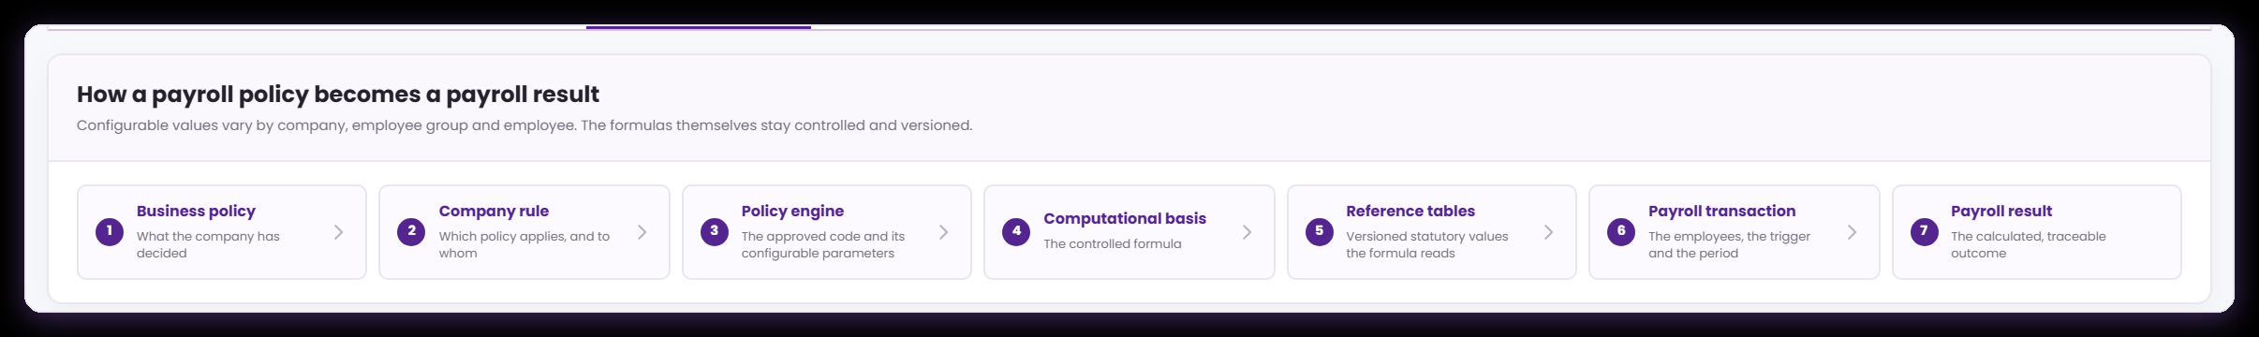
THE MODEL
A payroll policy becomes a payroll result in seven moves
Core › Company Configuration › Services Information › Payroll › Computational Basis › Policy engines
This chain is drawn on screen inside the Policy engines tab. It is the clearest available answer to 'where does my formula sit?'
Policy, rule, engine
Basis and reference
Transaction and result
The first three moves are governance: what the company decided, who it applies to, and which approved code carries the parameters.
Computational Basis holds the controlled formula; reference tables hold the versioned values it reads.
The payroll transaction supplies the employees, the trigger and the period. Only then does an amount exist.
Configurable values vary by company, employee group and employee; the formulas themselves stay controlled and versioned.
Notes:
This chain is the mental model for the whole session. Computational Basis is step 4 of 7 — it is deliberately narrow: it holds the formula, not the policy and not the parameters.
Presenter note: keep to the language payroll and finance teams use. For every screen, say what the user enters, where ATLAS gets the value, and what the next module does with the result. The records and amounts on screen are demonstration data.
Evidence: live ATLAS prototype captured 24 August 2026; ComputationalBasis.jsx, computationCatalog.js, payrollEngine.js, payrollTraceability.js; one posted payroll transaction.

Slide 5
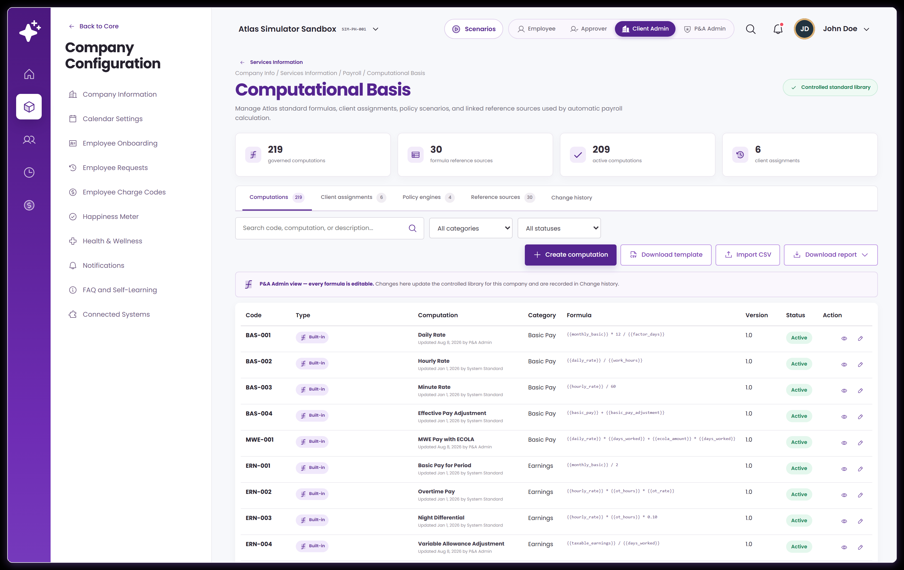
WHERE IT LIVES
Computational Basis is a Payroll service
Core › Company Configuration › Services Information › Payroll › Computational Basis
It sits inside Services Information alongside the payroll services whose results depend on it, rather than in a separate administration area.
Follow the path
One library per company
Five tabs, one story
Core, then Company Configuration, then Services Information, then the Payroll tab, then Computational Basis.
The header confirms a controlled standard library, extended with anything this company has added.
Formulas, assignments, engines, sources and history sit side by side on purpose.
Screens are live captures of the ATLAS prototype. The records, codes and amounts shown are demonstration data.
Notes:
Presenter note: keep to the language payroll and finance teams use. For every screen, say what the user enters, where ATLAS gets the value, and what the next module does with the result. The records and amounts on screen are demonstration data.
Evidence: live ATLAS prototype captured 24 August 2026; ComputationalBasis.jsx, computationCatalog.js, payrollEngine.js, payrollTraceability.js; one posted payroll transaction.

Slide 6
THE SHAPE OF THE LIBRARY
What is already in there before you add anything
Core › Company Configuration › Services Information › Payroll › Computational Basis
Most of what finance needs is already present as an ATLAS standard. Knowing what is there changes the usual task from authoring to selecting.
1
ATLAS standard formulas
2
Company formulas
3
An approved field palette
Basic pay and rate derivations, earnings, deductions, government contributions, tax, bonuses, benefits, retirement and separation — maintained centrally and versioned.
Anything this company needs that the standards do not cover, created here and marked admin-defined so the two never get confused.
The payroll values a formula may reference, each with a fixed token and a sample value, plus any published computation you want to build on.
4
Reference sources
5
Policy engines
6
Client assignments
Effective-dated tax and contribution tables, ceilings, premium rates and code lists, so a change of rate never means editing a formula.
Take-home protection, deduction and loan order, caps and retirement — rules that shape a calculated result rather than produce one.
The company's own statements of what each formula is for, who it covers and how often it applies.
The usual finance task is finding the right existing formula, confirming its version, and assigning it correctly.
Notes:
Presenter note: keep to the language payroll and finance teams use. For every screen, say what the user enters, where ATLAS gets the value, and what the next module does with the result. The records and amounts on screen are demonstration data.
Evidence: live ATLAS prototype captured 24 August 2026; ComputationalBasis.jsx, computationCatalog.js, payrollEngine.js, payrollTraceability.js; one posted payroll transaction.

Slide 7
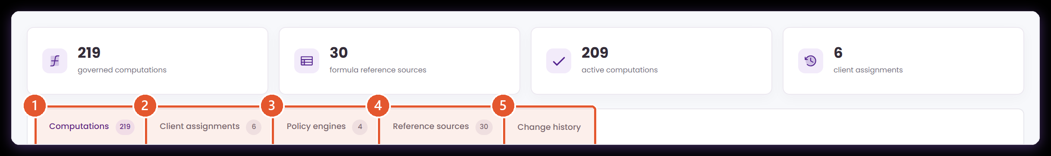
THE WORKSPACE
Five tabs, and the job each one does
Core › Company Configuration › Services Information › Payroll › Computational Basis
Everything Computational Basis governs lives behind these five tabs. Finance owns the first two; the other three carry the supporting evidence.
1
Computations
2
Client assignments
3
Policy engines
4
Reference sources
5
Change history
The formula library. This is where a calculation is written, tested, dated and published as a version.
The company's own record of what each formula is for, who it covers and how often it may be used.
Interactive engines — take-home protection, deduction order, caps, retirement — that shape a result rather than calculate an amount.
Effective-dated tables, rates, ceilings and code lists that formulas read, instead of carrying a value inside the expression.
Who changed which formula, table or assignment, when, and to which version. This is what keeps an earlier payroll explainable.
The counter beside each tab is a live total for the company you are working in.
Notes:
Presenter note: keep to the language payroll and finance teams use. For every screen, say what the user enters, where ATLAS gets the value, and what the next module does with the result. The records and amounts on screen are demonstration data.
Evidence: live ATLAS prototype captured 24 August 2026; ComputationalBasis.jsx, computationCatalog.js, payrollEngine.js, payrollTraceability.js; one posted payroll transaction.

Slide 8
VOCABULARY
The words on these screens, in plain English
Payroll and implementation use these terms differently. This is the meaning ATLAS gives them.
Computation
Computation code
Approved field
A named, versioned payroll calculation. It has a code, an expression, a test and an effective date.
The permanent ID — CUS-900, ERN-002. Everything downstream quotes the code, never the name.
One of the named inputs ATLAS can supply, written in the expression as {{allowance_units}}.
Mapped field
Expression
Reference source
An approved field actually used by a formula. The formula's dependency list.
The arithmetic itself, built only from approved fields and the operator palette.
An effective-dated table, rate or ceiling a formula reads instead of carrying the number inside it.
Client assignment
Policy engine
Version
The company's record of what a computation is for, who it covers and how often.
A rule that shapes a result — caps it, orders it, defers it — rather than calculating an amount.
A dated copy of a rule, retained so an earlier payroll stays explainable after the rule changes.
Notes:
Presenter note: keep to the language payroll and finance teams use. For every screen, say what the user enters, where ATLAS gets the value, and what the next module does with the result. The records and amounts on screen are demonstration data.
Evidence: live ATLAS prototype captured 24 August 2026; ComputationalBasis.jsx, computationCatalog.js, payrollEngine.js, payrollTraceability.js; one posted payroll transaction.

Slide 9
AN IMPORTANT DISTINCTION
Not every step in the ledger is a formula
Payroll › Payroll Processing › Transaction › Employee result › How it was computed
A posted payroll labels every step with its kind. Knowing which kind you are looking at tells you where to go when you want to change something.
KIND OF STEP
WHAT IT MEANS
WHERE YOU CHANGE IT
WHAT IT LOOKS LIKE
Configuration + computation
A formula whose inputs come from company or employee configuration.
Computational Basis, plus the configuration screen behind it.
Daily Rate — monthly salary × 12 ÷ factor days
Computation
A formula priced from transactional data such as approved time.
Computational Basis; the quantity comes from the source module.
Overtime Pay — approved hours × hourly rate × premium
Effective table lookup
A value read from a versioned statutory or company table.
The reference source or the Settings table, not the formula.
Withholding Tax — the bracket in force on the payout date
Policy engine
A rule that caps, orders or defers an amount already calculated.
Policy engines, using its configurable parameters.
Minimum Take-Home Pay — protect, then collect or defer
Payroll result
A total assembled from the steps above.
Through its inputs — adjust a step, not the total.
Gross Pay and Net Pay
Kinds and examples read from a posted payroll transaction.
Notes:
Presenter note: keep to the language payroll and finance teams use. For every screen, say what the user enters, where ATLAS gets the value, and what the next module does with the result. The records and amounts on screen are demonstration data.
Evidence: live ATLAS prototype captured 24 August 2026; ComputationalBasis.jsx, computationCatalog.js, payrollEngine.js, payrollTraceability.js; one posted payroll transaction.

Slide 10
01
Create a computation
From an empty form to a tested, dated, published version — every field on the way.
The register
The five-panel form
The saved record
Notes:
Presenter note: keep to the language payroll and finance teams use. For every screen, say what the user enters, where ATLAS gets the value, and what the next module does with the result. The records and amounts on screen are demonstration data.
Evidence: live ATLAS prototype captured 24 August 2026; ComputationalBasis.jsx, computationCatalog.js, payrollEngine.js, payrollTraceability.js; one posted payroll transaction.

Slide 11
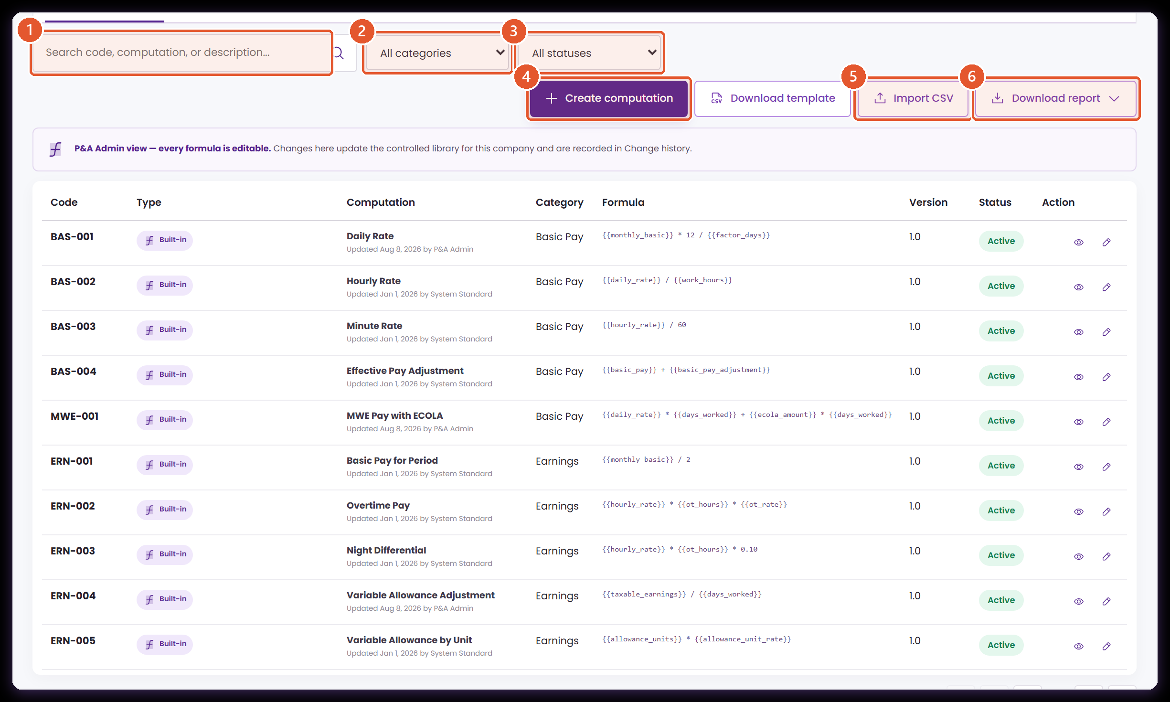
THE COMPUTATION REGISTER
Finding the right formula before you touch anything
Core › Company Configuration › Services Information › Payroll › Computational Basis › Computations
The register is where every finance task starts — whether you are checking an existing rule or about to add one.
1
Search
2
Category filter
Matches code, computation name and description. Search the code when you know it; search the description when you only know the business rule.
Narrows the list to one finance family — basic pay, earnings, deductions, government, tax, bonus, benefits, take-home pay, retirement and so on.
3
Status filter
4
Create computation
Separates what may be selected now (Active) from what is retained to explain earlier payrolls (Inactive).
Opens the three-step form: formula setup, test calculation, change details. Covered field by field from here on.
5
Import CSV
6
Download report
Bulk load for a migration. Each row's expression is validated on the way in, so anything needing attention is reported rather than saved.
Exports the register for review outside ATLAS — a useful attachment to a formula sign-off.
The register holds both ATLAS standard formulas and any the company has added.
Notes:
Presenter note: keep to the language payroll and finance teams use. For every screen, say what the user enters, where ATLAS gets the value, and what the next module does with the result. The records and amounts on screen are demonstration data.
Evidence: live ATLAS prototype captured 24 August 2026; ComputationalBasis.jsx, computationCatalog.js, payrollEngine.js, payrollTraceability.js; one posted payroll transaction.

Slide 12
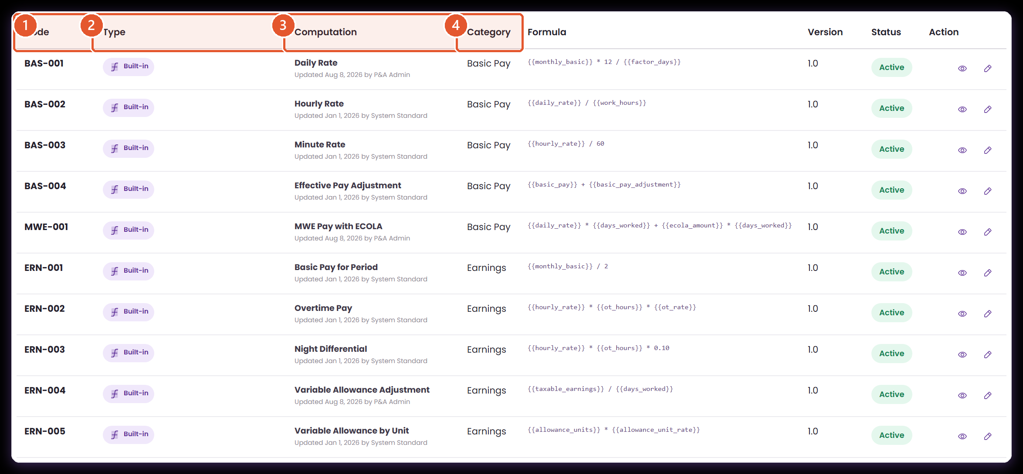
REGISTER FIELD GUIDE · 1 OF 2
What identifies a computation
Core › Company Configuration › Services Information › Payroll › Computational Basis › Computations
Four columns carry the identity of a rule. Get these right and everything downstream has something stable to point at.
1
Code
The permanent ID. Other modules, the payroll trail and the payslip all quote this code, so keep it stable once a version is released.
2
Type
Built-in is an ATLAS standard maintained centrally. Admin-defined was created for this company and is maintained here.
3
Computation
The business name, plus who last updated it and when. Name the amount being calculated, not the method used to calculate it.
4
Category
Decides where the formula appears when a payroll user filters, and which assignment types it suits.
Source · the Computations tab, with the demonstration record CUS-900 at the top of the list.
Notes:
Presenter note: keep to the language payroll and finance teams use. For every screen, say what the user enters, where ATLAS gets the value, and what the next module does with the result. The records and amounts on screen are demonstration data.
Evidence: live ATLAS prototype captured 24 August 2026; ComputationalBasis.jsx, computationCatalog.js, payrollEngine.js, payrollTraceability.js; one posted payroll transaction.

Slide 13
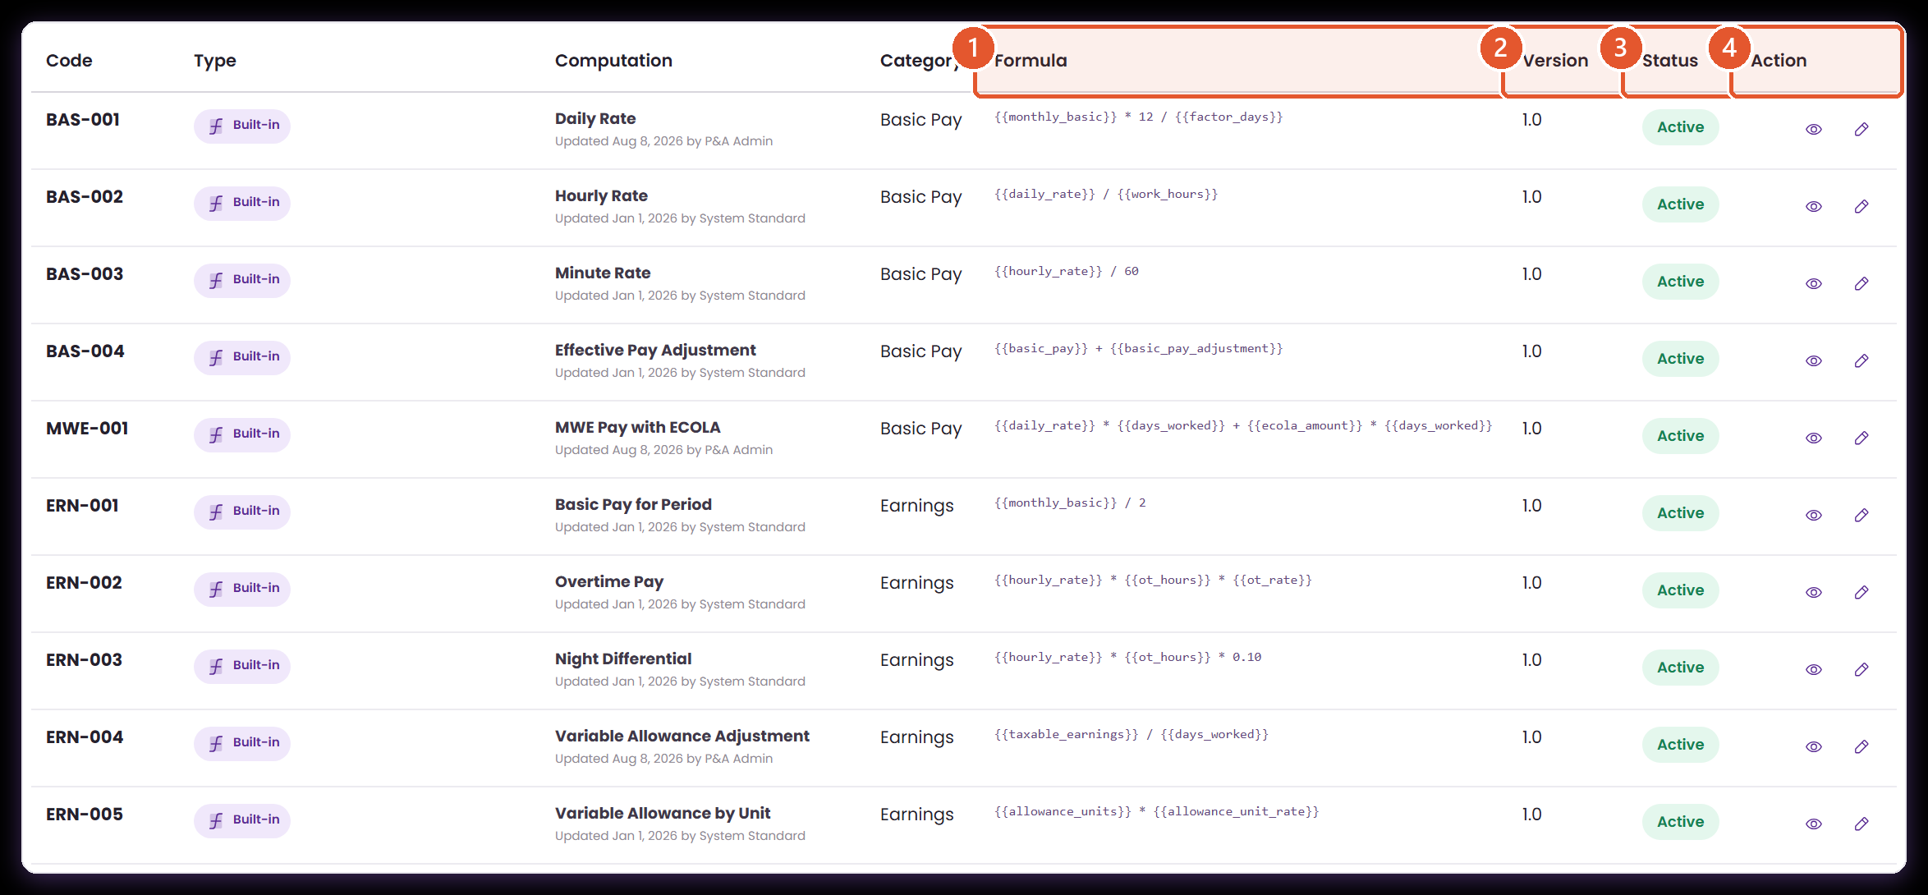
REGISTER FIELD GUIDE · 2 OF 2
What tells you whether you may use it
Core › Company Configuration › Services Information › Payroll › Computational Basis › Computations
The remaining columns answer a different question: is this rule ready to select right now, and what may I do to it?
1
Formula
The live expression, shown in full. Variables appear in double braces so they read differently from numbers and operators.
2
Version
The published version. A payroll transaction records the version it used, so this is the number an auditor reconciles against.
3
Status
Active means selectable for new assignments. Inactive keeps the record readable for history while taking it out of new use.
4
Action
View opens the read-only record; Edit maintains a company rule. Delete is protected — ATLAS looks after a code that an active client assignment still points at.
That delete protection is real behaviour: ATLAS checks client assignments before removing a computation.
Notes:
Presenter note: keep to the language payroll and finance teams use. For every screen, say what the user enters, where ATLAS gets the value, and what the next module does with the result. The records and amounts on screen are demonstration data.
Evidence: live ATLAS prototype captured 24 August 2026; ComputationalBasis.jsx, computationCatalog.js, payrollEngine.js, payrollTraceability.js; one posted payroll transaction.

Slide 14
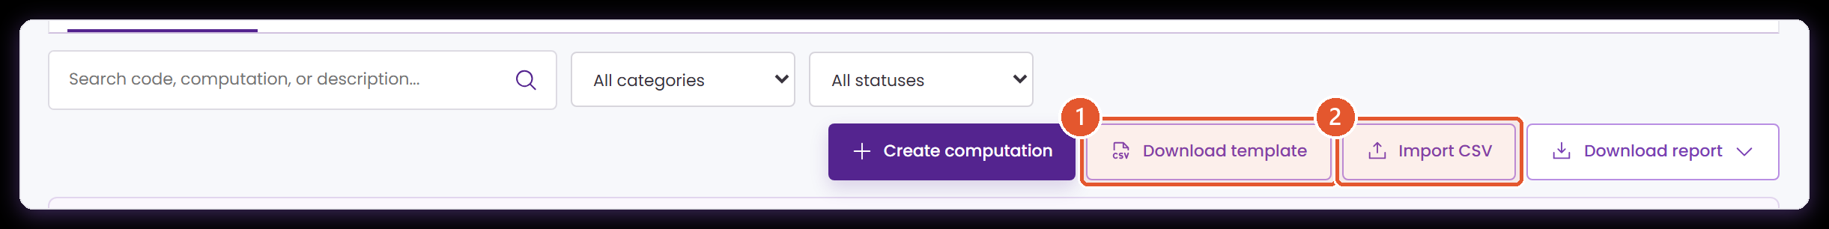
BULK MAINTENANCE
Start a bulk update from the template, not a blank sheet
Core › Company Configuration › Services Information › Payroll › Computational Basis › Computations
Download template gives you the exact headers the importer reads, filled with rows from this company's own library.
1
Download template
2
Import CSV
The required Code and Expression columns, the optional Name, Category, Status and Effective Date, three worked example rows, and a commented key listing every category, status and approved field.
Reads the same headers back. Each expression is validated on the way in, so a row that needs attention is reported rather than saved.
Reference sources have their own template too, on each source card beside Upload version.
Notes:
Presenter note: keep to the language payroll and finance teams use. For every screen, say what the user enters, where ATLAS gets the value, and what the next module does with the result. The records and amounts on screen are demonstration data.
Evidence: live ATLAS prototype captured 24 August 2026; ComputationalBasis.jsx, computationCatalog.js, payrollEngine.js, payrollTraceability.js; one posted payroll transaction.

Slide 15
DEMONSTRATION
Creating CUS-900, start to finish
Core › Company Configuration › Services Information › Payroll › Computational Basis › Computations › Create computation
A company allowance valued from an approved unit count and an assigned unit rate. Watch it once here; the next five pages take it apart field by field.
1
Describe the rule
Code CUS-900, a business name, the Earnings category, and a description that states what it excludes.
2
Build the expression
Insert allowance_units, apply ×, insert allowance_unit_rate. Both tokens come from the approved palette.
3
Test it
8 units × ₱250 returns ₱2,000, matching the manual calculation.
4
Date and explain it
Effective 1 September 2026, version 1.0, with a change note a reviewer can use.
ANIMATED CAPTURE · PLAYS IN SLIDE SHOW
Captured live; the animation is the real prototype, not a mock-up.
Notes:
Presenter note: keep to the language payroll and finance teams use. For every screen, say what the user enters, where ATLAS gets the value, and what the next module does with the result. The records and amounts on screen are demonstration data.
Evidence: live ATLAS prototype captured 24 August 2026; ComputationalBasis.jsx, computationCatalog.js, payrollEngine.js, payrollTraceability.js; one posted payroll transaction.

Slide 16
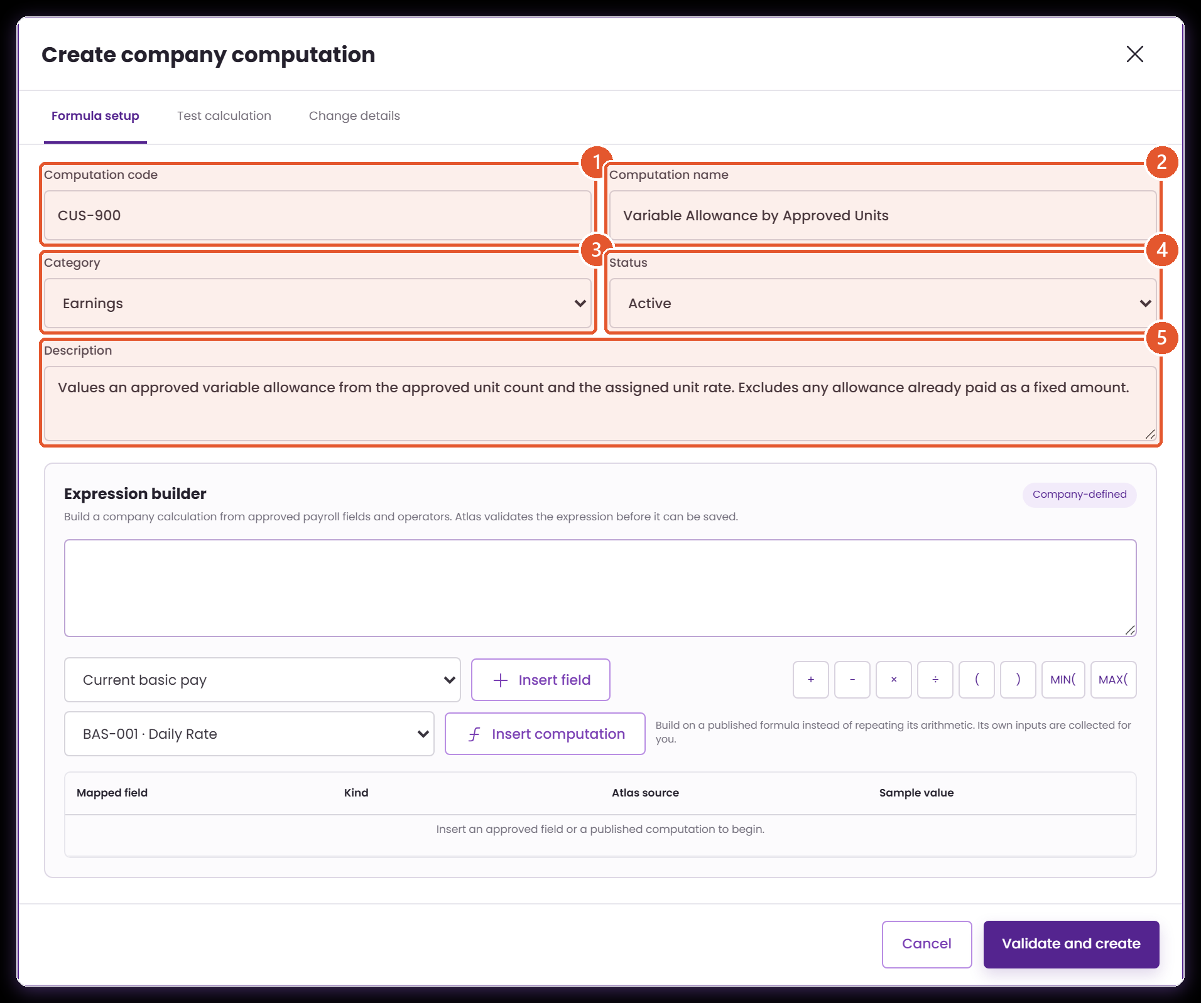
CREATE COMPUTATION · 1 OF 5
The business details, in plain language
Core › Company Configuration › Services Information › Payroll › Computational Basis › Computations › Create computation › Formula setup
Everything on this panel is written for the person who will read the rule in two years, not for the person typing it today.
1
Computation code
2
Computation name
Required and unique. ATLAS upper-cases it and keeps it fixed once saved. Choose a code that reads as a family — CUS- for company rules, ERN- for earnings.
Required. Use the wording that will appear on the assignment list and in conversation with payroll.
3
Category
4
Status
Choose the category of the result, not of the inputs. An allowance calculated from hours is still an earning.
Set it Active once the formula, its inputs and its consuming step are agreed. Inactive is the comfortable state while it is still under review.
5
Description
Required, and the most valuable field on the panel. State the rule, what it includes, and — just as usefully — what it excludes.
Demonstration record · CUS-900 Variable Allowance by Approved Units.
Notes:
Presenter note: keep to the language payroll and finance teams use. For every screen, say what the user enters, where ATLAS gets the value, and what the next module does with the result. The records and amounts on screen are demonstration data.
Evidence: live ATLAS prototype captured 24 August 2026; ComputationalBasis.jsx, computationCatalog.js, payrollEngine.js, payrollTraceability.js; one posted payroll transaction.

Slide 17
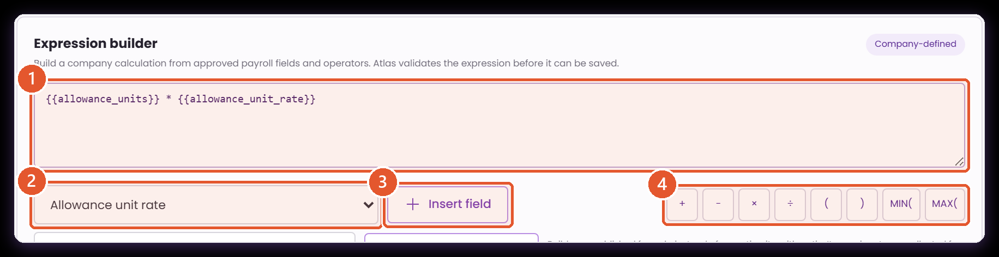
CREATE COMPUTATION · 2 OF 5
Building the expression from approved parts
Core › Company Configuration › Services Information › Payroll › Computational Basis › Computations › Create computation › Formula setup
The formula is assembled from a controlled palette of payroll fields and operators. That is what keeps the library governable.
1
Formula expression
2
Approved field
3
Insert field
4
Operator palette
The arithmetic ATLAS will evaluate. Build it in the order finance checks it on paper, so the two can be compared line for line.
The palette of payroll fields ATLAS can supply, each with a fixed token and a sample value. Adding a new field is a conversation with the module that owns the data.
Places the token at the cursor and adds its row to the mapped-field table below, so the dependency list always matches the expression.
Plus, minus, multiply, divide, parentheses, MIN( and MAX(. MIN and MAX are how a ceiling or a floor is expressed without writing a second rule.
ATLAS validates the expression before the record can be saved.
Notes:
Presenter note: keep to the language payroll and finance teams use. For every screen, say what the user enters, where ATLAS gets the value, and what the next module does with the result. The records and amounts on screen are demonstration data.
Evidence: live ATLAS prototype captured 24 August 2026; ComputationalBasis.jsx, computationCatalog.js, payrollEngine.js, payrollTraceability.js; one posted payroll transaction.

Slide 18
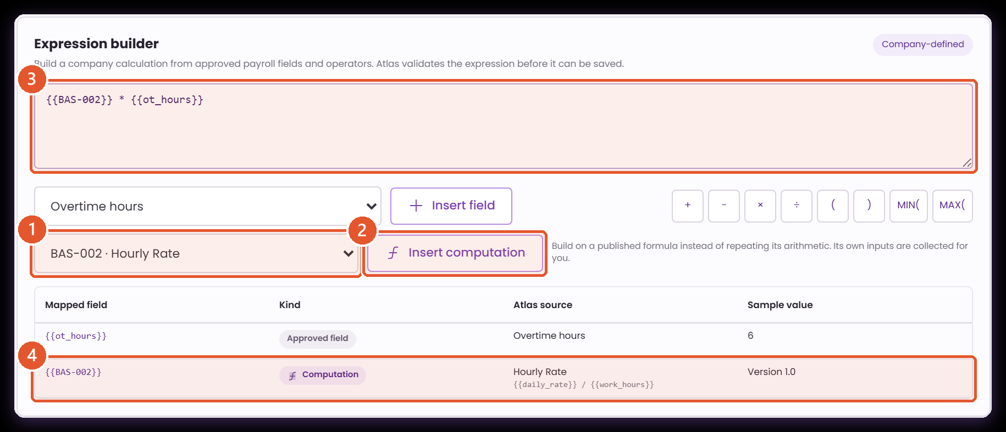
CREATE COMPUTATION · BUILDING ON A FORMULA
A formula can build on one you have already published
Core › Company Configuration › Services Information › Payroll › Computational Basis › Computations › Create computation › Formula setup
Rather than retyping the arithmetic of an existing rule, point at it. The published formula stays the single definition, and this one follows it.
1
Published computation
Every active computation in the library, offered as code plus name. The record you are editing is never in the list.
2
Insert computation
Places the code as a token in the expression, exactly as Insert field does for an approved field.
3
The expression
Field tokens and computation tokens sit side by side. Here, the published hourly rate multiplied by approved overtime hours.
4
It appears as a dependency
The mapped-field table gains a Kind column and lists the computation with its own expression, so the chain is visible without leaving the form.
ATLAS protects the chain: a self-reference, a loop, or an inactive computation is named on the spot and returns you to Formula setup.
Notes:
Presenter note: keep to the language payroll and finance teams use. For every screen, say what the user enters, where ATLAS gets the value, and what the next module does with the result. The records and amounts on screen are demonstration data.
Evidence: live ATLAS prototype captured 24 August 2026; ComputationalBasis.jsx, computationCatalog.js, payrollEngine.js, payrollTraceability.js; one posted payroll transaction.

Slide 19
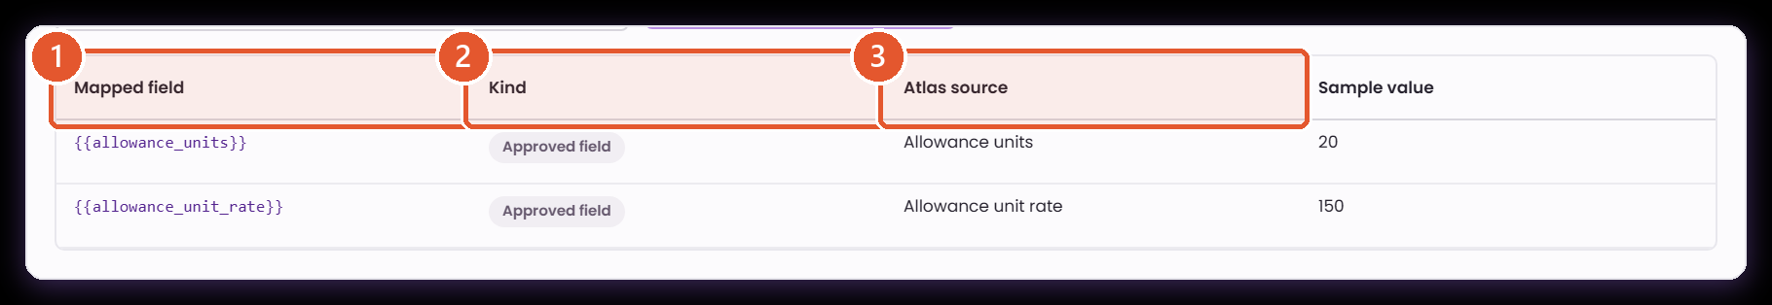
CREATE COMPUTATION · 3 OF 5
Mapped fields list every dependency
Core › Company Configuration › Services Information › Payroll › Computational Basis › Computations › Create computation › Formula setup
The table builds itself as you write the expression. Read it as the checklist of values the calculation will need when it runs.
1
Mapped field
2
Atlas source
3
Sample value
The exact token a consuming step supplies. This is the contract between the formula and the module that feeds it.
The approved field the token resolves to, in business wording — confirmation that the expression is built from recognised inputs.
A controlled example from the palette, useful for sanity-checking the scale of the result during setup.
Alongside this table, agree the owning module, data type, unit of measure and timing for each token — see 'Five decisions'.
Notes:
Presenter note: keep to the language payroll and finance teams use. For every screen, say what the user enters, where ATLAS gets the value, and what the next module does with the result. The records and amounts on screen are demonstration data.
Evidence: live ATLAS prototype captured 24 August 2026; ComputationalBasis.jsx, computationCatalog.js, payrollEngine.js, payrollTraceability.js; one posted payroll transaction.

Slide 20
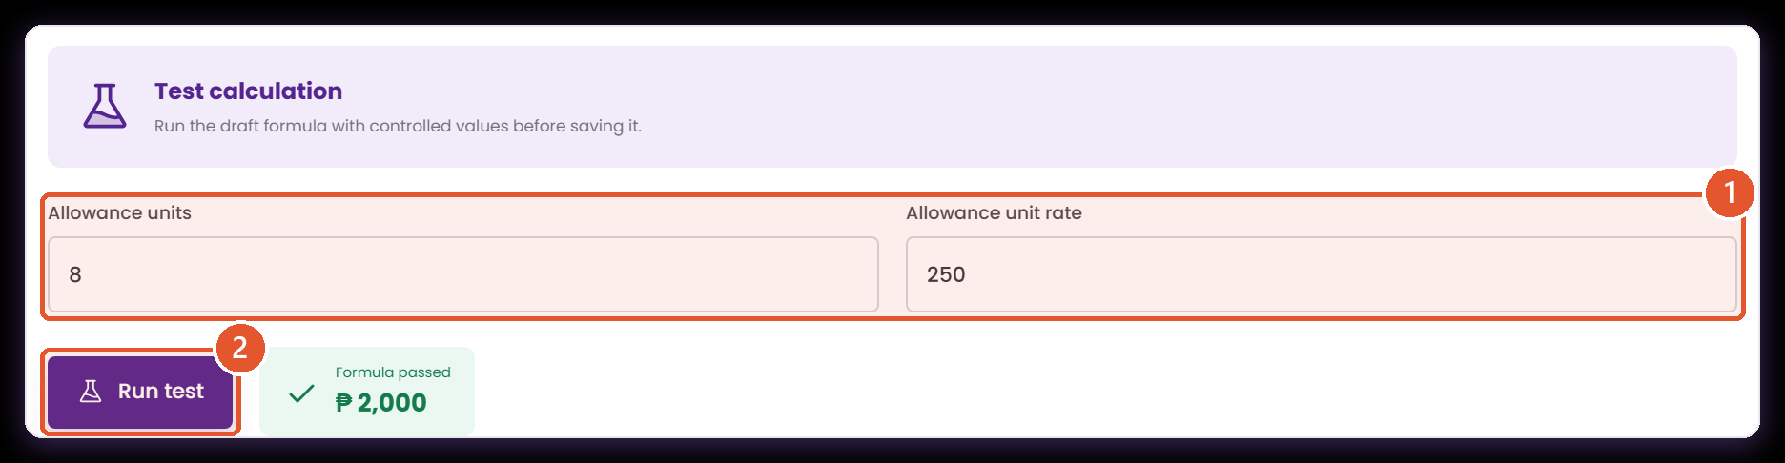
CREATE COMPUTATION · 4 OF 5
Testing before you publish
Core › Company Configuration › Services Information › Payroll › Computational Basis › Computations › Create computation › Test calculation
The test confirms the expression evaluates cleanly with values you choose. Whether the business policy behind it is right stays a finance judgement.
1
One input per mapped field
2
Run test
ATLAS generates a numeric box for every token. Use values a reviewer can recompute by hand rather than realistic-looking noise.
Evaluates the draft in place. Nothing is saved, no payroll transaction is created and no employee record changes.
Demonstration · 8 approved units × ₱250 returns ₱2,000, matching the manual calculation.
Notes:
Presenter note: keep to the language payroll and finance teams use. For every screen, say what the user enters, where ATLAS gets the value, and what the next module does with the result. The records and amounts on screen are demonstration data.
Evidence: live ATLAS prototype captured 24 August 2026; ComputationalBasis.jsx, computationCatalog.js, payrollEngine.js, payrollTraceability.js; one posted payroll transaction.

Slide 21
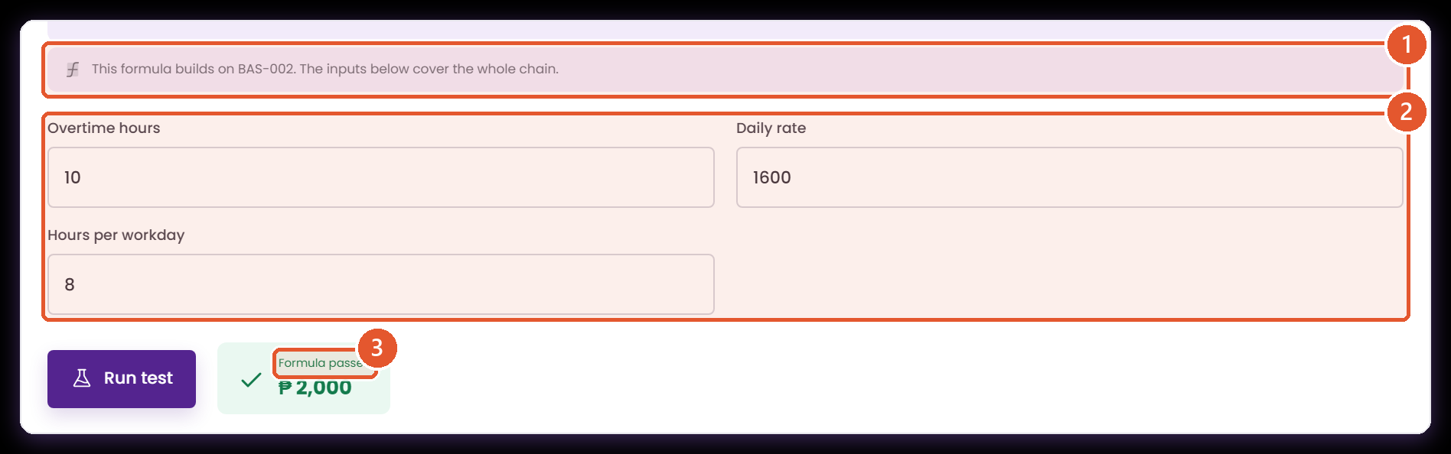
CREATE COMPUTATION · TESTING A CHAIN
Testing collects the inputs of the whole chain
Core › Company Configuration › Services Information › Payroll › Computational Basis › Computations › Create computation › Test calculation
You are asked for the values at the bottom of the chain, not for a figure you would have to work out first.
1
What it builds on
2
Inputs for the whole chain
3
One answer, end to end
Names the computations this formula depends on, so a reviewer knows the test covers more than the expression on screen.
The referenced hourly rate needs a daily rate and hours per workday, so ATLAS asks for those rather than for an hourly rate.
The chain resolves in order and returns a single figure a reviewer can reproduce by hand.
Demonstration · a daily rate of ₱1,600 over an 8-hour day, applied to 10 approved overtime hours, returns ₱2,000.
Notes:
Presenter note: keep to the language payroll and finance teams use. For every screen, say what the user enters, where ATLAS gets the value, and what the next module does with the result. The records and amounts on screen are demonstration data.
Evidence: live ATLAS prototype captured 24 August 2026; ComputationalBasis.jsx, computationCatalog.js, payrollEngine.js, payrollTraceability.js; one posted payroll transaction.

Slide 22
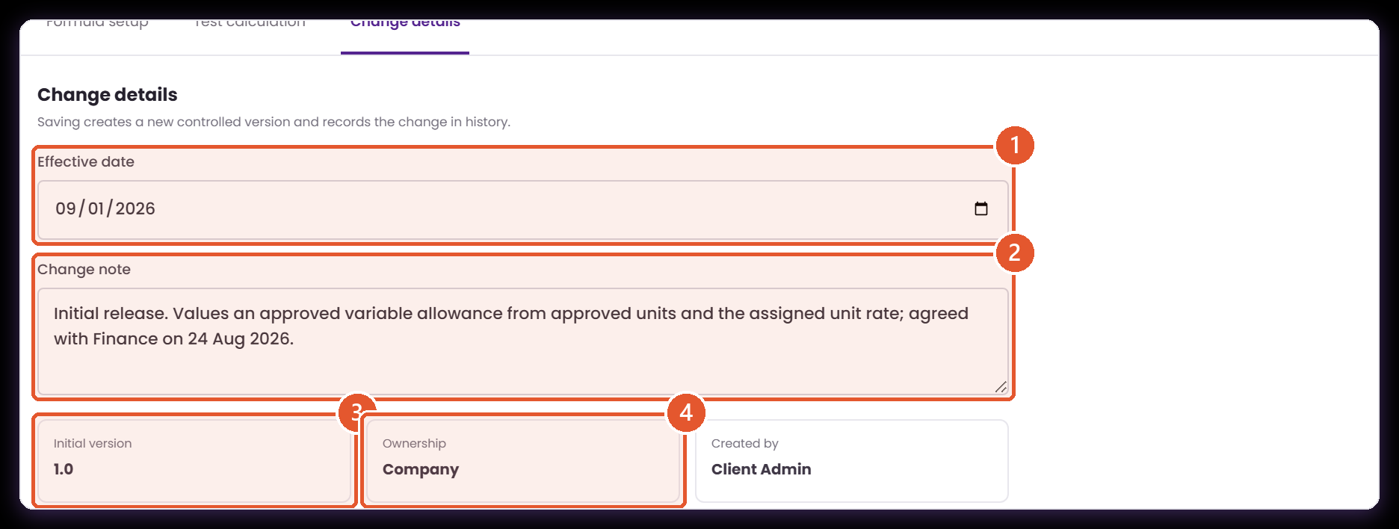
CREATE COMPUTATION · 5 OF 5
Dating the version and saying why
Core › Company Configuration › Services Information › Payroll › Computational Basis › Computations › Create computation › Change details
This panel is what keeps a payroll from last November explainable next November.
1
Effective date
2
Change note
3
Version
4
Ownership and author
The date from which this version is the right one to use. A transaction selects the version in force on its own payroll date.
Required. Write it for a reviewer who was not in the room: what changed, and which business decision drove it.
A new record starts at 1.0. Once a payroll has used a version, publish the next version so the earlier evidence stands unchanged.
Records that this is a company rule and who created it — what separates a client change from an ATLAS standard change.
Validate and create re-checks the expression, returning you to Formula setup if anything needs attention.
Notes:
Presenter note: keep to the language payroll and finance teams use. For every screen, say what the user enters, where ATLAS gets the value, and what the next module does with the result. The records and amounts on screen are demonstration data.
Evidence: live ATLAS prototype captured 24 August 2026; ComputationalBasis.jsx, computationCatalog.js, payrollEngine.js, payrollTraceability.js; one posted payroll transaction.

Slide 23
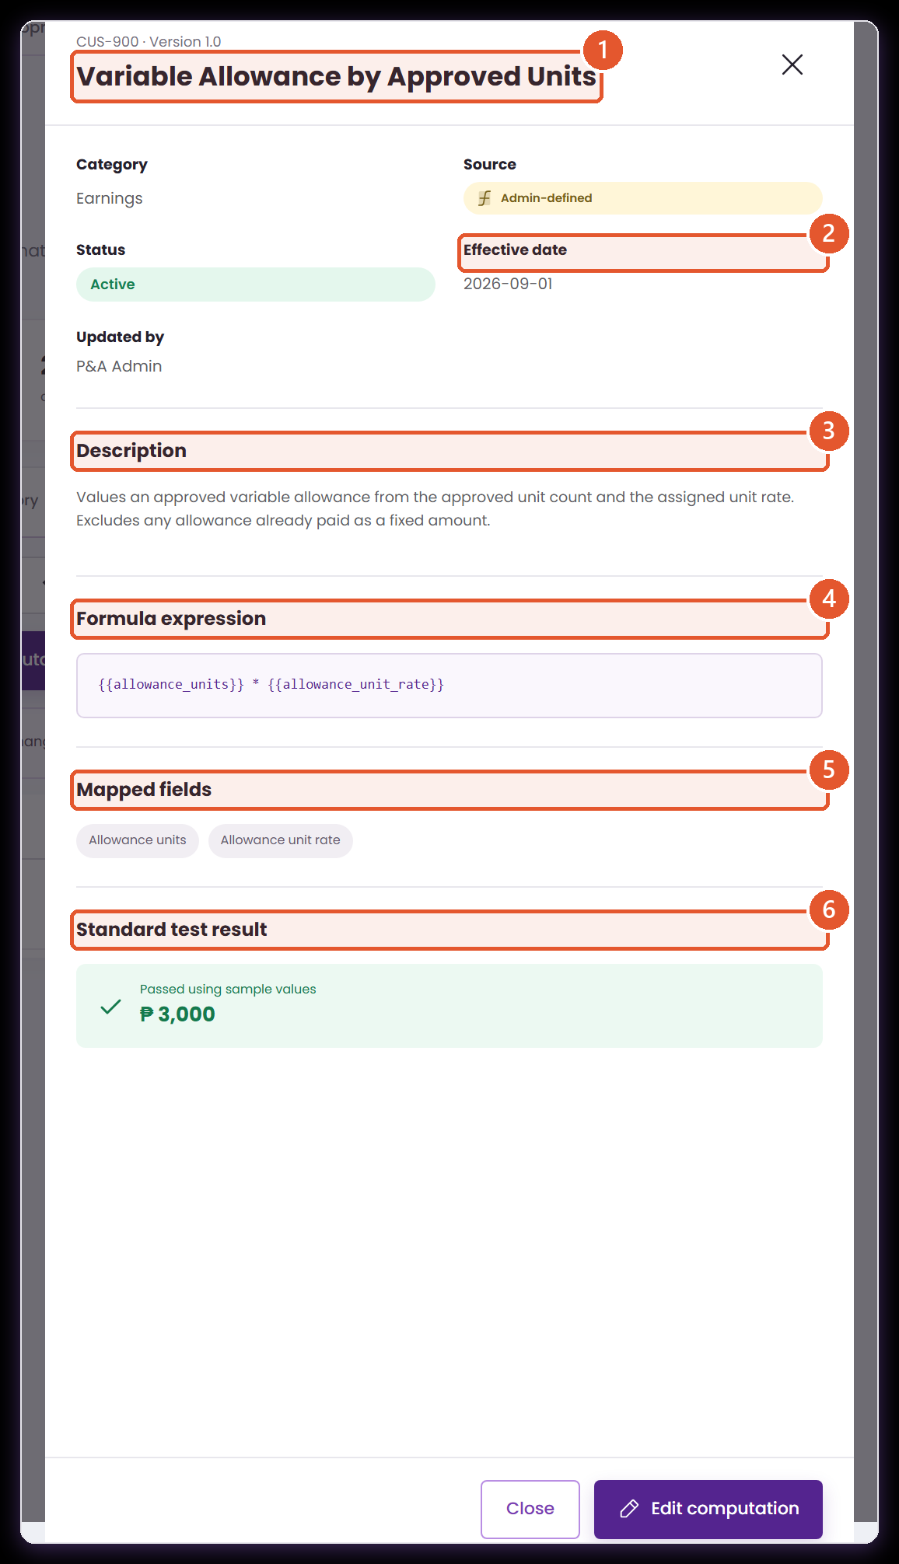
THE SAVED RECORD
Everything a reviewer needs, on one panel
Core › Company Configuration › Services Information › Payroll › Computational Basis › Computations › View
Opening any computation gives the same read-only view. This is the page to attach to a formula sign-off.
1
Identity
2
Governance facts
Code, version and business name — the three things a payroll trail quotes back at you.
Category, source type, status, effective date and who last updated the record.
3
Description
4
Formula expression
The business rule in words, carried across from setup.
The published arithmetic, exactly as the payroll engine evaluates it.
5
Mapped fields
6
Standard test result
The dependency list. Every chip is a value a consuming step provides.
A standing check that the stored expression still evaluates, shown against the palette's sample values.
Reached from the Computations tab using the view action on any row.
Notes:
Presenter note: keep to the language payroll and finance teams use. For every screen, say what the user enters, where ATLAS gets the value, and what the next module does with the result. The records and amounts on screen are demonstration data.
Evidence: live ATLAS prototype captured 24 August 2026; ComputationalBasis.jsx, computationCatalog.js, payrollEngine.js, payrollTraceability.js; one posted payroll transaction.

Slide 24
WORTH KNOWING
Two checks, and what each one is for
ATLAS gives you a test you drive yourself and a standing check on the saved record. They answer different questions, and both are useful.
THE TEST YOU RUN
THE CHECK ON THE RECORD
You choose the inputs
ATLAS chooses the inputs
On the Test calculation tab you supply your own values and ATLAS evaluates the draft expression with them, before anything is saved.
Open a saved computation and the Standard test result evaluates the stored expression against the palette's sample values.
It answers: is my arithmetic right?
It answers: does this still evaluate?
The expression parses, every token resolves, and the answer can be compared with the figure finance worked out by hand.
A standing confirmation that the published formula is healthy, available on any record at any time without setting anything up.
Keep the result with your sign-off
Use them together
Note the inputs and the answer in your approval record, so the reviewed figure travels with the decision.
Your test proves the business answer; the record's check proves the published formula still runs. Neither replaces the other.
Both are visible on the demonstration record CUS-900.
Notes:
Presenter note: keep to the language payroll and finance teams use. For every screen, say what the user enters, where ATLAS gets the value, and what the next module does with the result. The records and amounts on screen are demonstration data.
Evidence: live ATLAS prototype captured 24 August 2026; ComputationalBasis.jsx, computationCatalog.js, payrollEngine.js, payrollTraceability.js; one posted payroll transaction.

Slide 25
02
Assign it to the client
Recording what the rule is for, who it covers and how often it applies.
The register
The six fields
The scope rules
Notes:
Presenter note: keep to the language payroll and finance teams use. For every screen, say what the user enters, where ATLAS gets the value, and what the next module does with the result. The records and amounts on screen are demonstration data.
Evidence: live ATLAS prototype captured 24 August 2026; ComputationalBasis.jsx, computationCatalog.js, payrollEngine.js, payrollTraceability.js; one posted payroll transaction.

Slide 26
DEMONSTRATION
Assigning CUS-900 to the company
Core › Company Configuration › Services Information › Payroll › Computational Basis › Client assignments › Add assignment
Six choices turn a formula in the library into a rule this company has adopted.
1
Choose the purpose
Earnings computation — what payroll is trying to calculate.
2
Choose the business item
Earnings and Allowance Codes — the register that gives it context.
3
Choose the formula
CUS-900, selected from the active computations in the library.
4
Set scope and timing
All Employees, every payroll, Active — then save, and the new row appears at the top of the register.
ANIMATED CAPTURE · PLAYS IN SLIDE SHOW
Captured live; the counter beside the tab moves as the record saves.
Notes:
Presenter note: keep to the language payroll and finance teams use. For every screen, say what the user enters, where ATLAS gets the value, and what the next module does with the result. The records and amounts on screen are demonstration data.
Evidence: live ATLAS prototype captured 24 August 2026; ComputationalBasis.jsx, computationCatalog.js, payrollEngine.js, payrollTraceability.js; one posted payroll transaction.

Slide 27
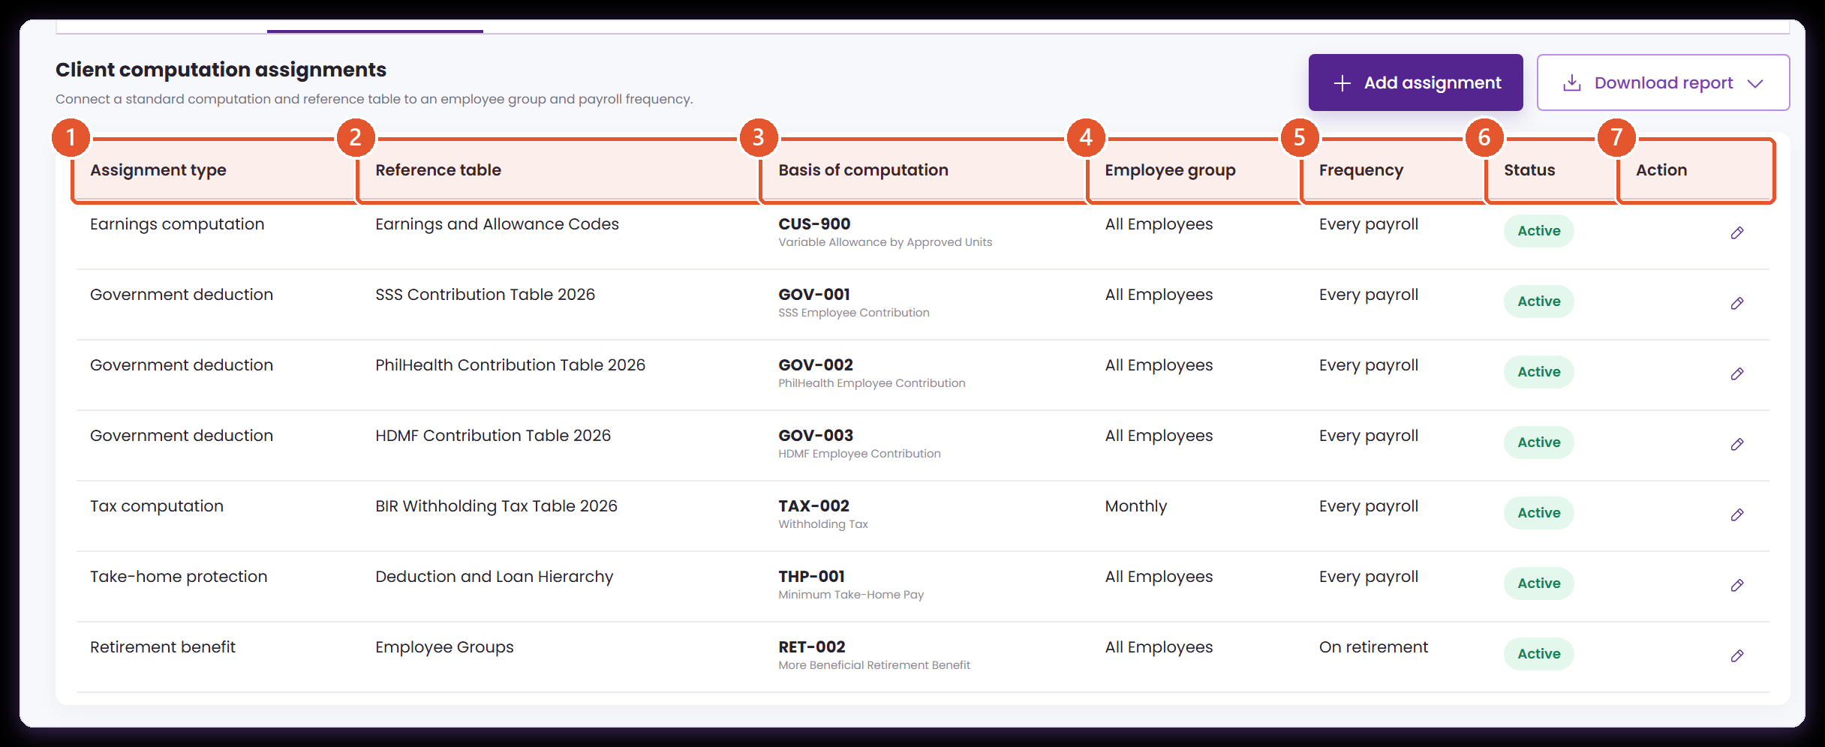
CLIENT ASSIGNMENTS
What the company says each formula is for
Core › Company Configuration › Services Information › Payroll › Computational Basis › Client assignments
An assignment is a governance statement in six parts. Read a row left to right and it should say a complete sentence.
1
Assignment type
2
Reference table
The business job: government deduction, tax, bonus, earnings, take-home protection or retirement benefit.
The enabled source or code list that gives the assignment its business context — for CUS-900, Earnings and Allowance Codes.
3
Basis of computation
4
Employee group
The computation code and name. This is the column that links the company's governance to a formula in the library.
All Employees, Monthly, Rank and File, Managers or Retirement Eligible. Choose the smallest group that genuinely shares the rule.
5
Frequency
6
Status
Every payroll, monthly, quarterly, annually or on retirement — the business event, not the calendar.
Active marks the assignment as in force. Inactive keeps the setup on record while taking it out of new use.
7
Action
Edit reopens the same six fields, so an assignment can be maintained as the company's policy develops.
Source · the Client assignments tab, with the CUS-900 row just added at the top.
Notes:
Presenter note: keep to the language payroll and finance teams use. For every screen, say what the user enters, where ATLAS gets the value, and what the next module does with the result. The records and amounts on screen are demonstration data.
Evidence: live ATLAS prototype captured 24 August 2026; ComputationalBasis.jsx, computationCatalog.js, payrollEngine.js, payrollTraceability.js; one posted payroll transaction.

Slide 28
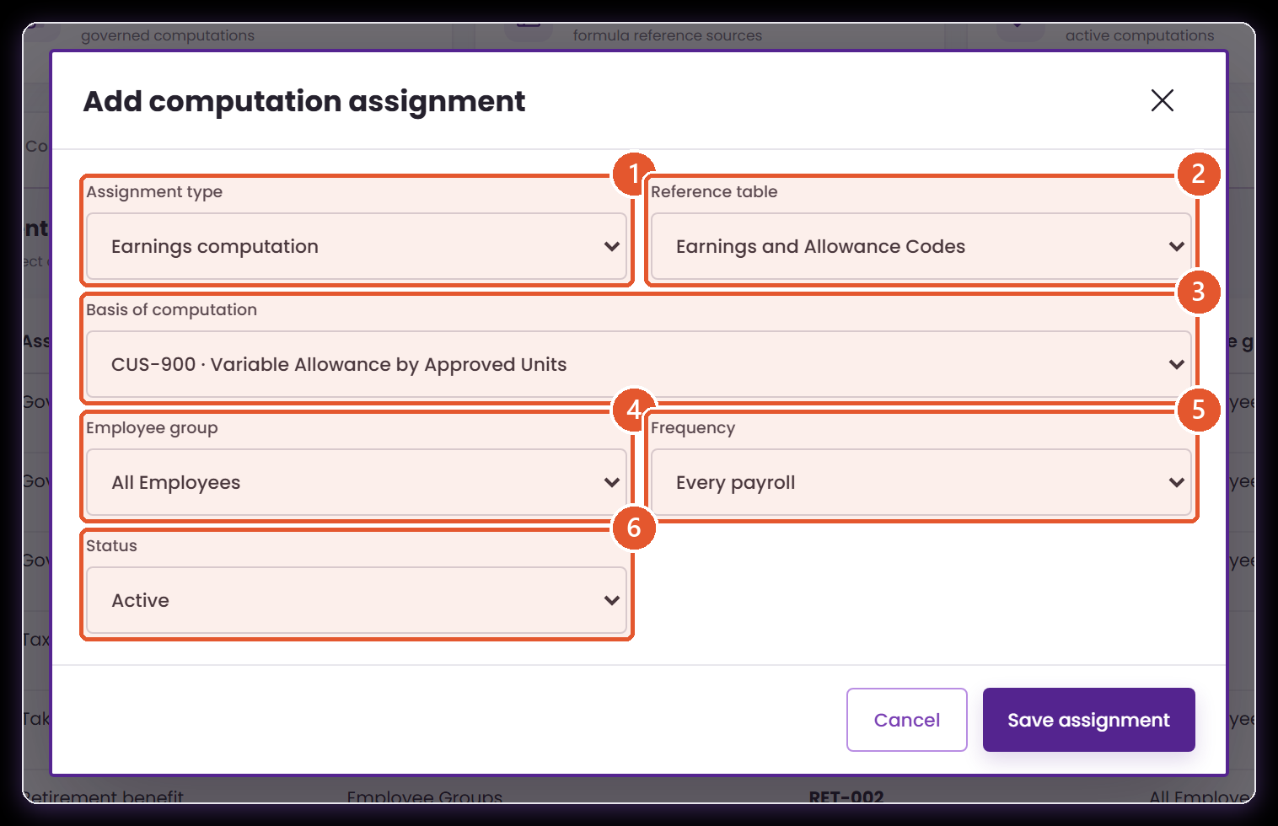
ADD ASSIGNMENT
Six choices, in the order finance thinks
Core › Company Configuration › Services Information › Payroll › Computational Basis › Client assignments › Add assignment
The form starts from the business purpose and ends at the formula, which is the right way round for a finance user.
1
Start with the purpose
2
Then the business item
What is payroll trying to calculate? A clearer starting point for finance than a formula code.
Only enabled sources are offered. For CUS-900 this identifies the earning being valued.
3
Then the formula
4
Who it covers
Every active computation, shown as code plus name so the link to the library is explicit.
Broad scopes are quick to create and harder to govern. Narrow deliberately.
5
When it may apply
6
Whether it is in force
Match the real business event, so an annual rule stays annual and a per-payroll rule stays per payroll.
Set Active once the formula, the reference source and the consuming step have all been agreed.
Demonstration · Earnings computation · Earnings and Allowance Codes · CUS-900 · All Employees · Every payroll.
Notes:
Presenter note: keep to the language payroll and finance teams use. For every screen, say what the user enters, where ATLAS gets the value, and what the next module does with the result. The records and amounts on screen are demonstration data.
Evidence: live ATLAS prototype captured 24 August 2026; ComputationalBasis.jsx, computationCatalog.js, payrollEngine.js, payrollTraceability.js; one posted payroll transaction.

Slide 29
WHAT IT GIVES YOU
What the client assignment record captures
Core › Company Configuration › Services Information › Payroll › Computational Basis › Client assignments
One row states the company's position on a formula, in language a payroll reviewer and an auditor can both read.
1
The business purpose
2
The formula it uses
3
Who it covers
Assignment type and reference table together say what payroll is calculating and which business item it belongs to.
Basis of computation names the code, which is the stable link between the company's governance and the library.
Employee group records the population the rule is meant for — all employees, or a narrower group that genuinely shares the rule.
4
When it applies
5
Whether it is in force
6
Protection for the formula
Frequency records the business event: every payroll, monthly, quarterly, annually, or on retirement.
Status separates a rule that is live from setup retained for reference.
While an active assignment points at a code, ATLAS looks after that computation in the library rather than letting it be removed.
An assignment is maintained in place; the formula it points at is the part that carries versions.
Notes:
Presenter note: keep to the language payroll and finance teams use. For every screen, say what the user enters, where ATLAS gets the value, and what the next module does with the result. The records and amounts on screen are demonstration data.
Evidence: live ATLAS prototype captured 24 August 2026; ComputationalBasis.jsx, computationCatalog.js, payrollEngine.js, payrollTraceability.js; one posted payroll transaction.

Slide 30
FOR THE MEETING
Scope rules to agree before an assignment goes Active
Each of these is a business rule about when two assignments may coexist. Agreeing them now is what makes the register trustworthy later.
1
Business purpose
2
Employee scope
3
Frequency or event
Two assignments for different earning codes sit comfortably together. Two for the same purpose and the same reference table need a decision.
Decide whether All Employees sits alongside a narrower group or overrides it — and if it overrides, set the precedence order.
Two every-payroll rules for the same purpose and group need a decision. An annual rule and a per-payroll rule do not.
4
Effective period
5
Existing payroll use
6
Who decides
Where date ranges overlap, agree whether the later row supersedes the earlier one and how that is recorded.
Once a payroll has used a version, amend by publishing a new effective version so the earlier evidence stands.
Name the owner for each rule above. A scope rule with a named owner is one that gets applied consistently.
These five checks form the specification for validation at the point of saving an assignment.
Notes:
Presenter note: keep to the language payroll and finance teams use. For every screen, say what the user enters, where ATLAS gets the value, and what the next module does with the result. The records and amounts on screen are demonstration data.
Evidence: live ATLAS prototype captured 24 August 2026; ComputationalBasis.jsx, computationCatalog.js, payrollEngine.js, payrollTraceability.js; one posted payroll transaction.

Slide 31
03
Keep the values outside the formula
Rates, ceilings and tables change on their own schedule. Reference sources are how a rate change stops being a formula change.
Two registers
Source anatomy
Change history
Notes:
Presenter note: keep to the language payroll and finance teams use. For every screen, say what the user enters, where ATLAS gets the value, and what the next module does with the result. The records and amounts on screen are demonstration data.
Evidence: live ATLAS prototype captured 24 August 2026; ComputationalBasis.jsx, computationCatalog.js, payrollEngine.js, payrollTraceability.js; one posted payroll transaction.

Slide 32
EASILY CONFUSED
Two registers with similar names, doing different jobs
ATLAS separates them deliberately, and the posted payroll consults both as separate steps. Using the right name in a requirements conversation saves rework later.
FORMULA REFERENCE SOURCES
REFERENCE TABLE
Where it lives
Inside Computational Basis, as its own tab.
A Settings module, company-wide.
How to reach it
Core › Company Configuration › Services Information › Payroll › Computational Basis › Reference sources
Core › Reference Table
What it holds
The REF-0xx sources a formula reads: tax tables, contribution tables, ceilings, premium rates and code lists.
Shared company reference values used across modules, not only by payroll formulas.
Who maintains it
Company sources are edited here. Linked statutory sources offer 'Manage in Settings', so the standard table stays controlled.
Maintained centrally as company reference data.
How payroll uses it
Resolves the effective version of each named source and passes the values to the computation steps.
Cross-checks ownership, so the same value is not duplicated in two places.
Both appear, separately, in the source trail of a posted payroll.
Notes:
Presenter note: keep to the language payroll and finance teams use. For every screen, say what the user enters, where ATLAS gets the value, and what the next module does with the result. The records and amounts on screen are demonstration data.
Evidence: live ATLAS prototype captured 24 August 2026; ComputationalBasis.jsx, computationCatalog.js, payrollEngine.js, payrollTraceability.js; one posted payroll transaction.

Slide 33
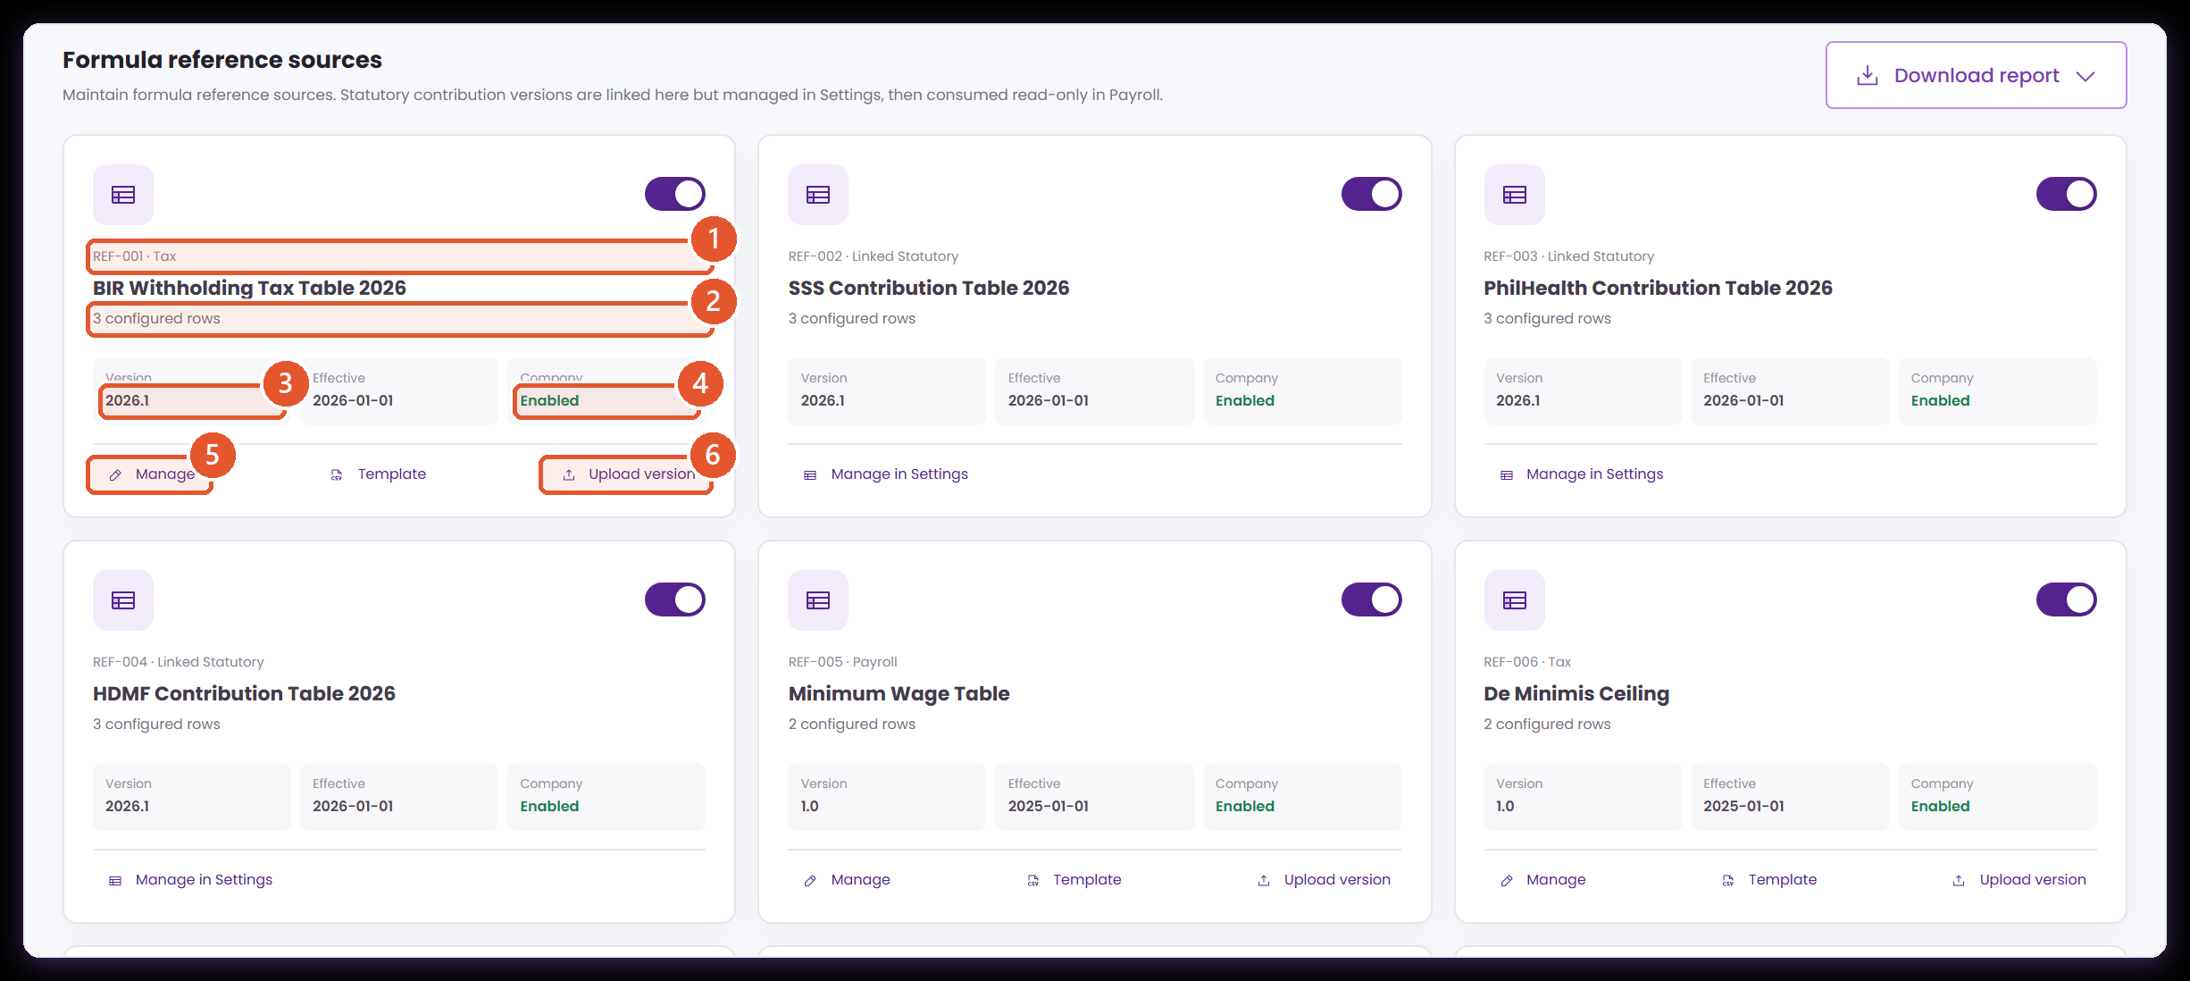
REFERENCE SOURCES
Anatomy of a reference source
Core › Company Configuration › Services Information › Payroll › Computational Basis › Reference sources
Rates, tables and ceilings change on their own schedule. Keeping them here means a change of rate is not a change of formula.
1
Code and category
2
Configured rows
The stable identifier and business family used when a computation or assignment points at this source.
How many records the current version holds — a quick sense check after an upload.
3
Version
4
Company status
Which dataset this is. The payroll trail quotes it, so it moves whenever the content moves.
Enabled sources can be selected by this company. Disabled ones stay readable for history.
5
Manage
6
Upload version
Opens the company-maintained rows. Linked statutory sources instead offer 'Manage in Settings', so the standard table stays centrally controlled.
Adds a new effective dataset alongside the existing one, leaving the version an earlier payroll used intact.
Statutory sources are linked here but maintained in Settings, then consumed read-only by Payroll.
Notes:
Presenter note: keep to the language payroll and finance teams use. For every screen, say what the user enters, where ATLAS gets the value, and what the next module does with the result. The records and amounts on screen are demonstration data.
Evidence: live ATLAS prototype captured 24 August 2026; ComputationalBasis.jsx, computationCatalog.js, payrollEngine.js, payrollTraceability.js; one posted payroll transaction.

Slide 34
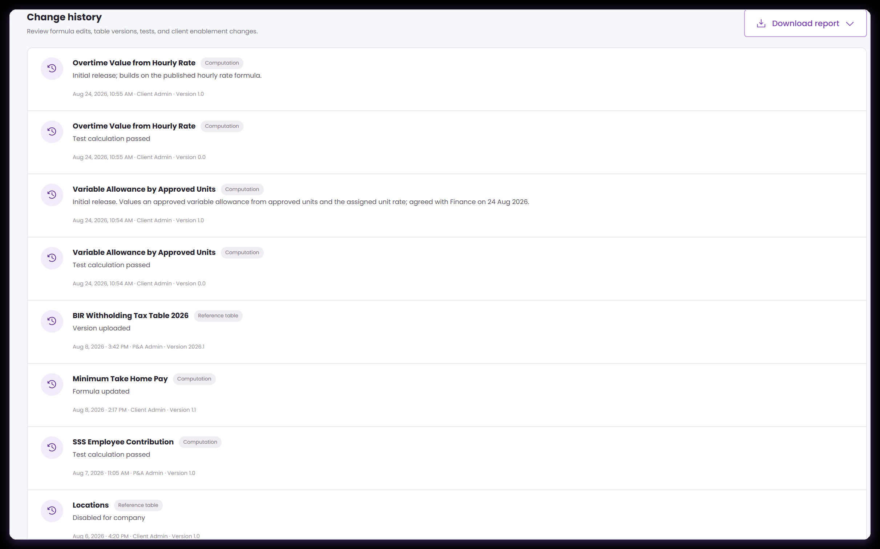
CHANGE HISTORY
Who changed what, when, and to which version
Core › Company Configuration › Services Information › Payroll › Computational Basis › Change history
Formula edits, table versions, test runs and client enablement all land in the same list, so a payroll setup can be reconstructed after the fact.
Three kinds of change, one list
Version is the link
It is the reconstruction tool
Formula edits, reference table versions and client enablement all land here with the same shape.
Each entry carries the version, which is what ties an audit question back to a specific payroll transaction.
When someone asks why November differed from October, this is the first screen to open.
Each entry carries the version, which is what ties an audit question to a specific payroll transaction.
Notes:
Presenter note: keep to the language payroll and finance teams use. For every screen, say what the user enters, where ATLAS gets the value, and what the next module does with the result. The records and amounts on screen are demonstration data.
Evidence: live ATLAS prototype captured 24 August 2026; ComputationalBasis.jsx, computationCatalog.js, payrollEngine.js, payrollTraceability.js; one posted payroll transaction.

Slide 35
04
Proof: following it into payroll
Setup is only half the story. This section opens a posted payroll and traces one employee's net pay back to the codes that produced it.
A posted run
The source trail
The calculation ledger
Notes:
Presenter note: keep to the language payroll and finance teams use. For every screen, say what the user enters, where ATLAS gets the value, and what the next module does with the result. The records and amounts on screen are demonstration data.
Evidence: live ATLAS prototype captured 24 August 2026; ComputationalBasis.jsx, computationCatalog.js, payrollEngine.js, payrollTraceability.js; one posted payroll transaction.

Slide 36
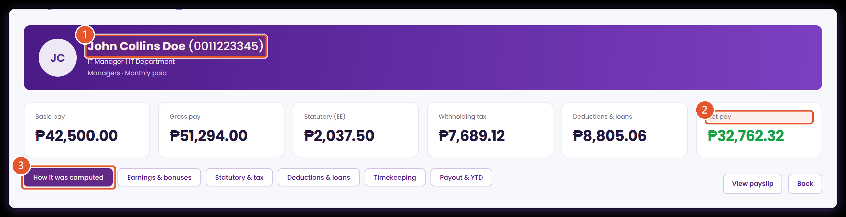
PROOF · A POSTED PAYROLL
One employee, one posted run, one set of numbers
Payroll › Payroll Processing › Transaction › Employee result
Everything in this section comes from a payroll transaction after it was calculated, approved and posted.
1
The employee
2
The result
3
How it was computed
Name, position, employee group and pay basis — the facts that decide which rules apply to this person.
Basic pay, gross pay, statutory, withholding tax, deductions and net pay, summarised before you open the working.
The tab that opens the full evidence: a step-by-step source trail followed by the calculation ledger.
Screens are live captures of the ATLAS prototype. The records, codes and amounts shown are demonstration data.
Notes:
Presenter note: keep to the language payroll and finance teams use. For every screen, say what the user enters, where ATLAS gets the value, and what the next module does with the result. The records and amounts on screen are demonstration data.
Evidence: live ATLAS prototype captured 24 August 2026; ComputationalBasis.jsx, computationCatalog.js, payrollEngine.js, payrollTraceability.js; one posted payroll transaction.

Slide 37
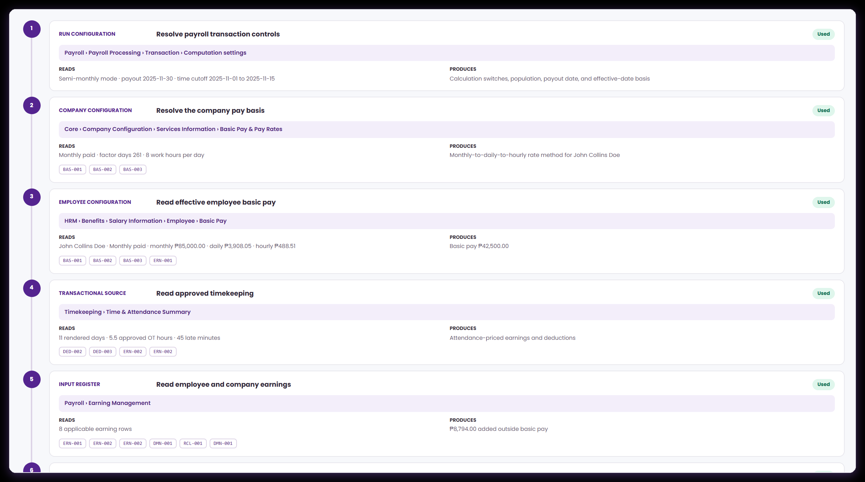
PROOF · THE OPENING STEPS
Before any formula runs, ATLAS establishes the facts
Payroll › Payroll Processing › Transaction › Employee result › How it was computed
Run settings, company pay basis, employee salary, approved time and the earnings register. Each step names the screen it read and what it produced.
Each step names its screen
Reads and produces
Codes are stamped on
Every card carries the exact ATLAS path, so a reviewer can reopen the source and check the input.
The left column is what went in, the right column is what came out. No step is a black box.
Where a step feeds specific computations, their codes appear as chips at the foot of the card.
Every step quotes a real navigation path, so a reviewer can reopen the same screen and check the input.
Notes:
Presenter note: keep to the language payroll and finance teams use. For every screen, say what the user enters, where ATLAS gets the value, and what the next module does with the result. The records and amounts on screen are demonstration data.
Evidence: live ATLAS prototype captured 24 August 2026; ComputationalBasis.jsx, computationCatalog.js, payrollEngine.js, payrollTraceability.js; one posted payroll transaction.

Slide 38
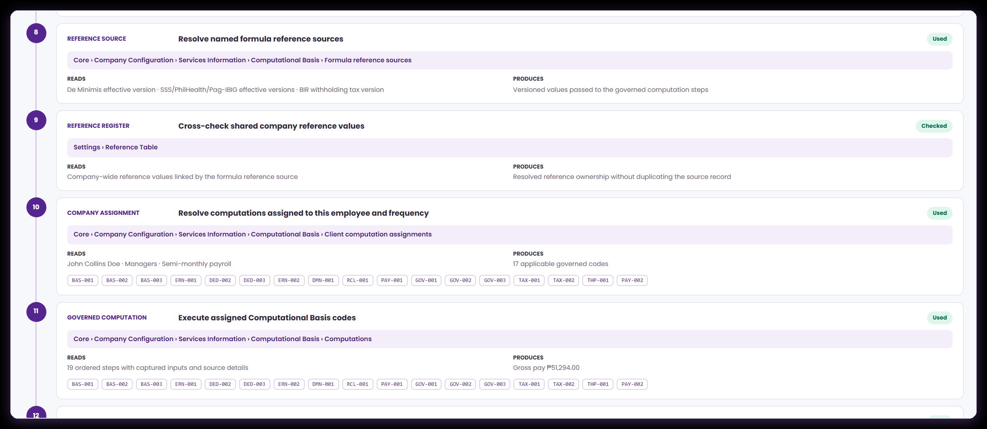
PROOF · THE SOURCE TRAIL
Where Computational Basis enters the payroll run
Payroll › Payroll Processing › Transaction › Employee result › How it was computed
Consecutive steps in the trail name this workspace by its exact navigation path. This is how a finance user proves the setup was used.
10
Company assignment
Names the Client assignments tab and reports the governed codes applicable to this employee and this frequency.
11
Governed computation
Names the Computations tab, executes the governed codes, and reports the ordered steps and the gross pay they produce.
The two steps before these separate the formula reference sources inside Computational Basis from the company-wide Reference Table.
Notes:
Presenter note: keep to the language payroll and finance teams use. For every screen, say what the user enters, where ATLAS gets the value, and what the next module does with the result. The records and amounts on screen are demonstration data.
Evidence: live ATLAS prototype captured 24 August 2026; ComputationalBasis.jsx, computationCatalog.js, payrollEngine.js, payrollTraceability.js; one posted payroll transaction.

Slide 39
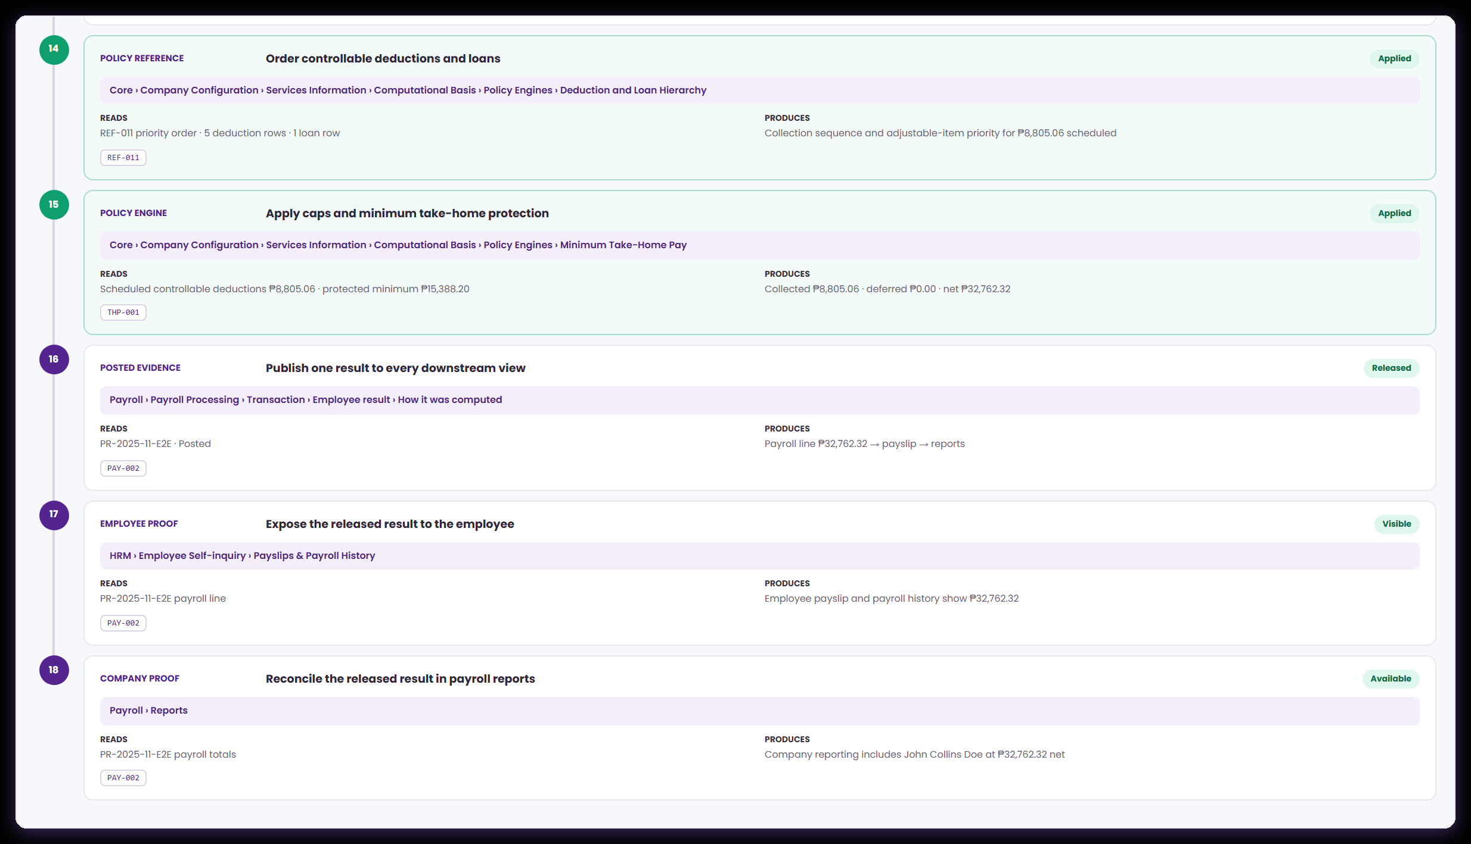
PROOF · THE SOURCE TRAIL
From calculated amount to employee and company proof
Payroll › Payroll Processing › Transaction › Employee result › How it was computed
The closing steps are what turn a number into evidence — and they are the steps auditors actually ask about.
15
Policy engine
Minimum Take-Home Pay compares the controllable deductions against the protected minimum, then collects or defers accordingly.
16
Posted evidence
One result is published to the payroll line, the payslip and the reports — not recalculated separately for each.
The final steps close the loop: the employee's own payslip view and the company payroll report quote the same net pay.
Notes:
Presenter note: keep to the language payroll and finance teams use. For every screen, say what the user enters, where ATLAS gets the value, and what the next module does with the result. The records and amounts on screen are demonstration data.
Evidence: live ATLAS prototype captured 24 August 2026; ComputationalBasis.jsx, computationCatalog.js, payrollEngine.js, payrollTraceability.js; one posted payroll transaction.

Slide 40
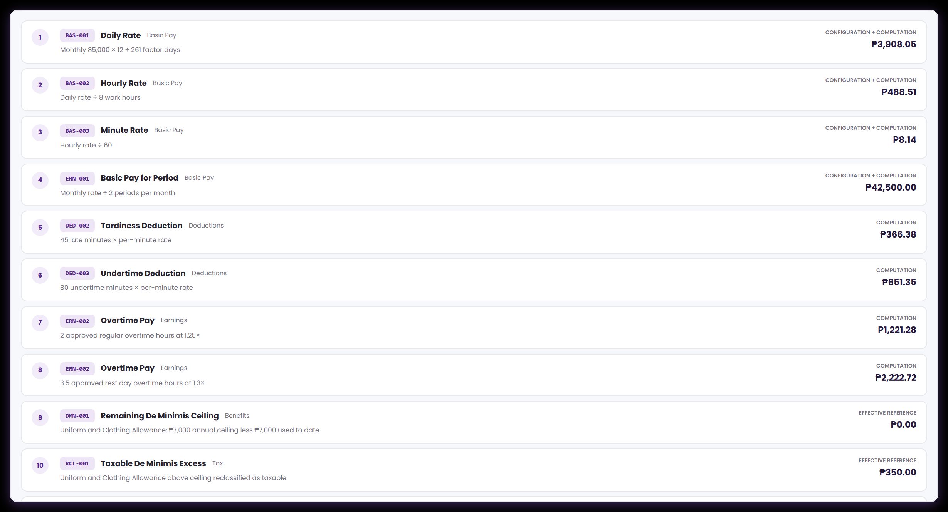
PROOF · THE CALCULATION LEDGER
Every amount names the code that produced it
Payroll › Payroll Processing › Transaction › Employee result › How it was computed
Rates, period pay, attendance deductions, overtime and de minimis — each step labelled with its computation code and its kind.
Code first
Working in words
Kind on the right
Every row leads with the computation code, so the amount and the rule can never be separated.
The middle column restates the calculation in the language finance uses to check it.
The label above each amount says which of the five kinds of step produced it.
Overtime appears twice because regular and rest-day hours are priced at different premiums.
Notes:
Presenter note: keep to the language payroll and finance teams use. For every screen, say what the user enters, where ATLAS gets the value, and what the next module does with the result. The records and amounts on screen are demonstration data.
Evidence: live ATLAS prototype captured 24 August 2026; ComputationalBasis.jsx, computationCatalog.js, payrollEngine.js, payrollTraceability.js; one posted payroll transaction.

Slide 41
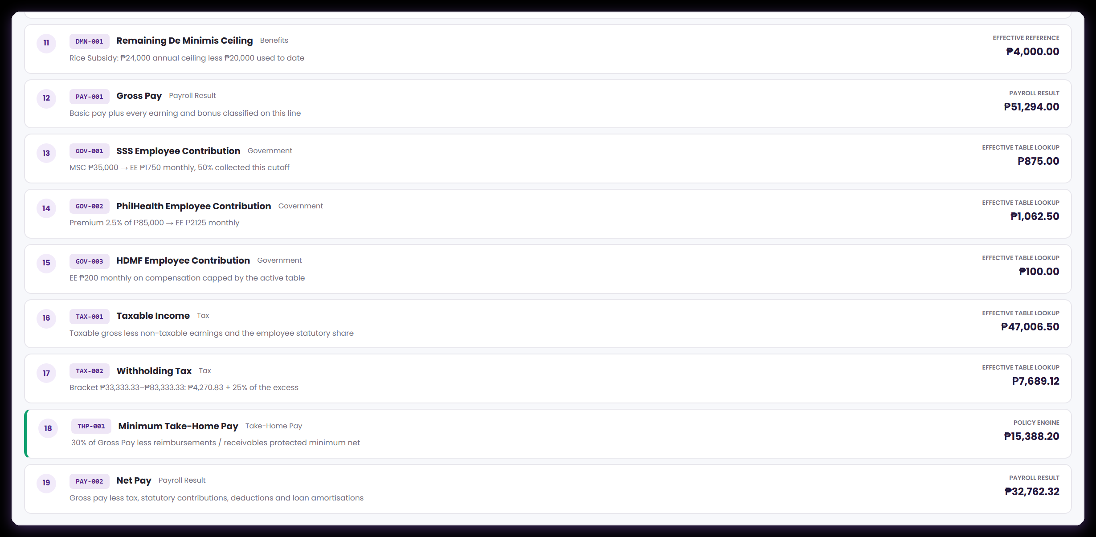
PROOF · THE CALCULATION LEDGER
Gross, statutory, tax, protection, net
Payroll › Payroll Processing › Transaction › Employee result › How it was computed
The second half turns gross pay into net pay through table lookups and a policy engine, and every line still names its code.
Gross is a step too
Statutory and tax are lookups
Net pay closes the chain
Gross pay is an explicit code rather than an implicit subtotal, so it can be pointed at in an audit.
The government and tax steps read the table versions in force on the payout date.
The final figure is the one the payslip and the company report both quote.
Take-home protection appears here as a policy engine step rather than an arithmetic formula — the distinction matters.
Notes:
Presenter note: keep to the language payroll and finance teams use. For every screen, say what the user enters, where ATLAS gets the value, and what the next module does with the result. The records and amounts on screen are demonstration data.
Evidence: live ATLAS prototype captured 24 August 2026; ComputationalBasis.jsx, computationCatalog.js, payrollEngine.js, payrollTraceability.js; one posted payroll transaction.

Slide 42
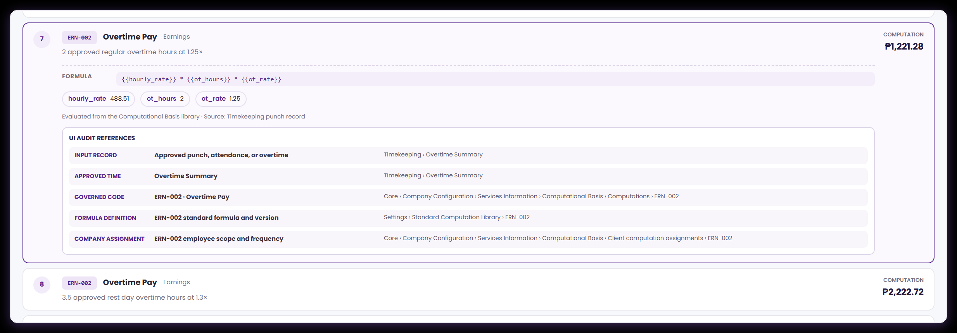
PROOF · READING ONE ROW
A ledger row opens into its own working
Payroll › Payroll Processing › Transaction › Employee result › How it was computed
Each row carries the code, the business category, the inputs that were captured, the kind of step and the resulting amount.
Example · overtime pay valuing approved rest-day hours at the applicable premium.
Notes:
Presenter note: keep to the language payroll and finance teams use. For every screen, say what the user enters, where ATLAS gets the value, and what the next module does with the result. The records and amounts on screen are demonstration data.
Evidence: live ATLAS prototype captured 24 August 2026; ComputationalBasis.jsx, computationCatalog.js, payrollEngine.js, payrollTraceability.js; one posted payroll transaction.

Slide 43
THE QUESTION EVERYONE ASKS
Editing a formula here changes the payroll figure
Worth being exact about how that works, because it is what makes the library worth governing carefully.
HOW IT WORKS TODAY
WHAT WE CONFIRM TOGETHER
Payroll reads this library
Which codes apply to whom
When a payroll transaction is calculated, Payroll Processing loads the stored computation library and passes it into the calculation.
How the client-assignment register drives selection — by purpose, employee group, frequency and effective date — is confirmed as part of integration.
It evaluates the published expression
Who may change a formula
Each step resolves its code, then evaluates that record's own expression against the captured inputs — the arithmetic is not written twice.
Agree the roles that may edit a company formula, and the review a change goes through before it becomes effective.
So an edit changes the number
When a version is frozen
Change a configurable formula in Computational Basis and the next calculation produces a different figure, with the trail naming the same code.
Agree the point at which a used version stops changing and a successor is published instead.
Behaviour confirmed in payrollEngine.js and PayrollProcessing.jsx.
Notes:
Presenter note: keep to the language payroll and finance teams use. For every screen, say what the user enters, where ATLAS gets the value, and what the next module does with the result. The records and amounts on screen are demonstration data.
Evidence: live ATLAS prototype captured 24 August 2026; ComputationalBasis.jsx, computationCatalog.js, payrollEngine.js, payrollTraceability.js; one posted payroll transaction.

Slide 44
THE CONSUMER CONTRACT
What makes a computation produce an amount
A formula is one half of a calculation. These are the four things that have to be true for it to put a figure on a payslip — worth walking through for every new code.
1
A published version
2
An assignment that says where
3
A step that supplies the inputs
The computation exists in the library with an approved expression, an effective date and a status of Active.
The company has recorded the purpose, the reference item, the employee group and the frequency the rule belongs to.
Some module — HRM, Timekeeping or a payroll register — provides a value for every mapped field the expression names.
4
A step that calls the code
5
Then the amount appears
6
And it is explainable
A point in the payroll workflow invokes the computation at the right moment in the run, with those values.
The result is posted to the assigned code and carried into the payroll line, the payslip, the reports and the trail.
Because the code, the version, the inputs and the reference versions were all captured at the moment it ran.
For a brand-new company code such as CUS-900, points three and four are the integration work to plan.
Notes:
Presenter note: keep to the language payroll and finance teams use. For every screen, say what the user enters, where ATLAS gets the value, and what the next module does with the result. The records and amounts on screen are demonstration data.
Evidence: live ATLAS prototype captured 24 August 2026; ComputationalBasis.jsx, computationCatalog.js, payrollEngine.js, payrollTraceability.js; one posted payroll transaction.

Slide 45
05
Connecting it to the rest of ATLAS
Where each value in a formula comes from, and what two real calculations look like end to end.
The module matrix
Overtime, in full
Take-home protection
Notes:
Presenter note: keep to the language payroll and finance teams use. For every screen, say what the user enters, where ATLAS gets the value, and what the next module does with the result. The records and amounts on screen are demonstration data.
Evidence: live ATLAS prototype captured 24 August 2026; ComputationalBasis.jsx, computationCatalog.js, payrollEngine.js, payrollTraceability.js; one posted payroll transaction.

Slide 46
THE INPUT CONTRACT
Where the values in a formula have to come from
A formula is only as good as the modules that feed it. This is the checklist to work through for every new computation.
ATLAS AREA
WHAT IT SUPPLIES
WHERE THE TRAIL NAMES IT
WHAT IT AFFECTS
HRM / Employee Masterfile
Salary, pay basis, employment dates, group, status, plan membership.
HRM › Benefits › Salary Information › Employee › Basic Pay
Rate variables, eligibility, and which assignment should apply.
Timekeeping
Approved days, hours, overtime, lates, undertime and approved unit counts.
Timekeeping › Time & Attendance Summary
The payable quantities that earnings and deductions are priced from.
Payroll registers
Earning, deduction and loan configuration with balances and schedules.
Payroll › Earning Management · Deduction Management
The business items a computation is valuing.
Reference and statutory
Effective-dated tables, ceilings, premium rates and code lists.
Computational Basis › Reference sources; Settings › Statutory Table
The rates a formula reads instead of carrying the number itself.
Payroll processing
Company, population, period, cutoff and payout date.
Payroll › Payroll Processing › Transaction › Computation settings
Which version of every rule is the effective one.
Paths taken from the source trail of a posted payroll transaction.
Notes:
Presenter note: keep to the language payroll and finance teams use. For every screen, say what the user enters, where ATLAS gets the value, and what the next module does with the result. The records and amounts on screen are demonstration data.
Evidence: live ATLAS prototype captured 24 August 2026; ComputationalBasis.jsx, computationCatalog.js, payrollEngine.js, payrollTraceability.js; one posted payroll transaction.

Slide 47
WORKED EXAMPLE 1
Overtime pay, from punch to payslip
Payroll › Payroll Processing › Transaction › Employee result › How it was computed
One computation code, four modules, and two ledger rows — because regular and rest-day overtime are priced separately.
STAGE
WHAT HAPPENS
IN THIS DEMONSTRATION
Employee files
An overtime request is raised against the real punch record.
2 hours, plus 3.5 hours on a rest day.
Approver approves
Only approved hours become payroll input; unapproved time is not payable.
5.5 approved overtime hours in total.
HRM supplies the rate
The hourly rate is derived from the company pay basis and the employee's salary.
Monthly salary → daily rate → hourly rate.
The formula runs
Overtime Pay evaluates hourly rate × hours × premium, once per premium band.
1.25× on the regular hours; 1.3× on the rest-day hours.
Payroll posts it
Both amounts land on the overtime earning line and flow into gross pay.
Two ledger rows, each naming the same computation code.
Demonstration data from a posted payroll transaction.
Notes:
Presenter note: keep to the language payroll and finance teams use. For every screen, say what the user enters, where ATLAS gets the value, and what the next module does with the result. The records and amounts on screen are demonstration data.
Evidence: live ATLAS prototype captured 24 August 2026; ComputationalBasis.jsx, computationCatalog.js, payrollEngine.js, payrollTraceability.js; one posted payroll transaction.

Slide 48
WORKED EXAMPLE 2
Minimum take-home pay, a policy engine at work
Core › Company Configuration › Services Information › Payroll › Computational Basis › Policy engines › Minimum Take-Home Pay
This one calculates nothing. It looks at what has already been calculated and decides how much of it may be collected this cutoff.
STAGE
WHAT HAPPENS
IN THIS DEMONSTRATION
Deductions are scheduled
Every controllable deduction and loan amortisation for the cutoff is totalled.
Five deduction rows and one loan row.
They are put in order
The deduction and loan hierarchy supplies the priority, so if something gives way it is the right thing.
Statutory never adjusted; company loans and optional deductions ranked below.
The floor is calculated
The protected minimum is derived from the configured percentage of the applicable base.
A protected minimum net pay for this employee.
The engine decides
Collect in full while net pay stays above the floor; otherwise defer the lowest-priority items.
Collected in full, with nothing deferred on this line.
Across the whole run
The same engine deferred value for other employees in the same transaction.
Deferred amounts are shown on the payslip with the remaining balance.
Demonstration data from a posted payroll transaction.
Notes:
Presenter note: keep to the language payroll and finance teams use. For every screen, say what the user enters, where ATLAS gets the value, and what the next module does with the result. The records and amounts on screen are demonstration data.
Evidence: live ATLAS prototype captured 24 August 2026; ComputationalBasis.jsx, computationCatalog.js, payrollEngine.js, payrollTraceability.js; one posted payroll transaction.

Slide 49
FOR THE MEETING
Five decisions to agree before go-live
Each one has come up somewhere in this walkthrough. They are business choices for finance and implementation to make together.
1
Which step calls each code
2
Where every variable comes from
3
How assignment drives selection
For every new company computation, name the module and the exact point in its workflow that supplies the inputs and invokes it.
For each mapped field: the owning module, data type, unit of measure, when it becomes available, and what payroll should do if it is not.
Confirm how purpose, employee group, frequency and effective date combine to decide which codes apply to an employee on a given run.
4
How scope rules are enforced
5
When a version is frozen
6
Who approves a release
Turn the five scope checks into validation at the point of saving an assignment, and name the owner of each.
Once a payroll transaction has used a version, publish a new effective version and leave the earlier evidence untouched. Agree who enforces this.
Define the finance owner, the reviewer, the test evidence required, and the deployment date — for formula, assignment and reference-source changes alike.
Every item traces back to a screen or a page earlier in this deck.
Notes:
Presenter note: keep to the language payroll and finance teams use. For every screen, say what the user enters, where ATLAS gets the value, and what the next module does with the result. The records and amounts on screen are demonstration data.
Evidence: live ATLAS prototype captured 24 August 2026; ComputationalBasis.jsx, computationCatalog.js, payrollEngine.js, payrollTraceability.js; one posted payroll transaction.

Slide 50
SUMMARY
What this walkthrough covered
A fair reading of what we demonstrated, so the meeting starts from a shared picture.
SHOWN ON LIVE SCREENS
WHAT WE TAKE INTO THE BUILD
A controlled, versioned formula library
The consumer for each new code
Codes, expressions, effective dates, change notes and history, with ATLAS standards and company rules clearly distinguished.
Which workflow step supplies the inputs and calls a newly created company computation.
A guarded authoring path
The input contract
An approved-field palette, expression validation, in-form testing, and protection for a code an active assignment points at.
Owning module, data type, unit and timing for every mapped field.
Live execution from the library
Assignment-driven selection
The payroll engine evaluates the stored expressions; every coded step in the ledger names the computation that produced it.
How the register decides which codes apply to an employee on a given run.
End-to-end evidence
Scope validation and approval
A source trail from run settings through to the employee's payslip and the company report, each step naming its screen.
The scope checks and the release workflow that surround a change.
Prototype captured 24 August 2026.
Notes:
Presenter note: keep to the language payroll and finance teams use. For every screen, say what the user enters, where ATLAS gets the value, and what the next module does with the result. The records and amounts on screen are demonstration data.
Evidence: live ATLAS prototype captured 24 August 2026; ComputationalBasis.jsx, computationCatalog.js, payrollEngine.js, payrollTraceability.js; one posted payroll transaction.

Slide 51
APPENDIX
How every screen in this deck was produced
So that anything here can be reproduced or challenged.
SOURCE
WHAT WAS USED
WHERE IT APPEARS
Live prototype
The ATLAS local application, captured 24 August 2026 at 2× resolution directly from the running app.
Every screenshot and both animated walkthroughs.
Posted payroll
A semi-monthly payroll transaction, calculated, approved and posted inside the prototype using demonstration employees.
The whole proof section and both worked examples.
Application source
ComputationalBasis.jsx, computationCatalog.js, payrollEngine.js, payrollTraceability.js, PayrollProcessing.jsx.
Every statement about behaviour that is not visible on a screen.
Demonstration data
CUS-900 · {{allowance_units}} × {{allowance_unit_rate}} · 8 × ₱250 = ₱2,000.
The creation and assignment walkthroughs. Sample values, not production payroll.
Callout markers are positioned from the live screen, so every number sits on the control it describes.
Notes:
Presenter note: keep to the language payroll and finance teams use. For every screen, say what the user enters, where ATLAS gets the value, and what the next module does with the result. The records and amounts on screen are demonstration data.
Evidence: live ATLAS prototype captured 24 August 2026; ComputationalBasis.jsx, computationCatalog.js, payrollEngine.js, payrollTraceability.js; one posted payroll transaction.

Slide 52
Four things to take away
1
A computation is a controlled rule, not a spreadsheet cell
Permanent code, approved inputs, an expression, a test, an effective date and a change note — and it can build on a rule you have already published.
2
The formula library drives the payroll figure
The engine evaluates the published expression, and every coded step in the ledger names the computation behind it.
3
An assignment states the company's intent
What a rule is for, who it covers and how often — the record a reviewer reads to understand why a formula applies here.
4
The evidence is the product
The source trail and the calculation ledger are what let finance answer an audit question without reverse-engineering a payslip.
ATLAS Phase 2 · Computational Basis · pre-meeting walkthrough · 24 August 2026
Notes:
Presenter note: keep to the language payroll and finance teams use. For every screen, say what the user enters, where ATLAS gets the value, and what the next module does with the result. The records and amounts on screen are demonstration data.
Evidence: live ATLAS prototype captured 24 August 2026; ComputationalBasis.jsx, computationCatalog.js, payrollEngine.js, payrollTraceability.js; one posted payroll transaction.

