Slide 1
ATLAS PHASE 2 · PAYROLL · PART 2
Computational Basis
What changed after your review: how payroll keeps its history, what can no longer be deleted, how one standard formula reaches many companies, and how each thing you pay now names the formula behind it and the people it reaches.
1 1 Protect
2 2 Govern
3 3 Version
4 4 Bind
5 5 Scope
Continues the Part 1 walkthrough · prototype screens captured on 27 August 2026
Notes:
Open by naming the eight things that changed, then say the deck follows them in order.
Presenter note: this deck continues the Part 1 walkthrough and covers what changed after the client's review. Screens were captured live from the ATLAS prototype on 27 August 2026, in the Atlas Simulator Sandbox company, against posted payroll PR-2025-11-E2E. Records, codes and amounts on screen are demonstration data — including the 8 units at PHP250 worked example carried over from Part 1.
Evidence: computationGovernance.js, computationCatalog.js, computationBindings.js, applicabilityScope.js, payrollEngine.js, payrollRuns.js, ComputationalBasis.jsx, serviceModules.jsx, StandardComputationAdmin.jsx.

Slide 2
WHAT CHANGED
Eight changes since your review
Each one came out of the review, and each has a live screen behind it in this deck.
1
Payroll keeps the version it ran on
2
Used rules stop being editable
3
One standard, applied per company
Part 1 left this open. A transaction now records the exact formula version behind every amount, and keeps resolving it after the formula moves on.
Once a posted payroll has applied a computation, edit and delete close — for the Super Admin too. Inactive replaces delete.
An Atlas standard is defined once and applied to selected companies. No company holds its own copy of a standard formula.
4
Codes, status and categories
5
Evidence that stays with the record
6
Values that change on a date
Codes are generated from the category, new rules start Inactive, and the category list is a controlled reference table.
Test results are stored against the version they tested, and change history carries the before and after values.
Reference sources keep every published version, and payroll resolves the one effective on its payout date.
7
Each payment names its formula
8
And names who it reaches
An earning, deduction, bonus or loan says which published computation produces its amount, and where each input in that formula comes from.
Applicability is stated once, in one vocabulary, and payroll applies a rule only to the employees it covers.
Every claim in this deck is a live screen capture or a named source file.
Notes:
This is the agenda. Ask which of the eight the client wants most time on.
Presenter note: this deck continues the Part 1 walkthrough and covers what changed after the client's review. Screens were captured live from the ATLAS prototype on 27 August 2026, in the Atlas Simulator Sandbox company, against posted payroll PR-2025-11-E2E. Records, codes and amounts on screen are demonstration data — including the 8 units at PHP250 worked example carried over from Part 1.
Evidence: computationGovernance.js, computationCatalog.js, computationBindings.js, applicabilityScope.js, payrollEngine.js, payrollRuns.js, ComputationalBasis.jsx, serviceModules.jsx, StandardComputationAdmin.jsx.

Slide 3
HOW TO READ THIS DECK
How the deck is organised
Most pages walk through a screen. A few set up a decision to agree in the meeting.
1
Continues Part 1
2
Walkthrough
3
Navigation path
This deck assumes the Part 1 walkthrough. It covers what changed after your review rather than repeating the module tour.
Screens captured from the running prototype on 27 August 2026, with numbered callouts on the controls they describe.
Every screen page carries the path needed to reopen it in ATLAS.
4
For the meeting
5
Demonstration data
6
One company, one pass
A few pages carry decisions to agree together. They are marked, and gathered again at the end.
Records, codes and amounts are samples from the prototype, including the worked example carried over from Part 1.
Every screen comes from the same sandbox company and the same posted transaction, PR-2025-11-E2E.
Screens are live captures of the ATLAS prototype. The records, codes and amounts shown are demonstration data.
Notes:
Say once that amounts on screen are demonstration data, so it does not need repeating.
Presenter note: this deck continues the Part 1 walkthrough and covers what changed after the client's review. Screens were captured live from the ATLAS prototype on 27 August 2026, in the Atlas Simulator Sandbox company, against posted payroll PR-2025-11-E2E. Records, codes and amounts on screen are demonstration data — including the 8 units at PHP250 worked example carried over from Part 1.
Evidence: computationGovernance.js, computationCatalog.js, computationBindings.js, applicabilityScope.js, payrollEngine.js, payrollRuns.js, ComputationalBasis.jsx, serviceModules.jsx, StandardComputationAdmin.jsx.

Slide 4
YOUR REVIEW · 1 OF 2
What you asked for, and where it now lives
The review items on authoring and inputs, and the change each one produced.
YOU ASKED FOR
WHAT NOW HAPPENS
SHOWN IN
Computation code should follow the category
Generated from the category and the next free sequence — ERN-007 for an earning, DED-004 for a deduction — then locked.
Creating a computation
A new rule should start inactive
New computations are created Inactive, in the company and central libraries alike, and are activated deliberately.
Creating a computation
Description should be optional
Description no longer blocks a save. It stays the recommended place to record inclusions and exclusions.
Creating a computation
Categories should come from a reference table
The Computation Category reference table owns the list and the code prefix each category generates.
Creating a computation
Map fields need owner, type, unit, timing and missing-value
All five are declared for every approved field, and shown on the map-field table and the record view.
Map fields
The remaining items are on the next page.
Notes:
Walk the left column only. The client wrote it; they will recognise it.
Presenter note: this deck continues the Part 1 walkthrough and covers what changed after the client's review. Screens were captured live from the ATLAS prototype on 27 August 2026, in the Atlas Simulator Sandbox company, against posted payroll PR-2025-11-E2E. Records, codes and amounts on screen are demonstration data — including the 8 units at PHP250 worked example carried over from Part 1.
Evidence: computationGovernance.js, computationCatalog.js, computationBindings.js, applicabilityScope.js, payrollEngine.js, payrollRuns.js, ComputationalBasis.jsx, serviceModules.jsx, StandardComputationAdmin.jsx.

Slide 5
YOUR REVIEW · 2 OF 2
What you asked for, and where it now lives
The review items on history, protection and scope — the structural half of the change.
YOU ASKED FOR
WHAT NOW HAPPENS
SHOWN IN
Payroll must keep the version it used
Each step records its version; the transaction stores a snapshot of every formula it applied and resolves through it.
Historical protection
Deletion should close once a code has been used
Edit and delete close on posted usage; deactivation closes on any linked transaction. Version history blocks deletion.
Delete protection
Computations should be company-scoped
Computations, assignments, reference sources, versions and history are all stored per company.
Company scope
Reference sources should keep old versions
Every published version is retained with its own effective date, and payroll resolves by payout date.
Effective-dated values
Business decisions still open are gathered near the end of the deck.
Notes:
These four are the ones with the largest build behind them.
Presenter note: this deck continues the Part 1 walkthrough and covers what changed after the client's review. Screens were captured live from the ATLAS prototype on 27 August 2026, in the Atlas Simulator Sandbox company, against posted payroll PR-2025-11-E2E. Records, codes and amounts on screen are demonstration data — including the 8 units at PHP250 worked example carried over from Part 1.
Evidence: computationGovernance.js, computationCatalog.js, computationBindings.js, applicabilityScope.js, payrollEngine.js, payrollRuns.js, ComputationalBasis.jsx, serviceModules.jsx, StandardComputationAdmin.jsx.

Slide 6
06
Payroll keeps the version it ran on
Part 1 ended on this question. A transaction now records the exact formula behind every amount.
The version on the line
The snapshot
Why it matters
Notes:
This is the most important section. Part 1 said an edit changes the next result; this is what protects the last one.
Presenter note: this deck continues the Part 1 walkthrough and covers what changed after the client's review. Screens were captured live from the ATLAS prototype on 27 August 2026, in the Atlas Simulator Sandbox company, against posted payroll PR-2025-11-E2E. Records, codes and amounts on screen are demonstration data — including the 8 units at PHP250 worked example carried over from Part 1.
Evidence: computationGovernance.js, computationCatalog.js, computationBindings.js, applicabilityScope.js, payrollEngine.js, payrollRuns.js, ComputationalBasis.jsx, serviceModules.jsx, StandardComputationAdmin.jsx.

Slide 7
THE QUESTION FROM PART 1
What happens to a payroll when the formula changes
Part 1 confirmed that payroll evaluates the stored library. The open question was what that meant for a run that had already gone out.
PART 1 · THE POSITION THEN
PART 2 · THE POSITION NOW
Payroll read the library at run time
The step records its version
Each step resolved its code and evaluated whatever expression the library held.
Every calculation step stores the version and effective date of the formula it applied.
The trail named the code
The transaction keeps a snapshot
A ledger row proved which code produced an amount, but not which version of it.
At calculation time ATLAS stores every code applied, with its expression as it stood.
An edit changed the next result
A posted run resolves its own snapshot
Correct, and expected. The concern was what it meant for a result already posted.
Publish version 1.4 tomorrow and the run that used 1.3 still reads, and reproduces, 1.3.
Confirmed in payrollEngine.js and payrollRuns.js, and covered by the governance test suite.
Notes:
Say plainly: the behaviour Part 1 described was right, and this closes the gap it left.
Presenter note: this deck continues the Part 1 walkthrough and covers what changed after the client's review. Screens were captured live from the ATLAS prototype on 27 August 2026, in the Atlas Simulator Sandbox company, against posted payroll PR-2025-11-E2E. Records, codes and amounts on screen are demonstration data — including the 8 units at PHP250 worked example carried over from Part 1.
Evidence: computationGovernance.js, computationCatalog.js, computationBindings.js, applicabilityScope.js, payrollEngine.js, payrollRuns.js, ComputationalBasis.jsx, serviceModules.jsx, StandardComputationAdmin.jsx.

Slide 8
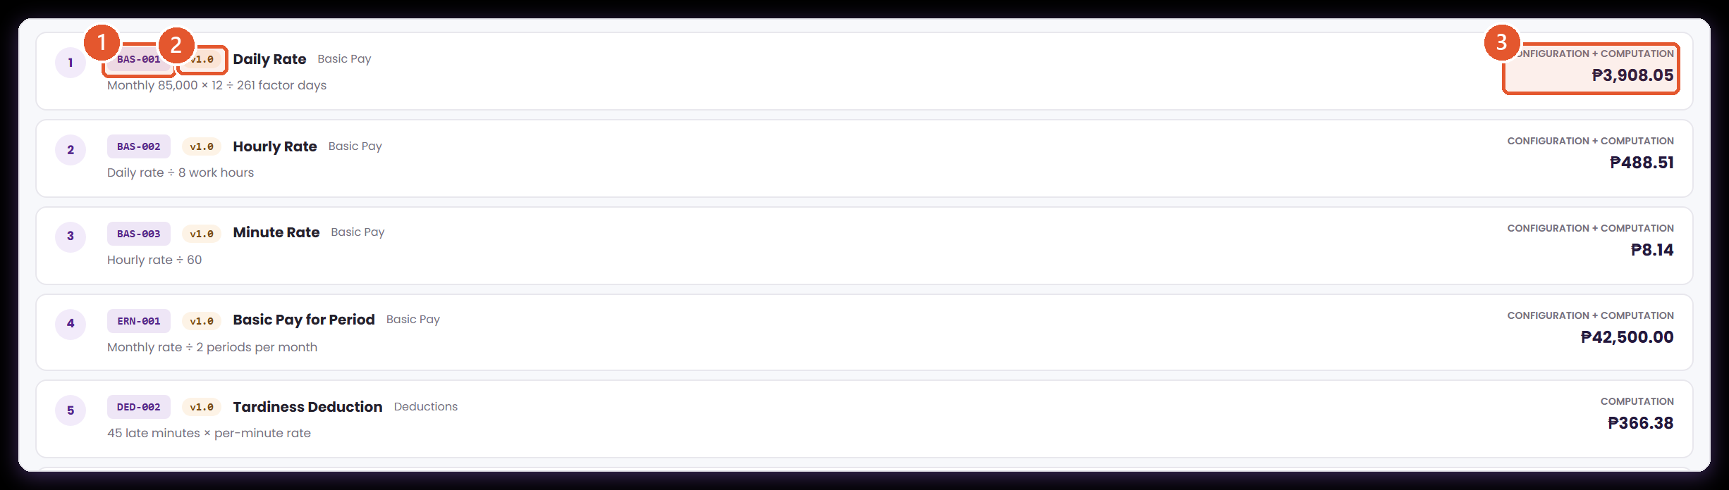
THE ANSWER TO PART 1'S OPEN QUESTION
Every amount now names the version that produced it
Payroll › Payroll Processing › Transaction › Employee result › How it was computed
Part 1 ended on a question: if a formula is edited, what happens to the payroll that already ran? A payroll line now records the version it applied, not just the code.
1
The code, as before
2
The version, which is new
3
The amount it produced
The governed code the step applied. This is what Part 1 showed, and it has not changed.
The exact published version this line evaluated. Edit the formula tomorrow and this figure still points at the version that produced it.
Because the version travels with the step, the amount stays reproducible from the formula that was in force, not the current one.
Source · the posted transaction PR-2025-11-E2E, first employee result.
Notes:
Point at the version chip. It is the whole change in one control.
Presenter note: this deck continues the Part 1 walkthrough and covers what changed after the client's review. Screens were captured live from the ATLAS prototype on 27 August 2026, in the Atlas Simulator Sandbox company, against posted payroll PR-2025-11-E2E. Records, codes and amounts on screen are demonstration data — including the 8 units at PHP250 worked example carried over from Part 1.
Evidence: computationGovernance.js, computationCatalog.js, computationBindings.js, applicabilityScope.js, payrollEngine.js, payrollRuns.js, ComputationalBasis.jsx, serviceModules.jsx, StandardComputationAdmin.jsx.

Slide 9
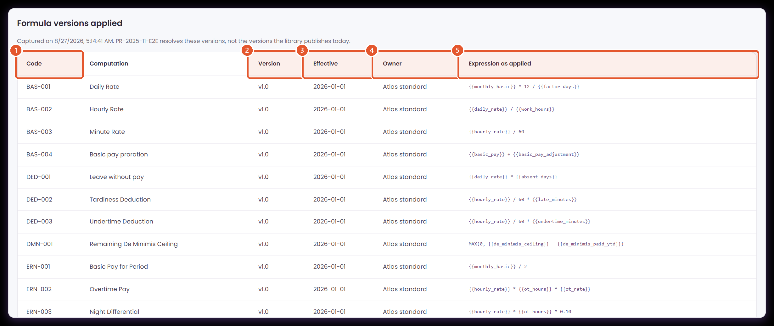
THE VERSION SNAPSHOT
A transaction keeps the formulas it was computed with
Payroll › Payroll Processing › Transaction › Employee result › How it was computed
When a transaction is calculated, ATLAS stores every code it applied together with that code's expression and version. The transaction then explains itself from its own record.
1
Every code applied
2
The version applied
One row per computation the run touched, whether it produced an earning, a deduction or a table lookup.
Captured at calculation time. Publishing a new version later does not reach back into this transaction.
3
The date it was effective from
4
Who owns the formula
Separates the Atlas standards from anything the company defined itself, which decides who a change has to go through.
Shows which dated version was in force on the payout date, so the choice can be checked rather than assumed.
5
The expression as applied
The arithmetic exactly as it stood when the run was calculated. This is the line to read out when someone asks how the figure arose.
Captured at calculation time on PR-2025-11-E2E. Sample amounts throughout.
Notes:
This table is the audit answer. It is captured, not derived on open.
Presenter note: this deck continues the Part 1 walkthrough and covers what changed after the client's review. Screens were captured live from the ATLAS prototype on 27 August 2026, in the Atlas Simulator Sandbox company, against posted payroll PR-2025-11-E2E. Records, codes and amounts on screen are demonstration data — including the 8 units at PHP250 worked example carried over from Part 1.
Evidence: computationGovernance.js, computationCatalog.js, computationBindings.js, applicabilityScope.js, payrollEngine.js, payrollRuns.js, ComputationalBasis.jsx, serviceModules.jsx, StandardComputationAdmin.jsx.

Slide 10
07
What can no longer be deleted
Once a posted payroll has used a computation, the actions available on it change.
The register
The reasons
The rules
Notes:
Frame this as protection of history, not restriction of users.
Presenter note: this deck continues the Part 1 walkthrough and covers what changed after the client's review. Screens were captured live from the ATLAS prototype on 27 August 2026, in the Atlas Simulator Sandbox company, against posted payroll PR-2025-11-E2E. Records, codes and amounts on screen are demonstration data — including the 8 units at PHP250 worked example carried over from Part 1.
Evidence: computationGovernance.js, computationCatalog.js, computationBindings.js, applicabilityScope.js, payrollEngine.js, payrollRuns.js, ComputationalBasis.jsx, serviceModules.jsx, StandardComputationAdmin.jsx.

Slide 11
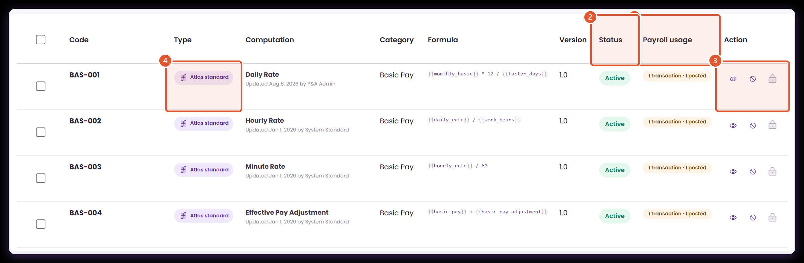
DELETE PROTECTION
The register now shows what payroll has already used
Core › Company Configuration › Services Information › Payroll › Computational Basis › Computations
A computation that has been through a payroll run stays fixed for the runs that used it. The register names those codes before anyone opens one.
1
Payroll usage
2
Status
3
What the row offers
4
Where it is maintained
How many transactions have applied this code, and how many of those were posted. Hover a chip to see the transaction numbers.
Active means payroll may select it now. Inactive keeps it available to explain earlier payrolls without offering it for new work.
View and activate stay available. Edit is replaced by a lock, and deactivate is greyed, because a posted transaction depends on this code.
An Atlas standard is defined centrally and reaches this company by applicability. A company rule is maintained here.
Every basic-pay code shown was applied by PR-2025-11-E2E, which is why each one is protected.
Notes:
Every code on this screen was used by the posted run, which is why every row is locked.
Presenter note: this deck continues the Part 1 walkthrough and covers what changed after the client's review. Screens were captured live from the ATLAS prototype on 27 August 2026, in the Atlas Simulator Sandbox company, against posted payroll PR-2025-11-E2E. Records, codes and amounts on screen are demonstration data — including the 8 units at PHP250 worked example carried over from Part 1.
Evidence: computationGovernance.js, computationCatalog.js, computationBindings.js, applicabilityScope.js, payrollEngine.js, payrollRuns.js, ComputationalBasis.jsx, serviceModules.jsx, StandardComputationAdmin.jsx.

Slide 12
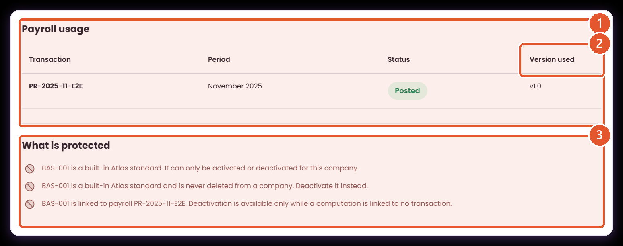
DELETE PROTECTION
The record says which transactions hold it, and why
Core › Company Configuration › Services Information › Payroll › Computational Basis › Computations › View
Opening a computation gives the reviewer the evidence behind the lock, in the same words the tooltip uses, so a refusal never has to be taken on trust.
1
Payroll usage
The transactions that applied this code, with the period and the status of each.
2
Version used
The version that transaction ran on. Read across the row to see which formula produced the amounts in it.
3
What is protected
Each restriction with its reason and the transaction that causes it. When nothing has used the code, this section does not appear at all.
Delete protection now checks payroll history, not only whether an assignment exists.
Notes:
The reasons name the transaction. Nothing has to be taken on trust.
Presenter note: this deck continues the Part 1 walkthrough and covers what changed after the client's review. Screens were captured live from the ATLAS prototype on 27 August 2026, in the Atlas Simulator Sandbox company, against posted payroll PR-2025-11-E2E. Records, codes and amounts on screen are demonstration data — including the 8 units at PHP250 worked example carried over from Part 1.
Evidence: computationGovernance.js, computationCatalog.js, computationBindings.js, applicabilityScope.js, payrollEngine.js, payrollRuns.js, ComputationalBasis.jsx, serviceModules.jsx, StandardComputationAdmin.jsx.

Slide 13
THE RULES
What may be edited, and what may be deleted
The same rule applies to a Client Admin and a Super Admin. What decides it is payroll history, not the role.
THE COMPUTATION
CAN BE EDITED
CAN BE DELETED
WHY
Atlas standard, in a company
Activate or deactivate only
Never
Formula changes belong to Settings. The company decides whether the standard applies and whether it is on.
Atlas standard, in Settings
While no posted transaction has used it
While no posted transaction has used it
One central definition. Once payroll has applied it, publish a new version instead.
Company-defined, unused
Yes
Yes
Nothing depends on it yet, so it can be corrected or removed outright.
Company-defined, used by a posted payroll
No — publish a new version
No — set it Inactive
The historical transaction must keep resolving the version it ran on.
Anything linked to an open transaction
Yes
No
Deactivation is refused while any non-cancelled transaction references the code.
Anything with published version history
Yes
No
Earlier payrolls resolve against those versions, so the code is retired rather than deleted.
Deactivation is stricter than deletion on purpose: it stops a code mid-cycle.
Notes:
The fourth row is the one to dwell on: Inactive replaces delete once payroll has used the code.
Presenter note: this deck continues the Part 1 walkthrough and covers what changed after the client's review. Screens were captured live from the ATLAS prototype on 27 August 2026, in the Atlas Simulator Sandbox company, against posted payroll PR-2025-11-E2E. Records, codes and amounts on screen are demonstration data — including the 8 units at PHP250 worked example carried over from Part 1.
Evidence: computationGovernance.js, computationCatalog.js, computationBindings.js, applicabilityScope.js, payrollEngine.js, payrollRuns.js, ComputationalBasis.jsx, serviceModules.jsx, StandardComputationAdmin.jsx.

Slide 14
08
One standard, applied per company
How a standard formula reaches many companies without any of them holding a copy.
The central library
Applicability
The model
Notes:
This answers the largest unresolved item from the review.
Presenter note: this deck continues the Part 1 walkthrough and covers what changed after the client's review. Screens were captured live from the ATLAS prototype on 27 August 2026, in the Atlas Simulator Sandbox company, against posted payroll PR-2025-11-E2E. Records, codes and amounts on screen are demonstration data — including the 8 units at PHP250 worked example carried over from Part 1.
Evidence: computationGovernance.js, computationCatalog.js, computationBindings.js, applicabilityScope.js, payrollEngine.js, payrollRuns.js, ComputationalBasis.jsx, serviceModules.jsx, StandardComputationAdmin.jsx.

Slide 15
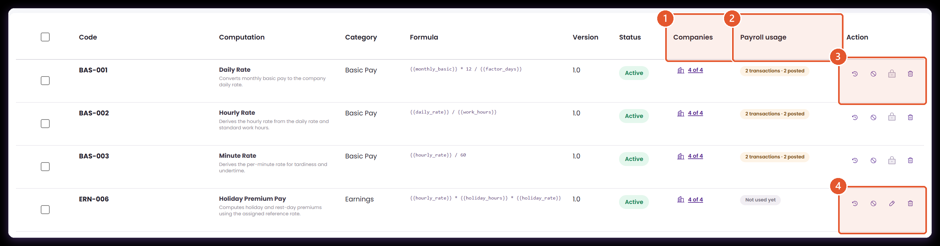
ONE STANDARD, APPLIED PER COMPANY
An Atlas standard is defined once, in Settings
Settings › Standard Computation Library › P&A Admin view
A standard formula exists in exactly one place. A company does not receive a copy of it — it receives a decision about whether the standard applies there.
1
Companies
2
Payroll usage
3
A standard payroll has used
4
A standard payroll has not used
How many companies this standard is applied to. Opening it gives the per-company view on the next page.
Aggregated across every company, because one edit here would reach all of them.
Edit and delete close once a posted transaction has applied the code — for a Super Admin as much as anyone.
Holiday premium, on the same screen, stays fully maintainable. The rule is payroll history, not the role signed in.
P&A Admin view, filtered to the rate formulas. Client Admins see this library read-only.
Notes:
Note the payroll-usage column is aggregated here, because one edit would reach every company.
Presenter note: this deck continues the Part 1 walkthrough and covers what changed after the client's review. Screens were captured live from the ATLAS prototype on 27 August 2026, in the Atlas Simulator Sandbox company, against posted payroll PR-2025-11-E2E. Records, codes and amounts on screen are demonstration data — including the 8 units at PHP250 worked example carried over from Part 1.
Evidence: computationGovernance.js, computationCatalog.js, computationBindings.js, applicabilityScope.js, payrollEngine.js, payrollRuns.js, ComputationalBasis.jsx, serviceModules.jsx, StandardComputationAdmin.jsx.

Slide 16
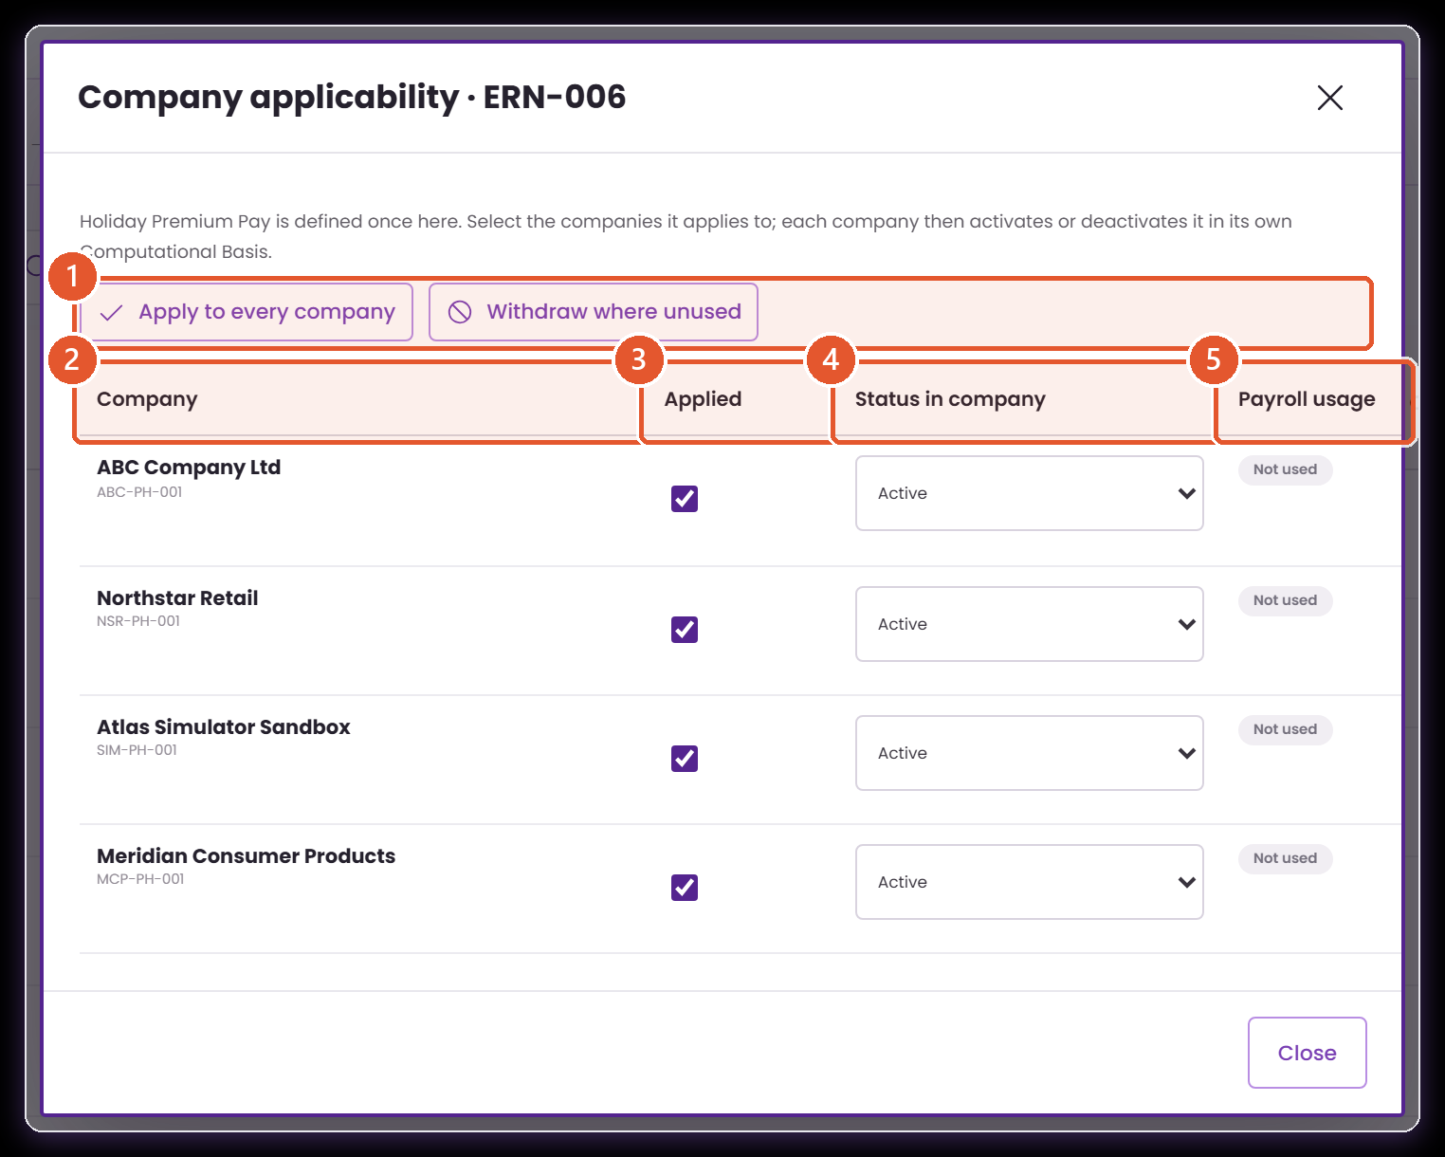
ONE STANDARD, APPLIED PER COMPANY
Choosing which companies a standard applies to
Settings › Standard Computation Library › Companies
This is the company-assignment model in one screen: select the companies, and each one then activates or deactivates the standard in its own Computational Basis.
1
Apply, or withdraw
2
The companies on the platform
Apply to every company is the usual setup case. Withdraw where unused skips any company whose payroll depends on the code.
One row per company. Set during company setup, and revisited whenever a new standard is published.
3
Applied
4
Status in company
Whether the standard reaches this company at all. Clearing it removes the code from that company's library without touching the central definition.
Each company activates or deactivates independently. One company switching a standard off does not affect any other.
5
Payroll usage
Withdrawal and deactivation are refused for a company whose payroll has already applied the code, and the refusal names the transaction.
Demonstration companies. Applicability is stored per code, per company.
Notes:
This is the screen used during company setup, and revisited when a new standard is published.
Presenter note: this deck continues the Part 1 walkthrough and covers what changed after the client's review. Screens were captured live from the ATLAS prototype on 27 August 2026, in the Atlas Simulator Sandbox company, against posted payroll PR-2025-11-E2E. Records, codes and amounts on screen are demonstration data — including the 8 units at PHP250 worked example carried over from Part 1.
Evidence: computationGovernance.js, computationCatalog.js, computationBindings.js, applicabilityScope.js, payrollEngine.js, payrollRuns.js, ComputationalBasis.jsx, serviceModules.jsx, StandardComputationAdmin.jsx.

Slide 17
THE MODEL
How a standard reaches a company
One definition, applied to selected companies, activated by each of them independently.
1
Defined once
2
Applied to companies
3
Activated per company
An Atlas standard formula exists in exactly one record, in Settings. Nothing copies it into a company.
During company setup, a Super Admin selects which companies a standard applies to. It can be revisited at any time.
Each company switches the standards applied to it on or off in its own Computational Basis, without affecting any other company.
4
Customised by variant
5
Scoped storage
6
Protected by usage
A company that needs different arithmetic creates its own computation rather than editing the standard, so the standard stays one definition.
Computations, assignments, reference sources, versions and change history are all held per company.
Withdrawing or deactivating is refused where that company's payroll already applied the code, and the refusal names the transaction.
A company that needs different arithmetic creates its own computation rather than editing the standard.
Notes:
Say the phrase 'a company never holds its own copy of a standard' — it is the point of the section.
Presenter note: this deck continues the Part 1 walkthrough and covers what changed after the client's review. Screens were captured live from the ATLAS prototype on 27 August 2026, in the Atlas Simulator Sandbox company, against posted payroll PR-2025-11-E2E. Records, codes and amounts on screen are demonstration data — including the 8 units at PHP250 worked example carried over from Part 1.
Evidence: computationGovernance.js, computationCatalog.js, computationBindings.js, applicabilityScope.js, payrollEngine.js, payrollRuns.js, ComputationalBasis.jsx, serviceModules.jsx, StandardComputationAdmin.jsx.

Slide 18
09
Creating a computation, revised
The same rule as Part 1, built again — with the code, the status and the inputs behaving differently.
The form
The map fields
The test
Notes:
Use the Part 1 example deliberately. The client already knows the business rule.
Presenter note: this deck continues the Part 1 walkthrough and covers what changed after the client's review. Screens were captured live from the ATLAS prototype on 27 August 2026, in the Atlas Simulator Sandbox company, against posted payroll PR-2025-11-E2E. Records, codes and amounts on screen are demonstration data — including the 8 units at PHP250 worked example carried over from Part 1.
Evidence: computationGovernance.js, computationCatalog.js, computationBindings.js, applicabilityScope.js, payrollEngine.js, payrollRuns.js, ComputationalBasis.jsx, serviceModules.jsx, StandardComputationAdmin.jsx.

Slide 19
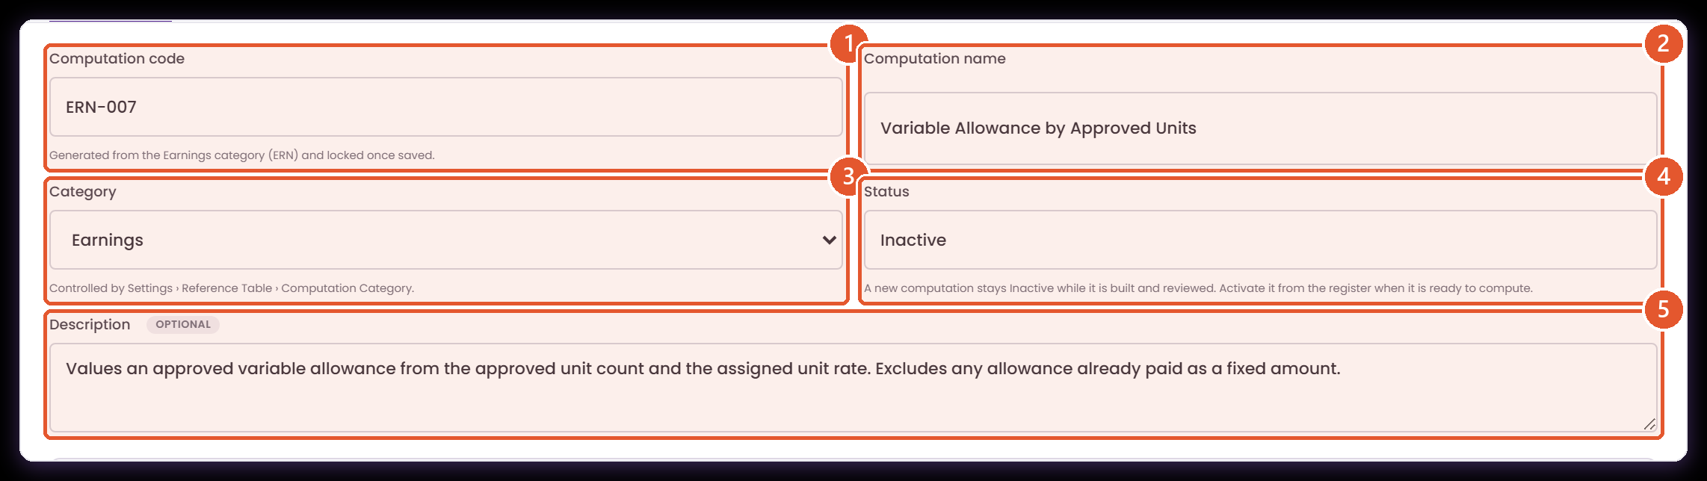
CREATING A COMPUTATION
The same rule as Part 1, with three fields behaving differently
Core › Company Configuration › Services Information › Payroll › Computational Basis › Computations › Create computation › Formula setup
This is the allowance from Part 1, built again. The code, the status and the description have all changed how they work.
1
Generated, not typed
2
Computation name
3
Category is controlled
4
It starts Inactive
5
Description is optional
Unchanged. Name the amount being calculated, in the words Finance reviews it in.
A rule under construction is not selectable by payroll. Somebody activates it once it has been reviewed.
Derived from the category and the next free sequence, then locked. Part 1 had you invent CUS-900; this is ERN-007.
The list comes from the Computation Category reference table, so a category is governed like any other reference value.
Still the best place to record what the rule includes and excludes, but it no longer blocks a save.
Demonstration record ERN-007, Variable Allowance by Approved Units.
Notes:
Contrast with Part 1: CUS-900 typed by hand, Active on save, description required.
Presenter note: this deck continues the Part 1 walkthrough and covers what changed after the client's review. Screens were captured live from the ATLAS prototype on 27 August 2026, in the Atlas Simulator Sandbox company, against posted payroll PR-2025-11-E2E. Records, codes and amounts on screen are demonstration data — including the 8 units at PHP250 worked example carried over from Part 1.
Evidence: computationGovernance.js, computationCatalog.js, computationBindings.js, applicabilityScope.js, payrollEngine.js, payrollRuns.js, ComputationalBasis.jsx, serviceModules.jsx, StandardComputationAdmin.jsx.

Slide 20
CREATING A COMPUTATION
The code follows the category until it is saved
Core › Company Configuration › Services Information › Payroll › Computational Basis › Computations › Create computation
Changing the category regenerates the code. After the first save it is fixed, because payroll transactions print it.
1
Pick the category first
The category decides the code family — ERN for an earning, DED for a deduction, BEN for a benefit.
2
The code follows
ATLAS takes the category's prefix and the first free three-digit sequence.
3
Then it locks
From the first save the code is read-only. Nothing downstream has to cope with a code that moved.
4
Built, tested, then published
The record is created Inactive at version 1.0, with the test evidence filed against it.
ANIMATED CAPTURE · PLAYS IN SLIDE SHOW
Recorded from the prototype. The animation plays in slideshow view.
Notes:
If the GIF does not play, the four notes carry the same sequence.
Presenter note: this deck continues the Part 1 walkthrough and covers what changed after the client's review. Screens were captured live from the ATLAS prototype on 27 August 2026, in the Atlas Simulator Sandbox company, against posted payroll PR-2025-11-E2E. Records, codes and amounts on screen are demonstration data — including the 8 units at PHP250 worked example carried over from Part 1.
Evidence: computationGovernance.js, computationCatalog.js, computationBindings.js, applicabilityScope.js, payrollEngine.js, payrollRuns.js, ComputationalBasis.jsx, serviceModules.jsx, StandardComputationAdmin.jsx.

Slide 21
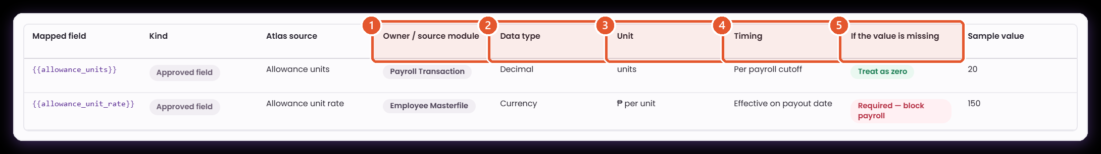
MAP FIELDS
Every input now declares where it comes from
Core › Company Configuration › Services Information › Payroll › Computational Basis › Computations › Create computation › Formula setup
Part 1 showed the token, its kind and a sample value. The five columns the meeting asked for are the contract between this formula and the module that supplies each value.
1
Owner / source module
2
Data type
3
Unit
4
Timing
5
If the value is missing
Currency, decimal, integer or rate. It decides how the value is read and how it should be rounded.
Pesos, hours, minutes, days, units or a multiplier. Two numbers of the same type still only combine when their units agree.
When the value is resolved: effective on the payout date, per cutoff, year to date, or computed inside this run.
Which part of ATLAS produces this value at run time — the masterfile, timekeeping, a reference source, a statutory table, or another computation.
What payroll does when the owning module supplies nothing. Treated as zero, or required and the run stops — the distinction the meeting asked to settle per field.
Every approved field in the palette carries all five, not only the ones shown here.
Notes:
This table is the answer to the owner/type/unit/timing/missing-value item.
Presenter note: this deck continues the Part 1 walkthrough and covers what changed after the client's review. Screens were captured live from the ATLAS prototype on 27 August 2026, in the Atlas Simulator Sandbox company, against posted payroll PR-2025-11-E2E. Records, codes and amounts on screen are demonstration data — including the 8 units at PHP250 worked example carried over from Part 1.
Evidence: computationGovernance.js, computationCatalog.js, computationBindings.js, applicabilityScope.js, payrollEngine.js, payrollRuns.js, ComputationalBasis.jsx, serviceModules.jsx, StandardComputationAdmin.jsx.

Slide 22
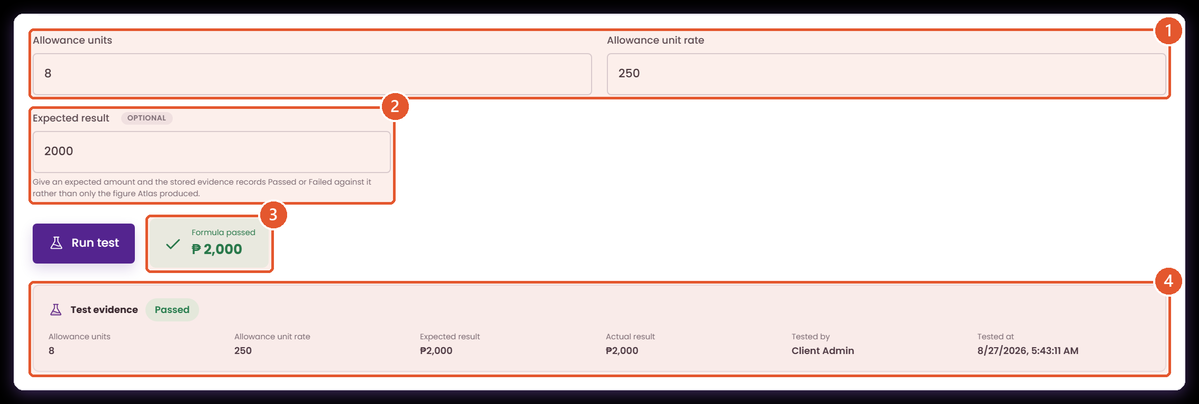
TEST EVIDENCE
The test result is kept, not recalculated later
Core › Company Configuration › Services Information › Payroll › Computational Basis › Computations › Create computation › Test calculation
Part 1 ran the test and showed the answer. The evidence is now stored against the version you publish, so a reviewer reads what was tested rather than a fresh sample.
1
One input per mapped field
2
Expected result
3
The run
4
The evidence that is stored
Unchanged. Use values a reviewer can verify by hand — here, eight approved units at ₱250.
New, and optional. State the amount you expect and ATLAS records Passed or Failed against it instead of only the figure it produced.
Evaluates the draft. It does not save the record, create payroll, or touch any employee.
Inputs, expected amount, actual amount, result, who tested it and when. This is filed with the version, and shown against it afterwards.
In this demonstration · 8 units × ₱250 = ₱2,000, matching the manual check.
Notes:
The evidence card is stored with the version. It is not recomputed when the record is opened.
Presenter note: this deck continues the Part 1 walkthrough and covers what changed after the client's review. Screens were captured live from the ATLAS prototype on 27 August 2026, in the Atlas Simulator Sandbox company, against posted payroll PR-2025-11-E2E. Records, codes and amounts on screen are demonstration data — including the 8 units at PHP250 worked example carried over from Part 1.
Evidence: computationGovernance.js, computationCatalog.js, computationBindings.js, applicabilityScope.js, payrollEngine.js, payrollRuns.js, ComputationalBasis.jsx, serviceModules.jsx, StandardComputationAdmin.jsx.

Slide 23
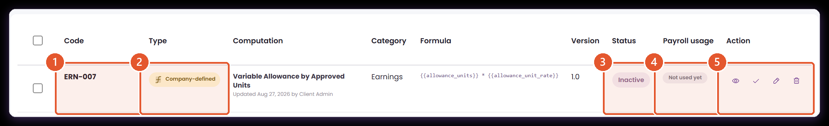
COMPANY-DEFINED COMPUTATIONS
A rule nothing has used stays fully editable
Core › Company Configuration › Services Information › Payroll › Computational Basis › Computations
The protections are about payroll history, not about locking the library. A company rule no transaction has touched can still be changed or removed.
1
Generated code
2
Company-defined
3
Inactive on creation
4
Not used yet
5
Every action available
ERN-007, from the Earnings category. It sorts and reads beside the Atlas earnings standards.
Created for this company and maintained here, unlike an Atlas standard.
It was created Inactive. Nothing selects it for payroll until somebody activates it.
No payroll transaction references it, which is what keeps the next column open.
View, activate, edit and delete. Compare this row with the protected standards shown earlier.
Demonstration record created during this walkthrough.
Notes:
The contrast slide: nothing has used this rule, so every action is still available.
Presenter note: this deck continues the Part 1 walkthrough and covers what changed after the client's review. Screens were captured live from the ATLAS prototype on 27 August 2026, in the Atlas Simulator Sandbox company, against posted payroll PR-2025-11-E2E. Records, codes and amounts on screen are demonstration data — including the 8 units at PHP250 worked example carried over from Part 1.
Evidence: computationGovernance.js, computationCatalog.js, computationBindings.js, applicabilityScope.js, payrollEngine.js, payrollRuns.js, ComputationalBasis.jsx, serviceModules.jsx, StandardComputationAdmin.jsx.

Slide 24
10
Evidence that stays with the record
Versions keep their own formula and their own proof, and the log carries the values that changed.
Version history
The diff
The log
Notes:
Short section, but it is what makes a formula sign-off reviewable months later.
Presenter note: this deck continues the Part 1 walkthrough and covers what changed after the client's review. Screens were captured live from the ATLAS prototype on 27 August 2026, in the Atlas Simulator Sandbox company, against posted payroll PR-2025-11-E2E. Records, codes and amounts on screen are demonstration data — including the 8 units at PHP250 worked example carried over from Part 1.
Evidence: computationGovernance.js, computationCatalog.js, computationBindings.js, applicabilityScope.js, payrollEngine.js, payrollRuns.js, ComputationalBasis.jsx, serviceModules.jsx, StandardComputationAdmin.jsx.

Slide 25
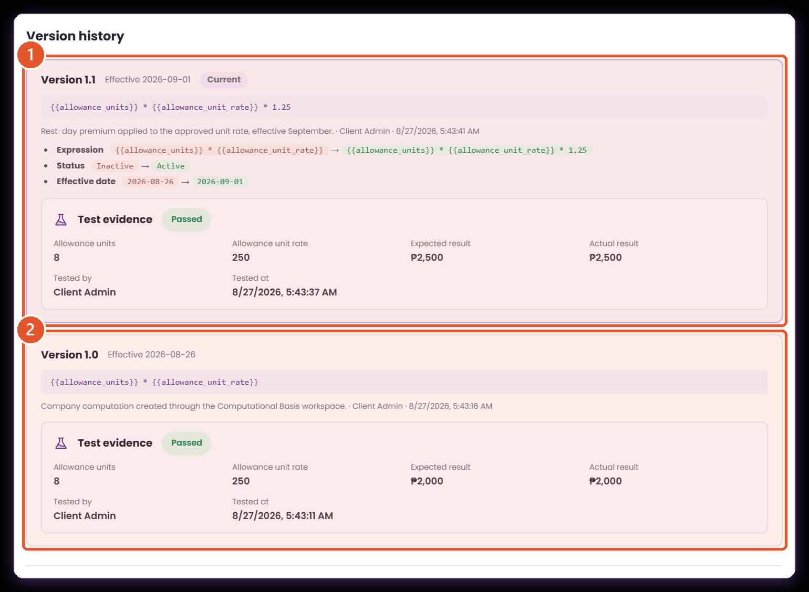
VERSION HISTORY
Each version keeps its formula and its proof
Core › Company Configuration › Services Information › Payroll › Computational Basis › Computations › View › Version history
Editing the rule published version 1.1 and left 1.0 intact. Both versions carry the expression they published and the test that was run against it.
1
The current version
Its expression, the change note, who published it and when, what changed against the version before it, and the test evidence recorded for this formula.
2
The version it replaced
Kept in full, with its own expression and its own evidence. This is what a payroll computed before the change still resolves against.
Editing the expression retires the earlier test, so each version publishes with proof of the formula it contains.
Notes:
Two versions, each with its own expression and its own test. This is the audit evidence.
Presenter note: this deck continues the Part 1 walkthrough and covers what changed after the client's review. Screens were captured live from the ATLAS prototype on 27 August 2026, in the Atlas Simulator Sandbox company, against posted payroll PR-2025-11-E2E. Records, codes and amounts on screen are demonstration data — including the 8 units at PHP250 worked example carried over from Part 1.
Evidence: computationGovernance.js, computationCatalog.js, computationBindings.js, applicabilityScope.js, payrollEngine.js, payrollRuns.js, ComputationalBasis.jsx, serviceModules.jsx, StandardComputationAdmin.jsx.

Slide 26
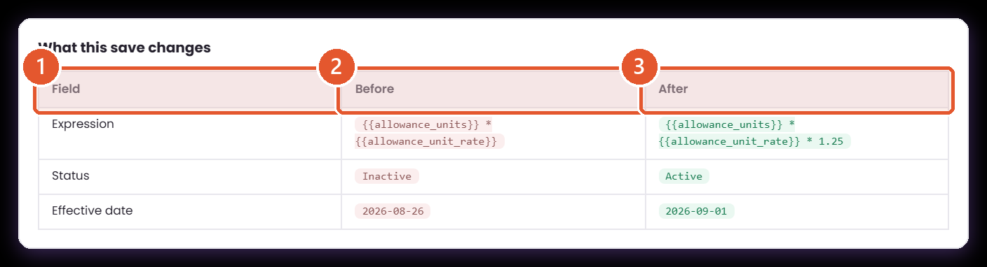
CHANGE HISTORY
You see what the save will change before you make it
Core › Company Configuration › Services Information › Payroll › Computational Basis › Computations › Edit computation › Change details
Change details now compares the draft against the published record and lists the fields that will move, with their values on both sides.
1
The fields tracked
2
Before
3
After
Expression, status, effective date, name, category and description. A change to any of them is recorded.
The value on the published record, as payroll would resolve it until this save goes through.
The value the draft will publish. The same list is written into change history when you save.
Demonstration edit: adding a rest-day premium and moving the effective date.
Notes:
The reviewer sees what the save will change before committing it.
Presenter note: this deck continues the Part 1 walkthrough and covers what changed after the client's review. Screens were captured live from the ATLAS prototype on 27 August 2026, in the Atlas Simulator Sandbox company, against posted payroll PR-2025-11-E2E. Records, codes and amounts on screen are demonstration data — including the 8 units at PHP250 worked example carried over from Part 1.
Evidence: computationGovernance.js, computationCatalog.js, computationBindings.js, applicabilityScope.js, payrollEngine.js, payrollRuns.js, ComputationalBasis.jsx, serviceModules.jsx, StandardComputationAdmin.jsx.

Slide 27
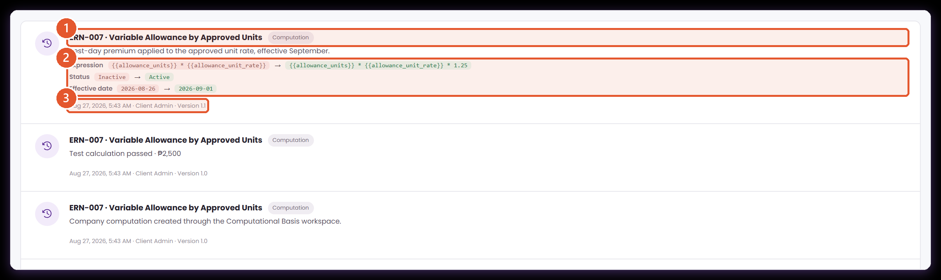
CHANGE HISTORY
The log records the change, not only that something changed
Core › Company Configuration › Services Information › Payroll › Computational Basis › Change history
Part 1's history gave the item, action, version, user and date. It now carries the before and after values on the same entry.
1
What was changed
2
Before and after
3
Who, when, which version
The code and name of the record, and the kind of thing it is — a computation, an assignment or a reference source.
Each changed field with its previous and new value, so an edit can be reconstructed without opening the record.
The actor, the timestamp and the version the change produced — the three facts an audit asks for.
Entries are recorded per company. Reference source versions and activations appear in the same list.
Notes:
The same change list is written into the log, per company.
Presenter note: this deck continues the Part 1 walkthrough and covers what changed after the client's review. Screens were captured live from the ATLAS prototype on 27 August 2026, in the Atlas Simulator Sandbox company, against posted payroll PR-2025-11-E2E. Records, codes and amounts on screen are demonstration data — including the 8 units at PHP250 worked example carried over from Part 1.
Evidence: computationGovernance.js, computationCatalog.js, computationBindings.js, applicabilityScope.js, payrollEngine.js, payrollRuns.js, ComputationalBasis.jsx, serviceModules.jsx, StandardComputationAdmin.jsx.

Slide 28
11
Values and volume
Rates that change on a date, and maintaining a register once it grows.
Reference versions
Bulk maintenance
Import
Notes:
Two smaller items from the review, grouped.
Presenter note: this deck continues the Part 1 walkthrough and covers what changed after the client's review. Screens were captured live from the ATLAS prototype on 27 August 2026, in the Atlas Simulator Sandbox company, against posted payroll PR-2025-11-E2E. Records, codes and amounts on screen are demonstration data — including the 8 units at PHP250 worked example carried over from Part 1.
Evidence: computationGovernance.js, computationCatalog.js, computationBindings.js, applicabilityScope.js, payrollEngine.js, payrollRuns.js, ComputationalBasis.jsx, serviceModules.jsx, StandardComputationAdmin.jsx.

Slide 29
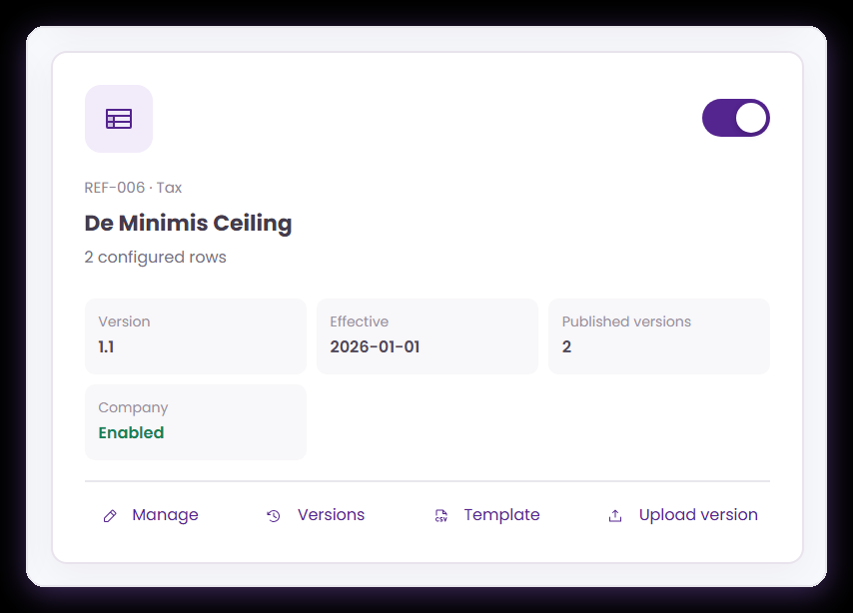
EFFECTIVE-DATED VALUES
A reference source now carries its published versions
Core › Company Configuration › Services Information › Payroll › Computational Basis › Reference sources
The card shows how many versions exist, and opens the history beside the usual manage, template and upload actions.
Published versions
Versions
Upload version
Every version that has been issued, not just the current one.
Opens the full history with each version's rows.
Publishes a new version and keeps the one it supersedes.
Statutory sources stay linked here and maintained in Settings.
Notes:
This is the card the next slide opens.
Presenter note: this deck continues the Part 1 walkthrough and covers what changed after the client's review. Screens were captured live from the ATLAS prototype on 27 August 2026, in the Atlas Simulator Sandbox company, against posted payroll PR-2025-11-E2E. Records, codes and amounts on screen are demonstration data — including the 8 units at PHP250 worked example carried over from Part 1.
Evidence: computationGovernance.js, computationCatalog.js, computationBindings.js, applicabilityScope.js, payrollEngine.js, payrollRuns.js, ComputationalBasis.jsx, serviceModules.jsx, StandardComputationAdmin.jsx.

Slide 30
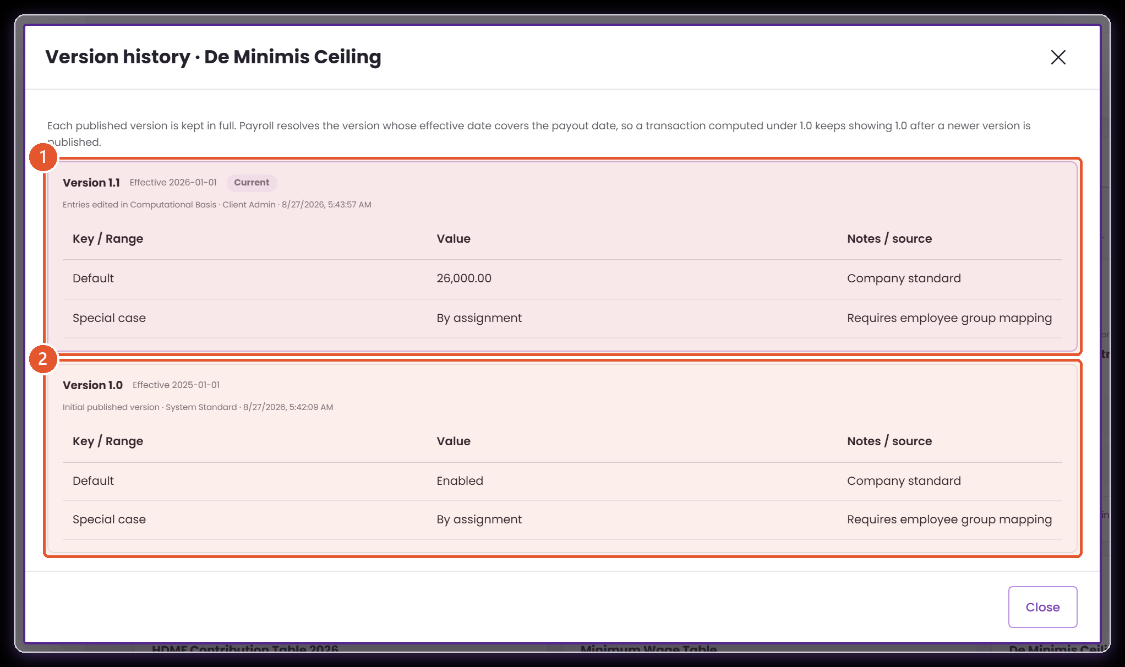
EFFECTIVE-DATED VALUES
A new rate does not overwrite the old one
Core › Company Configuration › Services Information › Payroll › Computational Basis › Reference sources › Versions
Publishing a new version of a reference source keeps the version it supersedes, so a payroll computed under the old ceiling still resolves the old ceiling.
1
The current version
Effective from its own date, with the rows as they now stand. Payroll uses this for any payout date on or after that date.
2
The version it replaced
Kept with its own rows and its own effective date. A payout date before the change still resolves these values.
Demonstration: a De Minimis ceiling republished with a January effective date.
Notes:
Two versions, two effective dates, two sets of rows. Payroll picks by payout date.
Presenter note: this deck continues the Part 1 walkthrough and covers what changed after the client's review. Screens were captured live from the ATLAS prototype on 27 August 2026, in the Atlas Simulator Sandbox company, against posted payroll PR-2025-11-E2E. Records, codes and amounts on screen are demonstration data — including the 8 units at PHP250 worked example carried over from Part 1.
Evidence: computationGovernance.js, computationCatalog.js, computationBindings.js, applicabilityScope.js, payrollEngine.js, payrollRuns.js, ComputationalBasis.jsx, serviceModules.jsx, StandardComputationAdmin.jsx.

Slide 31
BULK MAINTENANCE
Maintaining the register once it grows
Core › Company Configuration › Services Information › Payroll › Computational Basis › Computations
Filtering, selecting and moving a set of rules together, and loading a migration in one file.
1
Select what the filter found
2
Move a set together
3
Import creates as well as updates
Search and filter the register, then select every row the filter returned — not only the page on screen.
Activate or deactivate the whole selection in one action, with the codes that could not move reported by code and reason.
A row whose code exists updates that computation. A row whose code is new — or blank — creates one, generated from its category.
4
New rows arrive Inactive
5
Standards stay as they are
6
The template matches the importer
Imported records are created Inactive so a migration can be reviewed before any of it computes.
A company import leaves every Atlas standard untouched, and reports those rows as unchanged rather than passing over them in silence.
Download template carries the real headers, rows from this company, and a commented key of every category, status and approved field.
A bulk action reports the codes it could not move, and why, rather than skipping them silently.
Notes:
The import change is the one to call out: it creates records now, which it did not in Part 1.
Presenter note: this deck continues the Part 1 walkthrough and covers what changed after the client's review. Screens were captured live from the ATLAS prototype on 27 August 2026, in the Atlas Simulator Sandbox company, against posted payroll PR-2025-11-E2E. Records, codes and amounts on screen are demonstration data — including the 8 units at PHP250 worked example carried over from Part 1.
Evidence: computationGovernance.js, computationCatalog.js, computationBindings.js, applicabilityScope.js, payrollEngine.js, payrollRuns.js, ComputationalBasis.jsx, serviceModules.jsx, StandardComputationAdmin.jsx.

Slide 32
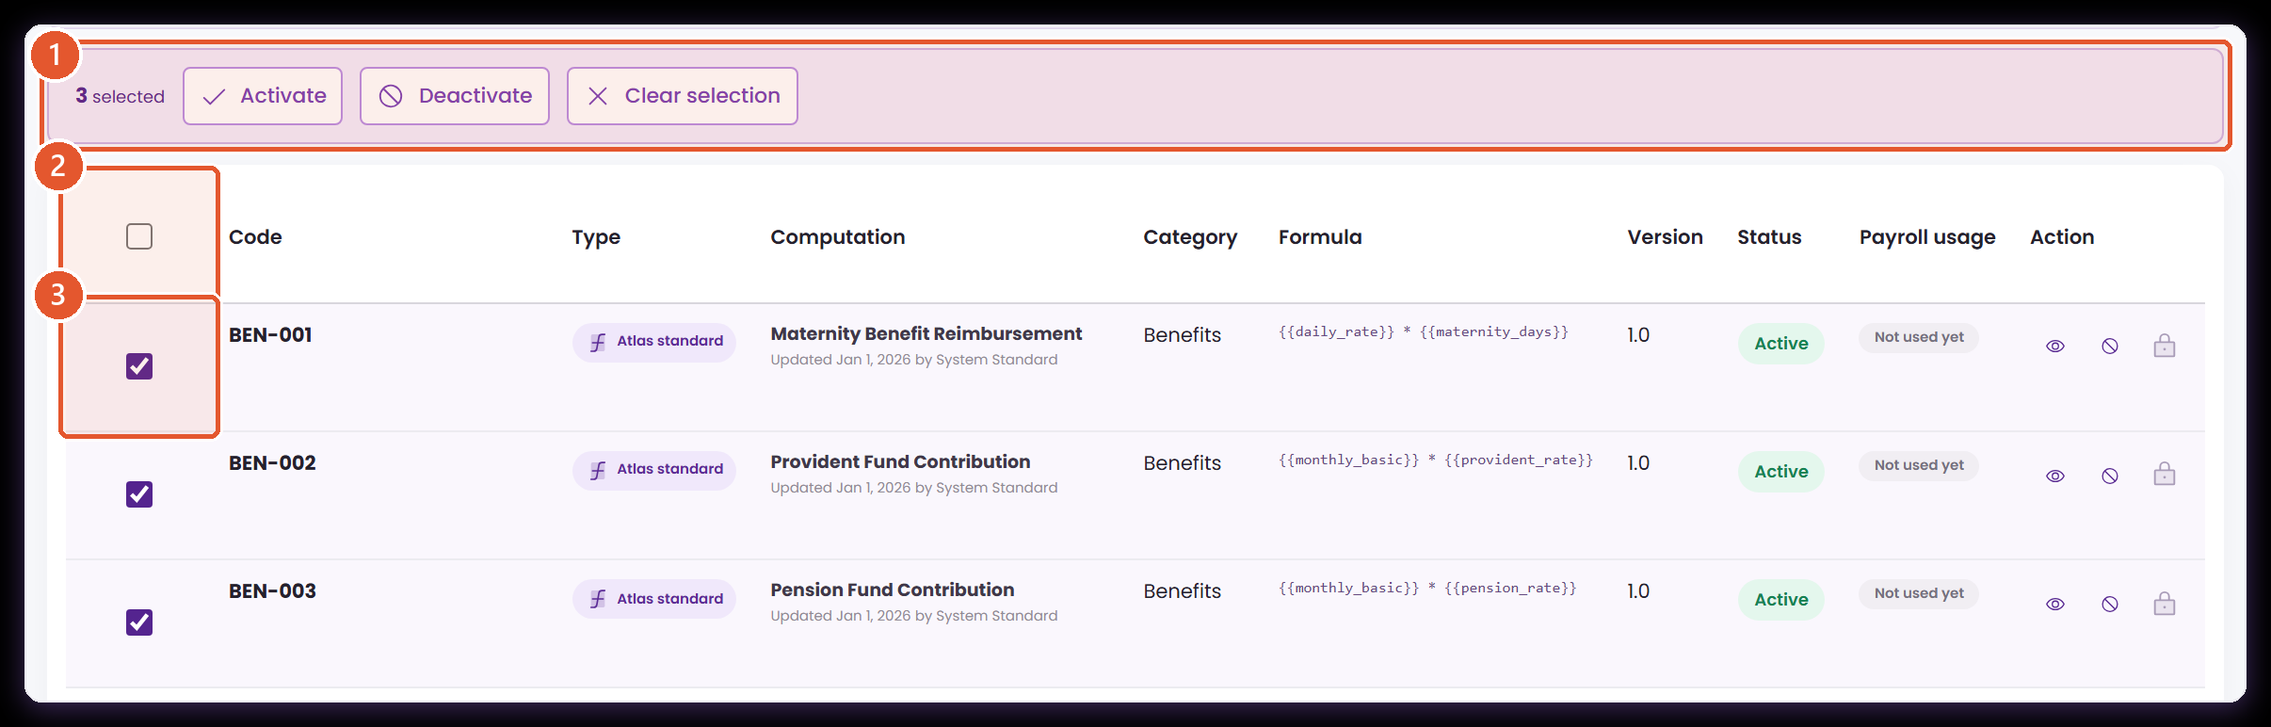
BULK MAINTENANCE
Filter, select, and move a set of rules together
Core › Company Configuration › Services Information › Payroll › Computational Basis › Computations
Filtering the register down and acting on what the filter found, which is how the register is maintained once a company has more than a handful of rules.
1
Act on the selection
2
Select all filtered
3
Select individually
Activate or deactivate everything selected. Anything a payroll transaction holds is reported by code rather than skipped silently.
Selects every row the current search and filters return, not only the page on screen.
Pick specific rules out of the filtered set when only some of them are moving.
Bulk import also creates records now, not only updates: see the next page.
Notes:
Select all applies to everything the filter returned, not only the page on screen.
Presenter note: this deck continues the Part 1 walkthrough and covers what changed after the client's review. Screens were captured live from the ATLAS prototype on 27 August 2026, in the Atlas Simulator Sandbox company, against posted payroll PR-2025-11-E2E. Records, codes and amounts on screen are demonstration data — including the 8 units at PHP250 worked example carried over from Part 1.
Evidence: computationGovernance.js, computationCatalog.js, computationBindings.js, applicabilityScope.js, payrollEngine.js, payrollRuns.js, ComputationalBasis.jsx, serviceModules.jsx, StandardComputationAdmin.jsx.

Slide 33
12
Every payment names its formula
Computational Basis holds the calculations. Services Information holds what the company pays. This is the join between them.
The register
The binding
On the payroll line
Notes:
Frame this as the join that was missing: the library and the payment catalogue never referred to each other.
Presenter note: this deck continues the Part 1 walkthrough and covers what changed after the client's review. Screens were captured live from the ATLAS prototype on 27 August 2026, in the Atlas Simulator Sandbox company, against posted payroll PR-2025-11-E2E. Records, codes and amounts on screen are demonstration data — including the 8 units at PHP250 worked example carried over from Part 1.
Evidence: computationGovernance.js, computationCatalog.js, computationBindings.js, applicabilityScope.js, payrollEngine.js, payrollRuns.js, ComputationalBasis.jsx, serviceModules.jsx, StandardComputationAdmin.jsx.

Slide 34
THE JOIN
Two catalogues that never referred to each other
The formula library and the payment configurations were each complete on their own. What was missing was the statement that connects a particular payment to a particular formula.
WHAT EACH ONE HELD
WHAT THE RECORD HOLDS NOW
The library held the arithmetic
The payment names its formula
A published, versioned, tested computation — but nothing saying which of the company's payments used it.
One field on the configuration: the published computation that produces this amount.
The configuration held the payment
And the source of every input
An earning or deduction with its taxability, its accounting mapping and its amount — but no formula.
Each variable in that formula is bound to where its value comes from, and the binding is stored with the record.
The connection was in people's heads
Payroll applies exactly that
Which calculation belonged to which payment was known, agreed and written down elsewhere, but not held in the record.
The bound formula becomes a step on the payroll line, with its code, its version and the sources it drew on.
Binding is optional: a configuration that binds nothing keeps the treatment it had before.
Notes:
The left column is not a criticism — it is what Part 1 showed working. The right column is what was added.
Presenter note: this deck continues the Part 1 walkthrough and covers what changed after the client's review. Screens were captured live from the ATLAS prototype on 27 August 2026, in the Atlas Simulator Sandbox company, against posted payroll PR-2025-11-E2E. Records, codes and amounts on screen are demonstration data — including the 8 units at PHP250 worked example carried over from Part 1.
Evidence: computationGovernance.js, computationCatalog.js, computationBindings.js, applicabilityScope.js, payrollEngine.js, payrollRuns.js, ComputationalBasis.jsx, serviceModules.jsx, StandardComputationAdmin.jsx.

Slide 35
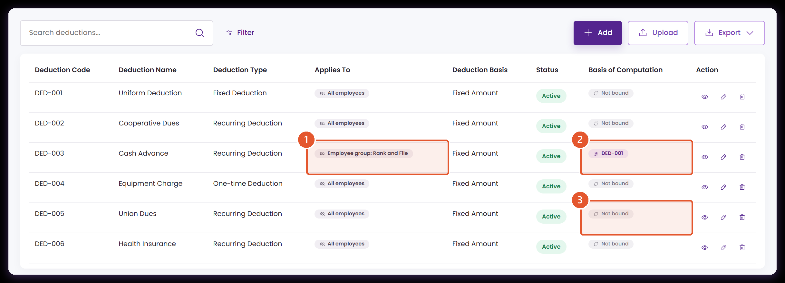
THE JOIN THAT WAS MISSING
Each thing you pay now names the formula behind it
Core › Company Configuration › Services Information › Payroll › Deductions
Computational Basis says what a calculation is. This register says what the company pays. Two new columns connect them: who a deduction reaches, and which published formula produces its amount.
1
Who it applies to
2
The formula that computes it
3
Or no formula at all
The employees this configuration reaches. Payroll applies it to those employees and to nobody else.
The published computation this deduction runs. Open the row to see where each of that formula's inputs comes from.
A configuration that binds nothing keeps the treatment it had before. Binding is something you add where it earns its place.
Cash Advance is bound here; the rest of the register is left as it was.
Notes:
Two new columns. The rest of the register is exactly as the client saw it in Part 1.
Presenter note: this deck continues the Part 1 walkthrough and covers what changed after the client's review. Screens were captured live from the ATLAS prototype on 27 August 2026, in the Atlas Simulator Sandbox company, against posted payroll PR-2025-11-E2E. Records, codes and amounts on screen are demonstration data — including the 8 units at PHP250 worked example carried over from Part 1.
Evidence: computationGovernance.js, computationCatalog.js, computationBindings.js, applicabilityScope.js, payrollEngine.js, payrollRuns.js, ComputationalBasis.jsx, serviceModules.jsx, StandardComputationAdmin.jsx.

Slide 36
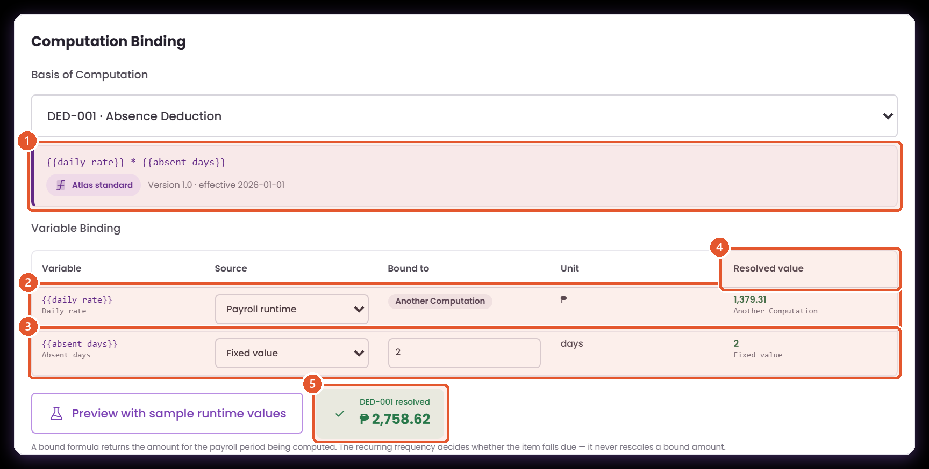
VARIABLE BINDING
Every input in the formula gets a stated source
Core › Company Configuration › Services Information › Payroll › Deductions › Edit › Computation Binding
Picking a formula raises the question the review kept returning to: where does each value come from? Each variable is answered here, and the answer is stored with the configuration.
1
The formula, as published
2
A value payroll produces
The expression, its version and its effective date, shown from the library rather than retyped here.
The daily rate comes from the employee's own salary record while the run computes, so each person is priced on their own rate.
3
A value this configuration decides
4
What each one resolves to
The figure each source currently yields, so a binding can be read rather than inferred.
The number of days is a property of this deduction, not of the employee, so it is set once here.
5
The amount, before you save
Runs the formula against sample values so the configuration can be checked without waiting for a payroll.
Two of the four sources are in use here; the others are a configuration field and a reference-source row.
Notes:
This is the centre of the section. Walk the two bound rows and the resolved column.
Presenter note: this deck continues the Part 1 walkthrough and covers what changed after the client's review. Screens were captured live from the ATLAS prototype on 27 August 2026, in the Atlas Simulator Sandbox company, against posted payroll PR-2025-11-E2E. Records, codes and amounts on screen are demonstration data — including the 8 units at PHP250 worked example carried over from Part 1.
Evidence: computationGovernance.js, computationCatalog.js, computationBindings.js, applicabilityScope.js, payrollEngine.js, payrollRuns.js, ComputationalBasis.jsx, serviceModules.jsx, StandardComputationAdmin.jsx.

Slide 37
THE SOURCES
Where a variable's value can come from
Core › Company Configuration › Services Information › Payroll › Deductions › Edit › Computation Binding
Four kinds of source, chosen once per variable rather than once per formula.
1
Payroll runtime
2
This configuration
3
Reference source
The module that owns the value supplies it while the run computes — the salary record, the timekeeping punches, or an earlier step of the same payroll.
A number set on the record itself: the default amount, a rate, a factor. Use it where the value belongs to the payment rather than the person.
A row of a formula reference source, read at the version effective on the payout date, so a rate change on a date reaches every configuration that cites it.
4
Fixed value
5
Chosen per variable
6
Checked before it saves
A constant that belongs to this configuration alone. The plainest option, and the right one where the number is genuinely a property of this rule.
The choice is made once for each input, not once for the formula, so a single calculation can draw on several modules at the same time.
A variable left unanswered stops the save and names itself, rather than resolving to nothing and quietly producing a smaller amount.
The worked example uses two of the four; the others are a field on the record and a reference-source row.
Notes:
The last two cards are the ones to dwell on: per variable, and checked before it saves.
Presenter note: this deck continues the Part 1 walkthrough and covers what changed after the client's review. Screens were captured live from the ATLAS prototype on 27 August 2026, in the Atlas Simulator Sandbox company, against posted payroll PR-2025-11-E2E. Records, codes and amounts on screen are demonstration data — including the 8 units at PHP250 worked example carried over from Part 1.
Evidence: computationGovernance.js, computationCatalog.js, computationBindings.js, applicabilityScope.js, payrollEngine.js, payrollRuns.js, ComputationalBasis.jsx, serviceModules.jsx, StandardComputationAdmin.jsx.

Slide 38
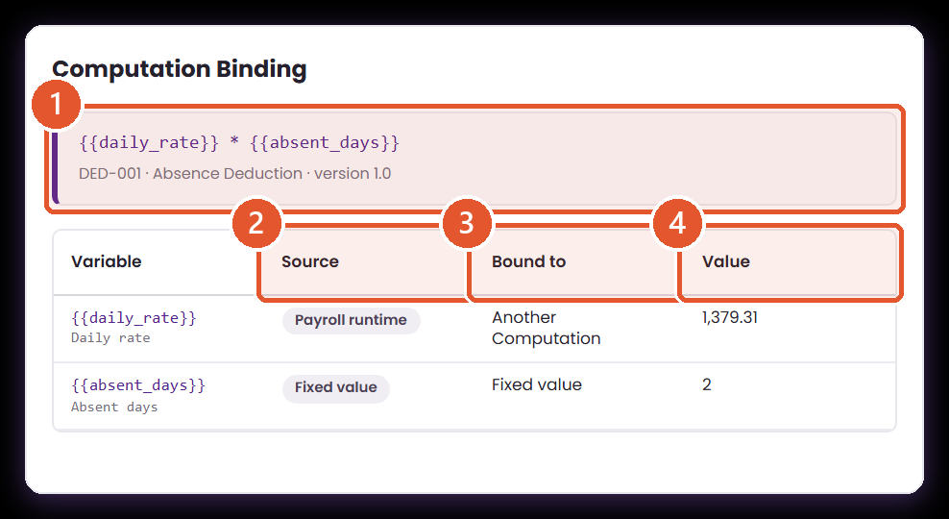
THE RECORD, AS A REVIEWER READS IT
The binding is part of the record, not a setting behind it
Core › Company Configuration › Services Information › Payroll › Deductions › View
Opening the configuration shows the formula and every variable with the source that feeds it — the page to read when someone asks why a deduction came out as it did.
1
The formula and its version
Named and dated, so the reviewer knows which published version this configuration is bound to.
2
The kind of source
Payroll runtime, this configuration, a reference source, or a fixed value. Four kinds, one per variable.
3
The source itself
Which module produces it, which field on this record, or which row of which reference source.
4
What it resolves to now
Today's figure for each input, so the record can be checked without opening a payroll.
The same table the editor shows, in read-only form.
Notes:
The read-only view. This is the page to open when someone questions an amount.
Presenter note: this deck continues the Part 1 walkthrough and covers what changed after the client's review. Screens were captured live from the ATLAS prototype on 27 August 2026, in the Atlas Simulator Sandbox company, against posted payroll PR-2025-11-E2E. Records, codes and amounts on screen are demonstration data — including the 8 units at PHP250 worked example carried over from Part 1.
Evidence: computationGovernance.js, computationCatalog.js, computationBindings.js, applicabilityScope.js, payrollEngine.js, payrollRuns.js, ComputationalBasis.jsx, serviceModules.jsx, StandardComputationAdmin.jsx.

Slide 39
ON THE PAYROLL LINE
A bound amount explains itself like any other
Payroll › Payroll Processing › Transaction › Employee result › How it was computed
The configuration's formula becomes a step on the payroll trail, carrying the code, the version, the sources it drew on and the amount it produced.
1
The code, and its version
2
Where each input came from
3
The amount
The governed computation and the exact version it applied — so a bound amount stays reproducible after the formula moves on, like every step in section 06.
The step names the source of every variable, so the figure can be traced back through the configuration to the modules that fed it.
Produced by evaluating the published formula, not by an amount typed beside the deduction.
The employee's own daily rate, so this figure differs per person by design.
Notes:
The bound step carries a version, exactly like every other step in section 06.
Presenter note: this deck continues the Part 1 walkthrough and covers what changed after the client's review. Screens were captured live from the ATLAS prototype on 27 August 2026, in the Atlas Simulator Sandbox company, against posted payroll PR-2025-11-E2E. Records, codes and amounts on screen are demonstration data — including the 8 units at PHP250 worked example carried over from Part 1.
Evidence: computationGovernance.js, computationCatalog.js, computationBindings.js, applicabilityScope.js, payrollEngine.js, payrollRuns.js, ComputationalBasis.jsx, serviceModules.jsx, StandardComputationAdmin.jsx.

Slide 40
13
Who a rule reaches
Employee group was written on several screens. It is now written once, in one vocabulary, and payroll acts on it.
One vocabulary
Three questions
Enforced, and reported
Notes:
This section is short. The point is singular: stated scope is now applied scope.
Presenter note: this deck continues the Part 1 walkthrough and covers what changed after the client's review. Screens were captured live from the ATLAS prototype on 27 August 2026, in the Atlas Simulator Sandbox company, against posted payroll PR-2025-11-E2E. Records, codes and amounts on screen are demonstration data — including the 8 units at PHP250 worked example carried over from Part 1.
Evidence: computationGovernance.js, computationCatalog.js, computationBindings.js, applicabilityScope.js, payrollEngine.js, payrollRuns.js, ComputationalBasis.jsx, serviceModules.jsx, StandardComputationAdmin.jsx.

Slide 41
SCOPE
Saying who a rule covers, once
Employee group appeared on more than one screen, in more than one vocabulary. Consolidating it means a group means the same thing everywhere, and the place it is written is the place that decides.
HOW SCOPE WAS DESCRIBED
HOW IT IS DESCRIBED NOW
Group appeared on several screens
One vocabulary
The configurations, the assignments and the policy engines each carried their own way of describing an employee group.
Everybody, an employee group, a department, or named individuals — the same four choices, reading from the same employee groups, everywhere.
Only some of them decided anything
Three places, three questions
The transaction, the registers and the policy engines were read by payroll. The configuration and assignment fields were recorded but never consulted.
Who is in the run, who carries the item, and who the rule can reach. Each question is answered in exactly one place.
Two records could disagree
Stated scope is applied scope
Nothing stopped a configuration saying one thing and the register another, with only one of them affecting the payroll.
What the configuration says is what payroll does, and where a rule is withheld the transaction records which employee and why.
The employee groups come from the same list HRM, the policy engines and payroll all read.
Notes:
If asked why this matters: two records that can disagree will eventually disagree.
Presenter note: this deck continues the Part 1 walkthrough and covers what changed after the client's review. Screens were captured live from the ATLAS prototype on 27 August 2026, in the Atlas Simulator Sandbox company, against posted payroll PR-2025-11-E2E. Records, codes and amounts on screen are demonstration data — including the 8 units at PHP250 worked example carried over from Part 1.
Evidence: computationGovernance.js, computationCatalog.js, computationBindings.js, applicabilityScope.js, payrollEngine.js, payrollRuns.js, ComputationalBasis.jsx, serviceModules.jsx, StandardComputationAdmin.jsx.

Slide 42
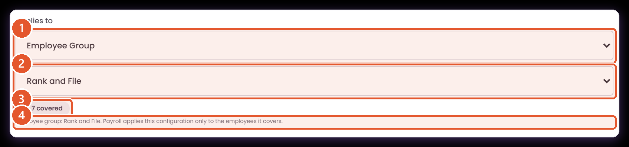
APPLICABILITY
One way of saying who a rule covers
Core › Company Configuration › Services Information › Payroll › Deductions › Edit › Deduction Details
The same four choices the policy engines already use — everybody, an employee group, a department, or named individuals — now sit on the payroll configurations too, and payroll honours them.
1
How to describe the group
2
Which one
3
How many that reaches
4
What it will do
Everybody, an employee group, a department, or a list of named people. Choose the smallest description that genuinely shares the rule.
The employee groups come from the same list HRM and the policy engines read, so a group means the same thing everywhere.
The count updates as you choose, so the scope can be checked against the roster before it is saved rather than after a payroll runs.
States the consequence in a sentence: payroll applies this configuration only to the employees it covers.
Seven of the sandbox company's employees fall in this group.
Notes:
The covered count is the control to point at — the scope is checkable before it is saved.
Presenter note: this deck continues the Part 1 walkthrough and covers what changed after the client's review. Screens were captured live from the ATLAS prototype on 27 August 2026, in the Atlas Simulator Sandbox company, against posted payroll PR-2025-11-E2E. Records, codes and amounts on screen are demonstration data — including the 8 units at PHP250 worked example carried over from Part 1.
Evidence: computationGovernance.js, computationCatalog.js, computationBindings.js, applicabilityScope.js, payrollEngine.js, payrollRuns.js, ComputationalBasis.jsx, serviceModules.jsx, StandardComputationAdmin.jsx.

Slide 43
ONE PLACE PER QUESTION
Where scope is decided
Three questions, each answered in exactly one place, so there is no second record to reconcile.
1
The transaction decides who is in the run
2
The register decides who carries an item
3
The configuration decides who it can reach
Payment mode, employment status and the included list settle which employees the payroll covers at all.
An earning or deduction is assigned to a named employee for a period, with its own amount and balance.
Applicability narrows a rule to a group, a department or named people. Payroll applies it inside that scope and withholds it outside.
4
A one-off answers to none of them
5
The groups come from one list
6
Existing records start unrestricted
An amount encoded directly on a transaction, or a loan already on schedule, is an instruction rather than a rule. It is never withheld.
Employee groups are read from the same place HRM, the policy engines and payroll all read, so a group means the same thing in each of them.
Configurations carried over from before cover every employee, so nothing stopped being paid on the day this arrived. Narrowing is a deliberate act.
Employee groups are shared with HRM and the policy engines rather than redefined for payroll.
Notes:
Read the first three headings in order — they are the sequence a payroll actually resolves.
Presenter note: this deck continues the Part 1 walkthrough and covers what changed after the client's review. Screens were captured live from the ATLAS prototype on 27 August 2026, in the Atlas Simulator Sandbox company, against posted payroll PR-2025-11-E2E. Records, codes and amounts on screen are demonstration data — including the 8 units at PHP250 worked example carried over from Part 1.
Evidence: computationGovernance.js, computationCatalog.js, computationBindings.js, applicabilityScope.js, payrollEngine.js, payrollRuns.js, ComputationalBasis.jsx, serviceModules.jsx, StandardComputationAdmin.jsx.

Slide 44
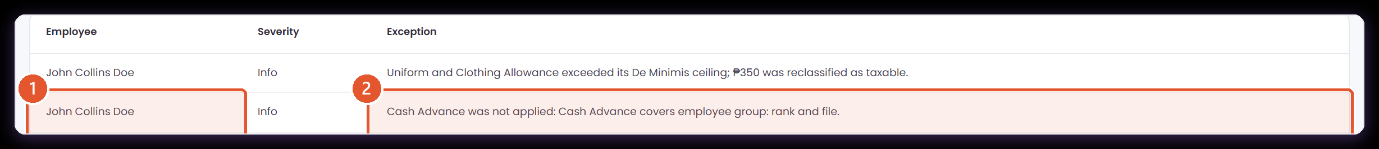
APPLICABILITY, ENFORCED
An employee outside the group is told about, not skipped
Payroll › Payroll Processing › Transaction › Exceptions
The same configuration, the same payroll run, a different employee. Because he is not in the group it covers, the deduction did not apply — and the run says so rather than leaving a silent gap.
1
Who it concerns
2
Why it did not apply
Named on the transaction's own exception register, beside everything else the run wants a human to look at.
Names the configuration and the group it covers, so the omission can be confirmed as intended rather than investigated as a fault.
Info, not an error: nothing went wrong, and the run completed.
Notes:
Info, not an error. The run completed; this is the record of a deliberate omission.
Presenter note: this deck continues the Part 1 walkthrough and covers what changed after the client's review. Screens were captured live from the ATLAS prototype on 27 August 2026, in the Atlas Simulator Sandbox company, against posted payroll PR-2025-11-E2E. Records, codes and amounts on screen are demonstration data — including the 8 units at PHP250 worked example carried over from Part 1.
Evidence: computationGovernance.js, computationCatalog.js, computationBindings.js, applicabilityScope.js, payrollEngine.js, payrollRuns.js, ComputationalBasis.jsx, serviceModules.jsx, StandardComputationAdmin.jsx.

Slide 45
FOR THE MEETING
Decisions to agree before go-live
These are the business decisions still open. Each one has a screen behind it in this deck.
1
Owner and fallback per field
2
Which companies get which standards
3
Approval before activation
The map-field table now declares owner, type, unit, timing and missing-value for every approved field. Confirm those defaults against how your source modules actually behave.
Applicability defaults to every company. Decide whether that is right at go-live, or whether standards should be applied selectively per client.
Today a rule is validated, tested and then activated. Confirm whether that is enough, or whether Draft → For Approval → Active is required.
4
Timekeeping and Computational Basis
5
Where company Computational Basis lives
6
Reference source ownership
Timekeeping produces the quantities; Computational Basis prices them. Confirm the boundary for absences, lates, undertime and approved overtime.
It sits under Services Information, with the standard library in Settings. Confirm that split, or move the company view.
Statutory sources are maintained in Settings and read here. Confirm who publishes a new version of each company-owned source, and on what notice.
7
Which payments to bind first
8
The scope each configuration starts on
Binding is optional and added where it earns its place. Agree which earnings and deductions should be computed from a formula at go-live, and which stay a fixed amount.
Existing records were carried over covering every employee, so nothing stopped being paid. Agree which of them should be narrowed, and to what.
The build proceeded on the defaults described here so the screens could be shown; each remains a decision to confirm.
Notes:
Close the meeting on this page. Agree owners and dates rather than debating each item here.
Presenter note: this deck continues the Part 1 walkthrough and covers what changed after the client's review. Screens were captured live from the ATLAS prototype on 27 August 2026, in the Atlas Simulator Sandbox company, against posted payroll PR-2025-11-E2E. Records, codes and amounts on screen are demonstration data — including the 8 units at PHP250 worked example carried over from Part 1.
Evidence: computationGovernance.js, computationCatalog.js, computationBindings.js, applicabilityScope.js, payrollEngine.js, payrollRuns.js, ComputationalBasis.jsx, serviceModules.jsx, StandardComputationAdmin.jsx.

Slide 46
SUMMARY
What this walkthrough covered
Eight changes, each shown on a live screen, so the meeting starts from the same baseline.
1
Payroll history is protected
2
Protection is provable
3
One standard, many companies
Every step records its version, and a transaction resolves the snapshot it captured rather than the current library.
The register, the record view and the Settings library all name the transactions that hold a code, and refuse with a reason.
A standard is defined once and applied per company, with each company controlling activation independently.
4
Authoring is governed
5
Evidence stays with the record
6
Values are effective-dated
Category-driven codes, Inactive on creation, controlled categories, optional description, and map fields that declare their contract.
Test evidence is filed against the version it tested; change history carries before and after values.
Reference sources keep every published version, and payroll resolves the version in force on the payout date.
7
Payments are bound to formulas
8
Scope is stated once and applied
A configuration names the computation that produces its amount and the source of every variable that computation needs.
One applicability model across the policy engines and the payroll configurations, enforced by the run and reported where it withholds.
Screens are live captures of the ATLAS prototype. The records, codes and amounts shown are demonstration data.
Notes:
A one-minute recap if time is short.
Presenter note: this deck continues the Part 1 walkthrough and covers what changed after the client's review. Screens were captured live from the ATLAS prototype on 27 August 2026, in the Atlas Simulator Sandbox company, against posted payroll PR-2025-11-E2E. Records, codes and amounts on screen are demonstration data — including the 8 units at PHP250 worked example carried over from Part 1.
Evidence: computationGovernance.js, computationCatalog.js, computationBindings.js, applicabilityScope.js, payrollEngine.js, payrollRuns.js, ComputationalBasis.jsx, serviceModules.jsx, StandardComputationAdmin.jsx.

Slide 47
APPENDIX
How this deck was prepared
So the screens and the claims behind them can be checked.
SOURCE
WHAT WAS USED
WHERE IT APPEARS
Live prototype
The ATLAS local application, captured on 27 August 2026 from the running build.
Every screenshot and the animated walkthrough.
Posted payroll
PR-2025-11-E2E, a semi-monthly run calculated, reviewed, approved and posted in the prototype through its own workflow.
The version snapshot, and every payroll-usage figure.
Application source
computationGovernance.js, computationCatalog.js, computationBindings.js, applicabilityScope.js, payrollEngine.js, payrollRuns.js, ComputationalBasis.jsx, serviceModules.jsx.
The rules described on the protection, company-scope, binding and applicability pages.
A second payroll
PR-2025-11-001, a November run calculated over the bound configuration so the same rule could be seen applying to one employee and withheld from another.
The bound payroll step and the exception register.
Automated checks
The prototype's test suite, including a governance suite covering delete protection, company isolation and version resolution.
Confirmation that the rules hold outside the screens shown.
Callout markers were placed from the element rectangles recorded when each screen was captured.
Notes:
Only needed if someone asks how the evidence was produced.
Presenter note: this deck continues the Part 1 walkthrough and covers what changed after the client's review. Screens were captured live from the ATLAS prototype on 27 August 2026, in the Atlas Simulator Sandbox company, against posted payroll PR-2025-11-E2E. Records, codes and amounts on screen are demonstration data — including the 8 units at PHP250 worked example carried over from Part 1.
Evidence: computationGovernance.js, computationCatalog.js, computationBindings.js, applicabilityScope.js, payrollEngine.js, payrollRuns.js, ComputationalBasis.jsx, serviceModules.jsx, StandardComputationAdmin.jsx.

Slide 48
Key takeaways
1
Payroll explains itself from its own record
A transaction stores the version and expression behind every amount, so an earlier payroll stays reproducible after the formula changes.
2
Use closes the door, not the role
What may be edited or deleted depends on whether a posted payroll applied the code — the same rule for a Client Admin and a Super Admin.
3
A standard is one record
Defined centrally, applied to selected companies, activated by each. No company holds its own copy.
4
A payment names its formula and its inputs
An earning or deduction says which computation produces its amount and where each variable comes from, and payroll applies exactly that.
5
Scope is stated once, and honoured
ATLAS Phase 2 · Computational Basis · Part 2 · 27 August 2026
Who a rule covers is said in one place, in one vocabulary, and payroll withholds the rule from anyone outside it — visibly.
Notes:
End here.
Presenter note: this deck continues the Part 1 walkthrough and covers what changed after the client's review. Screens were captured live from the ATLAS prototype on 27 August 2026, in the Atlas Simulator Sandbox company, against posted payroll PR-2025-11-E2E. Records, codes and amounts on screen are demonstration data — including the 8 units at PHP250 worked example carried over from Part 1.
Evidence: computationGovernance.js, computationCatalog.js, computationBindings.js, applicabilityScope.js, payrollEngine.js, payrollRuns.js, ComputationalBasis.jsx, serviceModules.jsx, StandardComputationAdmin.jsx.

